Slide 1
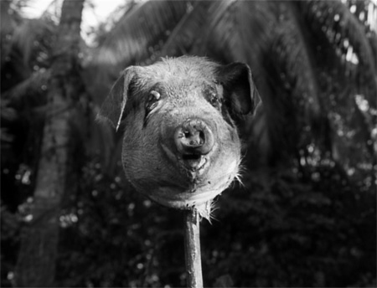
The Lord Of The Flies

Slide 2
Sir William Gerald Golding
Sir William Gerald Golding (19 September 1911 – 19 June 1993) was a British novelist, poet, playwright and Nobel Prize for Literature Winner, best known for his novel “Lord of the Flies”. He was also awarded the Booker Prize for literature in 1980 for his novel “Rites of Passage”, the first book of the trilogy “To the Ends of the Earth”.

Slide 3
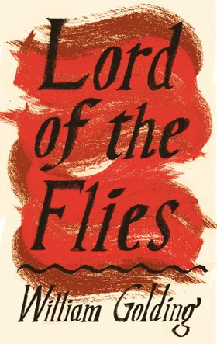
In 2008, The Times ranked Golding third on their list of "The 50 greatest British writers since 1945".

Slide 4
Who is Golding?
William Golding worked as a teacher in Greece and he believed even kids were not innocent creatures.
He believed that human were born with sin as a reference to the biblical myths.
He is an anti-humanist.

Slide 5
The book
Published in 1954, won Golding the Nobel Prize.
The book portrays children’s descent into savagery after a plane crash; left to themselves in a paradisiacal country, far from modern civilization, the well-educated children regress to a primitive state.

Slide 7
Symbolism and Characters
Ralph: symbolizes leadership
Piggy: innocence and intelligence
Jack: he worst aspects of human nature when unrepressed or untempered by society.
The Conch (horn): symbolizes the power to lead
Pig head: symbolizes first hunt and wild nature of humankind apart from society

Slide 8
Influences
LOST draws many of its initial plot devices and themes from Lord of the Flies, most notably being based on a plane crash on a deserted island, the existence of a "beast", and the emerging tensions between two leaders, one of whom happens to be named Jack. The overweight Hurley occasionally serves as the voice of reason, much like the novel's Piggy. Initially most of the survivors subsist on the hunting of wild pig, much like the boys in the novel. The initial similarities between the stories are openly commented on by the show's characters, such as Sawyer.

Slide 9
The central concern of Lord of the Flies is the conflict between two competing impulses that exist within all human beings: the instinct to live by rules, act peacefully, follow moral commands, and value the good of the group against the instinct to gratify one’s immediate desires, act violently to obtain supremacy over others, and enforce one’s will. This conflict might be expressed in a number of ways: civilization vs. savagery, order vs. chaos, reason vs. impulse, law vs. anarchy, or the broader heading of good vs. evil. Throughout the novel, Golding associates the instinct of civilization with good and the instinct of savagery with evil.

Slide 10
Background
The setting of the book is post World War II which is author’s own near future and a fictional nucleer war. Opposite of the Coral Island instead of talking about kid’s goodness potential it emphasizes our turn back of savagery in our roots. William Golding wrote this book to question the evil in human nature after seeing the violence during the WWII.

