Slide 1
EME 201 Materials Science
Ceramics

Slide 2
ENE 201 – Material Science – Ceramics
Ceramics are nonmetallic and inorganic materials.
Most of the ceramics are compounds of non-metallic and metallic elements.
The interatomic bonds of the ceramics are either totally ionic, or mostly ionic with some covalent bond.
Ceramic Structures
Ceramics are composed of at least two elements, or more, and they have crystal structures are usually more complex.
The degree of ionic character of ceramic bonds is dependent on the electronegativities of the atoms.
For ceramic materials that have ionic atomic bonding, the crystal structures are composed of electrically charged ions.
The metallic ions, or cations, are positively charged and anions (nonmetallic) are negatively charged.

Slide 3
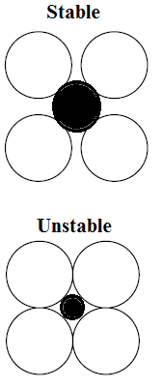
ENE 201 – Material Science – Ceramics
Crystal Structures
Crystal structures of the ceramic materials are influenced by the two characteristics of component ions
-The magnitude of the electrical charge on each of the component ions
-the relative sizes of the cations and anions.
The chemical formula of a compound indicates the ratio of cations to anions.
Ionic radii of the anions and cations are represented by r_{A} and r_{C}, respectively and their ratio is less than 1.
When the anions surrounds a cation and that cation is in contact with all the anions, it can be said that crystal structure of ceramic is stable.

Slide 4
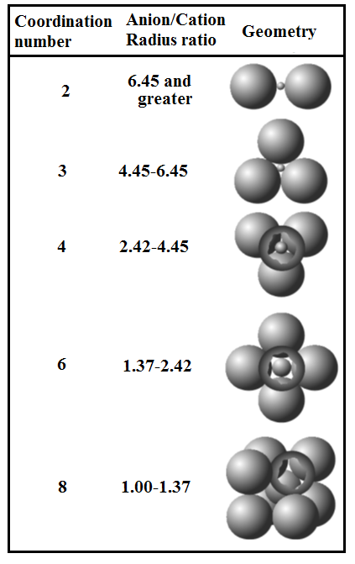
ENE 201 – Material Science – Ceramics
Crystal Structures
The coordination number of the ceramics is related to the cation–anion ratio.
In order to establish the cation-anion contact, there is a critical or minimum r_{C}/r_{A} ratio for a specific coordination number,
The coordination numbers and nearest-neighbor geometries for various r_{C}/r_{A} ratios are presented in Table.
For r_{C}/r_{A} ≤ 0.155, each cation is bonded to two anions (linear).
If 0.155 ≤r_{C}/r_{A} ≤0.225, each cation is bonded to three anions with coordination number 3 (planar equilateral triangle).
If 0.225 ≤r_{C}/r_{A} ≤0.414, the cation is located at the center of a tetrahedron, with anions at each of the four corners (the coordination number is 4).
If If 0.414 ≤r_{C}/r_{A} ≤0.732, each cation is bonded to six anions (octahedron).
If 0.732 ≤r_{C}/r_{A} ≤1, each cation is bonded to eight anions (cube).

Slide 5
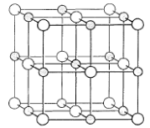
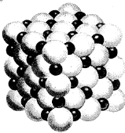
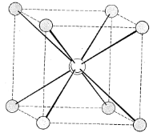
ENE 201 – Material Science – Ceramics
AX-Type Crystal Structures
When there are equal numbers of cations and anions, ceramic materials are often referred to as AX compounds, where A denotes the cation and X the anion.
Rock Salt Structure
The most common AX crystal structure is the sodium chloride (NaCl), or rock salt, type and the others can be listed as MgO, MnS, LiF, FeO, NiO and CaO.
The coordination number is 6, and 0.414 ≤r_{C}/r_{A} ≤0.732.
Unit cell for this type of crystal structure is FCC.
Cesium Chloride Structure
The coordination number of the cesium chloride (CsCl) is 8 for both ion types. The anions are at each of the corners of a cube, cation is at the cube center.

Slide 6
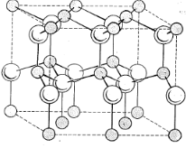
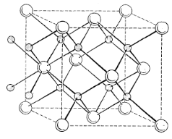
ENE 201 – Material Science – Ceramics
Zinc Blende Structure
All ions are tetrahedrally coordinated with a coordination number is 4. This is called the zinc blende, or sphalerite, structure.
S atoms occupy all the corner and face positions, whereas the Zn atoms occupy interior tetrahedral positions.
The examples of this type of crystal structure are ZnS, ZnTe, and SiC.
A_{m}X_{p}-Type Crystal Structures
With different charges on the cations and anions, the chemical formula of a compound can be A_{m}X_{p} (fluorite (CaF₂)).
The ionic radii ratio r_{C}/r_{A} is about 0.8 and coordination number is 8. Ca ions are at the centers, and fluorine ions at the corners. The other examples are ZrO₂, UO₂, PuO₂ and ThO₂.

Slide 7
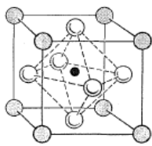
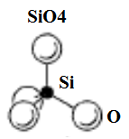
ENE 201 – Material Science – Ceramics
A_{m}B_{n}X_{p}-Type Crystal Structures
This type of crystal structure has two cations (A and B), their can be represented by A_{m}B_{n}X_{p}.
Barium titanate (BaTiO₃) having both Ba²⁺ and Ti⁴⁺ cations is an example of this classification.
Ba²⁺ ions are at all corners and a single Ti⁴⁺ is at the cube center and O²⁻ ions are at the center of each of faces.
Silicate Ceramics
Based units are silicon and oxygen (e.g. soils, rocks, clays, sand).
Crsytal structure has SiO₄⁴⁻ tetrahedrons.
Silicon (at the center of the cube) is bonded to four corner oxygen atoms.
There is a significant covalent character to the interatomic Si–O bonds.

Slide 8
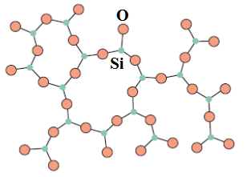
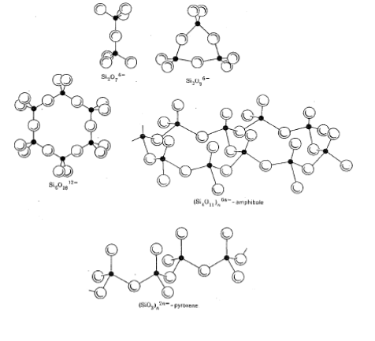
ENE 201 – Material Science – Ceramics
Silica (Silicon dioxide)
The most simple silicate material is silica (SiO₂).
Types of silica: quartz, cristobalite and tridymite.
Silica Glasses
Silica can also exist as a noncrystalline solid or glass with a high degree of atomic randomness.
The basic unit SiO₄⁴⁻ tetrahedron
Types of Silicates
There are various types of Silicates which have the formulas like SiO₄⁴⁻, Si₂O₇⁶⁻, Si₃O₉⁶.
Simple silacates and layered silcates are the examples of the silicates

Slide 9
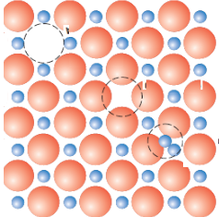
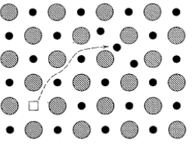
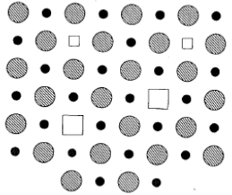
ENE 201 – Material Science – Ceramics
Imperfections in Ceramics
Atomic Point Defects
Atomic defects can exist in ceramic compounds.
Both vacancies and interstitials are possible; defects for each ion type may occur.
Conditions of electroneutrality must be maintained.
When there are equal numbers of positive and negative charges from the ions, then that state is called electroneutrality.
Defects in ceramics do not occur alone; a cation–vacancy and a cation–interstitial pair is called Frenkel defect.
Cation vacancy–anion vacancy pair known as a Schottky defect.

Slide 10
ENE 201 – Material Science – Ceramics
References
1) W. D. Callister, Jr., Materials Science and Engineering – an Introduction, 7th Ed., John Wiley & Sons, 2007
2) W.D. Kingery, H. K. Bowen, D. R. Ulhmann, Introduction to Ceramics, 2nd Ed., Wiley Interscience, 1967
3) B. S. Mitchell, an Introduction to Materials Engineering and Science - for Chemical and Materials Engineers, Wiley Interscience, 2004

