Slide 1
BIO 206 PLANT MORPHOLOGY
LECTURE NOTES
9th WEEK
DR. AYDAN ACAR ŞAHİN

Slide 2
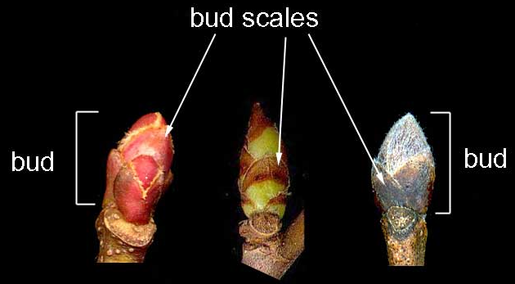
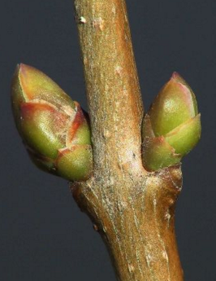
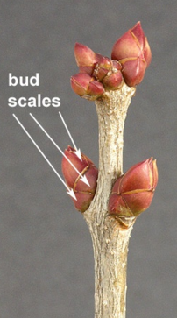
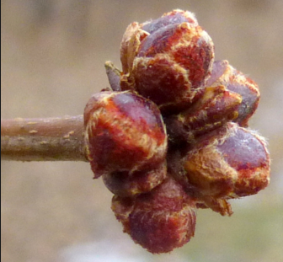
LEAF MODIFICATIONS
1. BUD SCALES
For many species each bud has one or more protective external bud scales varying among species in size, number, shape, color, pubescence and arrangement, often resulting in a distinctive appearance.
sp; Aesculus hippocastanum (At kestanesi)

Slide 3
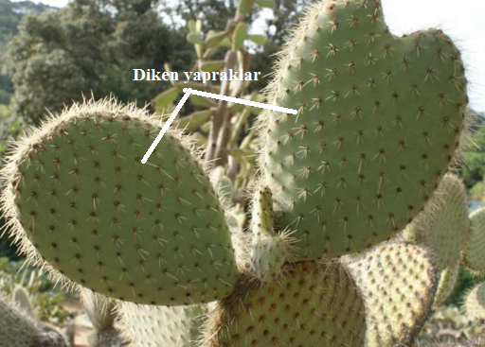
2. LEAF SPINES
In this type the leaves become wholly or partially modified into sharp pointed structures known as spines. This modification helps the plant to cut down transpiration and also protects the plants against the attacks of grazing animals.
sp; Opuntia ficus-indica / Cactus sp.

Slide 4
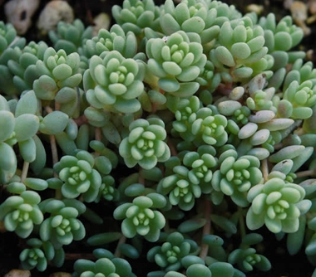
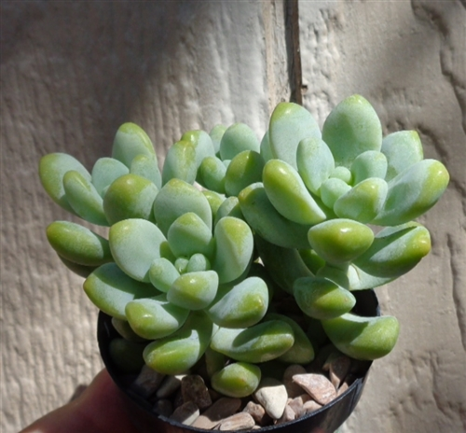
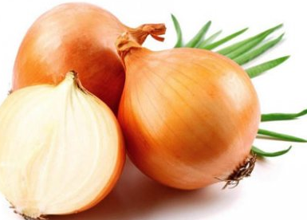
3. STORAGE, SUCCULENT, FLESHY
They are differentiated fleshy and thick leaves to store water and nutrients.
In the leaves of such plants that live in arid and salt regions, there is a large amount of vacuole-free, Paranchymatic cells with chlorophyll.
sp; Sedum (damkoruğu), Allium cepa (kurusoğan)

Slide 5
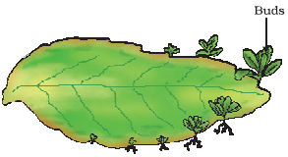
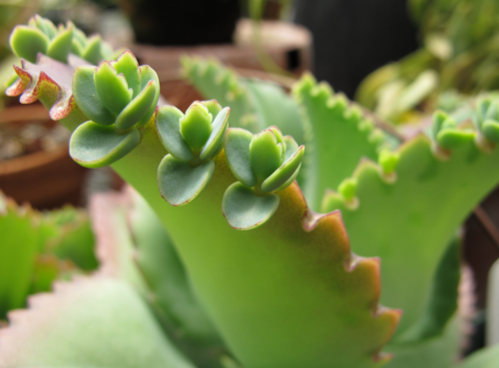
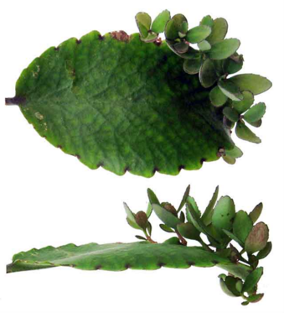
4. REPRODUCTIVE LEAF
The leaves of plants like the bryophyllum, begonia, and African violet can produce new plants with their small leaves on the edge of the main leaf.
Such leaves are often thick and fleshy.
sp; Bryophyllum sp.

Slide 6
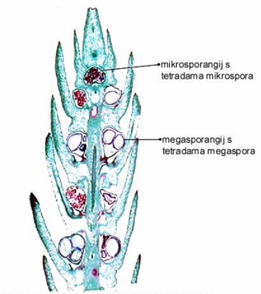
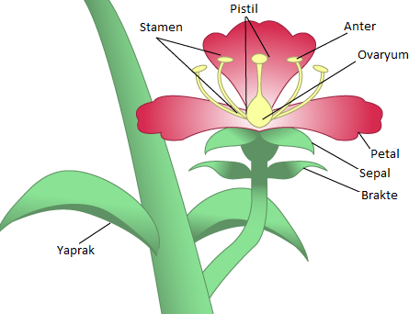
5. Floral leaves
The metamorphose of the true leaves forms floral leaves (sepale, petale, bracte, bracteol, etc.) and male-female organs (microsporophyll, megasporophyl) that play a role in sexual reproduction.

Slide 7
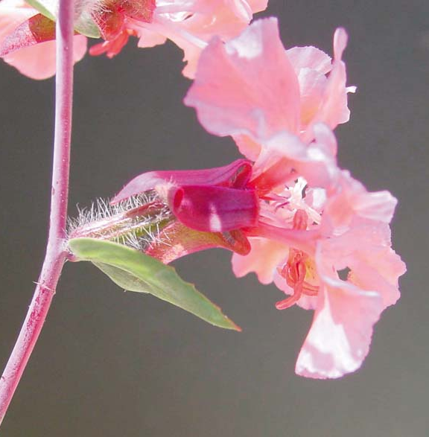
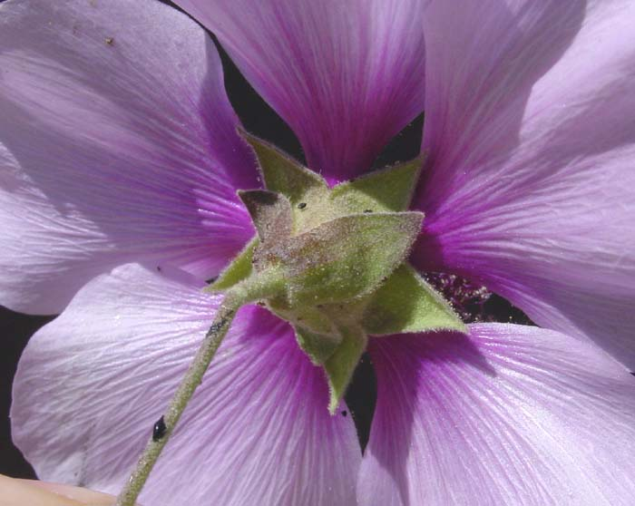
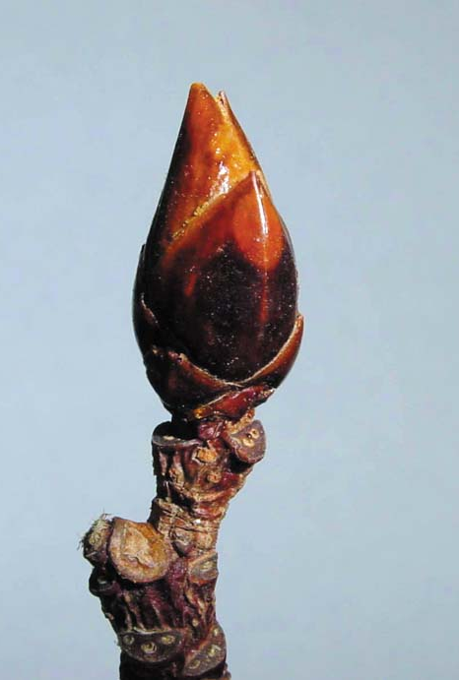
Leaf Structural Type
Bract (flower)
Epicalyx
Bud Scale

Slide 8
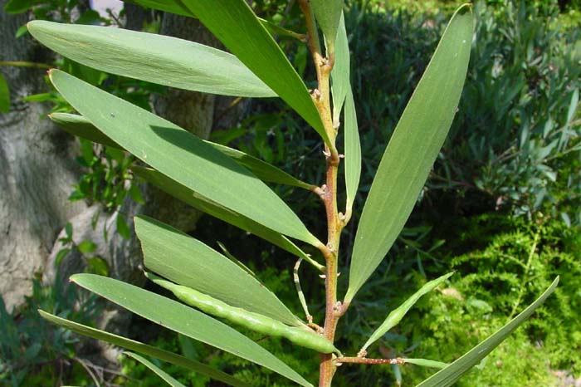
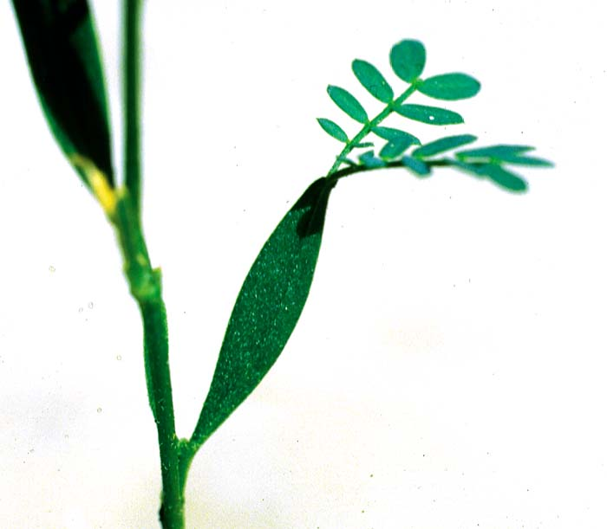
Leaf Structural Type
Phyllode - Acacia spp. (Fabaceae)

Slide 9
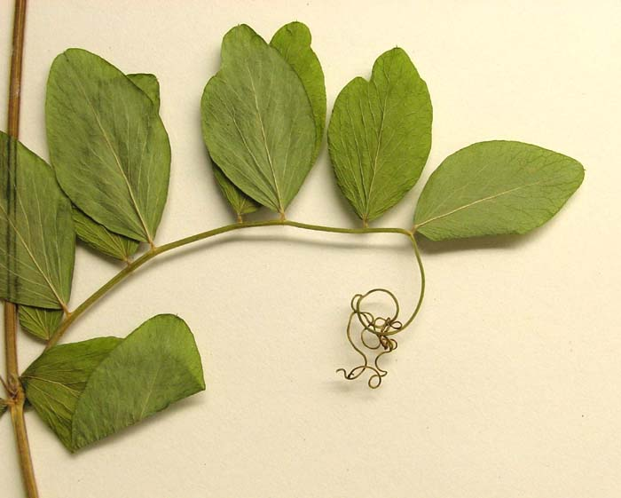
Leaf Structural Type
Tendril - Lathyrus (Fabaceae)

Slide 10
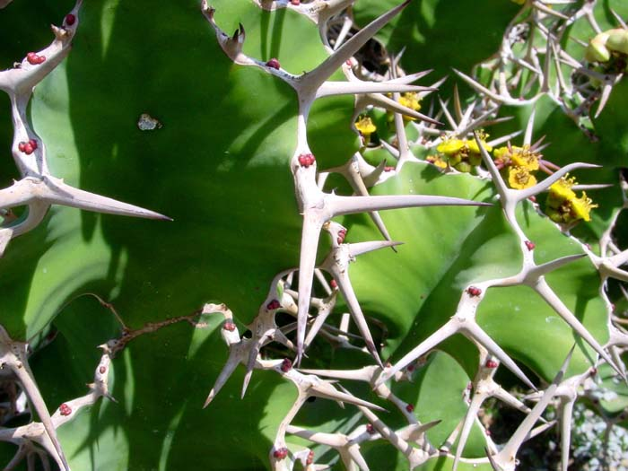
Leaf Structural Type
Stipular Spine - Euphorbia spp. (Euphorbiaceae)

Slide 11
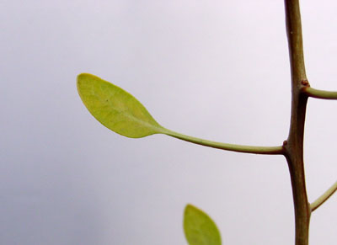
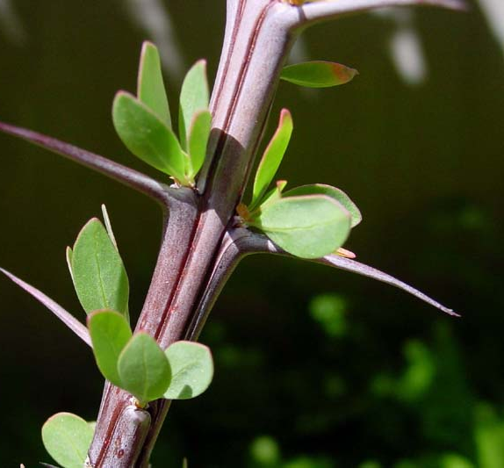
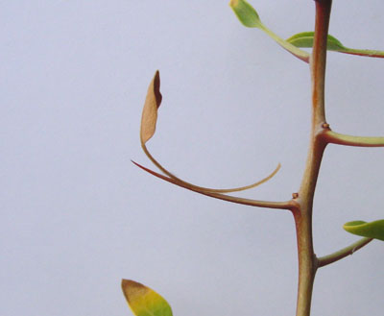
Leaf Structural Type
Petiolar Spine - Fouquieria splendens Ocotillo (Fouquieriaceae)

Slide 12
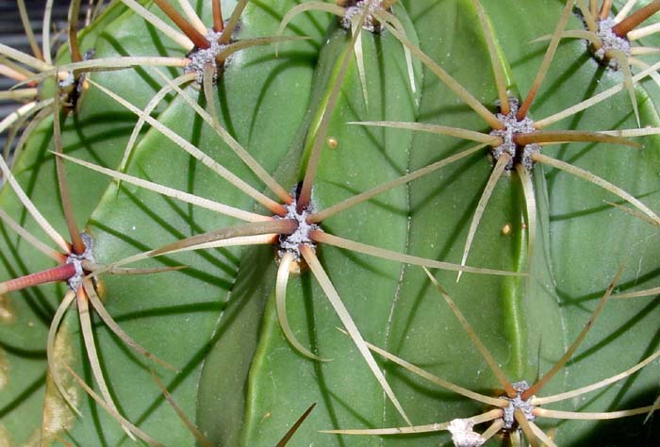
Leaf Structural Type
Leaf Spine (arising from areole) - Cactaceae

