Slide 1
ARGENTOMETRIC Cl⁻ DETERMINATION

Slide 2
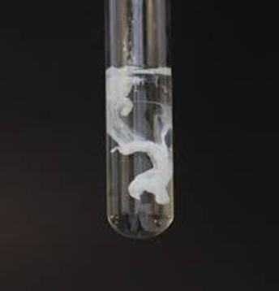
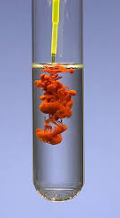
What happens when you add Ag⁺ ions into a solution containing Cl⁻ , CrO₄²⁻ ?
AgCI and Ag₂CrO₄ precipitate.
Which salt precipitates before? (AgCI Ksp = 1.56x10⁻¹⁰ , Ag₂CrO₄ Ksp = 2x10⁻¹² )
Ag₂CrO₄
If the concentration of Cl⁻ , CrO₄²⁻ are different? [Cl⁻] >>[CrO₄²⁻]
AgCl Ksp = [Ag⁺] x [Cl⁻]
Ag₂CrO₄ Ksp = [Ag⁺] x [CrO₄²⁻]
AgCl precipitates before.
Ag₂CrO₄ precipitates
After all Cl⁻ ions precipitate as AgCl?

Slide 3
AgNO₃ + NaCl → AgCI _{(s)} + NaNO₃
2AgNO₃ + K₂CrO₄ → Ag₂CrO_{4 (s)} + 2KNO₃ (indicator reaction)
While titrating Cl⁻ sample with AgNO₃, after all Cl⁻ ions precipitate as AgCl, Ag⁺ reacts with CrO₄²⁻ and Ag₂CrO₄ precipitates. (CrO₄²⁻ concentration should be low enough.)
With the first drop of excess AgNO₃, pink colored Ag₂CrO₄ precipitates.
Appearence of pink Ag₂CrO₄ color indicates the endpoint of the reaction between Ag⁺ and Cl⁻ .
Titration should be done at room temperature since the solubility of Ag₂CrO₄ increases rapidly at high temperatures.
The pH of the medium is also important in this experiment.
In acidic solutions, the chromate is converted into bichromate.
2CrO₄²⁻ + 2H⁺ → Cr₂O₇ ²⁻ + H₂O

Slide 4
Each student will receive a Cl⁻ sample of 20 mL in volumetric flask.
Dilute the sample by filling up the flask with distilled water.
Transfer 20-25 mL of diluted sample into an erlenmayer with your single-volume pippette.
Add ~ 20 mL distilled water and K₂CrO₄ into your erlenmayer.
Add a small amount of NaHCO₃ with your spatula, shake until the gas outlet is finished.
Put 0.1 M standardized AgNO₃ into the burette. (15-20 mL is enough)
Carry out the titration until pink color of Ag₂CrO₄ is observed.
AgNO₃ + NaCl → AgCI _{(s)} + NaNO₃
2AgNO₃ + K₂CrO₄ → Ag₂CrO_{4 (s)} + 2KNO₃

Slide 5
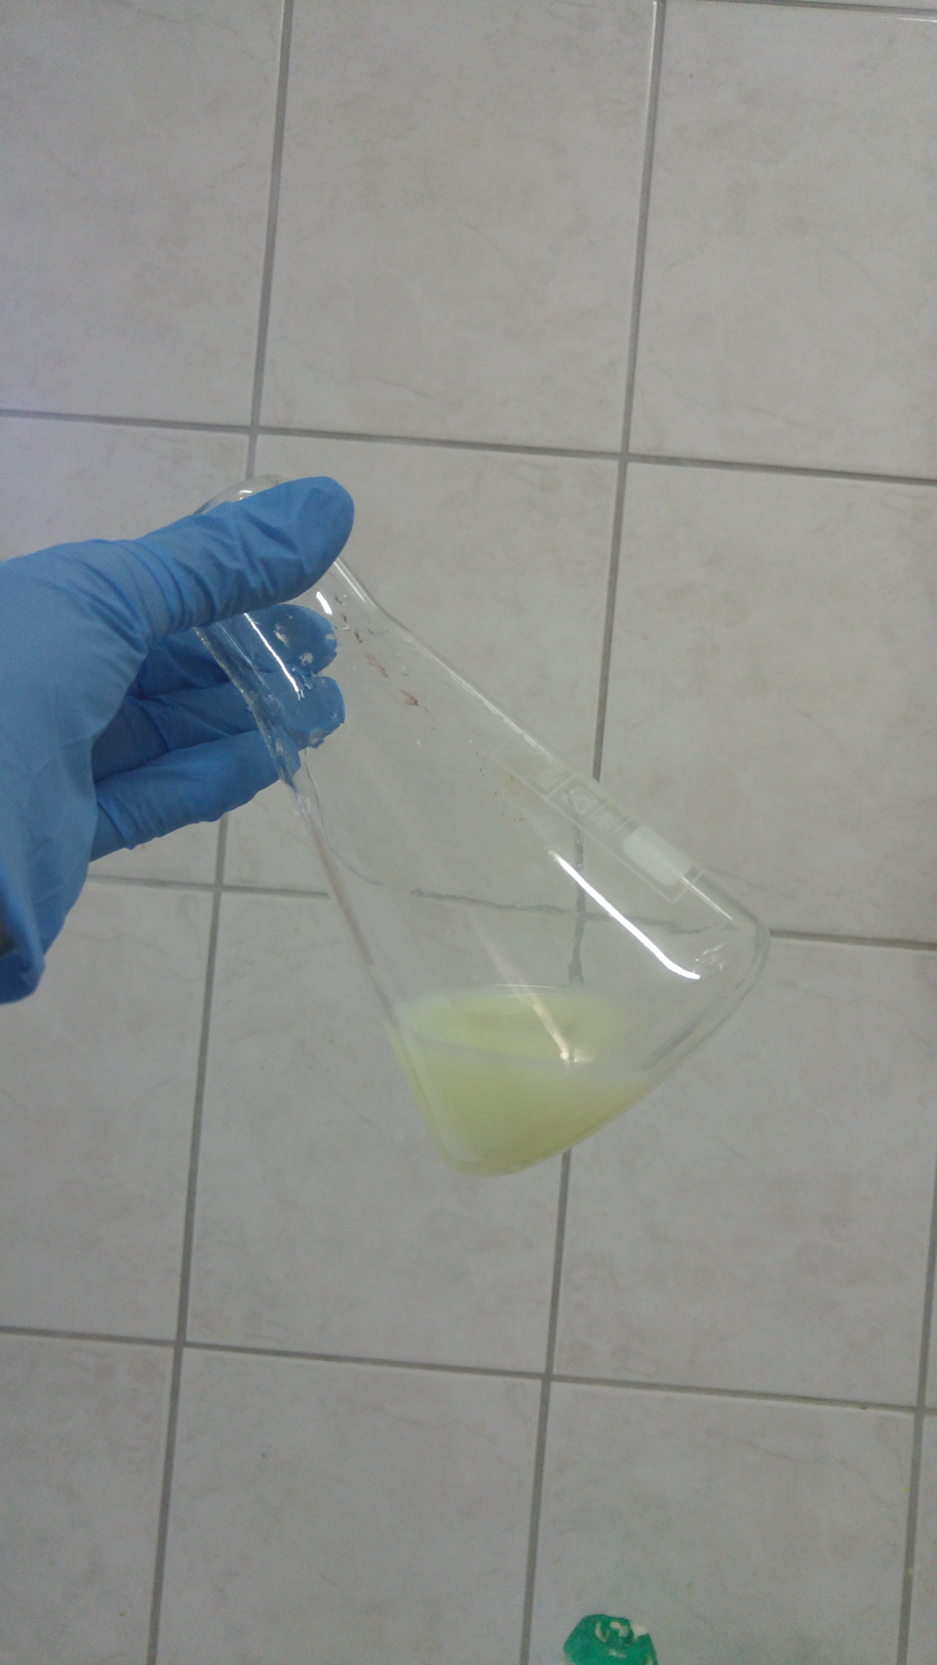
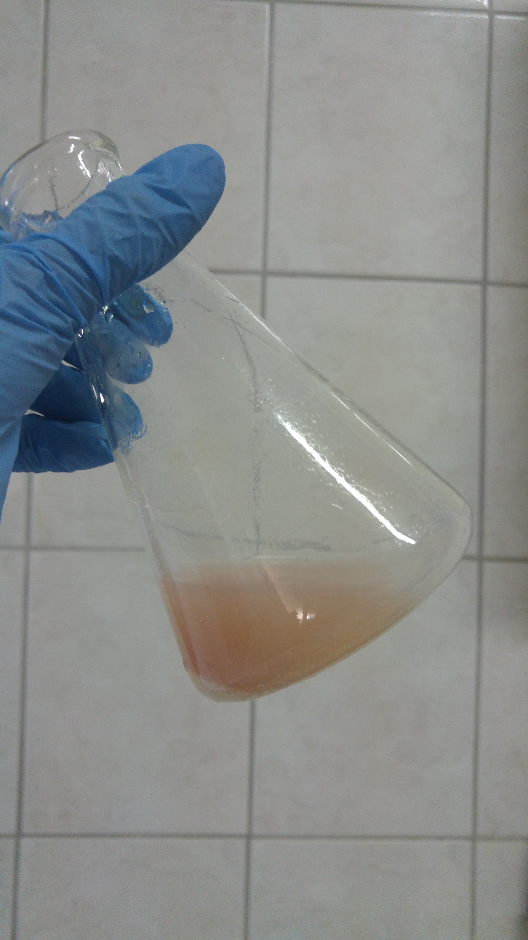
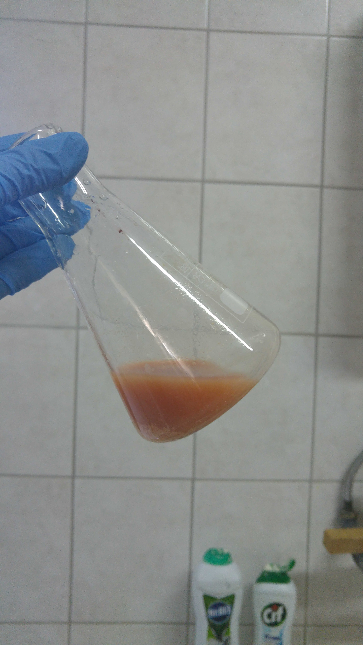

Slide 6
AgNO₃ + NaCl → AgCI + NaNO₃
Mol number of AgNO₃ consumed: $n_{AgNO_{3} = }M_{AgNO_{3}}×V_{AgNO_{3}}$
Reaction ratio 1:1
$$n_{AgNO_{3} = }n_{NaCl }$$
Concentration of diluted sample: $M_{NaCl}{ =\frac{{n_{NaCl }}_{ }}{V_{NaCl}} }_{ }$
Concentration of original sample:${ M}_{sample}$ = $M_{NaCl}$ x SF
$$C\left(g/L\right)=M_{numune}×58.5$$

Slide 7
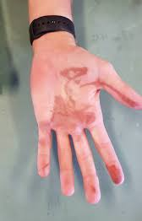
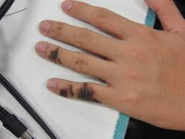
Reference
Analitik Kimya Pratikleri – Kantitatif Analiz (Ed. Feyyaz Onur), A.Ü. Eczacılık Fakültesi Yayınları No. 111, 2014.

