Slide 1
COM/BLM 376 Computer Architecture Chapter 2 Computer Evolution and Performance
Asst. Prof. Dr. Gazi Erkan BOSTANCI
ebostanci@ankara.edu.tr
Slides are mainly based on
Computer Organization and Architecture: Designing for Performance by William Stallings, 9th Edition, Prentice Hall

Slide 2
Outline
A Brief History of Computers
Designing for Performance
Multicore, MICs, GPGPUs
The Evolution of the Intel x86 Architecture
Embedded Systems and the ARM
Performance Assessment

Slide 3
A Brief History of Computers
The First Generation: Vacuum Tubes
ENIAC The ENIAC (Electronic Numerical Integrator And Computer), designed and constructed at the University of Pennsylvania, was the world’s first general purpose electronic digital computer.
The resulting machine was enormous, weighing 30 tons, occupying 1500 square feet of floor space, and containing more than 18,000 vacuum tubes. When operating, it consumed 140 kilowatts of power. It was also substantially faster than any electromechanical computer, capable of 5000 additions per second.

Slide 4
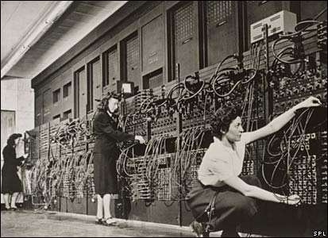
The ENIAC was a decimal rather than a binary machine. That is, numbers were represented in decimal form, and arithmetic was performed in the decimal system. Its memory consisted of 20 accumulators, each capable of holding a 10-digit decimal number. A ring of 10 vacuum tubes represented each digit.
At any time, only one vacuum tube was in the ON state, representing one of the 10 digits. The major drawback of the ENIAC was that it had to be programmed manually by setting switches and plugging and unplugging cables.

Slide 5
The Von Neuman Machine
The task of entering and altering programs for the ENIAC was extremely tedious.
Stored Program Concept
Suppose a program could be represented in a form suitable for storing in memory alongside the data. Then, a computer could get its instructions by reading them from memory, and a program could be set or altered by setting the values of a portion of memory.

Slide 6
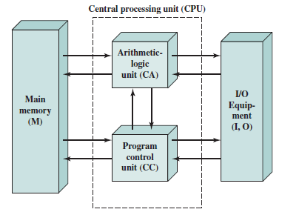
In 1946, von Neumann and his colleagues began the design of a new stored program computer, referred to as the IAS computer, at the Princeton Institute for Advanced Studies.
It consists of
A main memory, which stores both data and instructions
An arithmetic and logic unit (ALU) capable of operating on binary data
A control unit, which interprets the instructions in memory and causes them to be executed
Input/output (I/O) equipment operated by the control unit

Slide 7
With rare exceptions, all of today’s computers have this same general structure and function and are thus referred to as von Neumann machines. Thus, it is worthwhile at this point to describe briefly the operation of the IAS computer.
The memory of the IAS consists of 1000 storage locations, called words, of 40 binary digits (bits) each. Both data and instructions are stored there. Numbers are represented in binary form, and each instruction is a binary code.
Note that there is no universal definition for word since it depends on the instruction length for a given computer.
Each number is represented by a sign bit and a 39-bit value. A word may also contain two 20-bit instructions, with each instruction consisting of an 8-bit operation code (opcode) specifying the operation to be performed and a 12-bit address designating one of the words in memory numbered from 0 to 999).

Slide 8
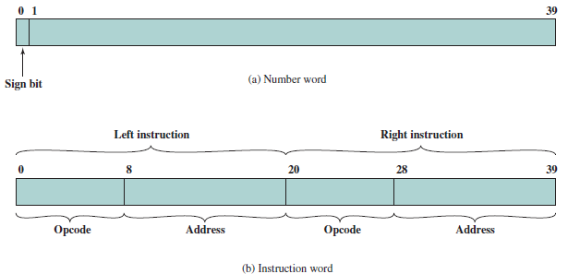
IAS Memory Formats

Slide 9
The control unit operates the IAS by fetching instructions from memory and executing them one at a time.

