Slide 1
ANTIVIRAL DRUGS
Prof.Dr.A.Tanju ÖZÇELİKAY

Slide 2
Viruses are obligate intracellular parasites;
They use the biochemical machinery of host cell to reproduce.
It is difficult to suppress their replication without doing significant harm to the host.
As a corollary, non-selective inhibitors of virus replication may interfere with host cell function and result in toxicity.
The antiviral drugs act by suppressing biochemical processes unique to viral replication.

Slide 3
Some infections require monotherapy for brief periods of time (eg, acyclovir for herpes simplex virus),
Some infections require dual therapy for prolonged periods of time (interferon alfa/ribavirin for HCV),
HIV requires multiple drug therapy for indefinite periods.

Slide 4
Viral replication requires several steps (1) :
attachment of the virus to receptors on the host cell surface
entry of the virus through the host cell membrane;
uncoating of viral nucleic acid;
synthesis of early regulatory proteins, eg, nucleic acid polymerases;

Slide 5
Viral replication requires several steps (2):
synthesis of new viral RNA or DNA;
synthesis of late, structural proteins;
assembly (maturation) of viral particles;
release from the cell.

Slide 6
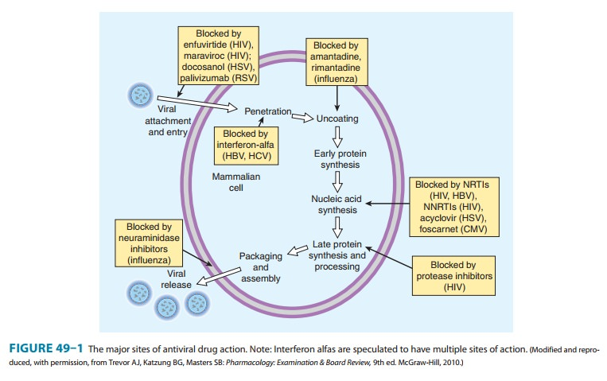

Slide 7
Antiviral agents can potentially target any of these steps.
antiviral agents must either block viral entry into the host cell.
or exit from the host cell or
be active inside the host cell.

Slide 8
Antiviral drugs share the common property of being virustatic; they are active only against replicating viruses and do not affect latent virus.
Antiviral therapy is now available for herpesviruses, hepatitis C virus (HCV), hepatitis B virus (HBV), papillomavirus, influenza, and human immunodeficiency virus (HIV).

Slide 9
AGENTS TO TREAT HERPES SIMPLEX VIRUS (HSV) AND VARICELLA-ZOSTER VIRUS (VZV)
HSV causes infection of the genitalia, mouth, face and other sites.
VZV is the cause of varicella (chickenpox) and herpes zoster (shingles)

Slide 10
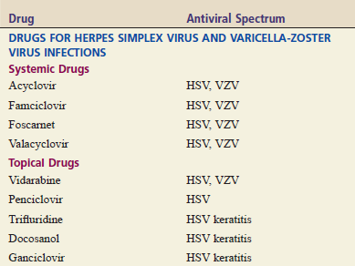

Slide 11
AGENTS TO TREAT HERPES SIMPLEX VIRUS (HSV) AND VARICELLA-ZOSTER VIRUS (VZV)
Three oral nucleoside analogs are used for the treatment : acyclovir, valacyclovir (a prodrug form of acyclovir,) and famciclovir (a prodrug form of penciclovir). They have a similar mechanism of action

Slide 12
AGENTS TO TREAT HERPES SIMPLEX VIRUS (HSV) AND VARICELLA-ZOSTER VIRUS (VZV)
Acyclovir
Acyclovir is the agent of first choice for most infections caused by HSV and VZV.
The drug can be administered topically, orally, and intravenously.
Acyclovir inhibits viral replication by suppressing synthesis of viral DNA.

Slide 13
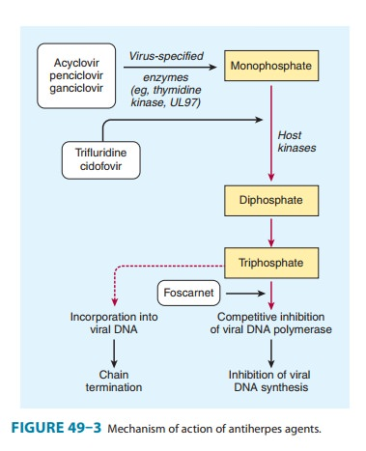
Acyclovir inhibits viral DNA synthesis by two mechanisms

Slide 14
Adverse Effects
Nausea, diarrhea, and headache have occasionally been reported when used orally
Intravenous infusion may be associated with reversible renal toxicity or neurologic effects (eg, tremors, delirium, seizures).
Acyclovir is eliminated unchanged by the kidneys. Accordingly, dosage must be reduced in patients with renal impairment.
Concurrent use of nephrotoxic agents may enhance the potential for nephrotoxicity.

Slide 15
AGENTS TO TREAT CYTOMEGALOVIRUS (CMV) INFECTIONS
Cytomegalovirus is a member of the herpesvirus group
In most healthy people, CMV infection is of little concern.
By contrast, people who are immunocompromised owing to HIV infection, cancer chemotherapy, or use of immunosuppressive drugs are at high risk for serious morbidity and even death
Although the incidence in HIV-infected patients has markedly decreased with the advent of potent antiretroviral therapy, clinical reactivation of CMV infection after organ transplantation is still prevalent.
Common sites for infection are the lungs, eyes, and GI tract.

Slide 16
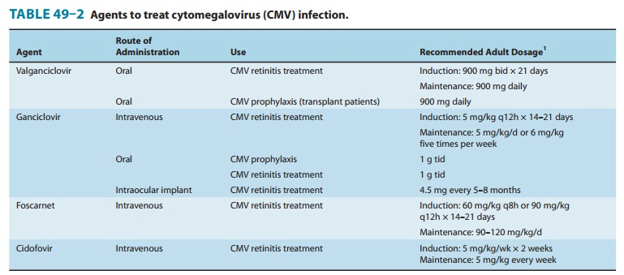

Slide 17
Ganciclovir
Ganciclovir is the drug of choice for prophylaxis and treatment of CMV infection.
Oral, IV, intraocular, topical to the eye. AIDS patients with CMV retinitis must take ganciclovir for life.
Like acyclovir, Ganciclovir inhibits the viral DNA polymerase.
Like acyclovir, ganciclovir is excreted unchanged in the urine. Hence, dosage must be reduced in patients with renal impairment.
The major adverse effects of ganciclovir are granulocytopenia and thrombocytopenia.
Use with caution in patients taking zidovudine or nephrotoxic
drugs (e.g., amphotericin B, cyclosporine)

Slide 18
Valganciclovir
Valganciclovir is prodrug of ganciclovir.
oral valganciclovir is just as effective as intravenous ganciclovir and much more convenient.
Foscarnet
Potential adverse effect of foscarnet is renal impairment.
Cidofovir
Cidofovir has been associated with severe renal impairment.
Dialysis has been required after only one or two doses.

Slide 19
ANTIHEPATITIS AGENTS
Viral hepatitis is the most common liver disorder.
The disease can be caused by six different hepatitis viruses, (A, B, C, D, E, and G).
All six can cause acute hepatitis, but only B, C, and D also cause chronic hepatitis.
Acute hepatitis resolves spontaneously, so intervention is generally unnecessary.
In contrast, chronic hepatitis can lead to cirrhosis,hepatocellular carcinoma, and life-threatening liver failure, and hence treatment should be considered.
Most cases (90%) of chronic hepatitis are caused by either
hepatitis B virus (HBV) or hepatitis C virus (HCV).

Slide 20
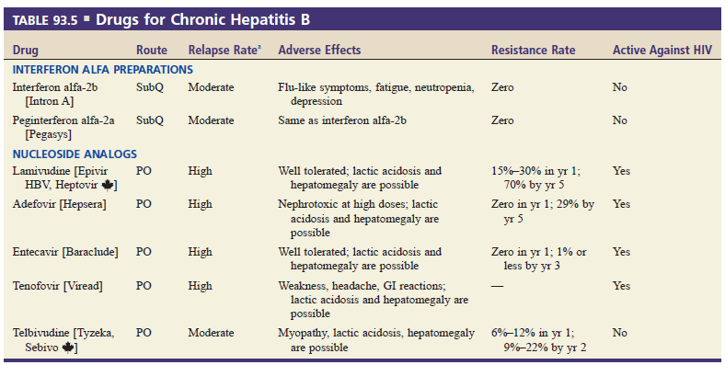
The goals of chronic HBV therapy are to sustain suppression of HBV replication, resulting in slowing of progression of hepatic disease (hepatic fibrosis and even reversal of cirrhosis, hepatocellular carcinoma),
Nucleoside analogs suppresses HBV replication by inhibiting viral DNA synthesis.

Slide 21
Hepatitis B can be prevented by vaccination. There is no vaccine for hepatitis C.
In contrast to the treatment of patients with chronic HBV infection, the primary goal of treatment in patients with HCV infection is viral eradication.
Hepatitis C is treated with interferon alfa, ribavirin, and HCV protease inhibitors

Slide 22
Interferon Alfa
Commercial production is by recombinant DNA technology.
Can not be used orally, Injectable preparations of interferon alfa are available for treatment of both HBV and HCV infections
Interferon alfa has multiple effects on the viral replication cycle. After binding to receptors on host cell membranes, the drug blocks viral entry into cells, synthesis of viral Messenger RNA and viral proteins, and viral assembly and release.

Slide 23
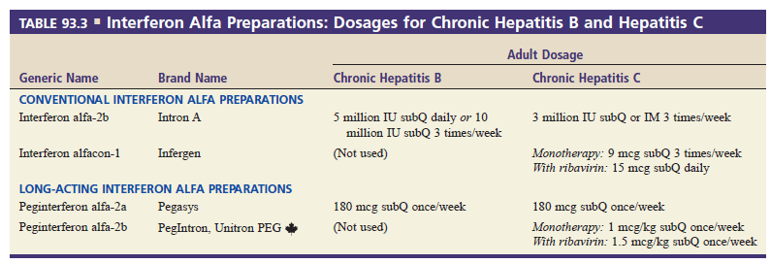
The adverse effects of interferon alfa include a flu-like syndrome (ie, headache, fevers, chills, myalgias, and malaise) and severe depression.

Slide 24
Ribavirin (Oral)
When used alone against HCV, ribavirin is not effective
Ribavirin is a nucleoside analog with a broad spectrum of antiviral activity, but its mechanism of action remains unclear.
The principal adverse effects of ribavirin are hemolytic anemia and fetal death or malformation.
Owing to its effects on the fetus, ribavirin is contraindicated for use during pregnancy.

Slide 25
Protease Inhibitors
Boceprevir , telaprevir, grazoprevir, paritaprevir, and
simeprevir.
PIs inhibit viral protease, an enzyme required for HCV
replication.
The HCV protease inhibitors are subject to a large number of drug interactions.

Slide 26
ANTI INFLUENZA AGENTS
Influenza is characterized by fever, cough, chills, sore throat, headache, and myalgia (muscle pain).
Influenza virus strains are classified by
- their core proteins (ie, A, B, or C),
species of origin (eg, avian, swine), and
geographic site of isolation.

Slide 27
ANTI INFLUENZA AGENTS
Influenza A, the only strain that causes pandemics,
Although influenza B viruses usually infect only people, influenza A viruses can infect a variety of animal hosts.
Current influenza A subtypes that are circulating among worldwide populations include H1N1 (swine-flu), H1N2, and H3N2.

Slide 28
Influenza is managed by vaccination and with drugs.
Vaccination is the primary management strategy; drug therapy is secondary.
Influenza vaccination reformulated each year is recommended for everyone age 6 months and older.
Before administering a vaccination, it is important to question the patient or family member about allergies, previous reactions to vaccines, and current health status.

Slide 29
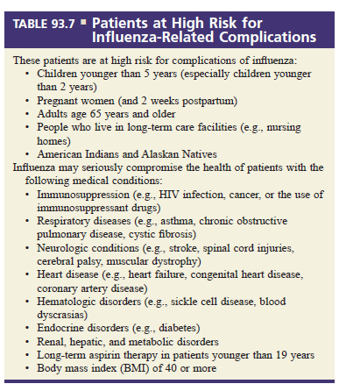

Slide 30
We have two types of antiviral drugs for influenza: neuraminidase inhibitors and adamantanes.
Neuraminidase inhibitors (oseltamivir, zanamivir, and peramivir) are highly active against all current strains of influenza A and B.
Dosing must begin early—preferably no later than 2 days after symptom onset and ideally much sooner. Why? Because benefits decline greatly
when treatment is delayed.
Antiviral effects derive from inhibiting neuraminidase, a viral enzyme
required for replication.
Resistance to neuraminidase inhibitors is uncommon.

Slide 31
The adamantanes—amantadine and rimantadine were the first influenza drugs available.
Because most current strains of influenza A and influenza B are resistant, it is not recommended to use for any influenza patients

