Slide 1
ANGLOPHONE LITERATURE

Slide 2
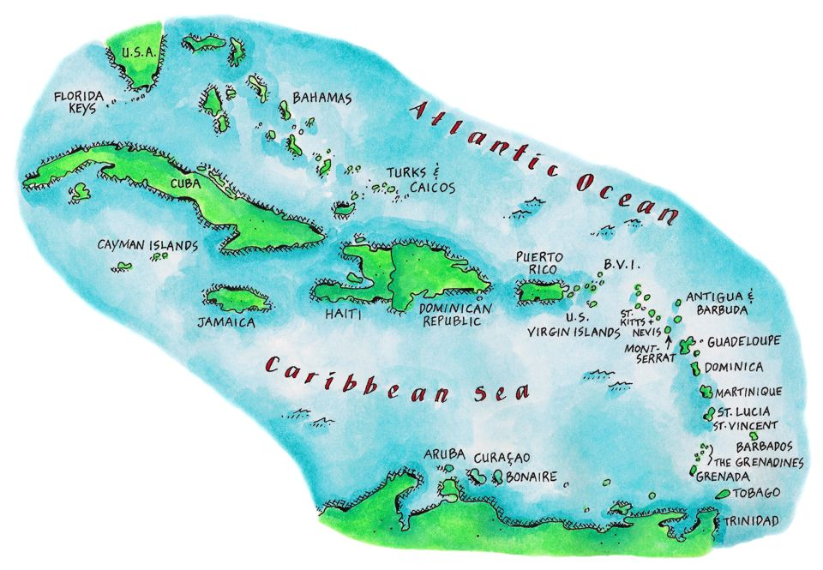
Outline of the Course
Caribbean History
Jean Rhys
«The Day They Burned The Books»
Setting
Characterization
Narrator and Point of view
Conflict
Turning Point
Concluding Part

Slide 3
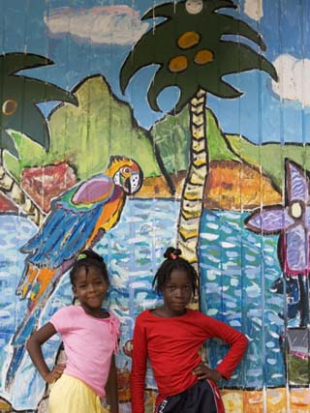
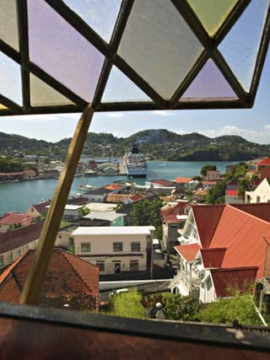
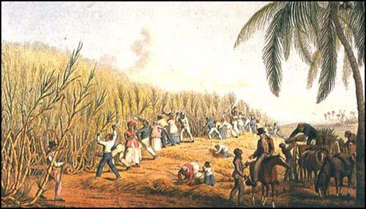

Slide 4
Countries & Territories Of The Caribbean
Anegada (UK),
Anguilla (UK),
Antigua & Barbuda,
Aruba (Neth),
Bahamas,
Barbados,
Bonaire (Neth),
Cancun (MX),
Cayman Islands (UK),
Cozumel (MX),
Cuba,
Curacao (Neth),
Dominica,
Dominican Republic,
Grenada,
Guadeloupe (France),
Haiti,
Isla Mujeres (MX),
Isla de Providencia (Col),
Jamaica,
Jost Van Dyke (UK),
Martinique (France),
Montserrat (UK),
Netherlands Antilles (Neth),
Puerto Rico (US),
Saba (Neth),
St. Barts (France),
St. Croix (US),
St. Eustatius (Neth),
St. John (US),
St. Kitts & Nevis,
St. Lucia,
St. Martin/Sint Maarten (Neth) (France),
St. Thomas (US),
St. Vincent & Grenadines,
San Andres (Col),
Tortola (UK),
Trinidad & Tobago,
Turks & Caicos (UK),
Virgin Islands (British),
Virgin Islands (U.S.)

Slide 5
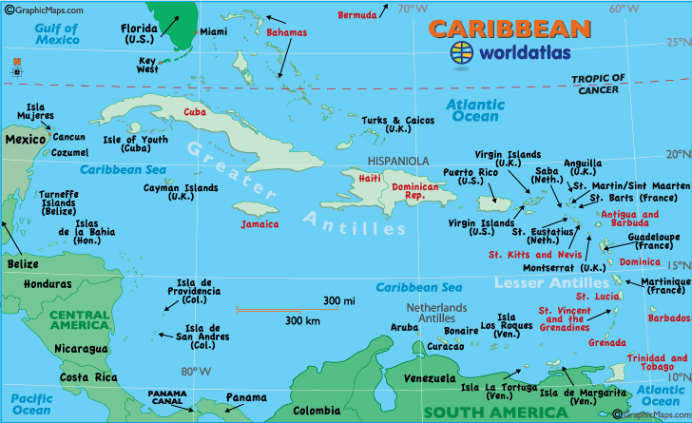

Slide 6
The concept of an Anglophone Caribbea usefully draws attention to the importance of the Caribbean Sea itself, which forms a branch of the Atlantic Ocean and constitutes one of the larger deep-water seas in the world. It is circumscribed by a chain of larger islands to the north, numerous smaller islands to the east, the mainland of South America and the Panamanian passage to the south and Central America to the west.

Slide 7
Turning from the sea to the land, the richness and fruitfulness of the environment gives the appearance of hospitability to human habitation, but the geography of the region also makes life intermittently dangerous.
At various times these physical dangers have had major effects on the economic and social life of the inhabitants.
Perhaps the most notorious dangers are those posed by the occasional hurricanes which pass westwards and northwards across the Caribbean.

Slide 8
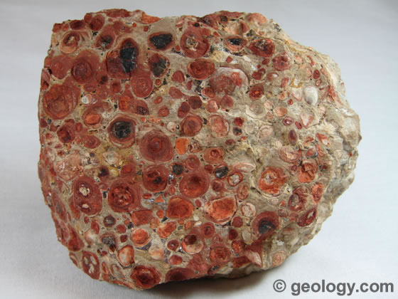
The region was underdeveloped as its natural resources—
sugarcane, bauxite or oil at different points in history— were drained away by the imperial powers such as Spain, France, Britain, Holland, Denmark and later the United States.

Slide 9
Thus, the region has a tormented and bloody history; the native Caribs fought off the European invaders for several centuries, but once the French got a foothold they battled back and forth with the English for over half a century, until the English finally prevailed by I 8 I 5.

Slide 10
3 particular phases in Caribbean history:
1. Establishment of the plantation system in the early 17th century which was marked by increased capital investment, the gradual replacement of free labour by slave labour and the evergrowing commitment to the export of sugar as the defining purpose of the territories.
2. The rise of abolutionist sentiment in Britain in the late 19th century and the decision of the British Parliament to abolish trade slaves in 1807.
3. Nascent trade unions and political parties demanded democratic reform and the allevation of working conditions

Slide 12
As a result of this slave trade and colonialism,
physical mixing of races, a combination of different cultural traditions took place in the Caribbean and this has had an astonishing global impact.
The end of the hegamony of the European empires over the Caribbean was accompanied almost everywhere by cultural renaissance. During the second trimester* of the twentieth century the region became a literary superpower by adapting European cultural practices for their own purposes.

Slide 13
Caribbean writers have posed an intellectual challenge to imperial pride. A short list of notable figures includes authors as diverse as Jean Rhys, Roger Mais, E. R. Braithwaite, Sam Selvon, George Lamming, Sylvia Wynter, Derek Walcott, Kamau Brathwaite, V. S. Naipaul and Jamaica Kincaid.

Slide 14
In the mid-twentieth century Anglophone Caribbean literature became a significant new canon. Major texts appearing in the 1950s included Samuel Selvon’s novel A Brighter Sun (1952), George Lamming’s novel In the Castle of My Skin (1953) and V. S. Naipaul’s collection of stories, Miguel Street (1959).

Slide 15
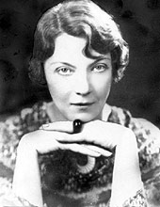
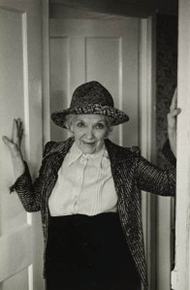
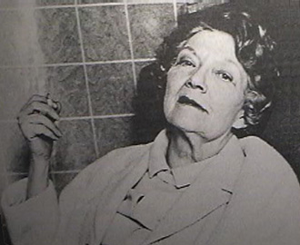
JEAN RHYS (1890-1979)

Slide 16
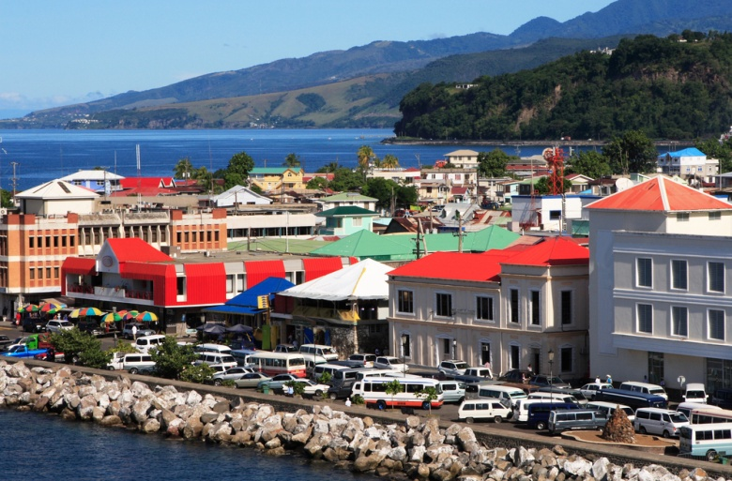
born in Roseau, to a Welsh father (dr.William Rees Williams) and , a Creole* mother, (Minna Williams).
christened Ella Gwendoline Rees Williams
later known as Ella, Vivien or Emma Grey, Ella Lenglet or Ella Hamer.
hated the name “Gwendolen” (meaning “white” in Welsh)

Slide 17
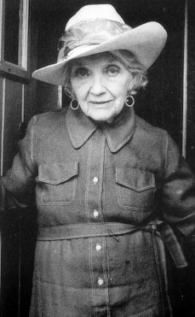
“Rhys” is a different spelling of her father’s family name of “Rees”, and «Jean» could have been chosen for her husband, Jean, or her “Cuban” ancestor Jean, or both. Rhys adopted a first name as her writing name which, depending on the context, could signify either gender (Jean as French is a man’s name, and as English a woman’s).

Slide 18
Rhys was born into a British colonial society and traveled as an impressionable teenager to the heart of the Empire at a time when it was still in its ascendancy. She did travel as a young woman, leaving the Caribbean, moving from London to Paris and Europe.

Slide 19
Rhys was culturally complex. She had a Caribbean upbringing and accepted her Celtic ancestry, but she resisted England (English and Anglo-Saxon were synonymous for her). Early direct experience of “this cold, dark country” was so unsettling that she found “my love and longing for books completely left me” (SP:90).

Slide 20
She was also complicated in terms of her sense of race, religious education and class.
Partly educated at a Catholic school, she was Anglican in church attendance along with her family.
In the colonial Caribbean, she belonged to the elite, but in England she was working-class as a chorus girl and an outsider as a Creole. She invented herself several times and longed to break out of the categories to which others consigned her.
In her fiction, she explored these tensions and contradictions.

Slide 21
Rhys’s complex identity and experience informed her sense of the world so strongly that she resisted writing only one side of any story. She is both colonial and postcolonial, white but Creole, and she expressed views and made remarks that demonstrate these contradictions.

Slide 22
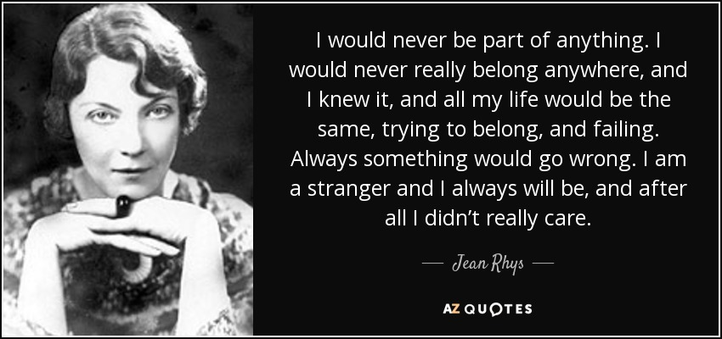

Slide 23
She lived long enough to witness the ending of the British Empire and the flow of immigrants from former colonies into Britain during the fifties and sixties.

Slide 24
Rhys represented Anglophone expatriates* and migrants (for example from the Antilles and Morocco). But she problematized the expatriates (mainly because of their implicitly colonizing, exploitative tendencies), and made clear that her migrants were marginalized within their new culture.
Her protagonists are isolated and numbed by their emotional traumas so that they often can scarcely register the immediate world around them, let alone go any further afield.

Slide 25
Rhys was unquestionably a Caribbean writer, but she was also a cosmopolitan, and her work often protests borders and separations.

Slide 26
Jean Rhys is the author of five novels
Quartet(1929),
After Leaving Mr. Mackenzie (1931),
Voyage in the Dark(1934), Good Morning, Midnight (1939),
Wide Sargasso Sea (1966)
—three story-collections and the posthumous Smile Please: An Unfinished Autobiography.

Slide 27
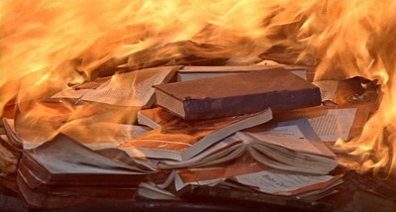
The Day They Burned The Books

Slide 28
“The Day They Burned the Books” is a short story published in Rhys’s collection Tigers Are Better Looking in 1968.
The story is a dramatic representation of the widow of an Englishman (“a decent, respectable, nicely educated coloured woman,” getting rid of the library beloved by her husband by selling some books and burning the rest.

Slide 29
Rhys’ cultural background penetrates into her stories and points out the depictions of her early childhood cultural values, methods of creating identity or autonomy, and unique social constructs of otherness.
In Rhys’ short story “The Day They Burned the Books” a cultural tension arises between western and Caribbean values, identity, and otherness that were personally relevant to Rhys’ early life growing up as a ‘colonial,’ or half-white half-colored person.

Slide 30
Title
WHAT IS THE SIGNIFICANCE OF THE TITLE OF THE STORY?

Slide 31
The title implies what is told in the story is a recollection of a past event. Moreover, “the day” in the title marks the significance of the “book burning” event that makes a difference in the narrator’s life.
In this sense, it signifies a turning point for Eddie and his mother. That is, by burning books Eddie’s mother declares her independence from English oppression whereas Eddie dissociates himself from the Caribbean ties by hating his colored mother now.

Slide 32
Setting
There is no specific time given in the story.
The events take place in exotic West Indies which is the region under the colonial rule of many Europian countries including England.
Therefore, the setting helps to reveal the main conflict between the colonizer (Mr. Sawyer) and the colonized (Mrs. Sawyer) and the inner conflict of the characters due to their mixed race and culturel imperialism.

Slide 33
Characterization
Eddie:
the narrator’s friend
He is the living image of his father which makes him “inherit” the master, “centre” status of his father but the narrator also mentions that he is “silent as his mother”. “Silence” as a matter of fact is a feature of the oppressed which reveals Edie’s inbetween position due to having an English father and colored mother.

Slide 34
Mr Sawyer:
Eddie’s father, agent for a small steamship line running between the islands and Sout America.
Mr. Sawyer is an educated British man who loathed the Caribbean islands
He is an alcoholic and consequential racist outburst result in him abusing verbally and physically his wife.

Slide 35
Mrs Sawyer:
Eddie’s mother, “decent, respectable, nicely educated, coloured woman who is exposed to his husband’s racist humiliations.
She is submissive and throughout the short story, there is not even one instance in which she speaks and all her opinions are expressed indirecty.
Mildred:
the servant of the Sawyer family who witnesses the abusive behaviour of Mr Sawyer with an English superiority to his colonial wife.

Slide 36
Narrator & Point of View
The narrator is the person telling the story. By point of view we mean from whose eyes the story is being told.
In “The Day They Burned The Books”, the story is told by “the first person” -“I” narrator- from a little girl’s point of view. However, we do not know how old the speaker actually is at the time she tells the story, but the point of view is that of a young girl.

Slide 37
Conflict
The main conflict is the cultural clash between the colonizer English and the colonized Caribbean.
This conflict is revealed mainly through the internal conflict Eddie experiences due to his mixed race.
Eddie is between two conflicting and competing cultures identifying himself with one emotionally, curious about other intellectually.

Slide 38
“
He [Eddie] would be so quite when others who had never seen it –none of us had ever seen it- were talking about its delights, gesticulating freely as we talked- London, the beautiful, rosy-cheeked ladies, the theatres, the shops, the fog, the blazing coal fires in winter, the exotic food (whitebait eaten to the sound of violins), strawberries and cream*- the word “strawberries” always spoken with a guttural and throaty sound which we imagined to be the proper English pronunciation.
”

Slide 39
Mr. Sawyer is also in conflict with both environment and his wife. In this regard, he settles in Carribea though he hates everything related to the place.
Likewise, he is married to a colored woman whom he humiliates with an English superiority and abuses verbally and physically.

Slide 40
“Look at the nigger showing off” he would say: and she would smile as if she knew she ought to see the joke but couldn’t. “You damned, long-eyed, gloomy half-caste, you don’t smell right” he would say ; and she never answer, not even whisper, “You don’t smell right to me, either.
”

Slide 41
The narrator also experiences inner conflict about her identity due to her being white Creole in the English colony.
She lives in an exotic place in the shadow of the imposition of the English culture through traditional English educational curriculum .
Eddie’s identity problem allows the narrator to recognize her inbetween status and her resentment of English education they had received

Slide 42
“
I also was tired of learning and reciting poems in praise of daffodils, and my relations with the few ‘real’ English boys and girls I had met were awkward. I had discovered that if I called myself English they would snub me haughtily: ‘You’re not English; you’re a horrid colonial’. Well, I don’t much want to be English,’ I would say. ‘It’s much more fun to be French or Spanish or something like that – and , as a matter of fact, I am a bit. […] Heads I win tails you lose— that was the English.
”

Slide 43
WHAT DO THESE FLOWERS MEAN TO BOTH EDDIE AND THE YOUNG NARRATOR OF “THE DAY THEY BURNED THE BOOKS”?
HOW DO THEY BOTH FEEL ABOUT THE ENGLISH—AND WHY?

Slide 44
Symbols
Daffodils
Strawberries
Books

Slide 45
Daffodils and strawberries symbolize English cultural hegamony in the Caribbean in other words cultural imperialism the Caribbean people are exposed to.
In this sense, the colonial children including the narrator learn to recite poems in praise of daffodils. Moreoever, they talk about the things such as daffodils and strawberries in England which they have not ever seen.

Slide 46
In the story, the cultural conflict is represented through the books in the library of Mr Sawyer. In that, books become an emblem of British nationality and Western culture within their Caribbean house.

Slide 47
WHAT DO MR. SAWYER’S BOOKS REPRESENT TO MRS. SAWYER? WHY DOES SHE WANT TO DESTROY THEM?

Slide 48
For Mrs. Sawyer books are symbols or reminder of their Western oppressors.
To Mr. Sawyer, books are symbol of the ‘Homeland’ and the Western world. This distinction carries itself with significant weigh throughout the short story.

Slide 49
Turning Point
The turning point is where events take a major turn as the story races towards its conclusion.
In the story, the turning point is the sudden death of Mr. Sawyer.
After Mr. Sawyer’s death, Eddie takes over the library of his father- in other words, accepts his English ties– and breaks away from his Carribean side with his mother’s burning books.

Slide 50
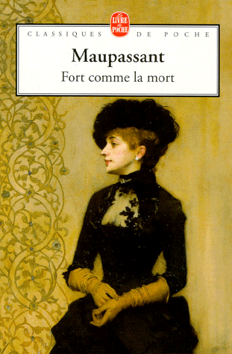
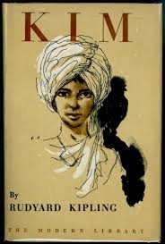
Concluding Part
At the end of the story Eddie and the narrator achieve to save two books from the library. The book Eddie graps is Rudyard Kipling’s Kim, but, the book got torn and it starts at page twenty whereas the book the narrator has saved is French Fort Comme La Mort.
What does this signify?

Slide 51
Two books represent the two imperial cultures to which the children are inheritors. Their survival indicates the survival of a literary tradition, though within the compromised circumstances of colonial inheritance.

Slide 52
ASSIGNMENT QUESTION
Discuss the effect of First-person narration on “The Day They Burned The Books.”
How would her viewpoint be different from that of an older person’s?

