Slide 1
The New Republic
AKE 117 American History I
Dr. Gamze Kati Gumus

Slide 2
What is a Republic?
a state in which supreme power is held by the people and their elected representatives, and which has an elected or nominated president rather than a monarch.
Notes:
From Oxford Dictionaries

Slide 3
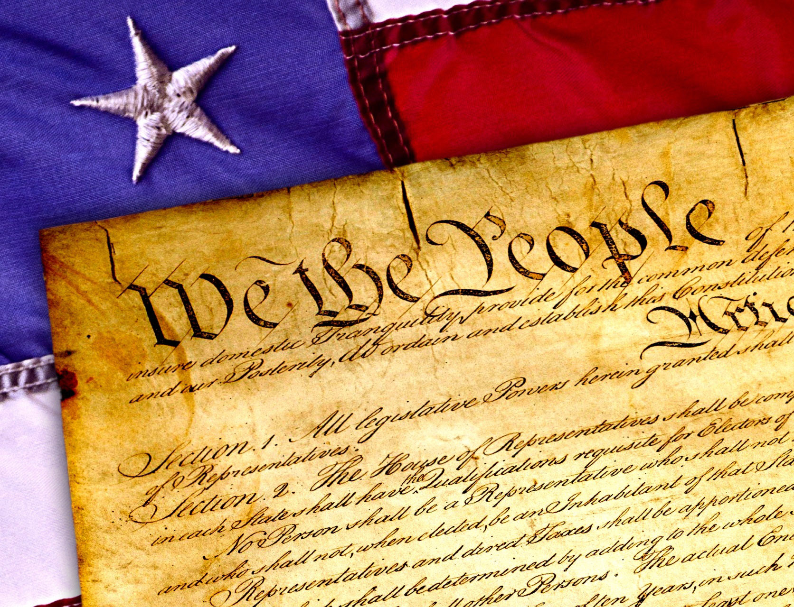
The Constitution…
A written document
Outline the powers of government
Specify the rights of citizens

Slide 4
What did the people not want?
Monarchies with their hierarchies, luxury, and corruption
Entrenched privilege
Inflated aristocracy
Poverty

Slide 5
What did they want?
An elective governmental system
Liberty
Equality
Social cohesion

Slide 6
An American Citizen
Virtuous: Leaves no room for corruption of the individual as well as the republic
Patriot: Loves his country and is not controlled by others
Property owner: Source of independence, sign of will, and evidence of permanent attachment to the community
Equal: What matters is ability not birth.
Yet, a distinct class of republican aristocracy was to exist.
Individual: Contradicts the idea of the common welfare.

Slide 7
Therefore, Americans…
Restricted the authority of the governors.
Justified the separation of powers: Keeping executive, legislative, and judicial government parts distinct.
Created an election system that aimed to represent the people and serve the higher good of the republic.

Slide 8
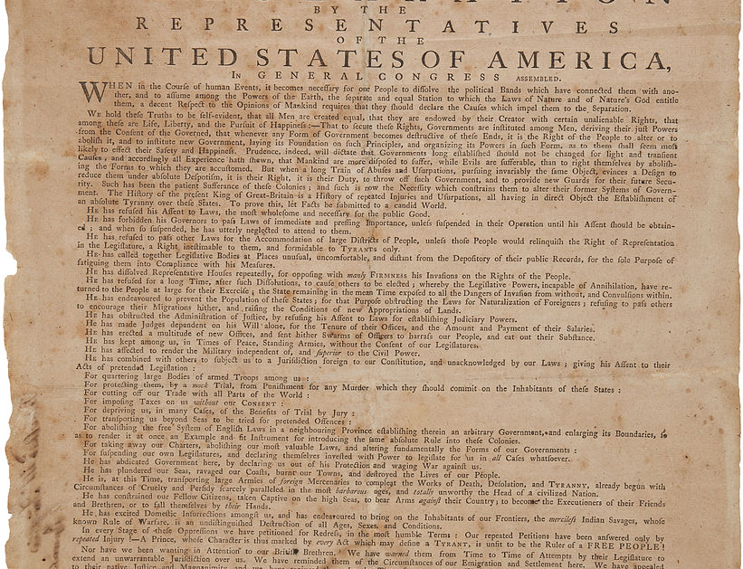
The Declaration of Independence (1776)
It is penned largely by Thomas Jefferson.
Congress officially approved of the Declaration on July 4, and yet many historians now accept that the document was not signed until August 2.*
It is one of the founding documents of the United States of America.
This Photo by Unknown Author is licensed under CC BY-SA
Notes:
https://www.history.com/topics/american-revolution/declaration-of-independence

Slide 9
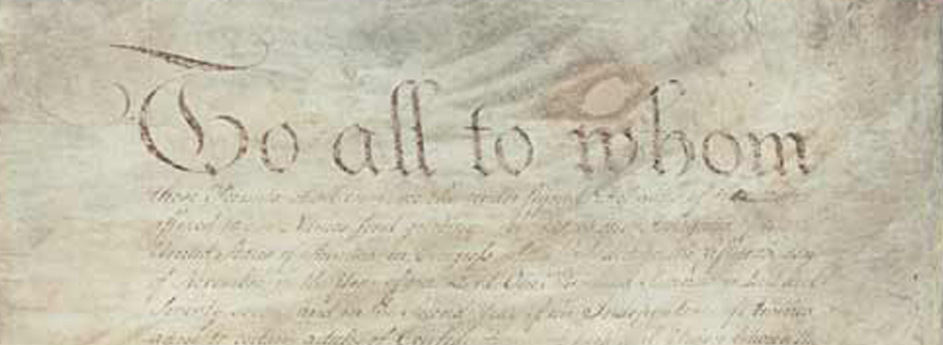
The Articles of Confederation
This Photo by Unknown Author is licensed under CC BY-SA-NC
It was presented to the states in November 1777, but it was signed by all the states in March 1781.
It was the first constitution of the United States, but in 1787 the Congress revised it and created a new and more detailed version.
Under America’s first governing document, the national government was weak and states operated like independent countries. At the 1787 convention, delegates devised a plan for a stronger federal government with three branches—executive, legislative and judicial—along with a system of checks and balances to ensure no single branch would have too much power. *
Notes:
https://www.history.com/topics/united-states-constitution/constitution

Slide 10
The Union
Each state was considered to be sovereign and independent.
Yet, they were connected parts of the United States.

Slide 11
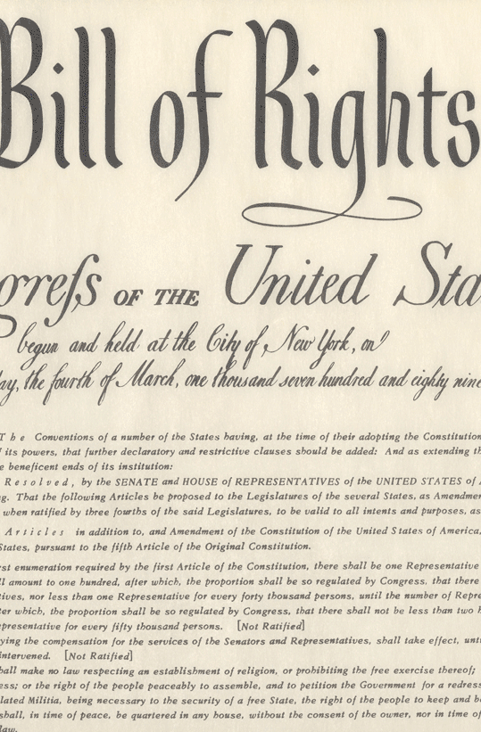
The Bill of Rights (1791)
It was written by James Madison.
Anti-Federalist delegates objected to the proposed draft, arguing that it provided a framework for a new centralized government but failed to safeguard individual liberties and states’ rights. They finally agreed to ratify the Constitution on the condition that Congress amend the document to include these protections.*
Despite its seemingly inclusive wording, the Bill of Rights did not apply to all Americans—and it wouldn’t for more than 130 years. At the time of its ratification, the “people” referenced in the amendments were understood to be land-owning white men only. Blacks only received equal protection under the law in 1868, and even then it was purely on paper. Women couldn’t vote in all states before 1920, and Native Americans did not achieve full citizenship until 1924.*
This Photo by Unknown Author is licensed under CC BY-SA
Notes:
https://www.history.com/news/8-things-you-should-know-about-the-bill-of-rights

Slide 12
Social and Economic Effects of the Revolution
Western lands were being organized into divided territories for settlement—settlements that were to gain the right to join the union and become independent states once they reached a population of 60,000 people.
Some Tories-also known as loyalists-left America after the war.
The country faced a backlash at the face of dropping exportation rates and closed markets. The South was considerably in a worse condition (loss of tobacco and cash crops, and the emancipation of slaves by the British army).
Economy started to recover by the 1780s, and interstate and inter regional commerce gained importance. This led to a demand of new canals and roads.

Slide 13
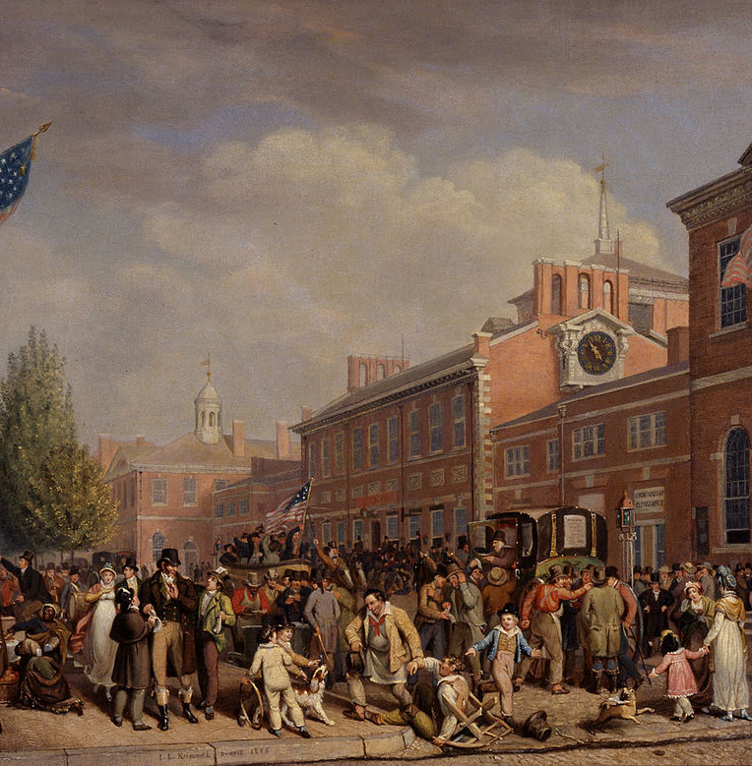
Social and Economic Effects of the Revolution
Social organizations were changing because of the rapid growth and movement of people.
People started to regard equality with the utmost importance; servants called themselves ”helps,” ordinary people claimed the right to the titles “Mr.” and “Mrs.”
However, wealth distribution was not equal after the Revolution.
People’s paternalistic understanding of master-apprentice relationship transformed into a new and remote, out-of-household business model.
This Photo by Unknown Author is licensed under CC BY-SA

Slide 14
The Betterment of Humanity in the light of Enlightenment Ideals
Educational Reforms:
State’s fundamental responsibility to educate all its citizens became essential.
New colleges founded.
Social reforms:
Americans’ desire to rule and change their environment as well as their own characters.
Charities and socities were estalished to help people.
Judicial reforms:
Liberalizing the harsh penal codes of the colonial period.
Reforming the criminal rather than punishing him.

Slide 15
The Betterment of Humanity in the light of Enlightenment Ideals
The family:
Children were to be treated as equal individuals, rather than a means of making money and bringing honor to the family.
The Primogeniture was repealed.
Family-arranged marriages gave way to love marriage.
Women:
Their social status was raised.
They, as wives and mothers, were seen to cultivate virtue and social affection in their husbands and children.
The education of women was a matter of debate.
Some women worked handicrafts at home, and thus gained economic independence. These domestic jobs, later paved them the way to work as factory workers and teachers.

Slide 16
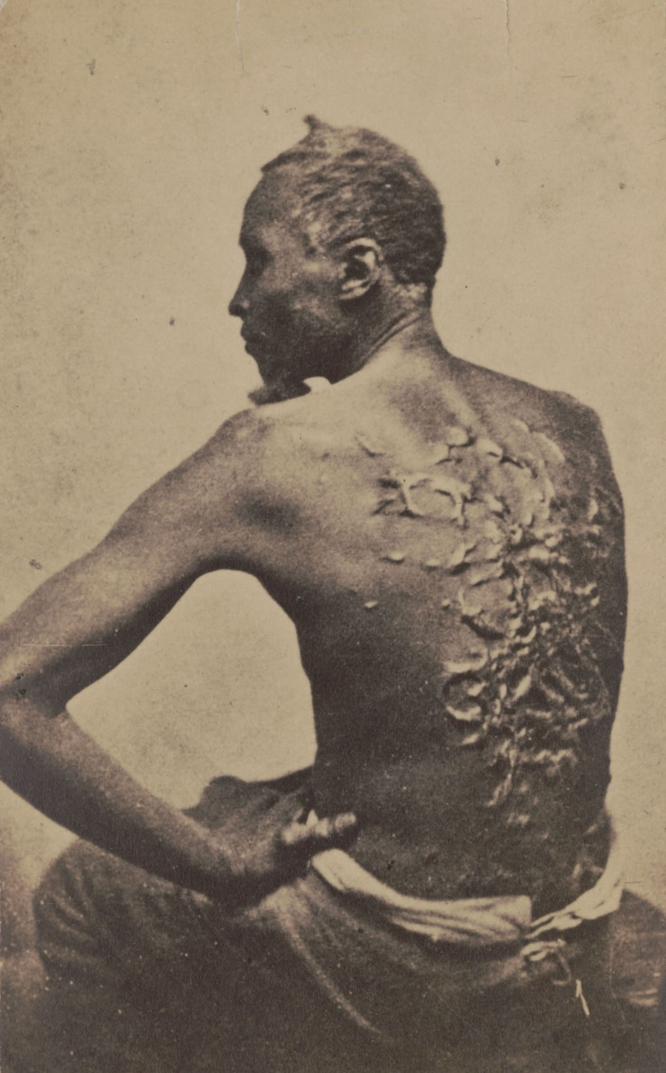
The Betterment of Humanity in the light of Enlightenment Ideals --but not for the Slave
Although slavery did not come to an end with the Revolution; Americans, who had taken African bondage for granted, now had to confront and justify the institution of slavery.
In 1774, the Continental Congress urged the abolition of the slave trade, and a half-dozen states compiled.
Antislavery associations were formed. (Quakers were the first-1775)

Slide 17
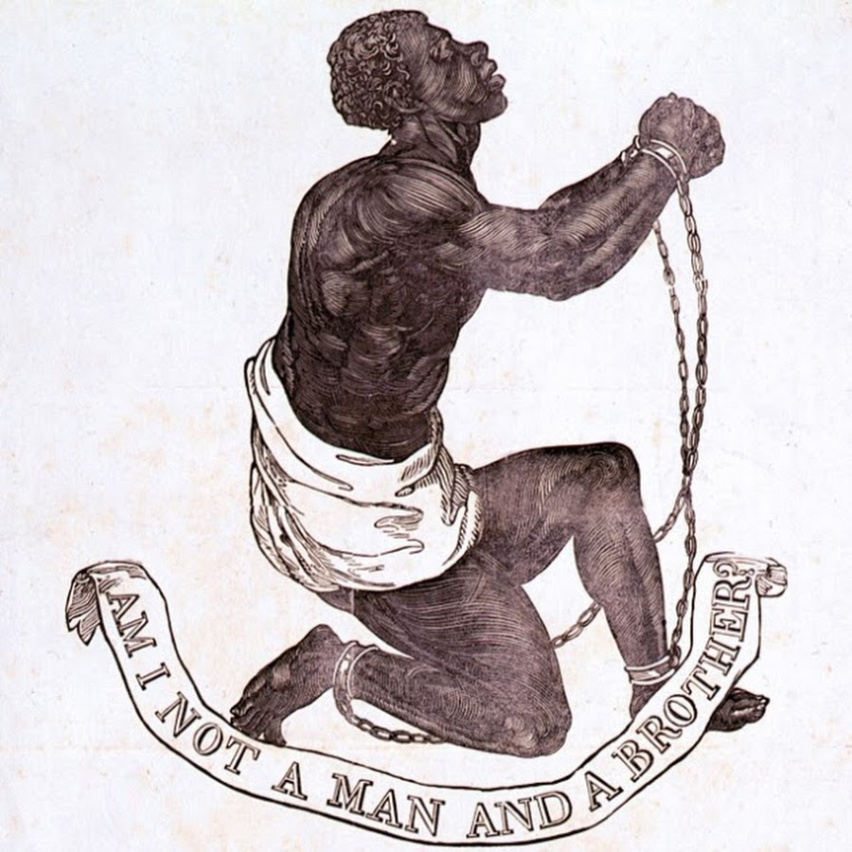
The North vs. The South on Slavery
North:
Urban, did not need slave labor as much.
Since slavery was not deeply rooted in the Northern society and economy, the political pressure was enough for abolition.
South:
Rural, depended on slave labor.
Slavery was deeply entrenched in the society and economy, which forbade an abolition just based on political pressure.
However, the declaration of “liberty for all” was problematic.
This Photo by Unknown Author is licensed under CC BY-SA
Notes:
Image published in 1837

Slide 18
Chronology
1776
The Declaration of Independence
1778
The Articles of Confederation
1791
The Bill of Rights
1787
The US. Constitution

