Slide 1
Nervous System
Doç Dr. Yasemin SALGIRLI DEMİRBAŞ
Resident ECAWBM

Slide 2
Case Story:

Slide 3
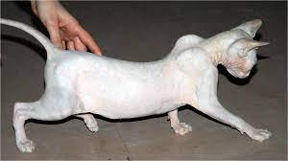
INTRODUCTION
All we are capable of doing is made possible by integrated activity of the cells of the nervous sytem.
To understand the function of the NS, we need to understand its parts.
In Kathryn’s situations: The cells of the nervous system are not functioning properly (Myasthenia gravis)

Slide 4
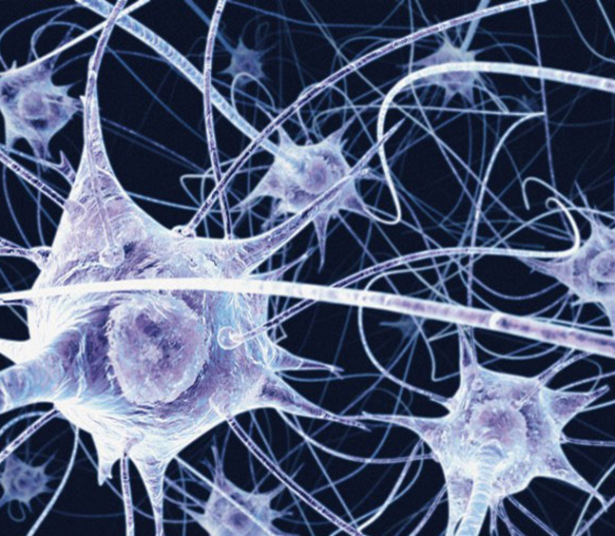
NEURONS
The human body is made up of trillions of cells.
Cells of the nervous system, called nerve cells or neurons, are specialized to carry "messages" through an electrochemical process.
The human brain has about 100 billion neurons that carry out the nerve impulses through a process called action potential.

Slide 5
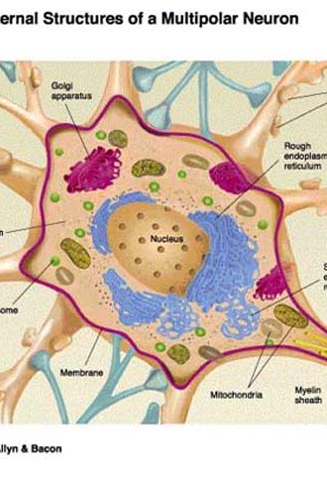
NEURAL TISSUE
The basic unit of the nervous system is the individual nerve cell, or neuron.
Nerve cells operate by generating electric signals that pass from one part of the cell to another part of the same cell and by releasing chemical messengers—neurotransmitters—to communicate with other cells.
Nerves are made up of bundles of nerve fibers.
Neuroglia carry out a variety of functions to aid and protect components of the nervous system.

Slide 6
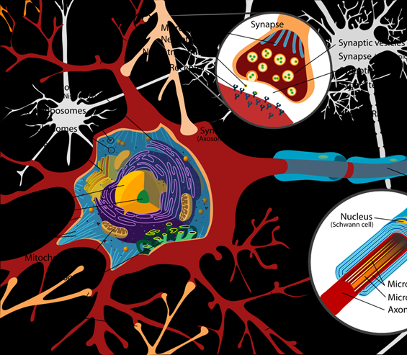
Similarities with other cells
1. Neurons are surrounded by a cell membrane.
2. Neurons have a nucleus that contains genes.
3. Neurons contain cytoplasm, mitochondria and other "organelles".
4. Neurons carry out basic cellular processes such as protein synthesis and energy production.

Slide 7
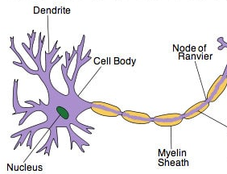
Differences from other cells:
1. Neurons have specialized extensions called dendrites and axons. Dendrites bring information to the cell body and axons take information away from the cell body.
2. Neurons communicate with each other through an electrochemical process.
3. Neurons contain some specialized structures (for example, synapses) and chemicals (for example, neurotransmitters).

Slide 8
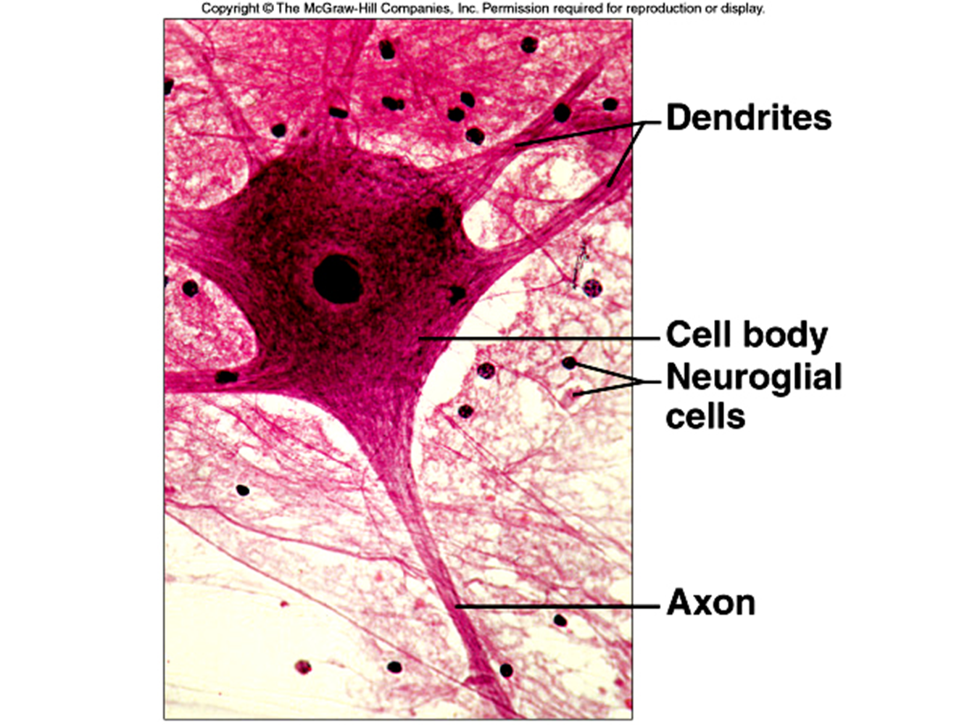
Structure of a neuron:
A single neuron consist of:
CELL BODY: contains the nucleus and ribosomes and thus has the genetic information and machinery necessary for protein synthesis
DENDRITES (Greek word- “tree”): convey incoming messages to the cell body.
Function much more like antennas to receive messages from other neurons.
The branching dendrites (some neurons may have as many as 400,000!) increase the cell’s receptive surface area - increase its capacity to receive signals from a myriad of other neurons.

Slide 9
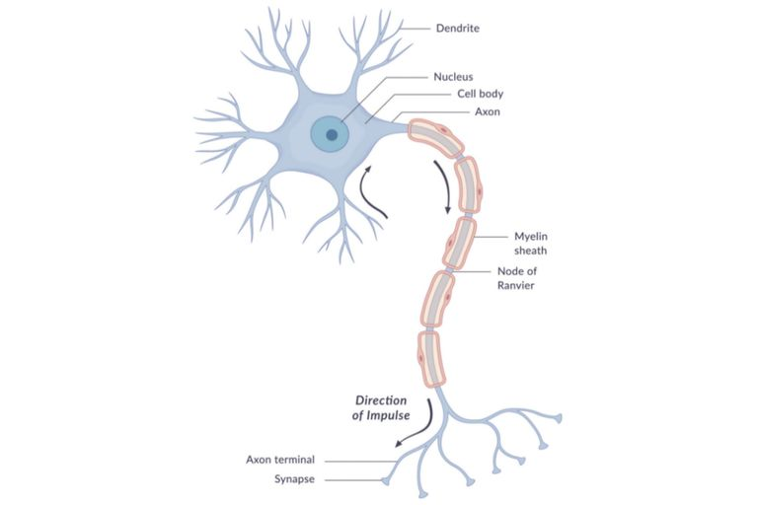
Structure of a neuron:
AXONS: sometimes also called a nerve fiber, is a single long process that extends from the cell body to its target cells.
functions much like an electrical cord carrying an electrical messagae from an outlet to an ppliance.
In length, axons can be a few micrometers or a meter or more.
The portion of the axon closest to the cell body plus the part of the cell body where the axon is joined are known as the initial segment, or axon hillock.
Presynaptic terminals (terminal buttons): The swollen, distal end of an axon; contains a neurotransmitter substance within synaptic vesicles.
Also called synaptic ending or synaptic button.

Slide 10
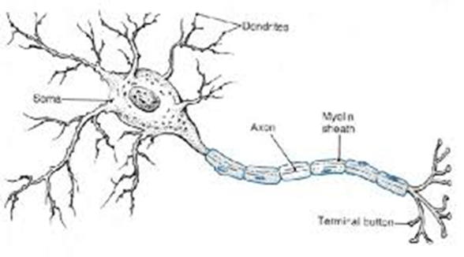
Differences between axons and dendrites:
Axons
Take information away from the cell body
Smooth Surface
Generally only 1 axon per cell
No ribosomes
Can have myelin
Branch further from the cell body
Dendrites
Bring information to the cell body
Rough Surface (dendritic spines)
Usually many dendrites per cell
Have ribosomes
No myelin insulation
Branch near the cell body

Slide 11
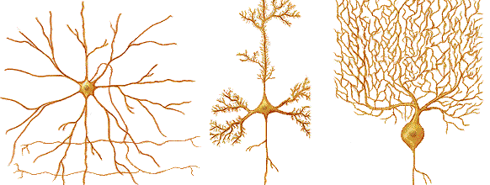
Types of neurons
Neurons come in many different shapes and sizes.
Some of the smallest neurons have cell bodies that are only 4 microns wide.
Some of the biggest neurons have cell bodies that are 100 microns wide. (Remember that 1 micron is equal to one thousandth of a millimeter!!).

Slide 12
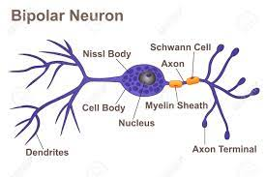
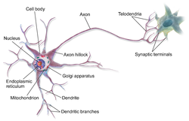
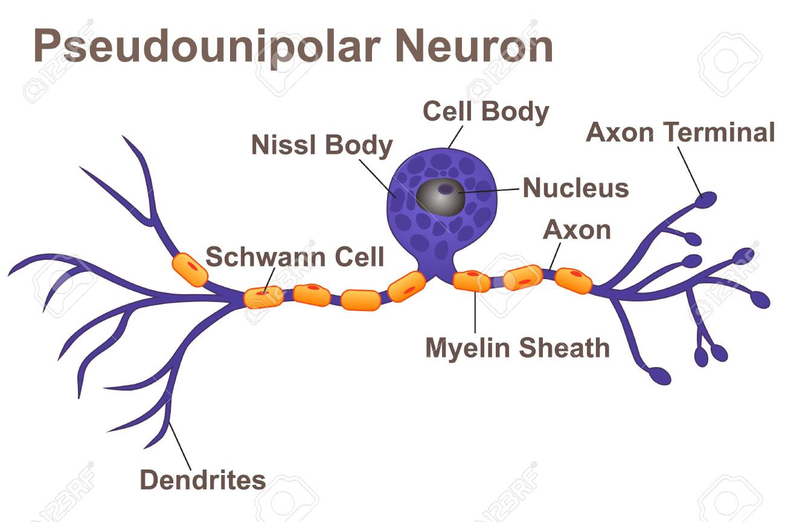
One way to classify neurons is by the number of extensions that extend from the neuron's cell body
Types of neurons
Bipolar neurons have two processes extending from the cell body
(examples: retinal cells, olfactory epithelium cells).
Multipolar neurons possesses a single axon and many dendrites (and dendritic branches), allowing for the integration of a great deal of information from other neurons.
These processes are projections from the neuron cell body.
Multipolar neurons constitute the majority of neurons in the central nervous system.
(examples: spinal motor neurons, interneurons).
Pseudounipolar cells These cells have 2 axons rather than an axon and dendrite.
One axon extends centrally toward the spinal cord, the other axon extends toward the skin or muscle.
(example: dorsal root ganglion cells).

Slide 13
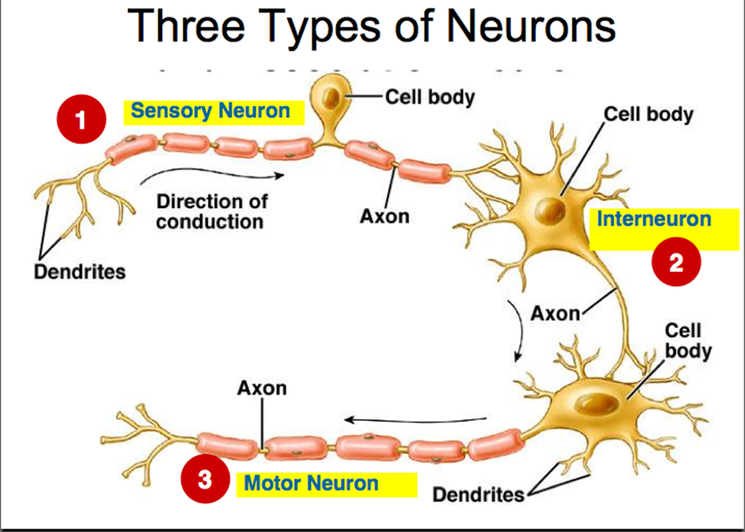
Types of neurons
Neurons can also be classified by the direction that they send information:
Sensory (or afferent) neurons: send information from sensory receptors (e.g., in skin, eyes, nose, tongue, ears) TOWARD the central nervous system.
Motor (or efferent) neurons: send information AWAY from the central nervous system to muscles or glands.
Interneurons: send information between sensory neurons and motor neurons.
Most interneurons are located in the central nervous system.

Slide 14
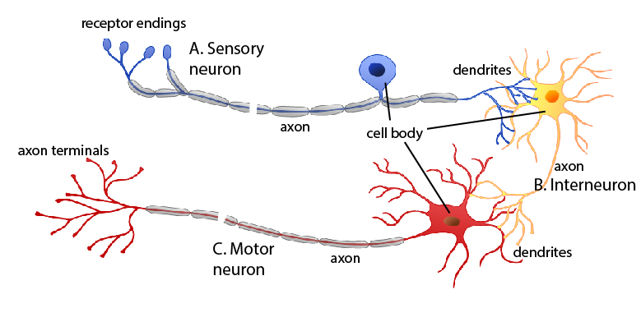
Functional Classes of Neurons
At their peripheral ends (the ends farthest from the central nervous system), afferent neurons have sensory receptors, which respond to various physical or chemical changes in their environment by causing electric signals to be generated in the neuron.
The receptor region may be a specialized portion of the plasma membrane or a separate cell closely associated with the neuron ending.

Slide 15
PNS
CNS
Sensory Pathway
Receptors
1. Sensory Neuron
Interneuron
(Integration)
2. Interneuron
3. Motor Neuron
Motor Pathway
Effector
Tissue

Slide 16
SUPPORTING CELLS
Neurons constitute only about half the volume of the nervous system.
The rest of NS contains a variety of supporting cells.
WHY?
Neurons have a high rate of metabolism but have no means of storing nutirents.
They must constantly be supplied with nutrients and oxygen.
These cells support and protect neurons.

Slide 17
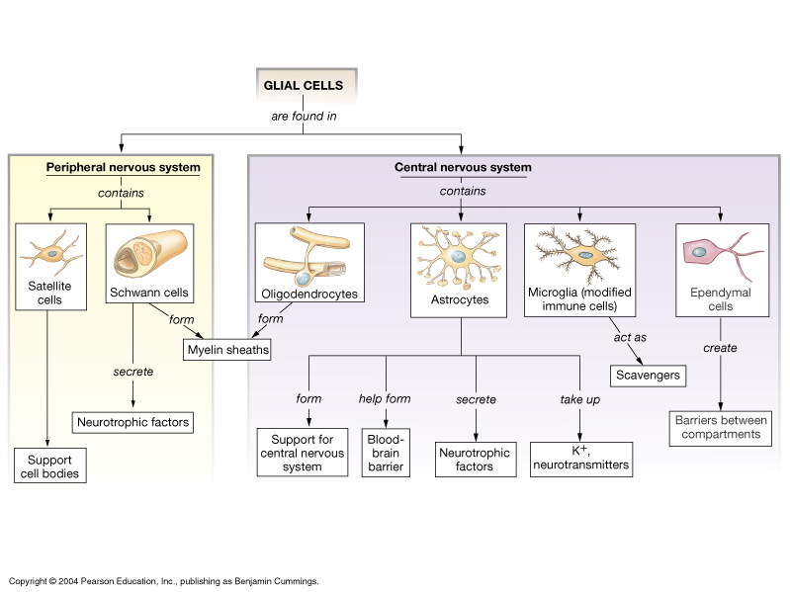

Slide 18
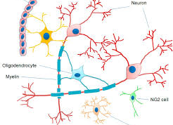
DONT UNDERESTIMATE GLIAL CELLS-NERVE GLUE
Ten or twenty years ago, glial cells were considered minor players in the nervous system, even though they outnumber neurons 10-fold.
Glia were thought to function as passive support cells, bringing nutrients to and removing wastes from the neurons, whereas the neurons carried out the critical nervous system functions of information processing, plasticity, learning, and memory.
Recent studies are changing this view and demonstrating that glial cells play a key role in these essential brain functions.

Slide 19
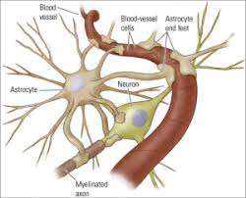
NEUROGLIAL CELLS
Neuroglial cells—usually referred to simply as glial cells or glia—are quite different from nerve cells.
The major distinction is that glia do not participate directly in synaptic interactions and electrical signaling, although their supportive functions help define synaptic contacts and maintain the signaling abilities of neurons.
Glia are more numerous than nerve cells in the brain, outnumbering them by a ratio of perhaps 3 to 1.
Although glial cells also have complex processes extending from their cell bodies, they are generally smaller than neurons, and they lack axons and dendrites

Slide 20
NEUROGLIAL CELLS IN DISEASES
Overwhelming evidence implicates glial cells in most neurological diseases.
For example, in multiple sclerosis (MS) macrophages destroy myelin in grey and white matter.
Cytological changes in oligodendrocytes – such as apoptosis, gross swelling with abnormal nuclei and deposition of activated complement – appear to precede or accompany the destruction of myelin by macrophages.
In turn, macrophage activity in MS seems to represent a reaction to dead myelin following loss of oligodendrocytes.

Slide 21
2 Glial Cells of the PNS
1. Schwann cells – create the myelin sheath for axons in the
PNS. Many Schwann cells help to myelinate axon.
2. Satellite cells - small cells that surround neurons ganglia in PNS.
Act to protect and repair ganglia.

Slide 22
4 Glial Cells of the CNS
3. Oligodendrocytes - create the myelin sheaths of axons in
CNS, providing insulation, allowing signals to propagate faster.
4. Astrocytes – help create the restrictive blood-brain barrier (BBB), to protect delicate nervous tissue.
5. Microglia - phagocytic (like macrophages), acting as defense cells in CNS. Cells multiply if CNS is damaged or infected.
Microglia derive from monocytes and are central to the brain’s immunity and defences.
Microglia also prune synapses and actively promote apoptosis, both of which are important in the CNS’ development
6. Ependymal cells - line fluid cavities of the CNS (e.g. ventricles and central canal).
They help create and secrete cerebrospinal fluid (CSF).

Slide 23
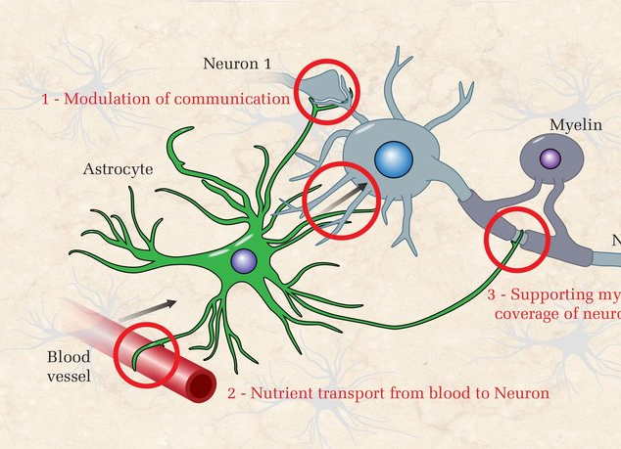
ASTROCYTES
Astrocytes also contribute to information processing in the CNS.
Some processes form cuffs or veils around synapses.
Signals between nerve terminals and these glial processes can modulate transmission.
Astrocytes also release several transmitters including glutamate, ATP, GABA and D-serine.
In other words, astrocytes fine-tune levels of neurotransmitters in the CNS

Slide 24
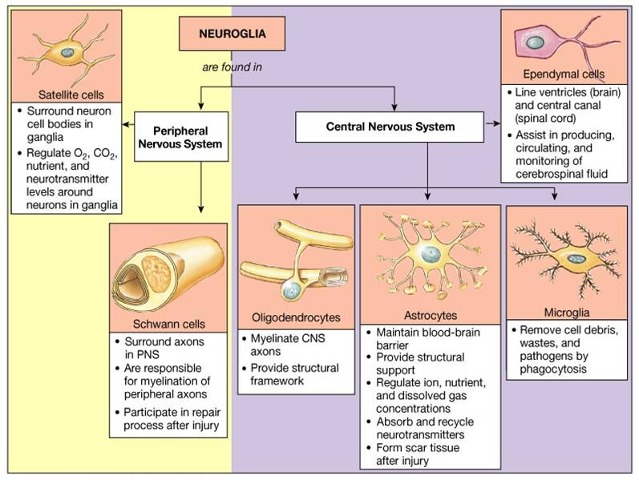

Slide 25
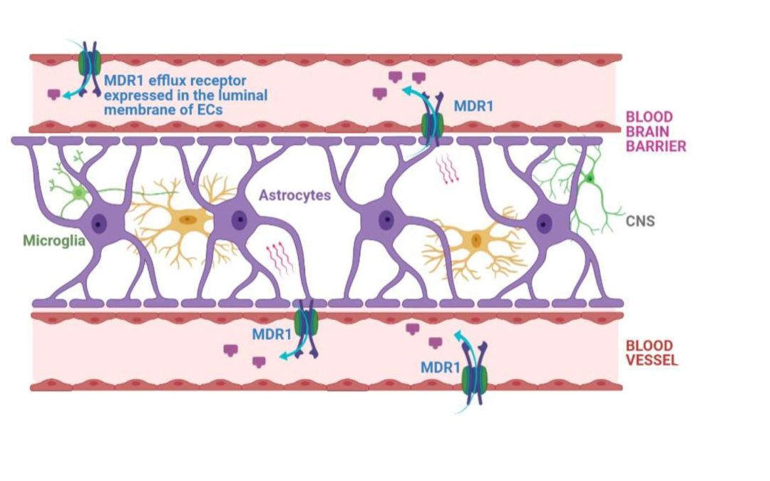

Slide 26
Graded Potentials
Localized change in membrane potential that varies
in magnitude and is decremental.
Action Potentials
Rapid reversal in membrane potential (due to changes in ion permeability), with constant magnitude and is non-decremental.

Slide 27
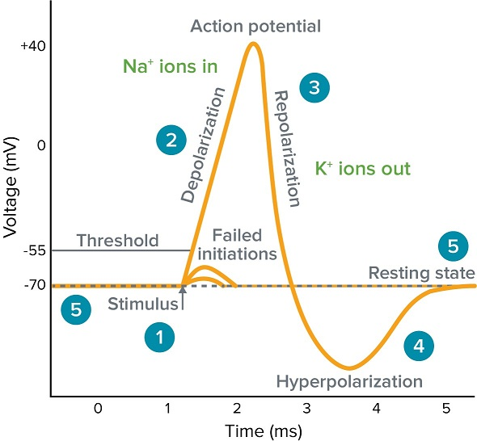
ACTION POTENTIAL
Are rapid, large alterations in the membrane potential during which time the membrane potential may change 100 mV, from -70 to +30 mV, and then repolarize to its resting membrane potential.
Nerve and muscle cells as well as some endocrine, immune, and reproductive cells have plasma membranes capable of producing action potentials.
These membranes are called excitable membranes, and their ability to generate action potentials is known as excitability

Slide 28
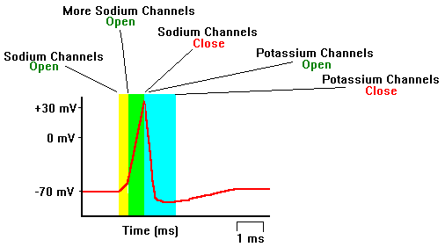
ACTION POTENTIAL
The action potential results from a transient change in membrane ion permeability, which allows selected ions to move down their concentration gradients.
In the resting state, the open channels in the plasma membrane are predominantly those that are permeable to potassium ions.
Very few sodium-ion channels are open,
the resting potential is close to the potassium equilibrium potential.

Slide 29
ACTION POTENTIAL
During an action potential, the membrane permeabilities to sodium and potassium ions are markedly altered.
The depolarizing phase of the action potential is due to the opening of voltage-gated sodium channels, which increases the membrane permeability to sodium ions several hundredfold.
This allows more sodium ions to move into the cell.
During this period more positive charge enters the cell in the form of sodium ions than leaves in the form of potassium ions, and the membrane depolarizes.
It may even overshoot, becoming positive on the inside and negative on the outside of the membrane.
In this phase, the membrane potential approaches but does not quite reach the sodium equilibrium potential (60 mV).

Slide 30
ACTION POTENTIAL
Action potentials in nerve cells last only about 1 ms and typically show an overshoot.
They may last much longer in certain types of muscle cells
The membrane potential returns so rapidly to its resting level because:
(1) the sodium channels that opened during the depolarization phase undergo inactivation near the peak of the action potential, which causes them to close; and
(2) voltage-gated potassium channels which open more slowly than sodium channels, open in response to the depolarization.
Closure of the sodium channels alone would restore the membrane potential to its resting level since potassium flux out would then exceed sodium flux in.

Slide 31
ACTION POTENTIAL
The process is speeded up by the simultaneous increase in potassium permeability.
Potassium diffusion out of the cell is then much greater than the sodium diffusion in, rapidly returning the membrane potential to its resting level.
In fact, after the sodium channels have closed, some of the voltage-gated potassium channels are still open
in nerve cells there is generally a small hyperpolarization of the membrane potential beyond the resting level
cellular accumulation of sodium and loss of potassium are prevented by the continuous action of the membrane Na,K-ATPase pumps.

Slide 32
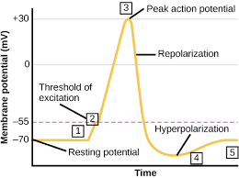
Mechanism of Ion-channel Changes
The potassium channels that open during an action potential are also voltage-gated.
In fact, their opening is triggered by the same depolarization that opens the sodium channels, but the potassium channel opening is slightly delayed.
What about the inactivation of the voltage-gated sodium channels that opened during the rising phase of the action potential?
This is the result of a voltage induced change in the conformation of the proteins that constitute the channel, which closes the channel after its brief opening.

Slide 33
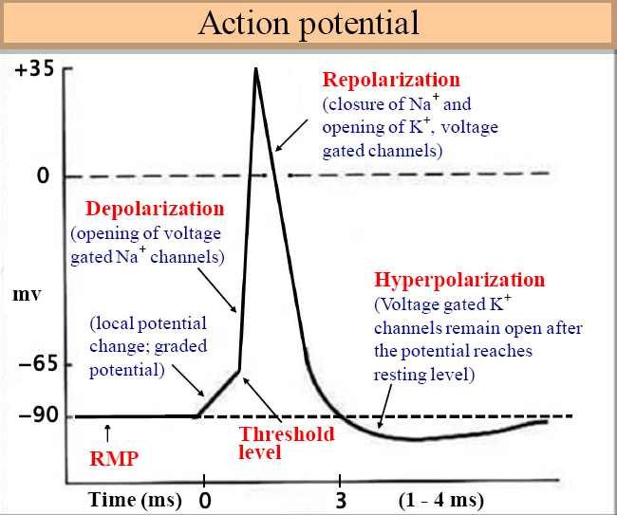
Threshold potentıal
Action potentials occur only when the net movement of positive charge through ion channels is inward.
The membrane potential at which this occurs is called the threshold potential,
Stimuli that are just strong enough to depolarize the membrane to this level are threshold stimuli
The threshold of most excitable membranes is about 15 mV less negative than the resting membrane potential.
Thus, if the resting potential of a neuron is 70 mV, the threshold potential may be 55 mV.

Slide 34
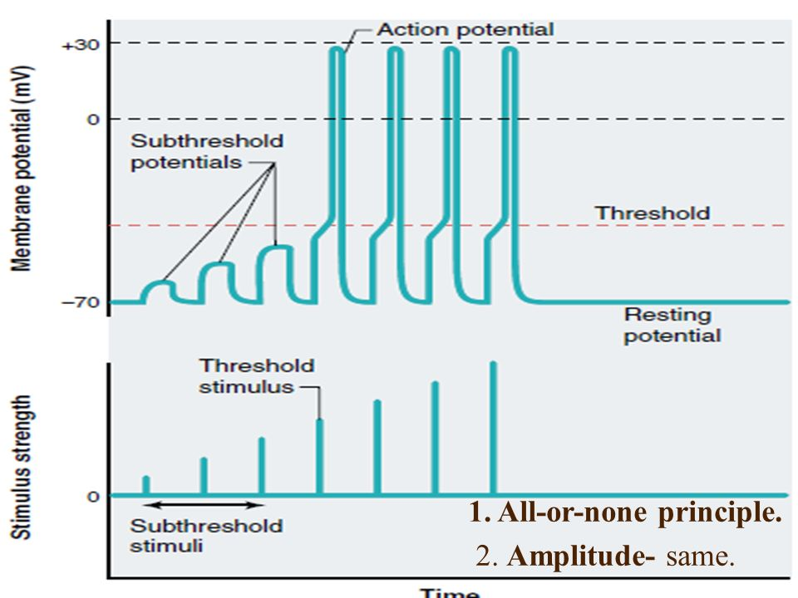
Threshold potentıal
At depolarizations less than threshold, outward potassium movement still exceeds sodium entry, and the positive-feedback cycle cannot get started despite the increase in sodium entry.
In such cases, the membrane will return to its resting level as soon as the stimulus is removed, and no action potential is generated.
These weak depolarizations are subthreshold potentials, and the stimuli that cause them are subthreshold stimuli.

Slide 35
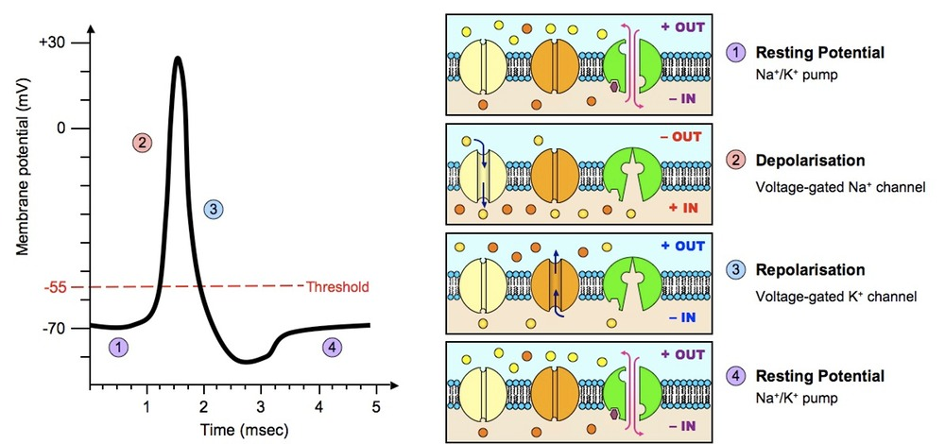
All – or-none
Stimuli of more than threshold magnitude also elicit action potentials,
The action potentials resulting from such stimuli have exactly the same amplitude as those caused by threshold stimuli.
This is because once threshold is reached, membrane events are no longer dependent upon stimulus strength.
Rather, the depolarization generates an action potential because the positive-feedback cycle is operating.
Action potentials either occur maximally or they do not occur at all.
Another way of saying this is that action potentials are all-or-none.

Slide 36
All – or-none
The firing of a gun is a mechanical analogy that shows the principle of all-or-none behavior.
The magnitude of the explosion and the velocity at which the bullet leaves the gun do not depend on how hard the trigger is squeezed.
Either the trigger is pulled hard enough to fire the gun, or it is not; the gun cannot be fired halfway

Slide 37
How does one distinguish between a loud noise and a whisper, a light touch and a pinch?
This information depends upon the number and pattern of action potentials transmitted per unit of time and not upon their magnitude.

Slide 38
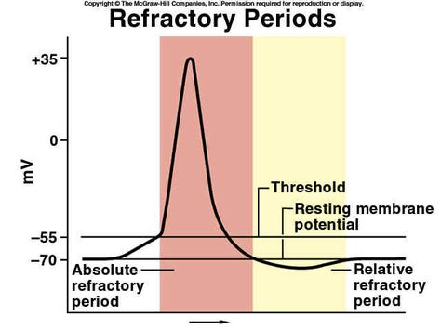
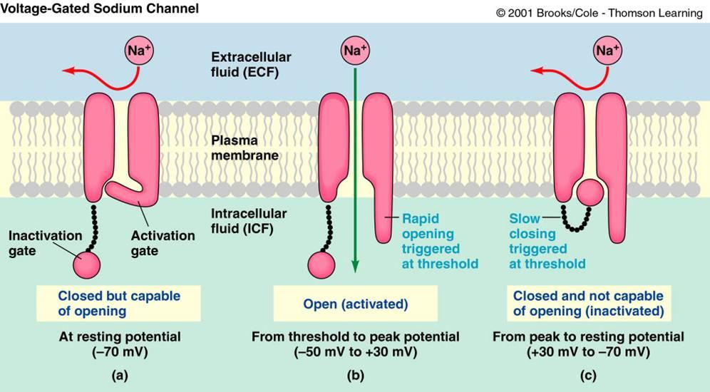
ABSOLUTE Refractory PerIod
During the action potential, the membrane is said to be in its absolute refractory period.
A second stimulus, no matter how strong, will not produce a second action potential
This occurs because the voltage-gated sodium channels enter a closed, inactive state at the peak of the action potential.
The membrane must repolarize before the sodium channel proteins return to the state in which they can be opened again by depolarization.

Slide 39
RELATIVE Refractory PerIod
Following the absolute refractory period, there is an interval during which a second action potential can be produced, but only if the stimulus strength is considerably greater than usual.
This is the relative refractory period, which can last 10 to 15 ms or longer in neurons
It coincides roughly with the period of after hyperpolarization.
During the relative refractory period, there is lingering inactivation of the voltage-gated sodium channels, and an increased number of potassium channels are open.
If a depolarization exceeds the increased threshold or outlasts the relative refractory period, additional action potentials will be fired.

Slide 40
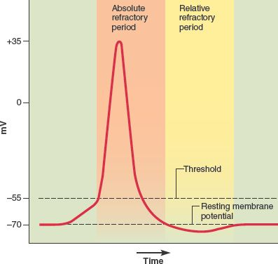
Functions of refractory perıod
The refractory periods limit the number of action potentials that can be produced by an excitable membrane in a given period of time.
They also increase the reliability of neural signaling because they help limit extra impulses.
The refractory periods are key in determining the direction of action potential propagation.

Slide 41
Graded vs. Action Potentials
1. Magnitude varies
1. No variation - All or None
2. 2. Decremental
(passive spread)
2. Non-decremental
(self-regenerating)
3. 3. No Refractory Periods
3. Two Refractory periods:
Absolute and Relative
4. Summation is possible
4. No Summation possible
5. Trigger: Threshold
5. Trigger: NT's, hormones
6. Occurs at axon hillock (one way direction)
6. Occurs at cell body
(direction can vary)

Slide 42
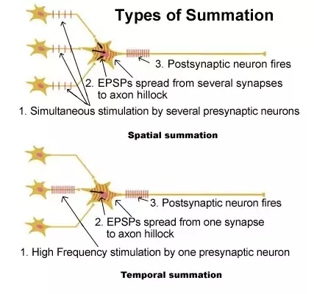
Summation of Graded Potentials
Spatial Summation:
As multiple simultaneous stimuli occur at different places on the neuron, the changes in membrane potential can be added and its magnitude increased or decreased.
Temporal Summation:
As the frequency of a single stimuli increases, the changes in membrane potential can be added and its magnitude can increase.

Slide 43
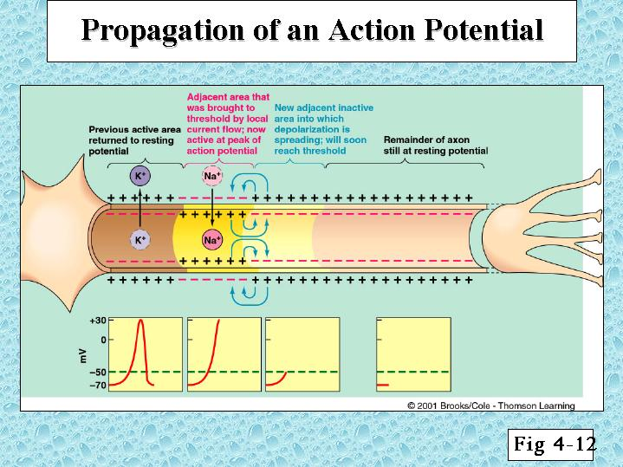
Action-PotentIal PropagatIon
There is a sequential opening and closing of sodium and potassium channels along the membrane.
The action potential doesn’t move but “sets off” a new action potential in the region of the axon just ahead of it.
Because the membrane areas that have just undergone an action potential are refractory and cannot immediately undergo another, the only direction of action potential propagation is away from a region of membrane that has recently been active

Slide 44
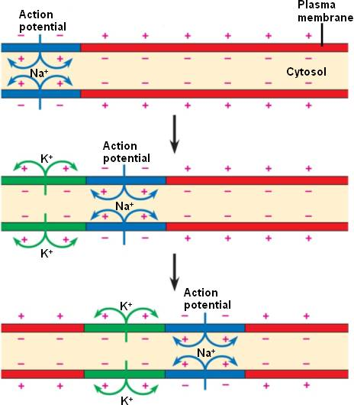
Action-PotentIal PropagatIon
The direction of propagation being determined by the stimulus location.
For example, the action potentials in skeletal-muscle cells are initiated near the middle of these cylindrical cells and propagate toward the two ends.
In most nerve cells, however, action potentials are initiated physiologically at one end of the cell (for reasons to be described in the next section) and propagate toward the other end

Slide 45
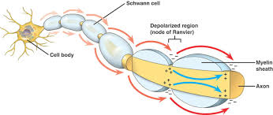
Action-Potential Propagation
The velocity with which an action potential propagates along a membrane depends upon fiber diameter and whether or not the fiber is myelinated.
The larger the fiber diameter, the faster the action potential propagates.
WHY?
A large fiber offers less resistance to local current; more ions will flow in a given time, bringing adjacent regions of the membrane to threshold faster.

Slide 46
Action-Potential Propagation
Myelin is an insulator that makes it more difficult for charge to flow between intracellular and extracellular fluid compartments.
There is less “leakage” of charge across the myelin
The concentration of voltage-gated sodium channels in the myelinated region of axons is low
Therefore, action potentials occur only at the nodes of Ranvier where the myelin coating is interrupted and the concentration of voltage-gated sodium channels is high.
Action potentials literally jump from one node to the next as they propagate along a myelinated fiber, and for this reason such propagation is called saltatory conduction

Slide 47
ANY QUESTION?

