Slide 1
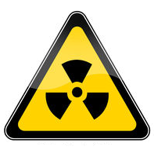
8 -WORKING WITH RADIOAKTIVE SUBSTANCES AND RADIATION
In this section, the rules to be followed when working with radioactive material and the answers to the following questions have been examined. - How to protect from lightning and internal rays? - How to prevent radioactive contamination?
This section also discusses working with x-rays, laser and intense light sources.

Slide 2
Rules to be followed during working with radioactive material
Persons in laboratories where radioactive materials are present are at risk of contamination from exposure to radioactive contamination or contamination by contact with these materials.
Precautions should be taken according to the physical and chemical properties of the working rays. These measures can be listed as follows:

Slide 3
Stay away!
The dose to be taken is reduced proportional with the square of the distance to the source of radiation. (The dose is proportional to the activity).
Prevent the beam by an appropriate barrier!
Around the radiation sources must be
surrounded by moving lead walls (sheets). The thickness of the lead depends on the activity and energy of the beam. In addition, the exposure time of laboratory personnel to the beam also affects lead sheet thickness.

Slide 4
Stay away In particular, it is necessary to avoid sources that emit more energy than 200 keV (1 eV = 1.602, 10-18 j). The intake dose is proportional to the activity. High-energy beta rays emitted from high active sources can reach long distances.
Prevent the beam by an appropriate barrier
It is also possible to protect from beta rays with the help of materials used to screen gamma rays. Unlike gamma rays, beta rays can be stopped with glass or plastic plates. Here, the material used to stop the beta beam should be of sufficient thickness, and it should not be allowed to form x-ray beams during barriering by selecting the appropriate material.

Slide 5
Stay away!
It is possible to prevent the alpha rays by staying away from the beam source because the distance that the alpha rays can reach in the air is short and it is under some kind of braking effect in the air. But the effect of staying away from the source in gamma and beta rays is small. Despite this, it is not true to be very close to the source, thinking that the skin will be contaminated by contact.
Prevent the beam by an appropriate barrier!
Screening can be done with thin-walled glass or plastic sheets. There is no need for lead shields to protect it.

Slide 6
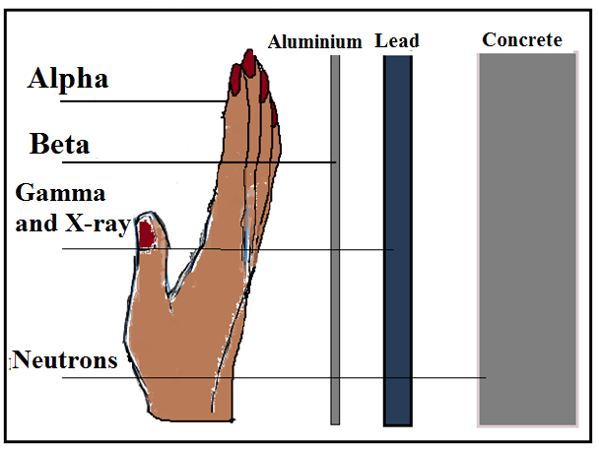
Stopping different beams by different barriers

Slide 7
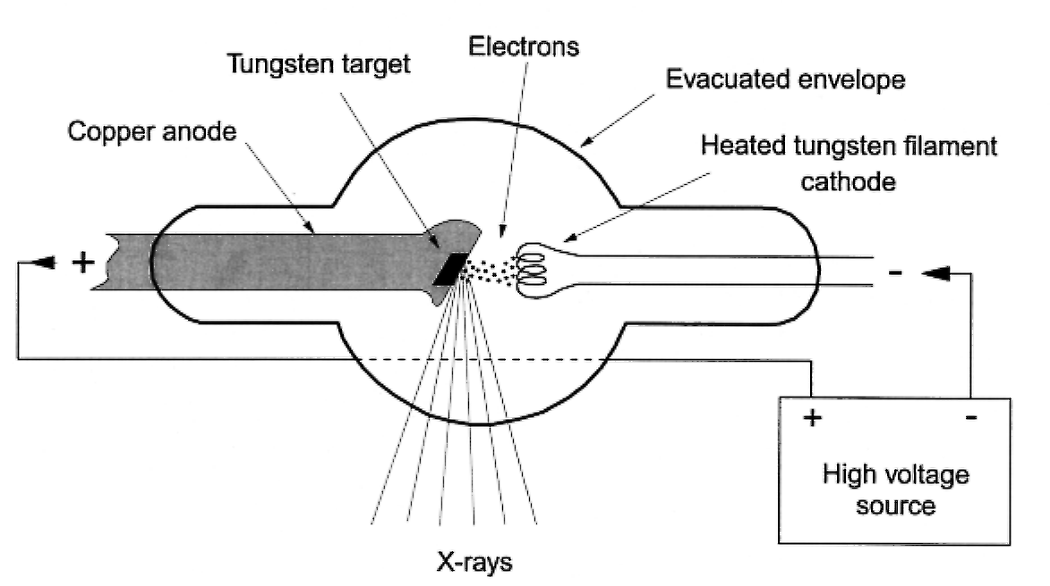
Working with Roentgen (X) rays

Slide 8
X-ray devices, which are frequently used in laboratories, are also dangerous sources such as other radiation sources. The presence of such devices should be marked with warning signs. Only the permitted persons can enter the room where these devices are located. Before starting to work with X-ray devices such as X-ray fluorescence analyzer, Mößbauer spectrometer, the working catalog of the device should be read very well. Persons working in the environment of X-rays should carry a film dosimeter (the system used to determine if a dose of x-ray is being taken) and this dosimeter should be checked at regular intervals

Slide 9
Laser Beams (Light Amplification by Stimulated Emission of Radiation)

Slide 10
