Slide 1
EME 201 Materials Science
INTRODUCTION

Slide 2
Classification of Materials
There are different ways of classifying materials.
One way is to describe classes of materials are given below:
1. Metals and alloys;
2. Ceramics, glasses, and glass-ceramics;
3. Polymers (plastics);
4. Semiconductors;
5. Composite materials, hybrid materials.

Slide 3
Metals and Alloys
Most of the elements present can be classified as metals, and about half of the mterials are of at least some industrial importance.
When the word metal is limited to the pure metal elements, common usage calls it as metal alloys.
Although pure metalls have a wide range of properties, pure metalls are quite limited in commercial use.
Metal alloys, combinations of two or more elements, are more versatile and hence metal alloys are the form in which most metals are used by industry.
Metallic materials are composed of crystalline structure.
Crystal structures are composed of unit cells repeated in a regular pattern to form a three-dimensional crystal-lattice structure.

Slide 4
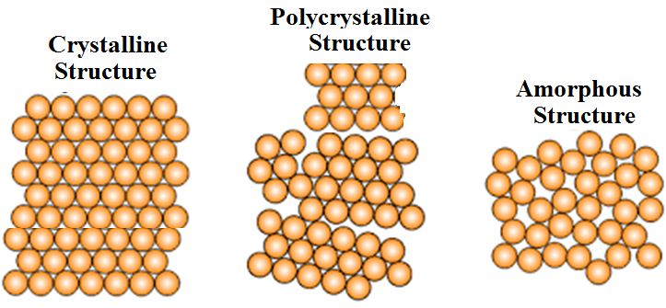
Metals and Alloys
Crystalline Structure of Materials

Slide 5
Ceramics
Ceramics can be called as inorganic crystalline materials.
Ceramics are also known as natural materials.
Beach sand and rocks can be illustrated as examples of naturally occurring ceramics.
Advanced ceramics are materials that are produced by refining naturally occurring ceramics and other special processes.
They are used as substrates in computer chips, sensors and actuators, capacitors, inductors and electrical insulation.
Certain types of ceramics are used as thermal barrier coatings to protect metallic surfaces in turbine engines.
Ceramics are also used for industrial applications such as catalyst support and oxygen sensors in consumer products.

Slide 6
Ceramics
Materials made from ceramics are used to make bricks, tableware, vitreous ware, refractories (heat-resistant material).
Generally, ceramics tend to be brittle due to the presence of porosity (small holes).
The ceramics must be heated to very high temperatures before melting.
The ceramics are strong, but they are very brittle.
Normally we prepare fine powder ceramics and they are converted into different shapes.
Advanced processing techniques ensure that the ceramics are sufficiently resistant to shading and can be used in load bearing applications such as impellers in turbine engines.

Slide 7
Glasses and Glass-Ceramics
Glass is also in the group of ceramic materials.
The main difference between the glass and the ceramics is the amorphous structure.
Mostly, the glass is produced from molten silica, which is oxide compound of silicon element.
The amorphous term refers to cetain types of materials that do not have a regular, periodic arrangement of atoms.
The fiber optics industry is based on optical fibers, which are made by using high-purity silica glass.
Glasses can also used in houses, cars, computer and television screens, and hundreds of other applications.

Slide 8
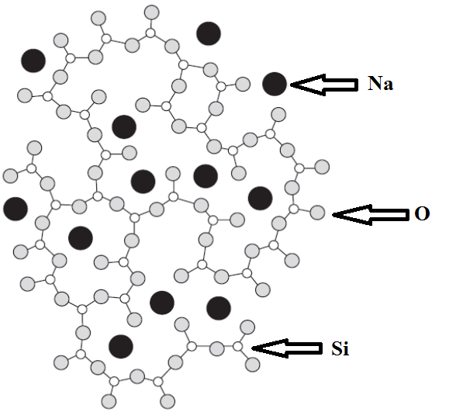
Glasses and Glass-Ceramics
Commercial glasses are composed of silica (SiO₂) mixed with metal or metal oxides, which greatly reduce the melting temperature of the material.
Mixing the silica with metal or metal oxides make the glass easier and cheaper to produce.
There are two types of commercial glasses:
-soda lime,
-borosilicate.
Sketch of the structure of soda lime glass

Slide 9
Glasses and Glass-Ceramics
Soda lime glasses
Commercial soda lime glasses have a typical compound composition
70 SiO₂ %, 10 CaO %, 15 Na₂O % and 5 other oxides %
Commercial soda lime glasses are produced for high volume products such as windows, bottles and jars.
The added metal oxides such as CaO, Na2O, act as network modifiers in the glass structure.
Borosilicate glasses
Commercial borosilicate glasses have a typical composition as following
80 SiO2 %, 15 B2O3 %, 5 Na2O % and 10 other oxides %

Slide 10
Glasses and Glass-Ceramics
Glass ceramics
A controlled heat treatment is required, first brought into the nucleus and then allowing the crystals to grow along the glass.
The amount of crystallization can exceed 90% by volume and produce crystal sizes less than 0.5 μm in the glass matrix.
Most of commercial glass ceramics are based on one of two aluminosilicate systems:
-(Li2O.Al2O3.nSiO2)
-(2MgO.2Al2O3.5SiO2)

Slide 11
REFERENCES
William D. Callister, ‘Materials Science and Engineering: An Introduction’, Seventh edition, John Wiley & Sons, Inc., U.S.A.
Brian S. Mitchell, ‘AN INTRODUCTION TO MATERIALS ENGINEERING AND SCIENCE FOR CHEMICAL AND MATERIALS ENGINEERS’, John Wiley & Sons, Inc., U.S.A, 2004.
J. W. Martin, ‘Materials for Engineering’, Third Edition, WOODHEAD PUBLISHING LIMITED, Cambridge, England.
Donald R. Askeland & Pradeep P. Fulay, ‘Essentials of Materials Science and Engineering’, Second Edition, Cengage Learning, Toronto, Canada.
G. S. Brady, H. R. Clauser, J. A. Vaccari, ‘Materials Handbook’, Fifteenth Edition, McGraw-Hill Handbooks.

