Slide 1
BIO 206 PLANT MORPHOLOGY
LECTURE NOTES
8th WEEK
DR. AYDAN ACAR ŞAHİN

Slide 2
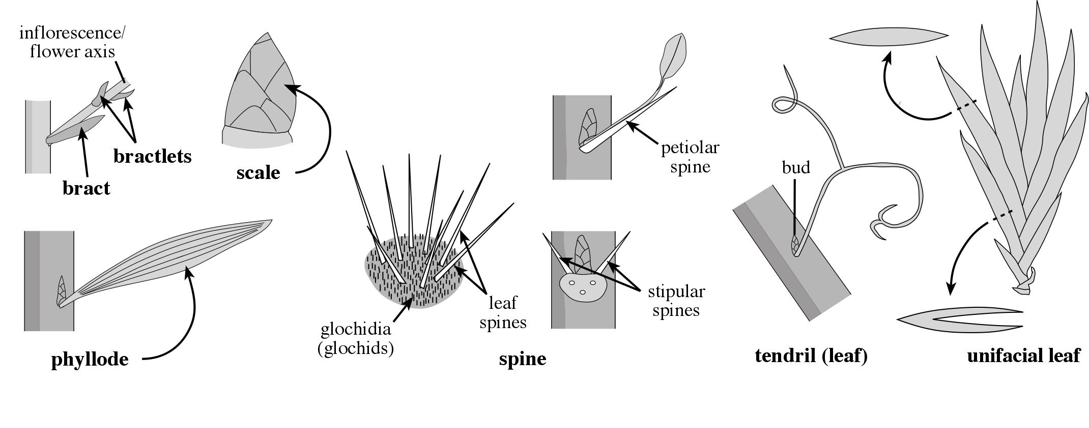
Leaf Structural Type
bractlets
scale
bract
phyllode
spine
tendril (leaf)
unifacial leaf

Slide 3
Leaf Type / Parts
imparipinnate
simple
pinnately
compound
paripinnate
bipinnately
compound

Slide 4
Leaf Type / Parts
palmate-ternate
pinnate-ternate
biternately compound
palmately
compound
ternately compound
= trifoliolate

Slide 5
Leaf Type / Parts
geminate
unifoliolate
bigeminate
geminate-pinnate
costa-palmate

Slide 6
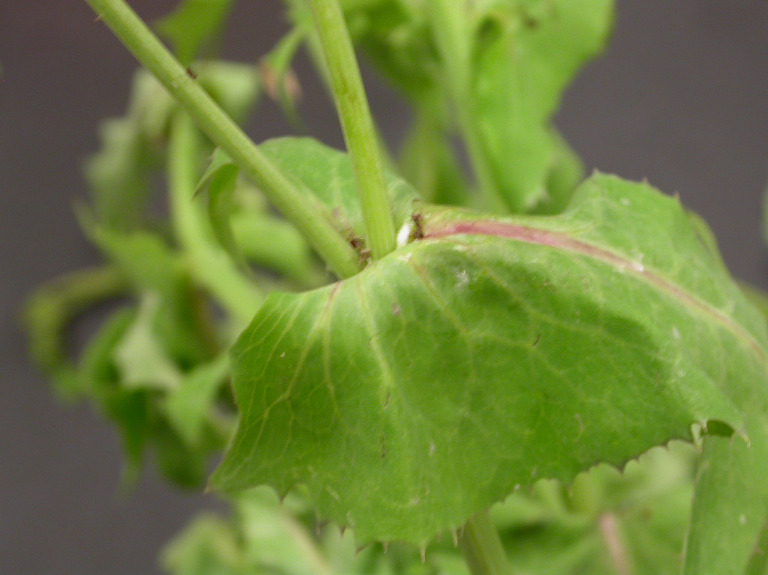
Leaf Attachment
petiolate
sessile
sheathing
decurrent
amplexicaul
perfoliate
connate-perfoliate

Slide 7
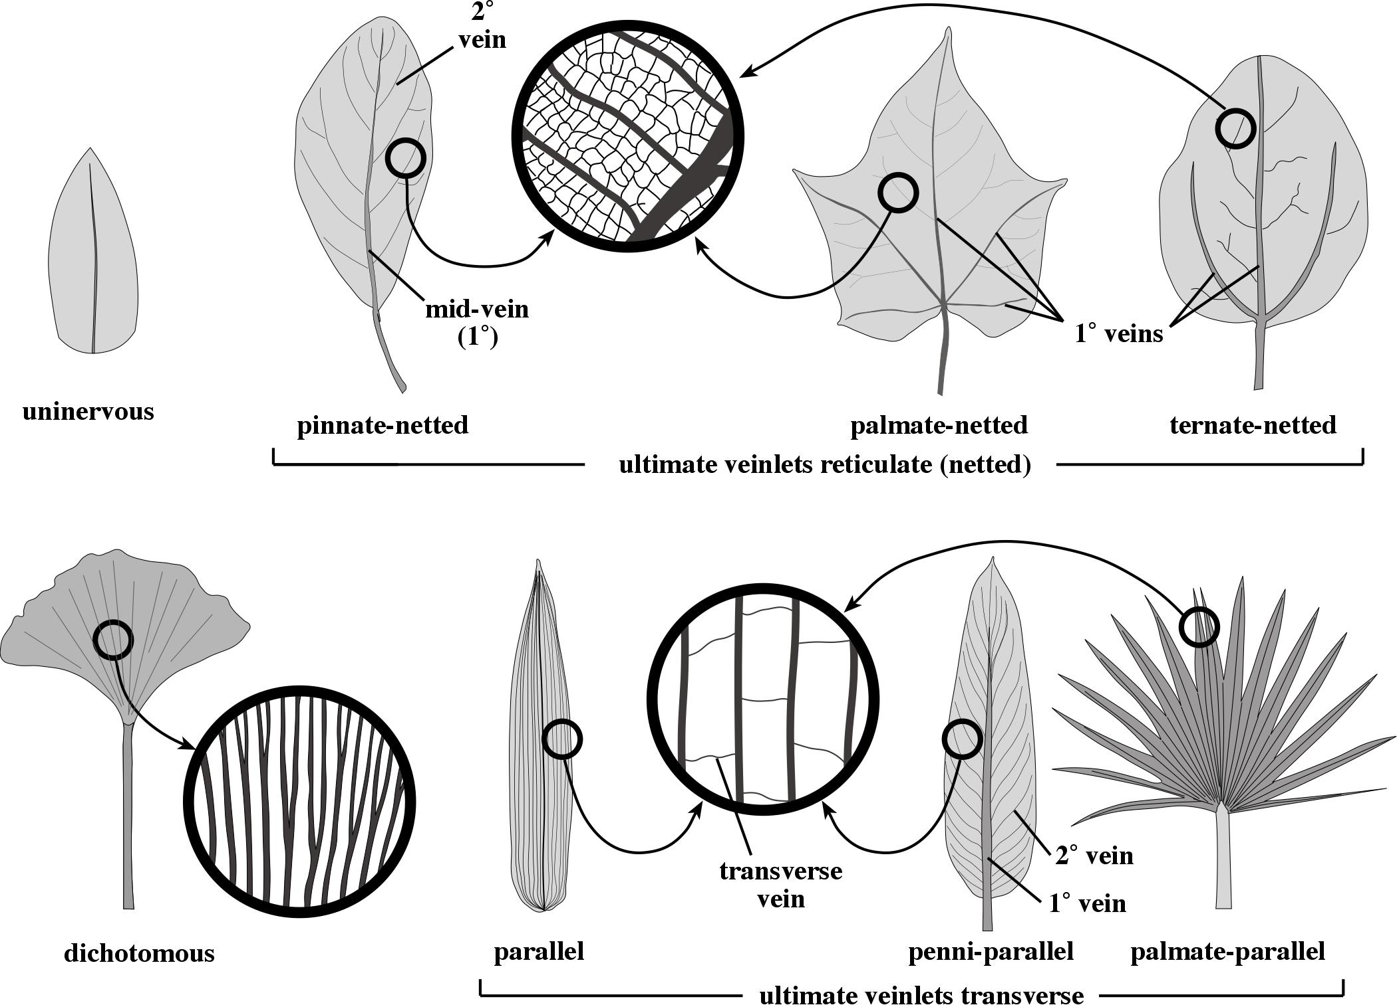
Leaf Venation

Slide 8
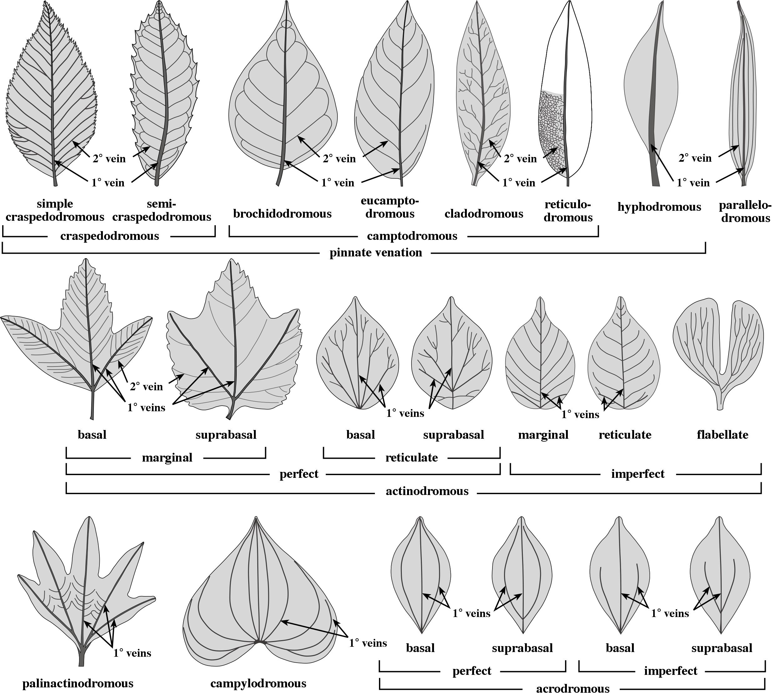
Leaf Venation

