Slide 1
SOLUTIONS OF THE FIXED POINT ITERATION AND THE NEWTON RAPHSON EXAMPLES IN PYTHON

Slide 2
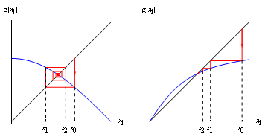
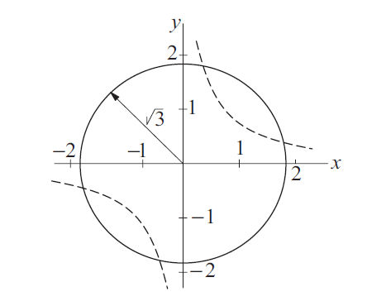
FIXED POINT ITERATION
NEWTON METHOD
f(x) x² -x – 1=0
g(x) x=1+1/x

Slide 4
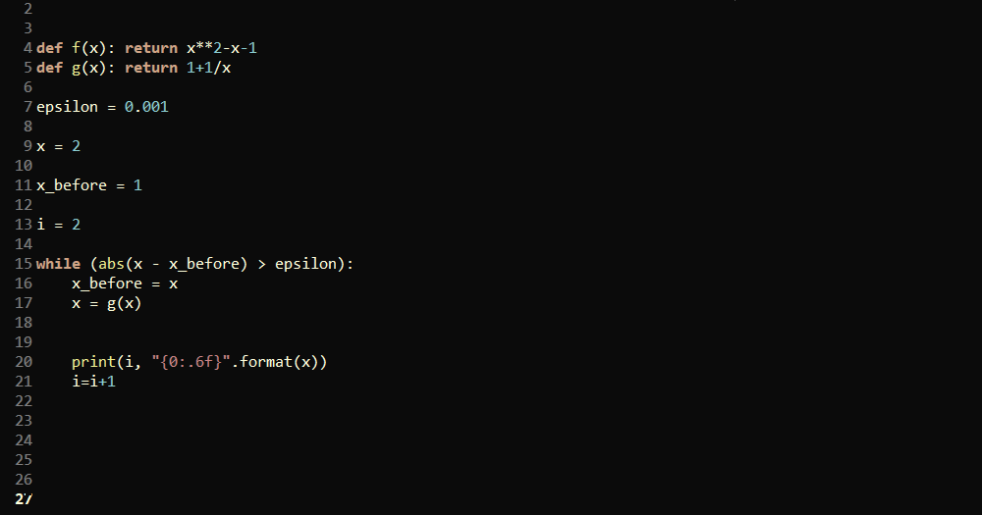

Slide 5
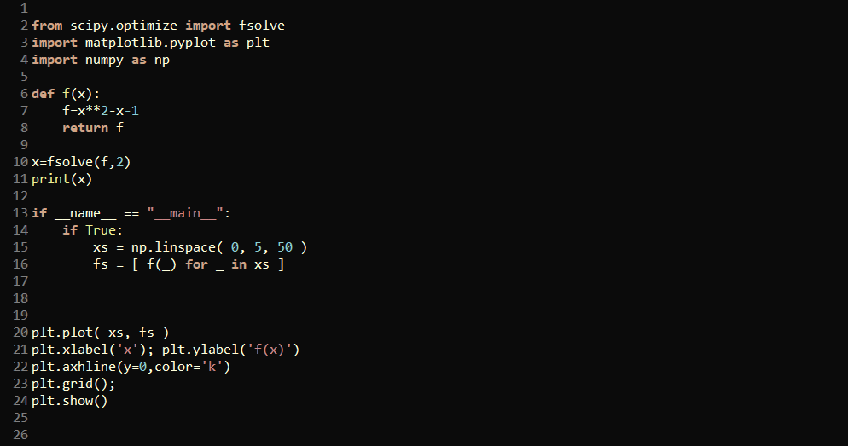
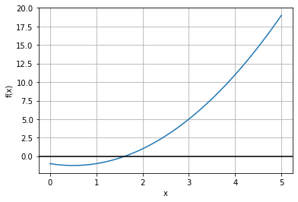

Slide 7
