Slide 1
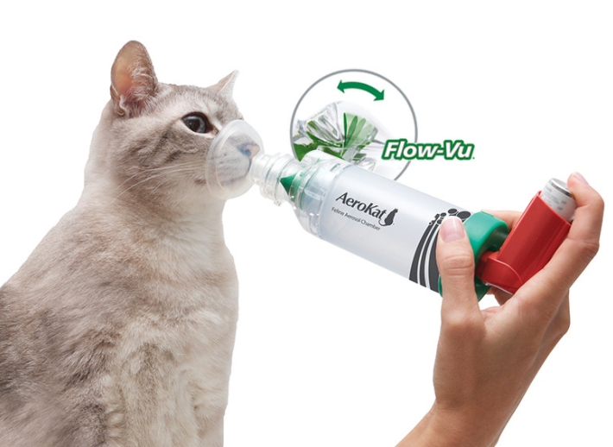
Drugs of Respiratory System

Slide 2
Respiratory System
Delivers oxygen to the cardiovascular system for distribution to the body and it removes carbon dioxide.
Maintain acid-base balance
Act as a blood reservoir, filtering and probably destroying emboli,
Metabolize some bioactive substances (eg, serotonin, prostaglandins, corticosteroids, and leukotrienes),
Activate angiotensin.

Slide 3
Gas transfer occurs in the alveoli of the lungs, where the air-blood barrier is a thin, permeable membrane

Slide 4
Subjected to pollution smoke, chemicals dust, & microorganism which means it is subjected to everything in the environment.

Slide 5
Drugs in Respiratory System
Drugs for air flow obstruction- Bronchodilators
Respiratory stimulants
Expectorants & cough suppressants.
Antitussive drugs
Mucokinetics
Mucolytics
Gases (Oxygen, Carbondioxide, Helium)

Slide 6
Broncodilators
Parasym.Nerv.Sys.- Broncoconstriction-sGMP (ꙟ), H1
Symp.Nervous syst.- α1- constriction
α2-dilation
Constirctive endogen active substances- Histamine, seratonine, chemotoxic factors, arachidonic acid cyclooxigenase deriv (PG, PG1, TxA2), lipooxigenase (LT, HETE)
PGE- PG1- broncodilation

Slide 7
Bronchodilators
1. B2 - Adrenoceptors agonist or stimulants
2. Phosphodiesterase blocker
3. Mast cell membrane stabilizers
4. Corticosteroids
5. Anticholinergic drugs
6. Leukotirene effective drugs
Antihistaminics
Inhibit smooth muscle constriction in blood vessels and the respiratory and GI tracts
Decrease capillary permeability
Decrease salivation and tear formation
Act by binding with the histamine receptor
Decongestants

Slide 8
B2 - Adrenoceptors agonist or stimulants
Bronchodilators
MAO- increased cAMP in the bronchial smooth muscles and mast cell leading to bronchodilation.
Cautious use in hypertension and cardiac disease
Nonselectives
Adrenaline
Isoprenaline
Ephedrine
Selectives
Orsiprenaline
Terbutaline
Salbutamole formoterol
Fenoterol
Samelterol
Xinafoate

Slide 9
Phosphodiesterase blockers
Bronchodilators
Blocking the enzyme phosphodiesterase leading to increase intracellular cAMP.
Xanthine derivatives
Teophylline, aminophylline, dyphylline

Slide 10
Mast cell membrane stabilizers
Bronchodilators
Prevent the release of broncho constrictor mediators.
Prevent wheezing, shortness of breath, and other breathing problems caused by asthma
Na cromoglycate [cromolyn-disodium crooglycate]
Nedocromil
Ketotifen

Slide 11
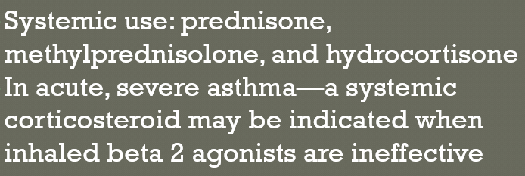
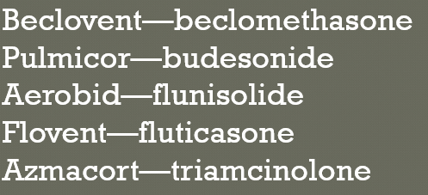
Corticosteroids
Bronchodilators
Asthma-Bronchial airways inflammation
Inhaled corticosteroids(ICS)-anti-inflammatory effects

Slide 12
Anticholinergic drugs
Bronchodilators
Act by decreasing muscarinic bronchoconstriction.
Block the action of acetylcholine-bronchial smooth muscle
Reduction of intracellular guanosine monophosphate (GMP) -bronchoconstrictive substance
Atrovent (ipratropium)
Spiriva (tiotropium)

Slide 13
Leukotriene effective drugs
Bronchodilators
Family of eicosanoid inflammatory mediators produced in leukocytes by the oxidation of arachidonic acid (AA) and the essential fatty acid eicosapentaenoic acid (EPA) by the enzyme.
Montelukast
Zafirlukast

Slide 14
Antihistaminics First Generation H1 Receptor Antagonists
Antihistaminics Second Generation H1 Receptor Antagonists
CNS depression or stimulation
Anticholinergic effects
Chlor-Trimeton (chlorpheniramine)
Benadryl (diphenhydramine)
Vistaril (hydroxyzine)
Phenergan (promethazine)
Selective acting-nonsedative
Astelin (azelastine)
Allegra (fexofenadine)
Claritin (loratadine)
Clarinex (desloratadine)
Zyrtec
Xyzal

Slide 15
Antiastmatic drugs
Symptomatic broncodilators
Β2-adrenoceptor agonists
Short acting (salbutamol, terbutaline)
Long acting (Salmeterol)
Anticholinergics (Ipratopium bromide)
Xantines (Teophylline) Contraindicated in acute gastritis , Narrow therapeutic,Multiple drug interactions
Prophylactic (antiinflammatory)
Mast cell stabilizers (sodium cromogylcate, nedocromil, ketotiphene)
Xanthines- teophylline
Glucocorticosteroids (beklametazone)
Antiinflammatory
Glucocorticosteroids (beklametazone)

Slide 16
Respiratory Stimulants-Clinical use
Asphyxia (Respiratory arrest)- newborn&surgical operations
Chronic obsturating bronchial disease (sleepiness, inability to couch out)-aggravation
Respiratory depression during Infectious disease
Shock, syncopal conditions
Poisons (Hypnotic drug, opioid analgesics, general anesthetics)

Slide 17
Respiratory Stimulants
Direct acting
Caffeine
Bemegride
Etimizol
Reflex acting
Cytiton
Lobeline hydrochloride
Ammonia solution
Mixed acting
Cordiamine (Niketamide)
Sulfocamphocaine
Carbogen(Carbondioxide)
Stimulates n-receptor of carotid sinus
Acceleration and deepening of respiration
Mixture of %93-93 oxygen with %5-7 carbondioxide
CO2 stimulates rep.cent. than alone use of O2

Slide 18
Doxapram
Stimulates the medullary respiratory center and the chemoreceptors of the carotid artery and aorta to increase tidal volume.
Anesthesia
1–5 mg/kg, IV, in dogs and cats (1–2 drops under the tongue of apneic neonates).
In adult horses, the dosage is 0.5–1 mg/kg, IV, while foals are dosed carefully at 0.02–0.05 mg/kg/min, IV.

Slide 19
Mucus
adhesive, viscoelastic gel
Biophysical properties - -long polymeric gel-forming mucins, MUC5AC and MUC5B.
Entraps and clears bacteria and inhibits bacterial growth and biofilm formation.
Protects the airway from inhaled irritants and from fluid loss.

Slide 20
Cystic fibrosis- almost no mucin (and thus no mucus) in the airway; inflammatory-cell derived DNA and filamentous actin polymers,
Retention of this airway pus - inflammation and airway damage.
Mucoactive medications
Expectorants,
Mucolytics,
Mucokinetic drugs.

Slide 21
Expectorants
Increase the volume of airway water or secretion -increase the effectiveness of cough.
Medications that improve the ability to expectorate purulent secretions.
Increase airway water or the volume of airway secretions
Secretagogues- increase the hydration of luminal secretions (eg, hypertonic saline or mannitol)
Abhesives- adhesivity of secretions and thus unstick them from the airway (eg, surfactants).

Slide 22
Mucokinetic drugs-Expectorants
Direct acting- Inhalation
Volatile oils-eucalyptus oil and oil of lemon.
Increase respiratory tract secretions
Indirect acting
Emetic drugs given at lower doses (ipecac)
Saline expectorants -stimulate bronchial mucous secretions via a vagally mediated reflex action on the gastric mucosa.
ammonium chloride, ammonium carbonate,
Mixed acting
Iodines
potassium iodide, calcium iodide, and ethylenediamine dihydroiodide. (Iodine-contraindicated in pregnant, hyperthyroid, or milk-producing animals)

Slide 23
Mucokinetic drugs-Expectorants
Saline mucokinetics
Iodine salts
Sodium iodine
Potasium iodine
Ammonium salts
Ammonium carbonate
Ammonium chloride
Sodium citrate
Stimulating
Guaiacol and Guaiacol glyceryl
Creozote
İpecac
Eucalyptus
Tereminth
Terpines
Benzoin
Tolu balsam
Poligala

Slide 24
Nasal Decongestants
α-adrenergic agonist - local vasoconstriction in mucous membranes- reduces swelling and edema.
Used topically as nasal decongestants in allergic and viral rhinitis, or systemically in combination with antihistamines as respiratory tract decongestants.
Systemic administration can result in hypertension, cardiac stimulation, urinary retention, CNS stimulation, and mydriasis. Systemic administration of antihistamines often causes sedation.

Slide 25
Nasal Decongestants
Relieve nasal obstruction and discharge
Adrenergic
Afrin
Sudafed (pseudoephedrine)
Contraindicated in severe hypertension, narrow angle glaucoma or MAOIs

Slide 26
Antitussive drugs
Central Couch Suppresants
Opioid Mechanism of Action
Codein
Ethylmorphine
Dextramethorphan
Dionin
Folcodin
Noscapin
Anileridine
Butorphanol
Non-opioid Mechanism of Action
Trimetaprazin tartarate
Diphenhydramine
Karamifen
Benzonatat
Isoaminyl
Peripherally acting Drugs
Libexin
Falimint

Slide 27
Codeine
Agonist activity at the opiate receptors
Direct suppressive action on the cough center and mucosal secretion.
Delay gastric empting
Plasma amylase and lipase levels,
Biliary tract pressure resulting from contraction of the sphincter of Oddi.the sphincter of Oddi.
May produceDEPENDENCE (psychiatric and physical)
Adverse effects:euphoria, hypotension, bradycardia, constipation, urinary retention, physical dependence

Slide 28
