Slide 1
REPRODUCTIVE HERD HEALTH
Prof.Dr. Şükrü Küplülü

Slide 2
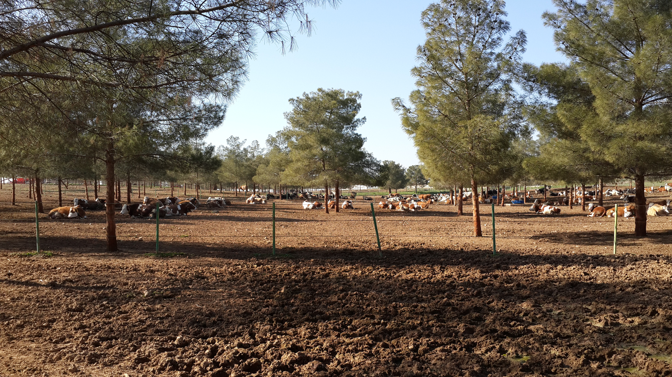
Definition of Reproductive Herd Health
What isReproductive herd health
?
(Külülü ve Vural, 2015 TİGEM)

Slide 3
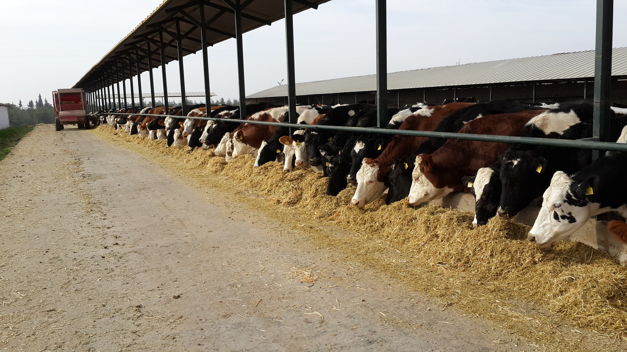
Purpose of Reproductive Herd Health
Objectives of reproductive
herd health
Human health
Animal health
Economy
environment
(Külülü ve Vural, 2015 TİGEM)

Slide 4
The necessity of reproductive herd health?
Genetic selection
Increased demand
Increased human population
(Cockroft, 2015)

Slide 5
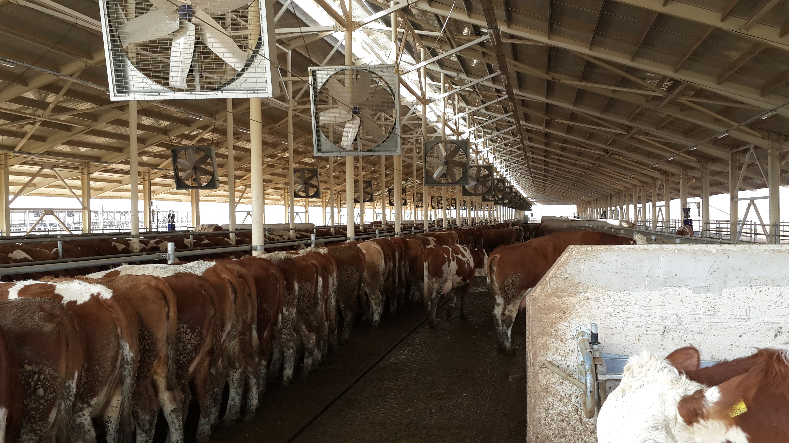
The necessity of reproductive herd health?
Increased yield increased susceptibility to diseases.
herd health necessity has come to the fore.
(Külülü ve Vural, 2015 TİGEM)

Slide 6
The necessity of reproductive herd health?
Cows Survival Rates and Calving Intervals in North-East America between 1957-2002
(Oltenacu ve Broom, 2010)

Slide 7
The necessity of reproductive herd health?
The role of veterinarian
?
(Külülü ve Vural, 2015 TİGEM)

Slide 8
The necessity of reproductive herd health?
Herd health application
principles
(Külülü ve Vural, 2015 TİGEM)

