Slide 1
Digital Image Processing
Doç. Dr. Mehmet Serdar Güzel

Slide 2
Lecturer
Instructor: Assoc. Prof Dr. Mehmet S Güzel
Office hours: Tuesday, 1:30-2:30pm
Open door policy – don’t hesitate to stop by!
Watch the course website
Assignments, lab tutorials, lecture notes

Slide 3
A Case Study
Viola Jones Face Detection Algorithm by
12290462 Samet ÖZKUL

Slide 4
Viola-Jones Face Detection Algorithm
The Viola–Jones object detection framework is the first object detection framework to provide competitive object detection rates in real-time proposed in 2001 by Paul Viola and Michael Jones.
The problem to be solved is detection of faces in an image
Features
Robust
Real Time
Face detection only

Slide 5
Stages
Haar Feature Selection
Creating an Integral Image
Adaboost Training
Cascading Classifiers

Slide 6
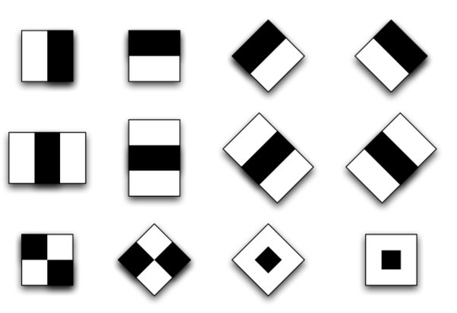
Haar Features
It was proposed by Alfréd Haar in 1909

Slide 8
Integral Image

Slide 9
Adaboost Training
Creates a small set of only best features (there are 162,336 of them ) to create more efficient classifiers
Positive and Negative Images
Compute thresholds

Slide 10
Cascading Filters

