Slide 1
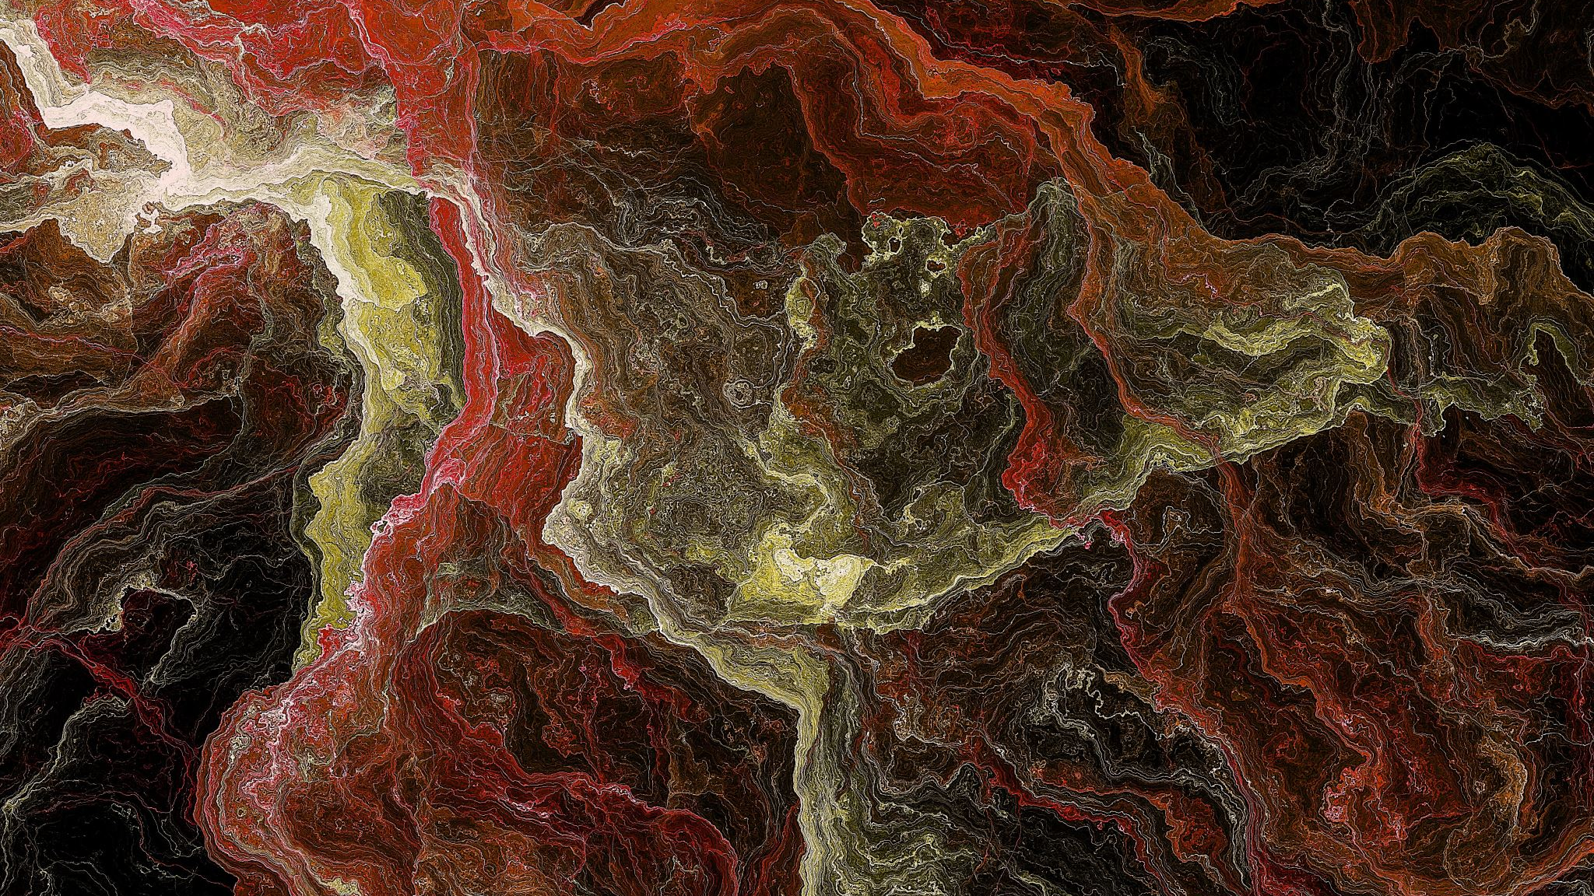
The Lottery by Shirley Jackson
Textual Analysis: Prose and Short Story
Dr. Gamze Katı Gümüş

Slide 2
Bitter Fruit by Abel Meeropol (1937)
Southern trees bear a strange fruit Blood on the leaves and blood at the root Black bodies swingin' in the Southern breeze Strange fruit hangin' from the poplar trees
Pastoral scene of the gallant South The bulgin' eyes and the twisted mouth Scent of magnolias sweet and fresh Then the sudden smell of burnin' flesh
Here is a fruit for the crows to pluck For the rain to gather, for the wind to suck For the sun to rot, for the tree to drop Here is a strange and bitter crop

Slide 3
Strange Fruit
https://www.youtube.com/watch?v=Web007rzSOI

Slide 4
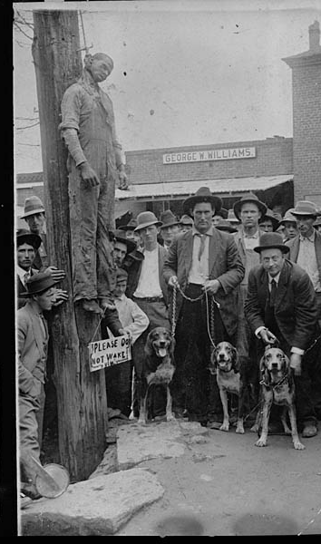
Charlie Hale, 1911

Slide 5
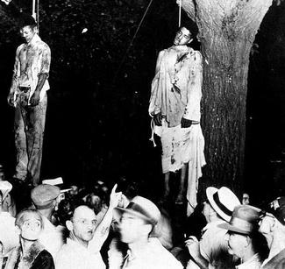
Thomas Shipp and Abram Smith, 1930

Slide 6
Will Brown, 1919

Slide 7
Jesse Washington, 1916

Slide 8
Short Film (1969)
https://www.youtube.com/watch?v=vQQoMCaUz5Y

Slide 9
Biblical Allusions
“Therefore, just as sin came into the world through one man, and death through sin, and so death spread to all men because all sinned.” (Romans 5:12)
“The soul that sins, it must die.” (Ezekiel 18:20)
You were ransomed from the futile ways inherited from your forefathers, not with perishable things such as silver or gold, but with the precious blood of Christ, like that of a lamb without blemish or spot.” (1 Peter 1:18-19)
Notes:
From https://elbourne.org/2018/05/the-curse-of-the-black-spot/

