Slide 1
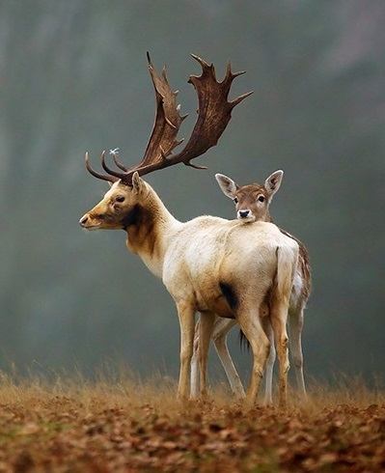
Life Principles
Dr. Arzu GÜRSOY ERGEN
Fen Fakültesi Biyoloji Bölümü
“I think the biggest innovations of the 21st century will be at the intersection of biology and technology.” ----Steve Jobs

Slide 2
3. Nature fits form to function Nature uses shape to determine functionality
Nature uses shape or form, rather than added material and energy, to meet functional requirements.
This allows the organism to accomplish what it needs to do using a minimum of resources.
Forms can be found in the shape of a beetle’s back and in the multi-layer structure of a tropical rainforest.
If we notice a form in nature, with very rare exceptions, there’s almost always a functional reason behind that form.

Slide 3
Biology Examples 1 Cat’s tongue
A cat’s tongue has small barbs, called papillae, that make it easier for the feline to remove meat from the bones and tissues of the small prey they capture.
The tongue is also used for effective grooming, which is actually a survival skill.
After a cat devours its prey, it grooms itself in order to remove any lingering evidence of the kill, so as not to attract larger predators to the scent.
Whether a cat is cleaning prey or cleaning itself, the tongue is able to do most of the work due to its barbed form.

Slide 4
Design Applications Tre Table
Created out of one continuous sheet of wood, the Tre Table takes the notion of multifunctional furniture to a whole new level.
The unique contoured shape of the design allows the table to be used as a coffee table, an end table, a computer desk, a dinner tray, or even a laptop stand and a magazine rack.

Slide 5
4. Nature recycles everything
In nature, one organism’s waste or decomposing body becomes a source of food and materials for other organisms.
While we talk about “recycling,” “upcycling” is a more accurate description of what happens in nature.
There are usually many organisms, or more accurately, ecosystems of organisms, that break down complex organic materials and molecules into smaller molecules that can then be taken up and reassembled into completely new materials.
Just as there is a hydrological cycle, there are many other cycles involving organic matter (carbon cycle, nitrogen cycle, etc.) that function as local, regional, and whole-earth systems.

Slide 6
Biology Examples Trees
In nature, the recycling loop isn’t direct. Wood doesn’t directly become wood again.
Instead, wood gets broken down into its various chemical components by a host of organisms, and then those components can be utilized by even more organisms.
At every stage of a log’s decay, some organism finds a use for the log.
It becomes a shelter for some, a place to perform a mating dance for others, and a place to store seeds or acorns.
Even before a dead tree falls, other organisms start breaking down the carbohydrates and proteins in the trunk and branches, drawing energy from them and creating by-products or waste that other organisms can use.
Some fungi are able to break down a complex chemical compound called lignin, which few other organisms can handle.
The fungus makes the components in lignin available to other organisms to use as building blocks for new chemicals.

