Slide 1
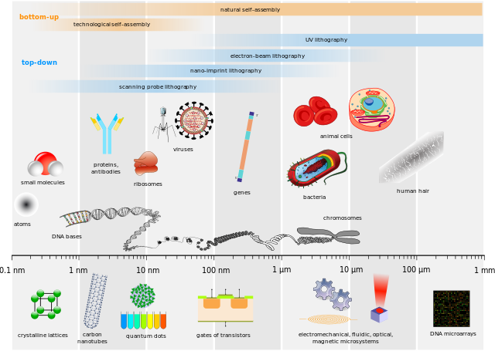
NANOPARTICLES IN NANOTECHNOLOGY
Particles with size in the range of 1 to 100 nm
Nanoparticles serve as the fundamental building blocks for various nanotechnology applications

Slide 2
Nanoparticles have contributed immensely in altering the physicochemical properties of the scaffold because of their variable size and shapes
Classified into five groups based on their nature:
Carbon based
Inorganic base
Metal based
Nanostructured hydrogels
Quantum dots based

Slide 3
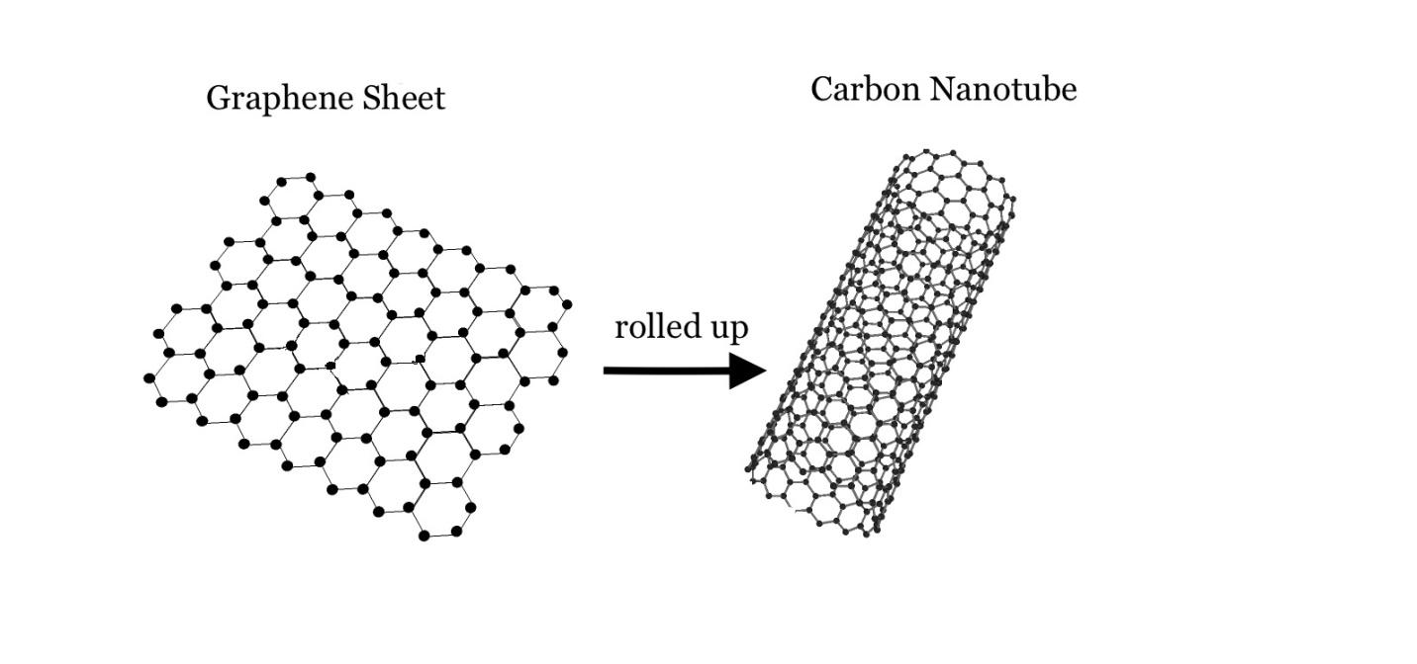
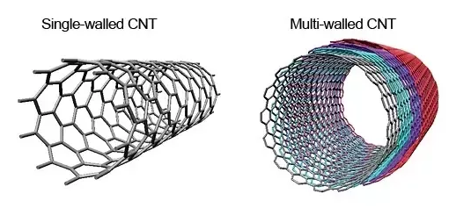
Carbon Nanotubes
Carbon nanotubes derived from graphene sheets
It consists of carbon atoms covalently bonded in a cylindrical crystalline lattice
Single-walled or multi-walled carbon nanotubes

Slide 4
Microenvironmental cues direct stem cells differentiation to a specific lineage

Slide 5
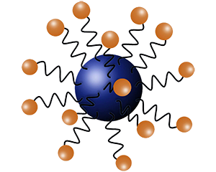
Metal and metal oxide nanoparticles
Provide structural variabilities by exhibiting conductor or insulator characters
Display unique chemical and physical properties with differential charge on the center and corner of the nanoparticle
Mostly been used in tracking stem cells post-transplantation

Slide 6
Inorganic based
Ceramic-based nanoparticles synthesized by a combination of a metal and a non-metal component
These are formed under higher temperature and pressure
These materials have high mechanical strength and low biodegradability

Slide 8
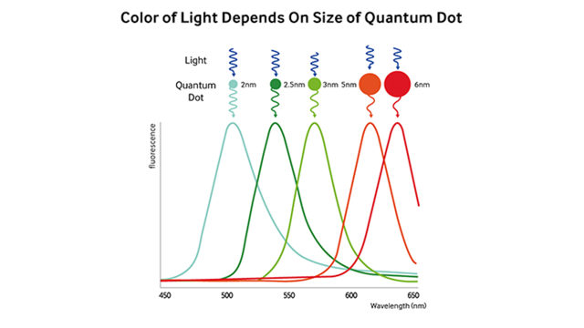

Slide 9
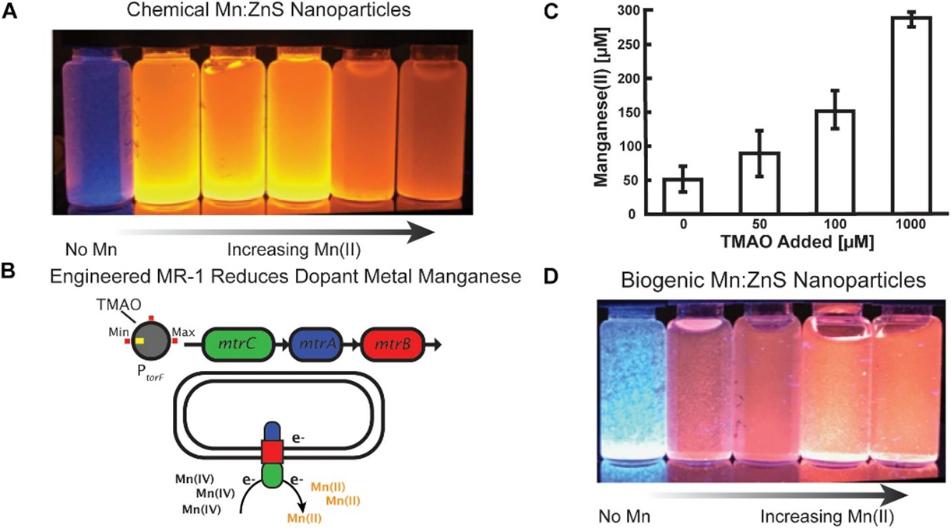
A major concern with the use of nanoparticles is their toxicity and environmental effects

Slide 12
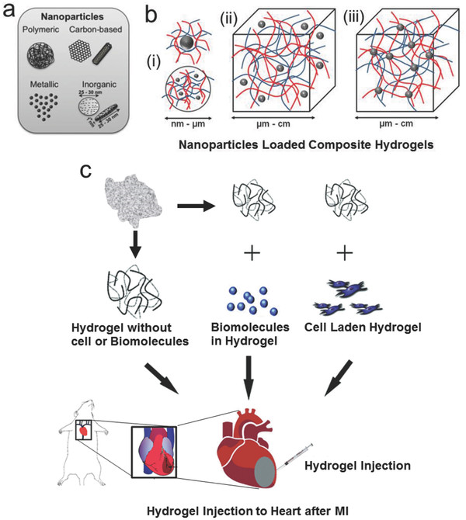
Nanostructured Hydrogels
Hydrogels are 3D polymeric
materials of a hydrophilic nature capable of holding large amounts of water
Copolymerization/crosslinking free-radical polymerizations are commonly used to produce hydrogels

Slide 13
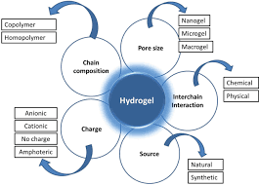
Hydrogels can be classified into
nanogels and micellar gels
Nanogels are hydrophobic in
nature so can be used to deliver products to cells
Nanostructured hydrogels are
selfassembled injectable carriers
of cell and proteins.

Slide 14
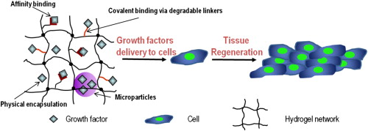

Slide 15
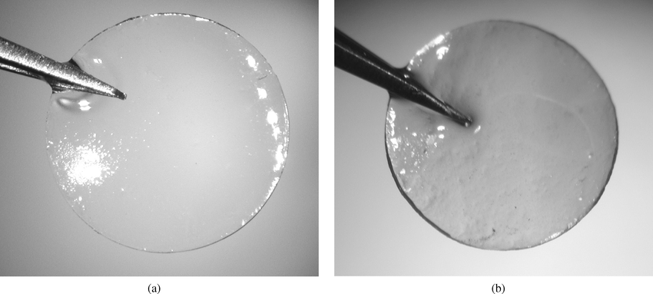
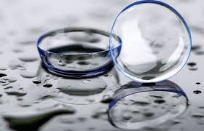
The degree of crosslinking determines the mechanical strength, durability, and swelling properties on the nanostructured hydrogels
The environmental conditions are pivotal for crosslinking the monomers
The in situ forming smart hydrogel can be functionalized by bioactive molecules to enhance growth and other functionality of stem cells

Slide 16
THE SPATIAL SHAPE AND ALIGNMENT IN STEM CELL FUNCTION

Slide 17
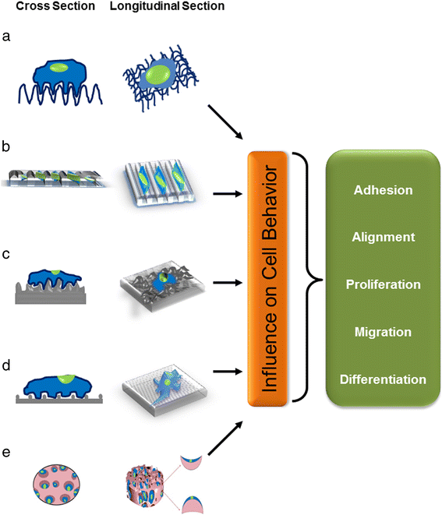
All techniques used for generating scaffolds provide a geometrical control of the morphology of cells
Since cell shape and function are tightly linked together, scaffolds that modulate cell shape can dictate cell functions

Slide 18
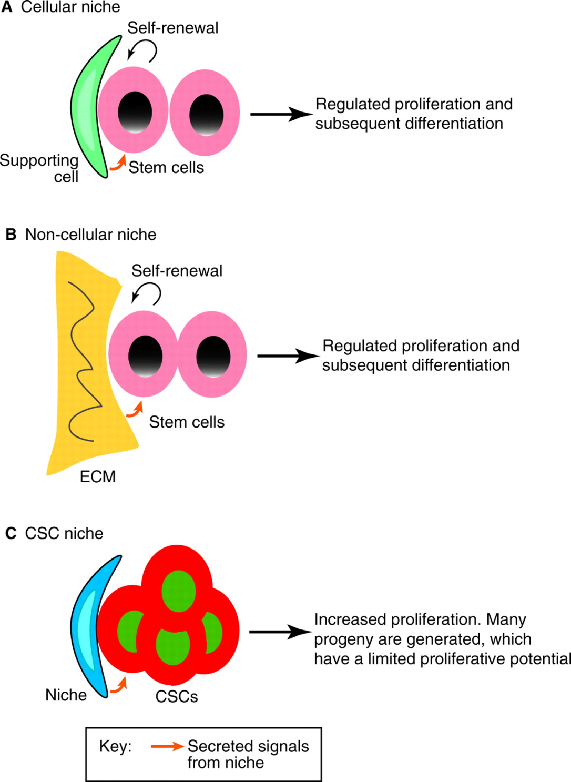
Microenvironmental cues including
mechanical forces are importantfor the
formation of “stem cell niches”
Mechanical forces appear to either
promote or block differentiation signals
induced by growth factors and cytokines

Slide 19
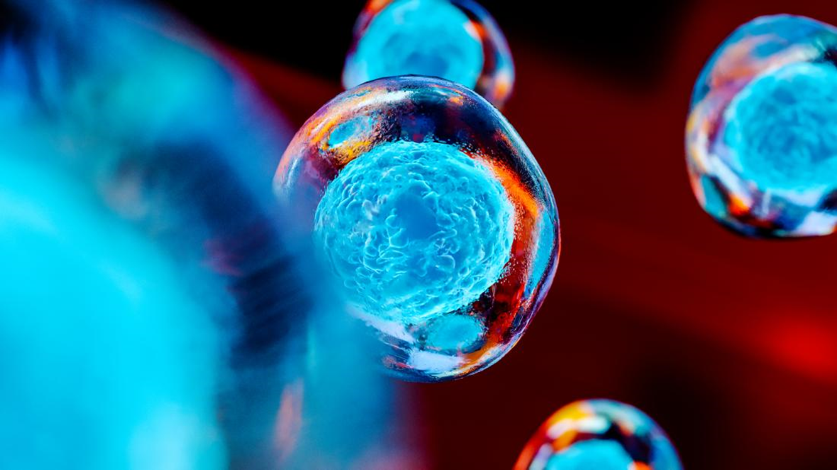
Biophysical regulators of stem cell fate
MAPK,
PI3K/Akt
RhoA/ROCK
Wnt/β-catenin

Slide 20
MAPK Pathway
The MAPK pathway plays a critical role during the
different stages of stem
cell differentiation; for
instance,temporal MAPK
signaling dictates
adipocyte differentiation

Slide 21
PI3K/Akt
In response to the extracellular signals, PI3K is crucial for inducing critical alteration to determine the cellular functions.
Upon binding to the cell surface receptors, growth factors can trigger the activation of the PI3K pathway promoting survival and self-renewal of stem cells.

Slide 22
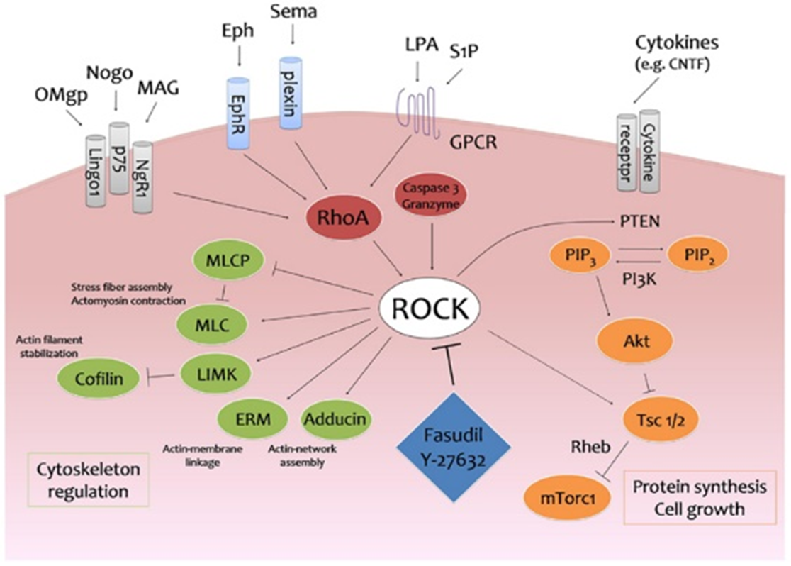
RhoA/ROCK
RhoA acts through Rho-kinase (ROCK) and is a key molecular regulator of actin cytoskeleton tension and focal adhesion formation.
By the activation of focal adhesion kinase through integrin-mediated signaling, this pathway acts as a downstream target

Slide 23
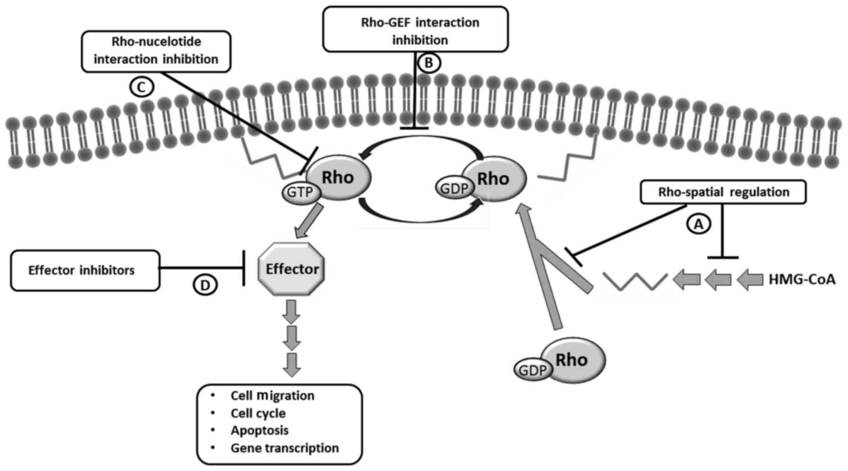
The RhoA/ROCK pathway influences the stem cell differentiation through the regulation as the transcription factor

Slide 24
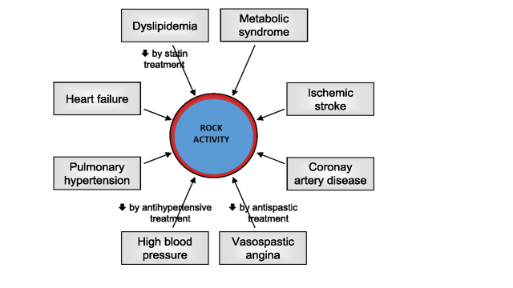

Slide 25
Wnt/ß-catenin
Wnt/β-catenin signaling regulates the fate decisions of almost all stem cell types in a spatio-temporal regulated manner. Wnt signaling results in either maintenance of the promotion of neural differentiation

