Slide 1
CURRENT
EEE 101
Lecture Notes
Mainly from Earl Gates, Introduction to Electronics, Cengage Learning

Slide 2
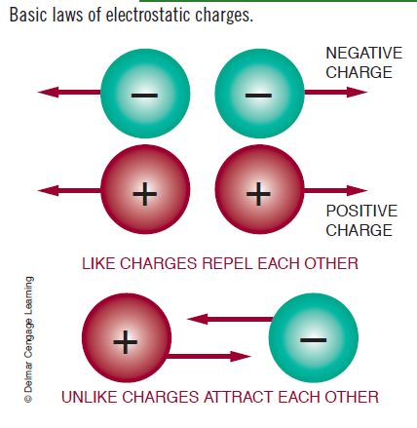
ELECTRIC CHARGES
1 C = 6.24 × 10¹⁸ electrons

Slide 3
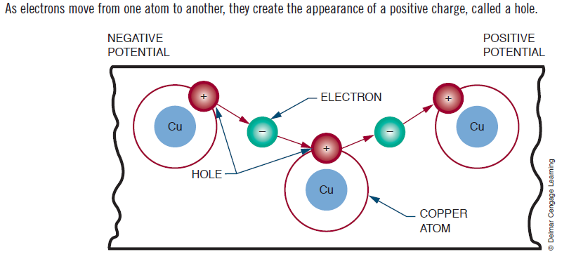
HOLE
Hole: Absence of an electron

Slide 4
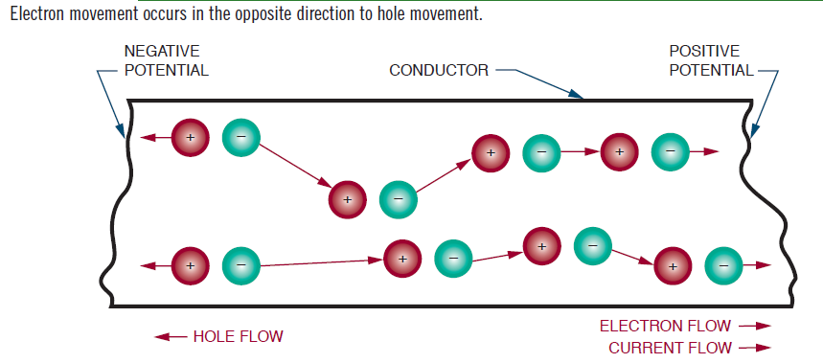
ELECTRON FLOW AND CURRENT
BE CAREFUL HERE!...

Slide 5
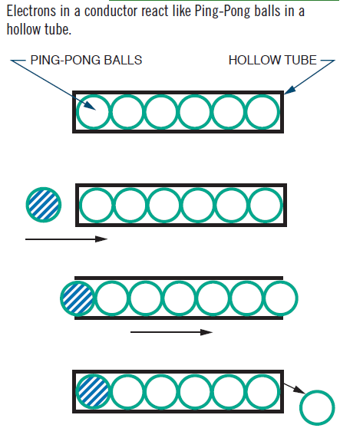
ELECTRON FLOW

Slide 6
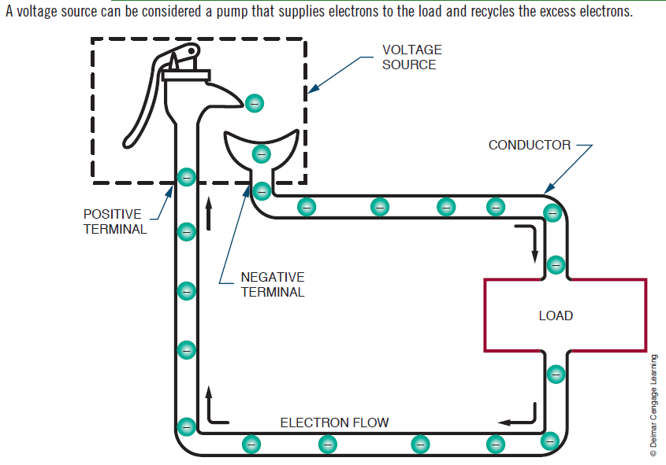
VOLTAGE SOURCE – MECHANICAL ANALOGY

Slide 7
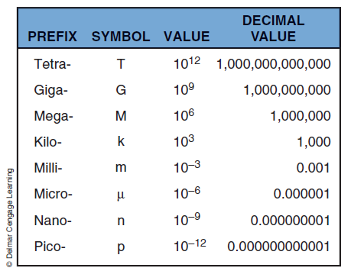
COMMONLY USED PREFIXES

Slide 8
Homework #2
“Smart” devices are quite popular nowadays; and hence, smart electrical or electronic appliances have become quite critical.
Choose 5 smart electrical or electronic appliances from your environment. For each appliance, explain in what sense the appliance is “smart”!...
Try to guess (or investigate) the underlying mechanism or operation principle of each appliance you have chosen.

Slide 9
Scilab Assignment #3
STEP 1
STEP 1a. Create a 3x3 matrix (the first matrix); name it as A.
STEP 1b. Create a 3x1 matrix (i.e. a column vector with three rows); name it as b1.
STEP 1c. Consider the matrix equation A x = b1
STEP 1d. Solve this equation.
STEP 2
STEP 2a. Now, create another 3x1 matrix (i.e. a column vector with three rows); name it as b2.
STEP 2b. Consider the matrix equation A x = b2
STEP 2c. Now, solve this equation.
STEP 3
STEP 3a. Now, create another 3x1 matrix (i.e. a column vector with three rows); name it as b3.
STEP 3b. Consider the matrix equation A x = b3
STEP 3c. Now, solve this equation.
HINT: Be clever and careful throughout the Steps 2 and 3.

