Slide 1
COM 412
Information Technology and Security Governance
Week 10
Information Security Implementation
Standards, Frameworks, Guideliness, and Legislation

Slide 2
Information Security Implementation
* Project management methodology for security
* Create security strategy
- Realistic
- Aligned with implementation program
- Implemented step-by-step
- Visionary
- Non-technical language
Notes:
We should follow standard project management methodology to implement a security capability.
So we can keep control of budget, deliverables, and outcomes.
For security capability we have to create our strategy first.
Strategy is used to describe the way the business will grow or develop over a long period of time with a number of specific targets it wants to achieve.
Security strategy determines high-level plans to improve security posture over a defined timeframe.
Security strategy;
- must be realistic to influence the business to invest money,
- must be aligned with implementation program,
- must be implemented step-by-step toward long-term objectives,
- your strategy should be visionary and must be written in plain, non-technical language, and simply.

Slide 3
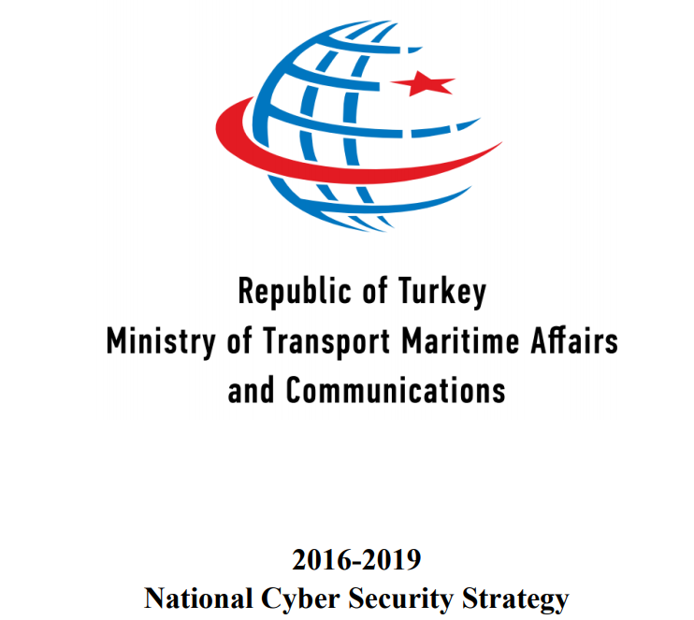
Notes:
National Cyber Security Strategy of Turkish Republic.

Slide 4
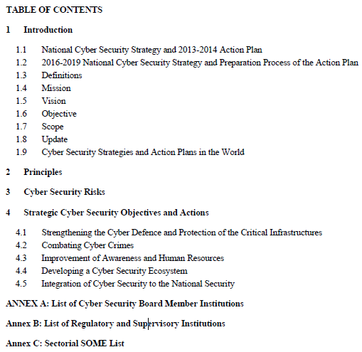

Slide 5
* Mission: Determining, coordinating and implementing efficient and sustainable policies to guarantee national cyber security.
* Vision (brief): Formation of an eco-system that has international competitive power in the field of cyber security.

Slide 6
* Objective:
- for all stakeholders to acknowledge the understanding that cyber security is an integral part of national security. - acquiring the competency that will allow taking administrative and technological precautions for maintaining the absolute security of all systems and stakeholders in national cyber space.
* Scope: including small and medium scaled industry, all natural and legal persons in addition to public information systems and information systems of critical infrastructures operated by public or private sector.

Slide 7
* Principles:
“Risk management involves rapid removal of technical vulnerabilities, preventing and responding to attacks and threats, and minimizing potential damages.”
* Risks:
“Interruption of energy, transportation etc. critical services as the result of denial of service attacks and similar targeted attacks on information systems used by critical infrastructures.“

Slide 8
* Strategic Cyber Security Objectives:
“Creation of a legislation conforming to international standards, which also contains cyber security auditing standards.”
“Founding a strong central public authority that will ensure coordination in the field of cyber security.”

Slide 9
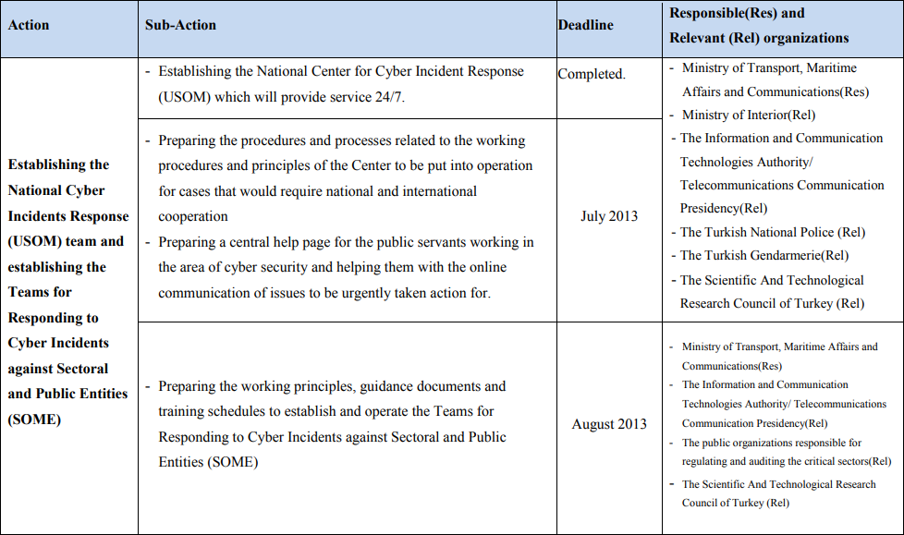
Notes:
For the purpose of realizing these objectives, the required actions are published as a seperate document,
Namely “National Cyber Security Action Plan”.
For each action the planned, accomplishment date and responsible/relevant institutions are declared.
This is a sample from 2013-2014 action plan since the current action plan is not publicly available.
You see here an action, it is about establishment of national and sectoral and public entities’ cyber incidents response team.
There are 3 sub–actions. On the right side you see the deadlines and responsible/relevant organizations.
The sub actions must be accomplished by these organization until the given deadlines.

Slide 10
* Action Headings
- Strengthening the Cyber Defence and Protection of Critical Infrastructures
- Combating Cyber Crimes
- Improvement of Awareness and Human Resources
- Developing a Cyber Security Ecosystem
- Integration of Cyber Security to the National Security
Notes:
The current action plan has five action headings and the actions were grouped under these headings, this grouping is like actions and sub-actions.
The headings are shown on the slide.

Slide 11
Standards
- Improving the efficiency and effectiveness
- Facilitating systems integration and interoperability
- Enabling different products or methods to be compared meaningfully
- Providing a means to assess new products or services
- Structuring the approach to deploying new technologies or business models
- Simplification of complex environments
Notes:
In general, purposes of standards are shown on the slide.
Cyber security standards enable organizations to practice safe security techniques to minimize the number of successful cyber security attacks.

Slide 12
Standards
* ISMS
* ISO 27001
* Cyber security standard
* Best practice specification
* Plan-Do-Check-Act (PDCA) model
Notes:
Information Security Management System (ISMS):
It is a systematic approach to managing confidential or sensitive corporate information so that it remains secure.
- ISO 27001 is an ISMS standard
- The world’s only cyber security standard
- Best practice specification that helps businesses and organisations develop a best-in-class ISMS
Adopts the Plan-Do-Check-Act (PDCA) model

Slide 13
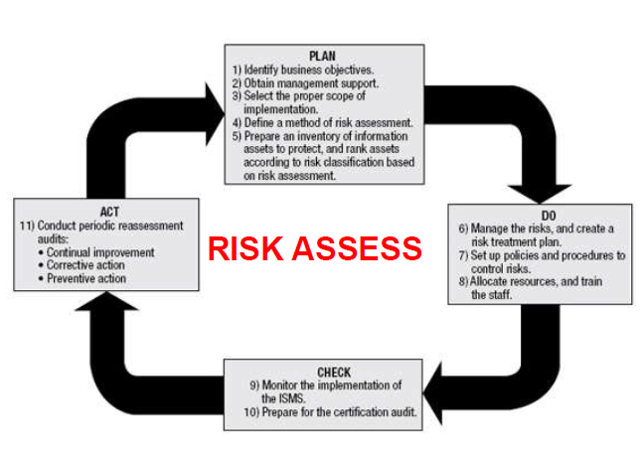
Standards
Notes:
“Plan Do Check Act” model is used by ISO 27001.
In Plan step WE:
◦ Establish ISMS policy, objectives, processes and procedures relevant to managing risk and improving information security to deliver results in
accordance with an organization’s overall policies and objectives.
◦ Implement and operate the ISMS policy, controls, processes and procedures.
In Check step WE:
◦ Assess and, where applicable, measure process performance against ISMS
policy, objectives and practical experience and report the results to management for review.
In Act step:
◦ Take corrective and preventive actions, based on the results of the internal ISMS audit and management review or other relevant information, to achieve
continual improvement of the ISMS.

Slide 14
Standards
* Why should an orgnaization care about ISO 27001?
- Compliance
- Marketing edge
- Lowering the expenses
- Putting business in order

Slide 15
Standards
* Information security policies (2 controls)
* Organisation of information security (7 controls)
* Human resource security (6 controls)
* Asset management (10 controls)
* Access control (14 controls)
* Cryptography (2 controls)
* Physical and environmental security (15 controls)
* Operations security (14 controls)
* Communications security (7 controls)
* System acquisition, development and maintenance (13 controls)
* Supplier relationships (5 controls)
* Information security incident management (7 controls)
* Information security aspects of business continuity management (4 controls)
* Compliance (8 controls)
Notes:
The Standard takes a risk-based approach to information security.
This requires organisations to identify information security risks and select appropriate controls to tackle them.
Those controls are outlined in Annex A of the Standard. There are 114 ISO 27001 Annex A controls, divided into 14 categories.
Organisations aren’t required to implement all of these controls. Some of them maybe non-applicable to your organization.
They’re simply a list of possibilities that you should consider based on your organisation’s requirements.

Slide 16
Standards
* ISO 27002
- Best practices for implementing information security controls (Code of practice for information security controls)
- Companion standard of ISO 27001
- Covers the controls that are an important part of information security management
- The number of controls in ISO 27002 has been changed to match the number in ISO 27001
- No certification
- The controls in ISO 27002 are named the same as in Annex A of ISO 27001
Notes:
The controls in ISO 27002 are named the same as in Annex A of ISO 27001:
for instance, in ISO 27002, control 6.1.2 is named “Segregation of duties” while in ISO 27001 it is “A.6.1.2 Segregation of duties.”
But, the difference is in the level of detail – on average, ISO 27002 explains one control on one whole page, while ISO 27001 dedicates only one sentence to each control.
Finally, the difference is that ISO 27002 does not make a distinction between controls applicable to a particular organization, and those which are not.
On the other hand, ISO 27001 prescribes a risk assessment to be performed in order to identify for each control whether it is required to decrease the risks, and if it is, to which extent it should be applied.

Slide 17
Standards
* A.6.2.1 Mobile Device Policy in ISO 27001:2013
Control: A policy and supporting security measures should be adopted to manage the risks introduced by using mobile devices.
* A.6.2.1 Mobile Device Policy in ISO 27002:2013
Control: A policy and supporting security measures should be adopted to manage the risks introduced by using mobile devices.
Implementation Guidance
When using mobile devices, special care should be taken to ensure that business information is not compromised. The mobile device policy should take into account the risks of working with mobile devices in unprotected environments.
The mobile device policy should consider:
…
…
Notes:
ISO 27001 includes the security controls as part of a section “titled Annex A”
which lists the security domains, security categories, control objectives and then the security controls.
ISO 27002 addresses the same content as Annex A
but adds an additional section titled "Implementation Guidance" to each security control.

Slide 18
Standards
* ISO 27035: Information technology — Security techniques — Information security incident management
- covers the processes for managing information security events, incidents and vulnerabilities
- expands on the information security incident management section of ISO 27002
Notes:
ISO 27035
This standard covers the processes for managing information security events, incidents and vulnerabilities.
The standard expands on the information security incident management section of ISO 27002.

Slide 19
Standards
* ISO 27035:
- The standard lays out a process with 5 key stages:
-- Prepare
-- Identify and report
-- Assess
-- Respond
-- Learn
- Has 3 parts
Notes:
The standard has three parts.

Slide 20
Standards
* ISO 27035 Part 1: Principles of incident management
- Describes an information security incident management process
- Says how to improve incident management
- Incident management process is described in five phases:
-- Plan and prepare
-- Detection and reporting
-- Assessment and decision
-- Responses
-- Lessons learned
Notes:
Part 1: Principles of incident management
It describes an information security incident management process consisting of five phases, and says how to improve incident management.
the incident management process is described in five phases.

Slide 21
Standards
* ISO 27035 Part 2: Guidelines to plan and prepare for incident response
- Concerns assurance that the organization is in fact ready to respond appropriately to information security incidents
- “Are we ready to respond to an incident?”
- Plan and Prepare and Lessons Learned phases
- 8 main clauses:
-- Establishing information security incident management policy
-- Updating of information security and risk management policies
-- Creating information security incident management plan
-- Establishing an Incident Response Team
-- Defining technical and other support
-- Creating information security incident awareness and training
-- Testing (or rather exercising) the information security incident management plan
-- Lesson learned
Notes:
Part 2: Guidelines to plan and prepare for incident response
This part concerns assurance that the organization is in fact ready to respond appropriately to information security incidents that may occur.
It addresses the question “Are we ready to respond to an incident?” and promotes learning from incidents to improve things for the future.
It covers the Plan and Prepare and Lessons Learned phases of the process laid out in part 1.
It includes 8 main clauses.

Slide 22
Standards
* ISO 27035 Part 3: Guidelines for ICT incident response operations
- Concerns security operations
- Provides the guidelines for ICT incident response operations
- Steps through the core parts of the typical incident response process
Notes:
Part 3: Guidelines for ICT incident response operations
this part concerns ‘security operations’, specifically the organization and processes necessary for the information security function
and concerns respond to security events and incidents - mostly active, deliberate attacks in fact.
“This document provides the guidelines for incident response operations.
This document is not concerned with non-ICT incident response operations such as loss of paper-based documents.
The guidelines are based on the “Detection and Reporting”, the ”Assessment and Decision” and the ”Responses” phases of the model.

Slide 23
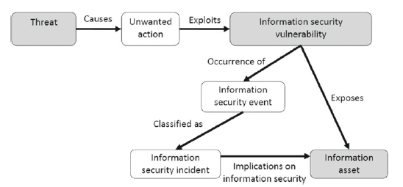
Standards
Notes:
“Relationship of objects in an information security incident” according to ISO 27035 standard.
A threat causes an unwanted action that exploits a vulnerability.
Occurence of this causes an information security event and this may be classified as an incident.
A security event is any observable occurrence that is relevant to information security.
This can include attempted attacks that expose security vulnerabilities.
But a security incident is a security event that results in damage or risk to information security assets and operations.

Slide 24
Standards
* ISO 31000
- Risk management principles and guideliness
- Cannot be used for certification purposes
- Internationally recognized benchmark
- ISO 27005 (information security risk management) focuses on the specifics of management information security
Notes:
ISO 31000- Risk management – Guidelines; provides principles, a framework and a process for managing risk.
It can be used by any organization regardless of its size, activity or sector.
Using this standard can help organizations increase the likelihood of achieving objectives, improve the identification of opportunities and threats
and effectively allocate and use resources for risk treatment.
However, ISO 31000 cannot be used for certification purposes, but does provide guidance for internal or external audit programmes.
Organizations using it can compare their risk management practices with an internationally recognized benchmark.
ISO 27005 can be used in information security risk management.
ISO 27005 focuses on the specifics of management information security risks.
ISO 31000 provides a great foundation for managing risks right across your organization, however, there are nuances of managing information risks.
* ISO 27000 series, is a series of best practices to help organisations improve their information security.
* Published by ISO (the International Organization for Standardization) and the IEC (International Electrotechnical Commission), the series explains how to implement an ISMS (information security management system).
* The series consists of 46 individual standards.
* ISO 27000, provides an introduction to the family as well as clarifying key terms and definitions.
* ISO 27001 is the central standard in the ISO 27000 series, containing the implementation requirements for an ISMS.
* ISO 27001 is the only standard in the series that organisations can be audited and certified against.
* Other standards are supplementary ones and guideliness.

Slide 25
Frameworks
* COBIT
- IT governance framework
- Published by ITGI and ISACA
- Provides a common language
- Based on five key principles
Principle 1: Meeting Stakeholder Needs
Principle 2: Covering the Enterprise End-to-End
Principle 3: Applying a Single Integrated Framework
Principle 4: Enabling a Holistic Approach
Principle 5: Separating Governance from Management
Notes:
COBIT is a framework for developing, implementing, monitoring and improving information technology governance.
COBIT stands for “Control Objectives for Information and Related Technology”.
The COBIT framework is published by the IT Governance Institute (ITGI) and ISACA
In the United States, COBIT is the most commonly used framework.
The goal of the COBIT framework is to provide a common language for IT professionals, business executives and compliance auditors.

Slide 26
Frameworks
* COBIT
- 7 aspects to support 5 principles:
-- Principles, Policies and Frameworks
-- Processes
-- Organizational Structures
-- Culture, Ethics and Behavior
-- Information
-- Services, Infrastructure and Applications
-- People, Skills and Competencies
- COBIT vs. ITIL
Notes:
- COBIT and IT Infrastructure Library (ITIL) are both important analytical tools for governing IT services.
- The two frameworks, which overlap somewhat, can be used together quite effectively.
- While the ITIL framework has a narrow focus on IT service management (ITSM),
the COBIT framework has a broader, risk management focus that can be applied to almost any area of the business.
COBIT audits are always conducted by ISACA Certified Information Systems Auditors (CISAs).

Slide 27
Legislation in Turkey
* The Law on the Protection of Personal Data No. 6698
* Turkish Data Protection Authority
Notes:
The Law on the Protection of Personal Data No. 6698 was published in 2016. There are also 7 regulations about this law.
Turkish Data Protection Authority and a board with 9 members.
The mission of the Authority is to provide the protection of personal data and develop awareness in this respect in the public eye.
Key principles set out in the Law which state that data must be:
• Processed lawfully and fairly.
• Accurate and where necessary, kept up-to-date.
• Processed for specified, explicit and legitimate purposes.
• Relevant, limited and proportionate to the purposes for which they are processed.
All personal data processing must be carried out in accordance with these principles.

