Slide 1
ZOONOTIC DISEASSES IN TURKEY
Dr. Bahar onaran

Slide 2
Zika
Crimean-Congo Hemorrhagic Fever
West Nile Fever
Brucellosis

Slide 3
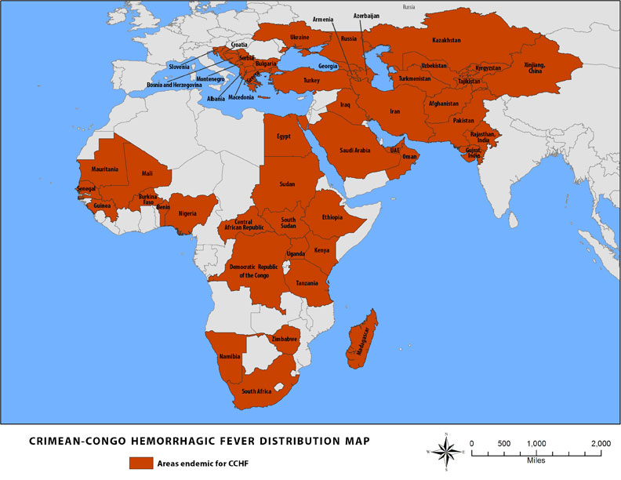
Crimean-Congo Hemorrhagic Fever (CCHF)
Crimean-Congo hemorrhagic fever (CCHF) is a tick-borne viral disease of humans that affects a wide geographic area of Africa and Eurasia, including Turkey, Iran, Pakistan, Afghanistan and Russia. Since the first detection of CCHF cases in Turkey in 2002, more than 9700 patients have been reported, with an overall mortality rate just under 5%

Slide 4
Signs and Symptoms
Crimean-Congo hemorrhagic fever (CCHF) is an acute illness affecting multiple organ systems and characterized by extensive ecchymosis, visceral bleeding, and hepatic dysfunction.
initial signs and symptoms include headache, high fever, back pain, joint pain, stomach pain, and vomiting. Red eyes, a flushed face, a red throat, and petechiae (red spots) on the palate are common. Symptoms may also include jaundice, and in severe cases, changes in mood and sensory perception.
As the illness progresses, large areas of severe bruising, severe nosebleeds, and uncontrolled bleeding at injection sites can be seen, beginning on about the fourth day of illness and lasting for about two weeks. In documented outbreaks of CCHF, fatality rates in hospitalized patients have ranged from 9% to as high as 50%.
The long-term effects of CCHF infection have not been studied well enough in survivors to determine whether or not specific complications exist. However, recovery is slow.
CCHF virus is transmitted to humans by bites of infected ticks. CCHFV has also been transmitted to patients or viremic livestock through contact with blood or tissue

Slide 5
Diagnosis
Laboratory tests that are used to diagnose CCHF include;
antigen-capture enzyme-linked immunosorbent assay (ELISA),
real time polymerase chain reaction (RT-PCR),
virus isolation attempts,
detection of antibody by ELISA (IgG and IgM).
Laboratory diagnosis of a patient with a clinical history compatible with CCHF can be made during the acute phase of the disease by using the combination of detection of the viral antigen (ELISA antigen capture), viral RNA sequence (RT-PCR) in the blood or in tissues collected from a fatal case and virus isolation.
Immunohistochemical staining can also show evidence of viral antigen in formalin-fixed tissues. Later in the course of the disease, in people surviving, antibodies can be found in the blood. But antigen, viral RNA and virus are no more present and detectable.

Slide 6
Treatment
Treatment for CCHF is primarily supportive.
Care should include ;
careful attention to fluid balance and correction of electrolyte abnormalities,
oxygenation and hemodynamic support,
appropriate treatment of secondary infections.
The virus is sensitive in vitro to the antiviral drug ribavirin. It has been used in the treatment of CCHF patients reportedly with some benefit.
Recovery
The long-term effects of CCHF infection have not been studied well enough in survivors to determine whether or not specific complications exist. However, recovery is slow.

Slide 7
Prevention
Agricultural workers and others working with animals should use insect repellent on exposed skin and clothing.
Wearing gloves and other protective clothing is recommended.
Individuals should also avoid contact with the blood and body fluids of livestock or humans who show symptoms of infection.
It is important for healthcare workers to use proper infection control precautions to prevent occupational exposure.
there is no safe and effective vaccine currently available for human use. Further research is needed to develop these potential vaccines as well as determine the efficacy of different treatment options including ribavirin and other antiviral drugs.

Slide 8
Brucellosis
Although almost a century has gone by since its first description in the country, Turkey has not been able to eradicate brucellosis, which remains a major public health problem.
Brucellosis is an infectious disease caused by bacteria.
People can get the disease when they are in contact with infected animals or animal products contaminated with the bacteria. Animals that are most commonly infected include sheep, cattle, goats, pigs, and dogs, among others

Slide 9
Transmission
Eating undercooked meat or consuming unpasteurized/raw dairy products
Breathing in the bacteria that cause brucellosis (inhalation)
people in laboratories that work with the bacteria
Bacteria entering the body through skin wounds or mucous membranes
slaughterhouse workers
meat-packing plant employees
veterinarians
People who hunt animals may also be at risk

Slide 10
Signs and Symptoms
Initial symptoms can include:
fever
sweats
malaise
anorexia
headache
pain in muscles, joint, and/or back
fatigue
Some signs and symptoms may persist for longer periods of time. Others may never go away or reoccur.
These can include:
recurrent fevers
arthritis
swelling of the heart (endocarditis)
neurologic symptoms (in up to 5% of all cases)
chronic fatigue
depression
swelling of the liver and/or spleen

Slide 11
Treatment
Before treatment begins, a diagnosis of brucellosis infection must be made by a doctor.
Tests will be performed to look for bacteria in samples of blood, bone marrow, or other body fluids. In addition, a blood test can be performed to detect antibodies against the bacteria.
Once a diagnosis is made, a doctor can prescribe antibiotics.
Depending on the timing of treatment and severity of illness, recovery may take a few weeks to several months. Death from brucellosis is rare, occurring in no more than 2% of all cases.

Slide 12
Prevention
The best way to prevent brucellosis infection is to be sure you do not consume:
undercooked meat
unpasteurized dairy products, including:
milk
cheese
ice cream
People who handle animal tissues (such as hunters and animal herdsman) should protect themselves by using:
rubber gloves
goggles
gowns or aprons

Slide 13
Despite being endemic in Turkey, brucellosis remains under-diagnosed and under-reported.
Adherence to traditional farming practices and lifestyles and the consumption of fresh dairy produce contribute to the high incidence of brucellosis.
The successful implementation of a national brucellosis control program requires;
strong political will,
good funding,
collaboration (especially between the public health and veterinary sectors).
Primary healthcare workers should always keep the symptoms of acute and chronic brucellosis in mind when treating patients!

