Slide 1
Galvanic Cells
Electrochemical cells are a circuit by allowing the transfer of electrons through it which include following contains. An extremely important of oxidation and reduction reactions are used to provide useful electrical energy in batteries
An anode, the electrode where oxidation takes place
A cathode, the electrode where reduction takes place
An electrolyte, to allow conduction of ions within the solution in each half cell
A salt bridge or semipermeable membrane, to allow conduction of ions between half cells. To establish an electrical connection between the solutions of the two electrodes and becomes part of the completed circuit.
the external circuit that connects the two electrodes includes wires, a load, and meters

Slide 2
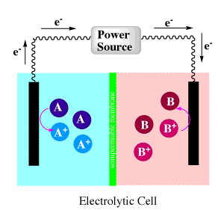
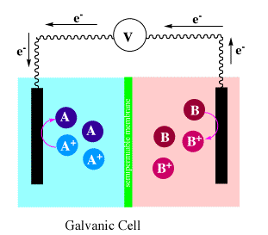
While energy is stored in an electrochemical cell, is released when the cell is allowed to run as galvanic cell.
Electrochemical cells which generate an electric current are called voltaic cells or galvanic cells.
For reliable measurement of the EMF of a galvanic cell it is necessary to use some form of potentiometer.

Slide 3
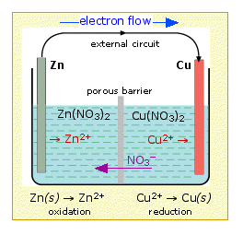
Details of the Daniell Cell
in 1836 English chemist John Frederick Daniell developed a voltaic cell or Daniel Cell which used zinc and copper’s salt solutions as electrolyte. The simplest this electrochemical cell have made from copper and zinc metals. In these reactions, electrons can be transferred from the zinc to the copper through an electrically conducting path by electric current
As a zinc atom provides the electrons, it becomes a positive ion and goes into aqueous solution, decreasing the mass of the zinc electrode. On the copper side, the two electrons received allow it to convert a copper ion from solution into an uncharged copper atom which deposits on the copper electrode, increasing its mass.
Zn(s) --> Zn²⁺(aq) + 2e (Anode)
These reactions are called as half-reactions in electrochemistry
Cu²⁺(aq) + 2e⁻ --> Cu(s) (Cathode)

Slide 4
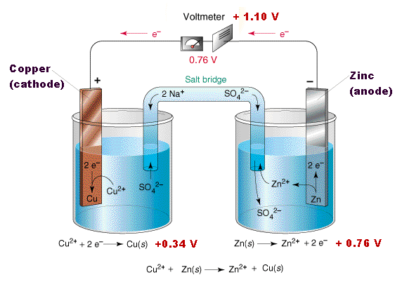
If the zinc ion concentration is increased, the anode reaction is shifted to the left, resulting in a lower voltage being produced by the cell.
The electrochemical reaction has a negative value of the Gibbs free energy and a positive cell potential difference.
For the zinc/copper cell under the standard conditions, the calculated cell potential is 1.1 volts.
What happens when the Daniell cell is used to do work ?

Slide 5
A standard-state cell in which the concentrations of the Zn²⁺ and Cu²⁺ ions are both 1 molar.
As the reaction goes forward, zinc metal is consumed and copper metal is produced.
When does the cell potential become zero?
The cell potential is zero if and only if the reaction is at equilibrium.
When the reaction is at equilibrium,
there is no net change in the amount of zinc metal or copper ions in the system, so no electrons flow from the anode to the cathode. If there is no longer a net flow of electrons, the cell can no longer do electrical work. Its potential for doing work must therefore be zero.

Slide 6
The Nernst Equation of Daniel Cell
If Daniell cell is substituted into the Nernst equation gives the following result, which represents the cell potential for the Daniell cell at 25 C at any moment in time.
When the reaction quotient is very small, the cell potential is positive and relatively large.
When the reaction quotient is very large, the cell potential is negative. This means that the reaction would have to shift back toward the reactants to reach equilibrium.

Slide 7
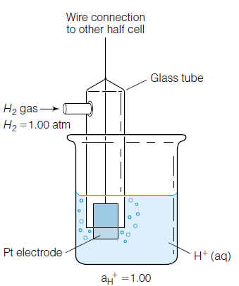
Standard Electrode Potentials
No satisfactory method has been devised for measuring the exact difference in electrical potential between a single metal electrode and a solution of its ions However, the differ ence between the potentials of two electrodes can be readily measured.
The voltage between this electrode and the solution is arbitrarily taken to be zero. The standart hydrogen electrode is electrode chosen for comparision; its potential is defined as zero volt.
We arbitrarily assign the value zero to the potential for the standart hydrogen electrode.

Slide 8
Measurement of Electrod Potentials
To measure the electrode potential of zinc, an electrochemical cell is set up consisting of a zinc rod in contact with a 1 M solution of zinc ions as one half of the cell and a standart hydrogen electorde as the other half. The two part of the cell are connected by a salt bridge consisting of a saturated solution of KCl. This bridge permits K+ and Cl- ions to migrate through it freely from cell to cell. The potential difference between the two electrodes is read on the voltmeter.

Slide 9
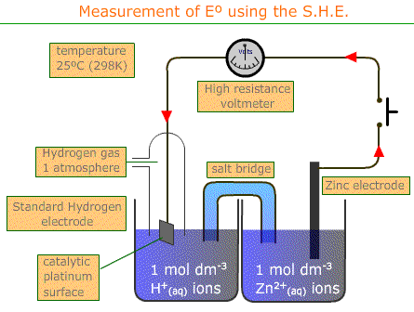
The difference in potential between the two half cells as measured by a voltmeter is 0.76 V
Zn I Zn²⁺, 1.0 M II H⁺, 1.0 M I H_{2(g)}, 1 atm (Pt-Pt)

Slide 10
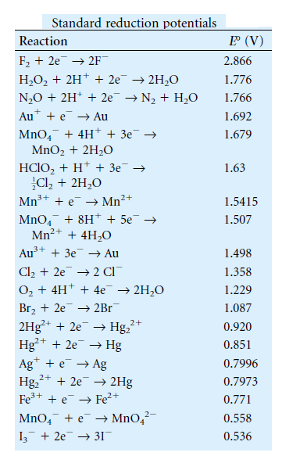
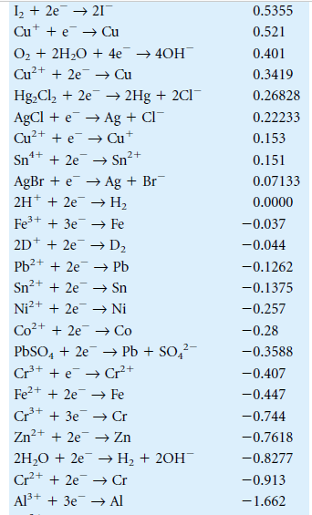
For the reverse reaction, the reduction of zinc ion to metallic zinc, The electrode potential has the same absolute value but opposite sign and therefore is – 0.76 V for half reaction of
Zn²⁺ + 2e → Zn

