Slide 1
Diplomatik Yabancı Dil V
Prof. Dr. Funda Keskin Ata
Arş. Gör. Tuğba Yürük

Slide 6
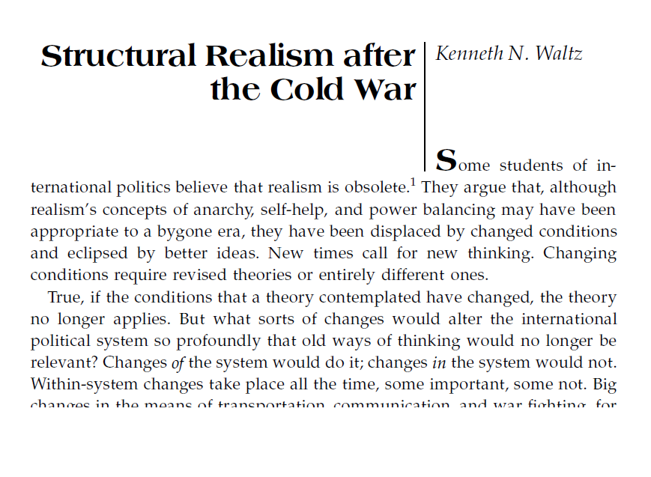
Speaking Session: IR Education in Turkey
How did you decide to study IR?
What did you expect before

