Slide 1
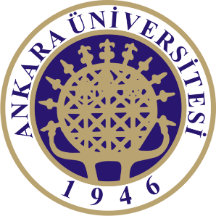
Sub-Departamento de Língua Portuguesa | Faculdade de Línguas, História e Geografia |
UNIVERSIDADE DE ANKARA
ISP 420 – Portekiz Kültürü | Cultura Portuguesa

Slide 2
Summary
Os Portugueses na Europa
Analysis of the article “Portugal’s history since 1974” (Lloyd-Jones, 2001)
Analysis of the book “Contemporary Portugal: Politics, Society and Culture” (Costa Pinto, 2011)
Cultural Features
European Integration
Lusofonia

Slide 3
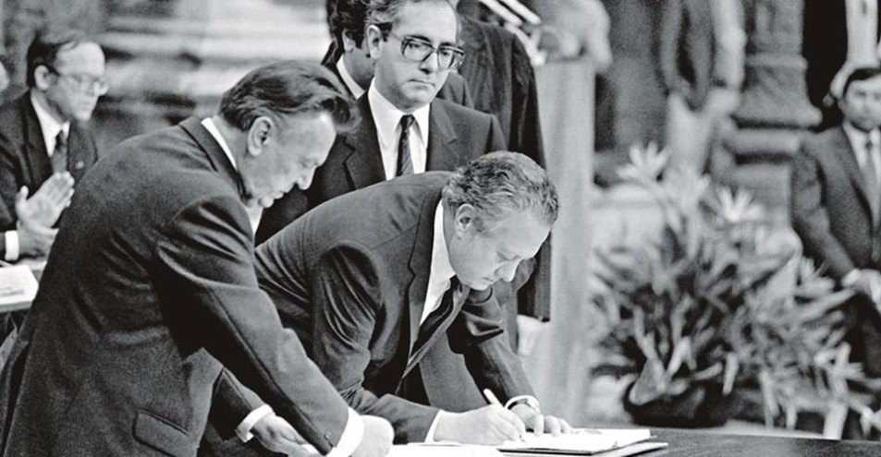
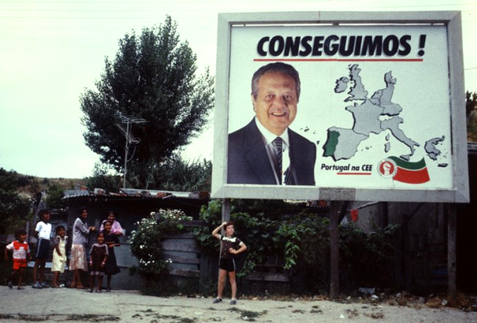
European Integration
Portugal's entry into the European Economic Community (EEC) in 1986 resulted from several years of difficult negotiations with the other partners.
“(…)country’s economic prospects had vastly improved with the sudden influx of European fund transfers ($320m in 1986, rising to $23.5bn in 1996) – all of which was to be used to help Portugal catch up with the rest of the European Community member states.” (Lloyd-Jones,p.12)

Slide 4
Cultura de fronteira – O desejo de Outro
António Quadros “Espírito da Cultura Portuguesa”
Mar Nau Viagem Império Oriente Descobrimento
Saudade Demanda Amor Encoberto
“Revitalização da identidade histórica por via de uma abertura relacional a outras identidades (Europa; África; Brasil….), um autêntico mergulho no “outro” que provocatoriamente abre os nossos complexos (sebastianismo, lirismo sonhador, fatalismo oriental….)”
“(…) forçando a sociedade civil a não depender em absoluto do Estado, “matando” definitivamente o D.Sebastião dentro de cada português”
Miguel Real, Traços Fundamentais da Cultura Portuguesa, p.177

Slide 5
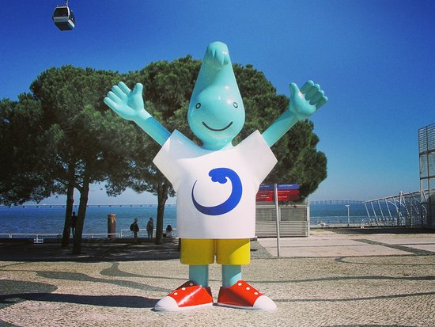
Portugal in and of Europe
“No longer with its back to Europe, Portugal is now a modern European democracy. It has abandoned its previous isolationism and has re-established good relations with its neighbors and former colonies.” (Lloyd-Jones,p.15)
“Todas as comemorações que, desde a década de 1980 têm atravessado Portugal, culminando na Expo 98, devem o seu legítimo fundamento histórico aos feitos e obras realizadas por Portugal e o Império (…) (Real, 176)

Slide 6
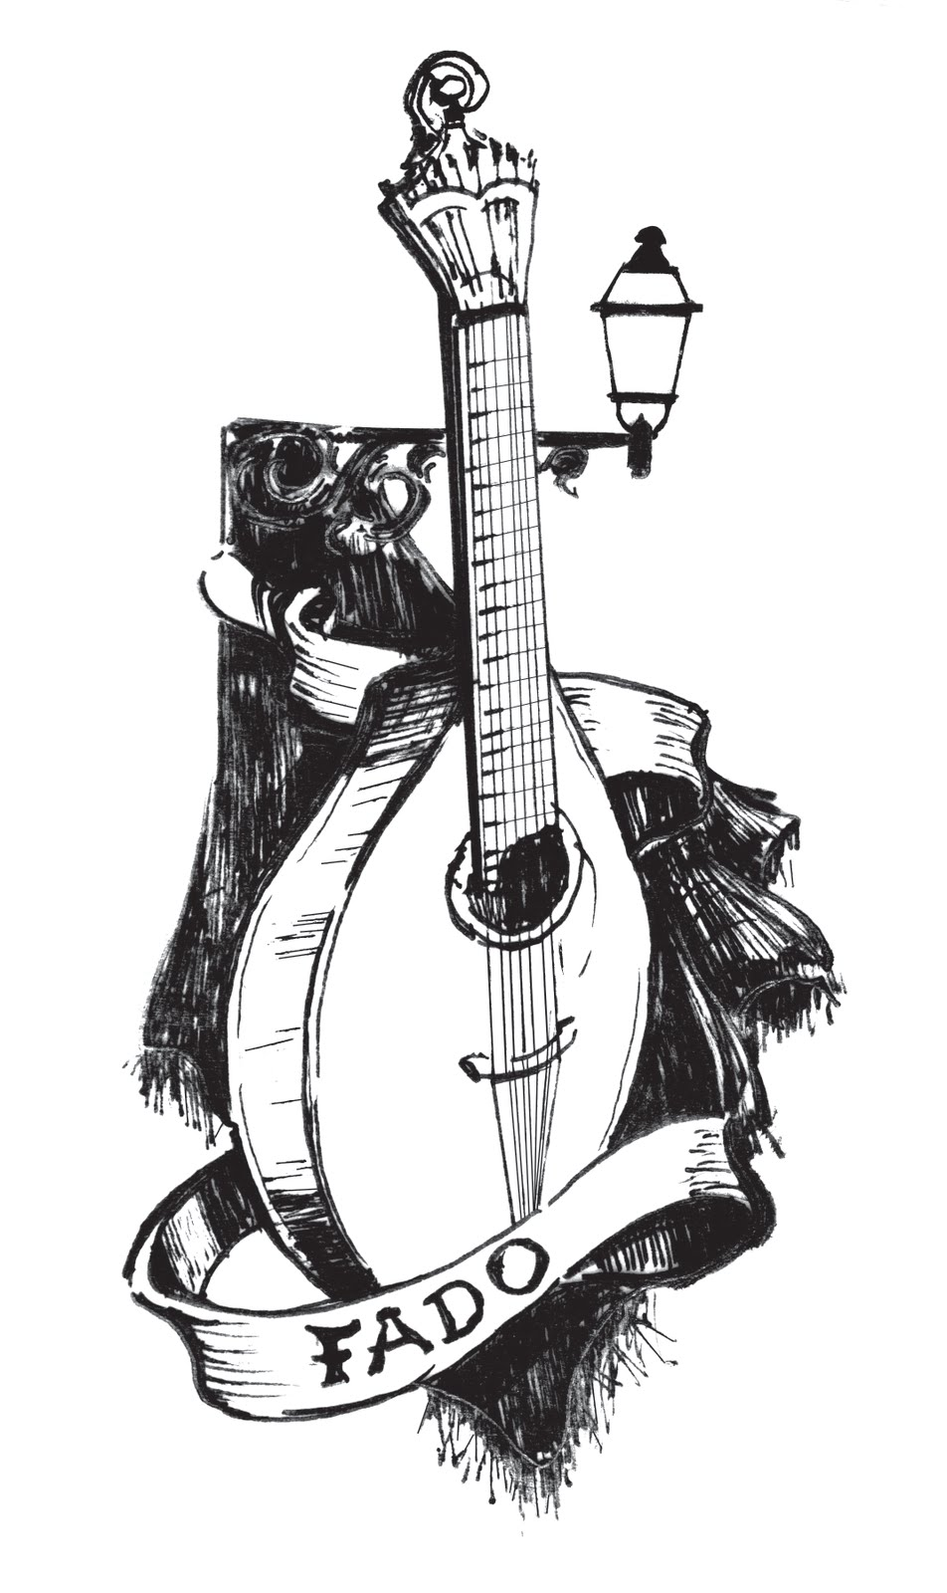
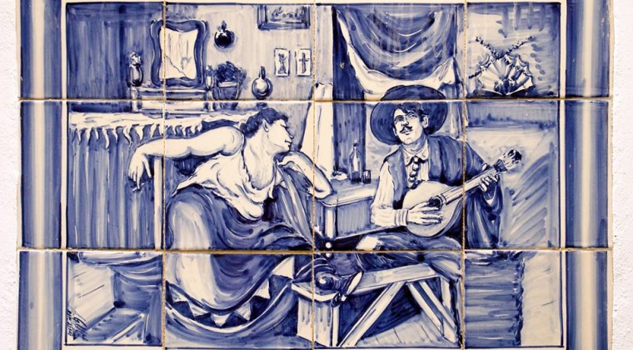
“Old wine in a new bottle?”

Slide 7
Social Change in Portugal
“Although Portugal was already a fairly homogeneous country in terms of currency, language (…) a large part of the country did live to a different rythm than that of the capital and the other main urban areas. Several factors contributed to national integration(…)” (Barreto, p.202)
Expansion of health services and social security (increase in life expectancy and decrease of birth death rate;
Establishment of school, postal and bank networks;
Expansion of economically active population (inclusion of women) – but also less dependency on primary sector and creation of tertiary economy;
Along with it ‘coastalization’ and urbanization intensified and growth of university population;
Social structures approaching European standards.

Slide 8
The formation of a new Portuguese identity?
“No século XXI nasceu uma nova teoria da cultura portuguesa derivada da queda do Império e da proposta do estabelecimento de um possível vínculo histórico com as ex-colónias, operando uma continuidade cultural sob e sobre a descontinuidade política” (Real, p.189)
Or…an open future for its history with the potentials of Portuguese Language?
“Portugal’s inclusion into the European mainstream during the late-1990s has also enabled it to re-evaluate its relationship with the wider world. The creation of the Community of Portuguese Speaking Nations (CPLP–Comunidade de Países da Língua Portuguesa) in 1996 allowed it to begin mending fences with its former colonies.” (Lloyd-Jones, p.14)
A língua portuguesa é a sexta língua mais falada no mundo / ~ 255 milhões

Slide 10
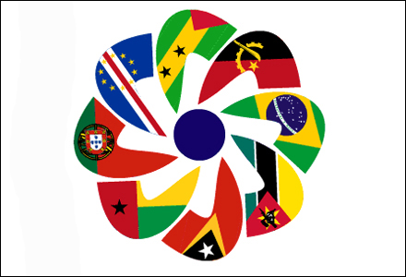
CPLP

Slide 11
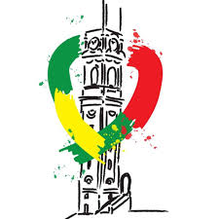
“A Lusofonia corresponderia a um campo geográfico-histórico e cultural abrangido por todas as nações, países, povos e comunidades falantes da língua portuguesa ou de um dialecto desta directamente derivado (…) um genuíno programa civilizacional (…) unindo num vínculo único povos que a História fez encontrar e desencontrar.” (Real, 189-90)

