Slide 1
Most frequent infectious disease
More common in women??
May be limited to bacterial colonization in urine or bacteria may invade urinary tissues

Slide 2
Complicated Urinary Tract Infections
Structural or functional urinary dysfunction
Symptoms light or heavy
Systemic problems in some: fever, bacteremia, septic shock

Slide 3
E. Coli is the reason 90% of community-acquired
uncomplicated cases

Slide 4
microbiologic testing BEFORE
any
antibiotic

Slide 5
Recurrent UTI
Relapse (20%) or reinfection (>80%)
Prophylaxis, if reinfections
≥ 3 / year
OR
≥ 2 / 6 months

Slide 6
Symptoms shortly after completion of a therapy suggest structural abnormality

Slide 7
Acute bacterial prostatitis responds well to antimicrobial theraphy?

Slide 8
Determinant of theraphy:
Sufficient [drug] in urine
Q: factors that what affect
this?
1. Plasma concentration?
2. GFR?
3. Active transport?
4. Protein binding?

Slide 9
Urinal pH?

Slide 10
Lower UTI- Outpatient-Adult
 | AB | Dose |  | length
Non-complicated | Co-trimoxazole | 1 DS tb (800/160) | 2x | 3 d
 | Nitrofurantoin | 100 mg | 2x | 5 d
 | fosfomycin | 3 g | single | 1 d
 | ciprofloxacin | 250 mg | 2x | 3 d
 | levofloxacin | 250 mg | 1x | 3 d
 | Amoxicillin-clavulanate | 500 mg | 3x | 5-7 d
complicated | Co-trimoxazole | 1 DS tb (800/160) | 2x | 7-10 d
 | ciprofloxacin | 250-500 mg | 2x | 7-10 d
 | levofloxacin | 250 mg 750 mg | 1x | 10 d 5 d
 | Amoxicillin-clavulanate | 500 mg | 3x | 7-10 d
recurrent | Nitrofurantoin | 50 mg | 1x | 6 ay
 | Co-trimoxazole | 1/2 tb (400/80) | 1x | 6 ay
Acute pyelonephritis | Co-trimoxazole | 1 DS tb (800/160) | 2x | 14 d
 | ciprofloxacin | 500 mg | 2x | 14 d
 | levofloxacin | 250 mg 750 mg | 1x | 10 d 5 d
 | Amoxicillin-clavulanate | 500 mg | 3x | 14 d

Slide 11
Evidence Based Ampiric Treatment
of Acute Non-complicated Cystitis
Nitrofurantoin x 5d (A,I)
Co-trimoxazole x 3 d (A, I)
fosfomycin trometamol x 1 d (A,I)
Floroquinolone x 3 d (A,I)
ß-Lactams x 3-7 d (B, I)
Pivmecillinam x 3-7 d (A, I)
Good evidence
Moderate evidence
I. At least one proper controlled study

Slide 12
Pregnancy
Amoxicillin-clavulanate x 7 d
Sefalosporin x 7 d
Co-trimoxazole x 7 d*
* Not on 3rd trimester

Slide 13
URINARY ANTICEPTICS
Used only for UTI
Concentrate in urine, do not reach
antibacterial concentrations in tissues

Slide 14
Nitrofurantoin
IN UNCOMPLICATES CYSTITIS ONLY
Needs to be activated by the bacteria to be effective
Activity enhanced @ pH5.5 or below
Broad spectrum, no clear mechanism of action
Absorbed well and excreted so fast that no systemic antibacterial action achieved (may reach toxic levels in renal insufficiency, contraindicated)
4 times / day (100mg), 7 days
Adverse effects nausea, vomiting, hypersensitivity, pulmonary toxicity

Slide 15
Methenamine mandelate
Methenamine hippurate
Urinary antiseptic only:
1g 4 times daily; 1g twice daily, respectively

Slide 16
Methenamine mandelate
Methenamine hippurate
Some bacteria are not affected since they make a strongly alkaline urine
Acidifying drugs (ascorbic acid) may be used to increase efficiency

Slide 17
LET’S REMEMBER
BASIC PHARMACOLOGY
OF CO-TRIMOXAZOLE

Slide 18
SulFONAMIDES
TRIMETHOPRIM
Short acting
Intermediate acting
Long acting
Combination Sulfamethoxazole+trimethoprime
sulfisoxazole
Sulfamethoxazole (in combination only)
Sulfadiazine
(no longer available, risk of Stevens Johnson!)
Sulfadimetoxine
Sulfamethoxipyrazine

Slide 19
SulFONAMIDES
TRIMETHOPRIM
Adults | 160mg TMP+ 800mg SMZ | Every 12 hours / 14 days
Children | 4mg/kg TMP+ 20mg/kg SMZ | Every 12 hours / 10 days

Slide 20
SulFONAMIDES
TRIMETHOPRIM
Adverse
Hypersensitivity
2. Kernicterus
3. Crystalluria

Slide 21
WHAT ABOUT
FLUOROQUINOLONES?

Slide 22
Adults | 250-500mg | Every 12 hours / 7-14 days
Children

Slide 23
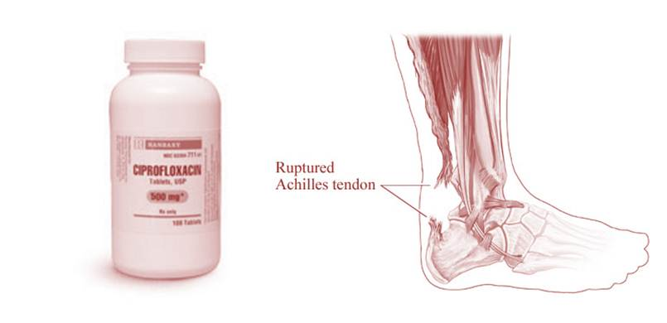
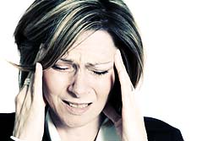
FLUOROQUINOLONES
Adverse
Contraindicated
in patients <18

Slide 24
3 g
Single dose
empty stomach
Safety not confirmed
for patients under 12

