Slide 1
Smart Micro/nanoparticles in Stimulus-Responsive Drug/gene Delivery Systems
Mohamed Belal ABBADİ
Mohammad Ahmed Malluhi
Hicran Aldemir
Emine Çökelik

Slide 2
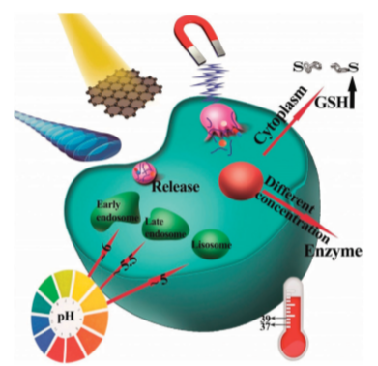
Micro/Nanoparticles
DDSs for targeted-delivery and controlled-release of drugs and other cargos such as gene, nucleic acid etc.
DDSs must be site-spesific and time released control.
These MNPs designed to be responsive to pH variations, redox potential, enzymatic activation, thermal gradients, magnetic fields, light, and ultrasound (US) etc.

Slide 3
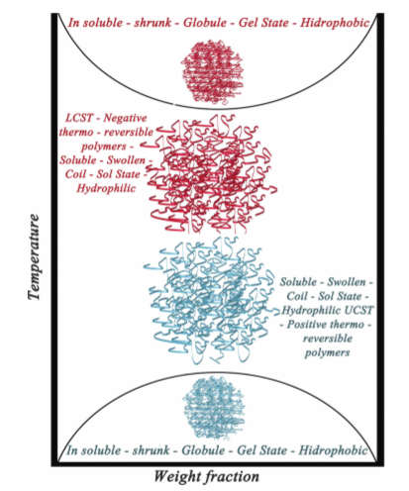
Physical Based Stimuli 1- Thermo-Responsive MNPs
Temperature is both internal and external stimuli.
Upper critical solution temperature-type (UCST) or a lower critical solution temperature-type (LCST).
A phase transition : swelling or shrinking.

Slide 4
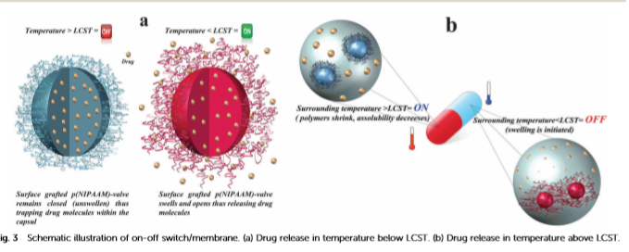
PNIMAAm and Its Derivatives
Nanovalves

Slide 5
Other Commonly Used Structures:
Core-shell Thermo-Responsive DDSs
Smart Nanoboms

Slide 6
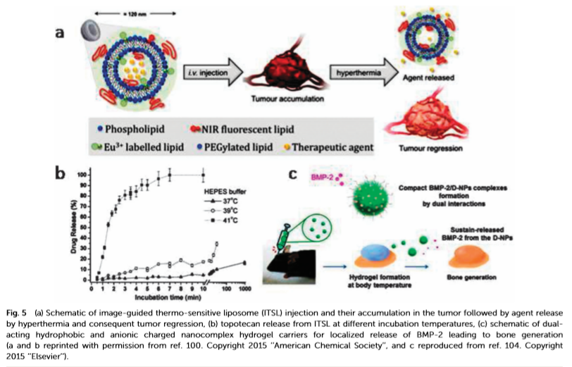
Other used materials in termo-responsive MNPs
Polyethylene glycol (PEG)
Temperature-sensitive liposomes (TSL)

Slide 7
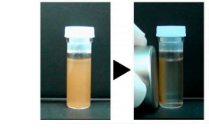
2- Magnetic-Responsive MNPs
External stimuli
Single domain MNPs with intrinsic superparamagnetic features
MNPs to generate heat under the influence of external high-frequency AMF is called magnetic hyperthermia.

Slide 8
Example:

Slide 9
3- Electrical-Responsve MNPs
NPs that contain large numbers of ionizable groups
Example : Ying et al. developed electro-responsive hydrogel NPs for targeted delivery of an antiepileptic drug.
Nanocomposite composed of graphene oxide (GO)

Slide 10
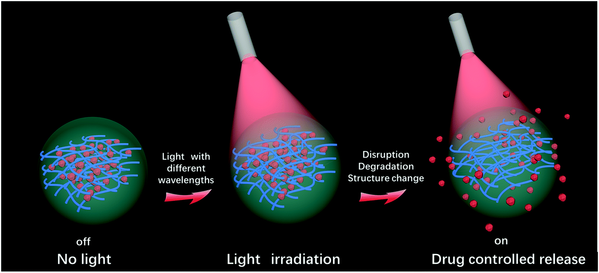
4- Light-Responsive MNPs
Light irradiation is used to stimulate or trigger drug release.
Ultraviolet (10–400 nm)
Visible
Near infrared (650–900 nm) of the light spectrum
All of MNPs have a chromophore in their architecture to harvest the light.

Slide 11
Variety of mechanisms that can cause light-triggered cargos released from nanocarriers:
photo-isomerization
photo-induced cleavage of bonds
photo-oxidation
reversible photo-cross-linking
light-triggered switch in polarity.
For example:
Azobenzene (commonly used chromophore) : Reversible isomerization

Slide 12
Example : colloidosome microcapsules
Organosilica NPs with oppositely charged surfaces were exposed to light irradiation (365 nm).
This induced electrostatic interactions leading to surface charge reversion (the positive charges turned to negative)
The repulsive forces between negative charges disassembled the colloidosomes and resulted in drug released.

Slide 13
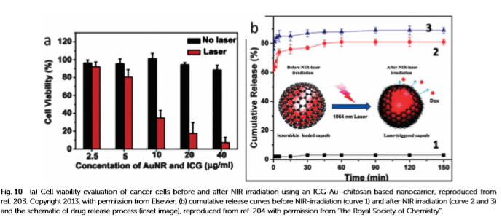
The light absorbed by a nanomaterial is converted to localized heat
DOX loaded GO–poly(allylamine hydrochloride) (PAH) composite capsule
NIR irradiation ruptured the capsules and drugs were released.

Slide 14
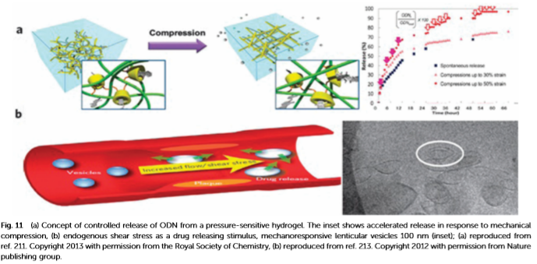
5- Mechanical-Responsive MNPs
Based on the assembly and disassembly of mechano-responsive molecules with applied physical stimuli such as pressure, shear stress, compressive force, tensile force etc.

Slide 15
6- Ultrasound-Responsive MNPs
Based on two physical mechanisms: heat and cavitation.
Three required proporties in the design of the MNPs:
Reliable and stable drug encapsulation,
Efficient drug release,
Capability of monitoring drug release for imaging and therapeutic purposes.
Ultrasound :
Triggers the release of drugs from carriers
Increase the permeability of biological barriers
Enhance drug diffusion by increasing temperature

Slide 16
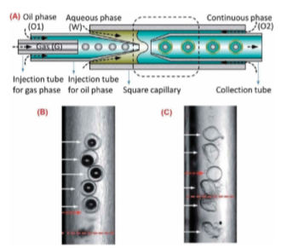
Microbubbles
A microbubbles consists of a gas core and a shell.
Microfluidic Technology

Slide 17
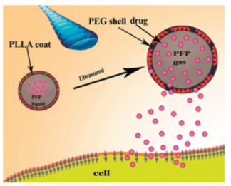
Example : Au Nanocages
Encapsulating anticancer drugs and phase-change materials(PCM)
US transfers acoustic energy in the focal site to raise the temperature rapidly
The PCM inside the cages would be melted
the ﬂuid PCM would escape from the interiors of nanocages
And release the encapsulated small molecule drugs into the surrounding medium.

Slide 18
Chemical stimuli-responsive MNPs
pH-Responsive MNPs
Redox-responsive MNPs

Slide 19
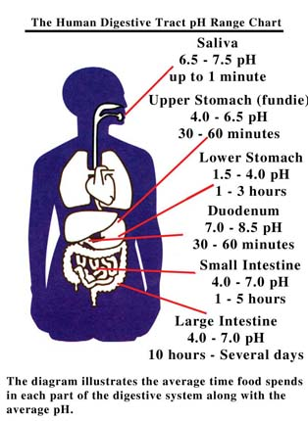
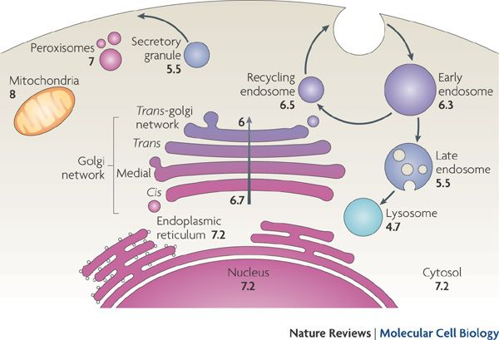
pH-Responsive MNPs
Delivery of protein and peptide drug
Notes:
https://www.alleganynutrition.com/supporting-pages/the-human-digestive-tract-ph-range-diagram/
https://www.nature.com/articles/nrm2820/figures/1?draft=marketing
Based on the Ph differences exists among subcellular organnlles as well as the Ph differences between the Gastrointestinal Organs developing of Ph-responsive DDs.
At the organ level oral drug delivery was designed to differentiate drug realse along the Gİ tract with maltple clinical product
At the intracellular level ph responsive nano particle have been studied to escape the acidic endolysosomal compartments for cytosolic drug delivery.

Slide 20
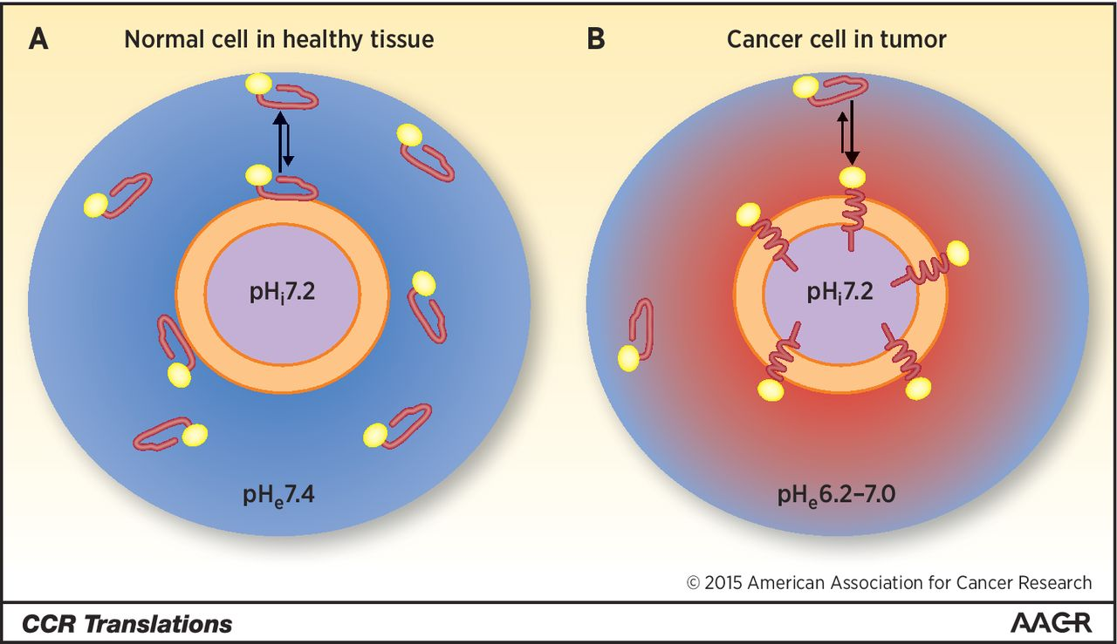
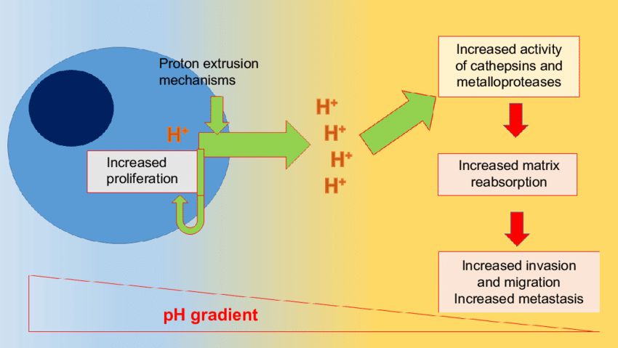
pH-Responsive MNPs
Delivery of protein and peptide drug
Notes:
At the tissue level various drug carriers has been designed to exploit the ph difference between the health and tumor cells.
Ph differences between the healthy cells and canceruos cells, as
the canceruos cells has a law Ph values due what in known Warburg effect * due to the rapid proliferation of canceruos cells causng indequate supply of oxegyn and neutrients leading the formation of lactic acid by glycolysis rather than then oxidative phosphorylation in normal cells.
https://www.researchgate.net/figure/ntracellular-and-extracellular-pH-in-tumor-cells-proton-extrusion-mechanisms-create-an_fig7_309225661
proton extrusion mechanisms create an extracellular acidic milieu and a slightly alkaline intracellular environment. Low extracellular pH contributes to the activation of enzymes that digest extracellular matrix, while the slightly alkaline cytoplasm is appropriate for increased proliferation. Organelles like lysosomes are highly acidic in cancer cells. Migrating cells exhibit an intracellular pH gradient along the migration axis which is related to NHe-1 activity.
https://clincancerres.aacrjournals.org/content/21/20/4502.figures-only 2. Schematic presentation of pHLIP peptide (red) conjugated with fluorescent dye (yellow) interaction with plasma membrane of a normal cell in healthy tissue (A) and a cancer cell in tumor (B). The extracellular pH in healthy tissue is around pH7.4. On the other hand, pH gradient exists near the surface of cancer cells: The pH near the plasma membrane is lowest (around pH6.0–6.2), increasing with distance from the membrane. pHLIP peptides are weakly bound to the surface of the cell membrane in healthy tissue. However, at low extracellular pH in tumors, pHLIPs insert into the plasma membrane, tethering imaging probe to cancer cells. In tumors, the equilibrium is shifted toward membrane-inserted form of the peptide, leading to accumulation of the peptide and an imaging agent within a tumor. At the same time, in healthy tissue, the equilibrium is shifted toward membrane non-bound form of the peptide, which results in washing of the peptide from healthy tissue.

Slide 22
pH-responsive MNPs
Fundamental mechanisms of designing:
Protonation of the copolymers with the ionic groups ( charge conversion )
Chitosan drug release in the intestinal environment
Acid cleavable bonds ( breaking the covalent bond in acidic solution )
Acyl hydrazine , acetal/ketal, cis-acotinyl , imine, substituted trityl, orthoester linkers
are pH-labile bonds
Formulations used :
Micelles, liposomes, polymersomes, protein Nano capsule, ( in organic ) mesoporous silica nanoparticles.

Slide 23
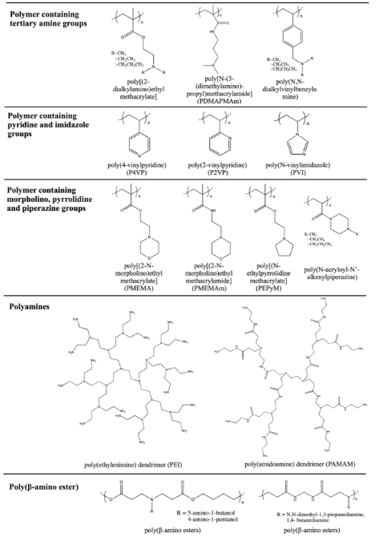
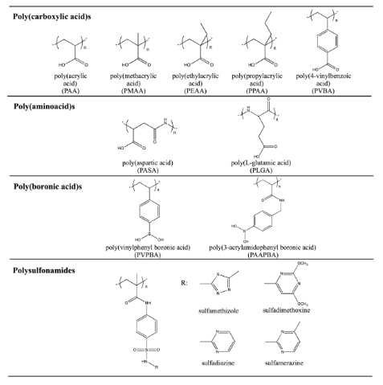
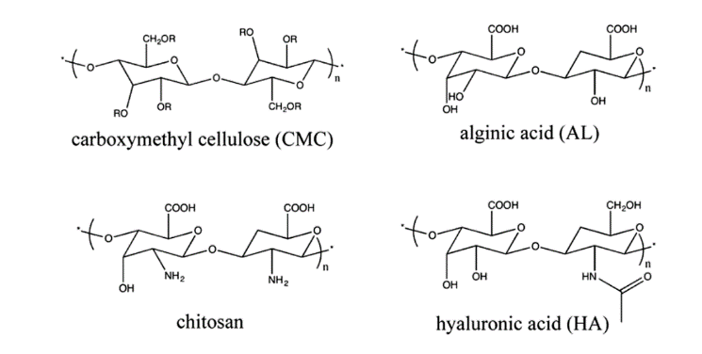
İonizable PH sensitive groups present in polymeric NPs.
PH responsive natural polymers
PH responsive acidic polymers
PH responsive basic polymers
Notes:
İonizable PH sensitive polymeric system with a variable degree of ionaziaton
These groups accept protons at law PH and releaze them at high PH depending on the Pka leading to the transation between the hydrophbic and hydrophilic states
Prtonation and deprotonation : The proporty that can load the drugs in carriers and releaze them when the environmental ph changes.
The PH induced hydrophobic/hydrophilic transation can be used to control the assembly and desassembly of nanoparticles and swelling and deswelling of hydrogels in the aquies environmet .
Acidic : go under deprotonization forming an anions at law PH values
Basic : goes under protonization at law PH values forming cationic amonuim groups and releazing them under basic conditoins.
The carboxylic acid group is deprotonaizing at law ph value, polycarboxylate have been used to construct ph responsive vesicles polymeris micells dendrimer and nano spheres.
In recent years, the use of natural biodegradable polymers has also gained great attention owing to their good biocompatibility and easy modification by simple chemistry. Several natural polymers are also used in the pH- responsive self-healing gel system. Dextran, hyaluronic acid (HA), heparin, alginic acid, cellulose, chitosan, and gelatine are among the most widely used natural polymers (Figure 3.4). By proper chemical modification, these polymers can exhibit pH-sensitivity for DDS.50,5 For example, chitosan is a polycationic biopolymer (pK, 6.3) which is soluble in acidic solution and widely used for drug and gene delivery.

Slide 24
Covelent Acid labile chamical Bonds
These bonds are stable at natural ph and hydrolyses at acidic ph.
Notes:
pH-Responsive linkages have been widely exploited in the development of polymeric drug delivery systems, which trigger drug release selectively at tumor tissues or endosomes and lysosomes of cells. Herein we report new pH-sensitive amphiphilic poly(ketal adipate)-co-poly(ethylene glycol) block copolymers (PKA-PEG), which have acid-cleavable ketal linkages in their hydrophobic backbone. PKA-PEG copolymers self-assemble to form stable micelles with a mean diameter of ~175 nm, which can encapsulate a payload of anticancer drugs and rapidly dissociate to release drug payload at the acid environment. The micelles are biocompatible and exhibit abilities to disrupt endosomes to enhance the cytosol drug delivery. Taken together, we anticipate that the pH-sensitive PKA-PEG micelles have great potential as anticancer drug carriers.

Slide 25
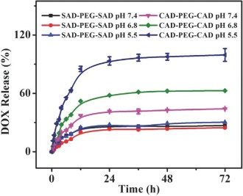
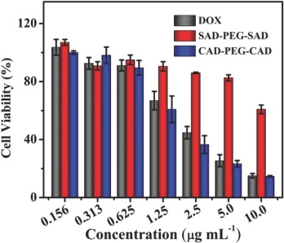
Notes:
1. the drug release level of CAD‐PEG‐CAD was low at neutral pH, while increased significantly with the decrease of pH. The stimuli‐responsive property of CAD‐PEG‐CAD could minimize the loss of drug in the circulatory system and then reduce the side effects in vivo. These properties make the pH‐responsive prodrug have great potential for tumor chemotherapy.
2. results showed that CAD‐PEG‐CAD exhibited the most efficient inhibition capability for cellular proliferation than the other groups at the same test condition, which should be resulted from the rapid release of DOX at the acidic intracellular microenvironment. In contrast, the worst antitumor activity of SAD‐PEG‐SAD should be ascribed to its higher structural stability.

Slide 26
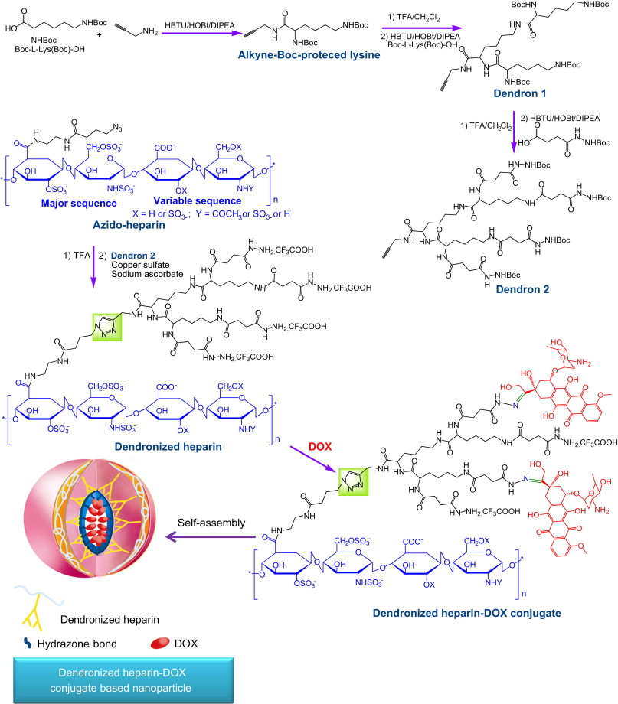
Notes:
preparation and characterization of dendronized heparin–DOX conjugate as pH-stimuli and nanoscale drug delivery system for breast tumor therapy.
Its antitumor efficacy and biosafety were assessed well. The heparin was dendronized with low generation dendron via click reaction; DOX was conjugated to the surface of dendron through pH-sensitive hydrazone bond, resulting in compact nanoparitcle via the self–assembly, as shown ,
The in vitro and in vivo characteristics of nanoparticle as pH-stimuli drug delivery system, such as size, zeta potential, drug release, antitumor efficacy, antiangiogenic effect and toxicity, were evaluated, which showed the dendronized heparin–DOX conjugate based nanoparticle provide a potential drug delivery vehicle for breast cancer therapy.

Slide 27
pH-Sensitive nanocarriers can be used to avoid the premature
degradation of drugs in cellular compartments such as lysosomes.
Dual cargo release systems with selectively controlled release of two different drugs can be designed.

Slide 28
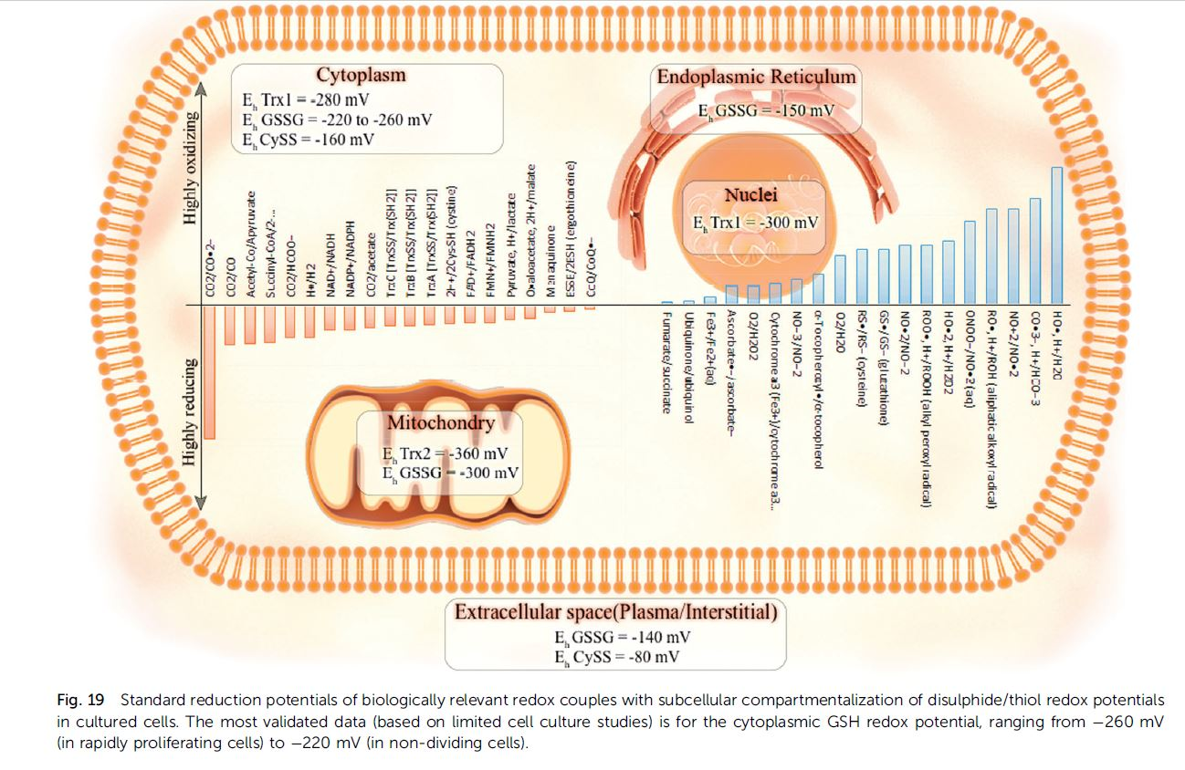
Redox-responsive MNPs
Gluathione GSH ratio
Redox-responsive vehicles releasing
Notes:
GSH in 2 to 3 orders higher in the intracellular the extracellular. 2-10 mM and 2-20uM
Which provide law redox potential inside the cell.
It’s found that Redox-responsive vehicles releasing ph-responsive vehicles tend to release drug in the cytosol.

Slide 29
Design of reduction-sensitive Nano systems
degradable micelles using disulphide links in the hydrophobic backbone, Amphiphilic copolymers with a single disulphide bond connecting the two polymer block can self-assemble in to micelles.
GSH-responsive crosslinking agents that are incorporated either in the core or in the shell
coated mesoporous silica nanomaterials
disulphide crosslinked nanogels
Liposomes
Dendrimer-drug conjugates containing thiol-cleavable bonds

Slide 30
Disassembling/destabilizing of the system.
Thiol- Disulphide exchange with the redox-potential change > DDs trigger
Disulphide degrading in the presence of reduction agents then by oxidation the resulting thiol group can form the disulphide bond
Disulphide bond can be incorporated into either on the backbone or crosslinkers to make the RRN
Design Ex: target protein encapsulated into a positively charged polymeric shell, interconnected by disulphide containing cross-linkers via in situ interfacial polymerization.
Core-cross-linking can increase the stability of micelles

Slide 31
Redox-responsive MNPs
Notes:
Experiment show that release of Dox from

Slide 33
Biological stimuli-responsive MNPs
Different biomoleculear-responsive MNPs.
Glucose
ATP
DNA specific sequences
Enzyme responsive MNPs
Notes:
The existence of some biomolecules such as glucose, ATP, DNA etc in different concentrations in specific physiological sites or in pathological conditions of living systems made it possiple to think about designing smart DDS that are stimuli-risponsive to these biomolecule.

Slide 34
Different biomolecular-responsive MNPs
Glocuse-responsive controled release of insulin :
Notes:
Let start with glucose, the blood glucose concetration is high in the diabetes patients due to the disability of their bancreas to make and release enough amount of insülin .
So in this technique , In high glucose concentration environment , Glucose Oxidase enzyme will convert glucose molecules to gluconic acid which will increase the acidity by lowering the PH value away than the body PH value. This in return will trigger the swelling of Chitosan matrix that form the nanovalves. This swelling will allow the releasing of the insulin particles that were entrapped inside.

Slide 35
Different biomolecular-responsive MNPs:

Slide 36
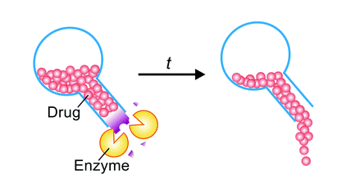
Enzyme Responsive MNPs
What they are.
why they are useful for being used
in nanotechnology for The design
of Smart DDS: their features ?
Their modes of actions.
Ex : Hydrolases : protease enzyme.
Notes:
Enzyme importance: why they are useful for being used in nanotechnology for The design of Smart DDS:
Ability to recognize different biomolecules.
Having high catalytic capability.
Very powerful selectivity and favorable effeciency in enzyme- catalyzed reaction.
The overexpression of some types of enzymes in specific sites or tissues of the body
The dysregulation of enzymes activity due to some diseases can be useful for diagnosis purposes of those diseases.

Slide 37
Enzyme responsive MNPs examples:
Notes:
Protease enzymes have a powerful role in the processes Dna replication , transcription and cell poliferation and inflammations and etc.
That maked it an ideal choice for being used in the smart DDSs in cancer since it is overexpressed in the tomur cells.
The enzyme is used to trigger the release of the drug loaded by nanoparticles And since many types of the enzyme are only found inside the cell compartments
, the drug will only be released inside the targeted cell making the delivery more specific, more accurate and in the same time more efficient.

Slide 38
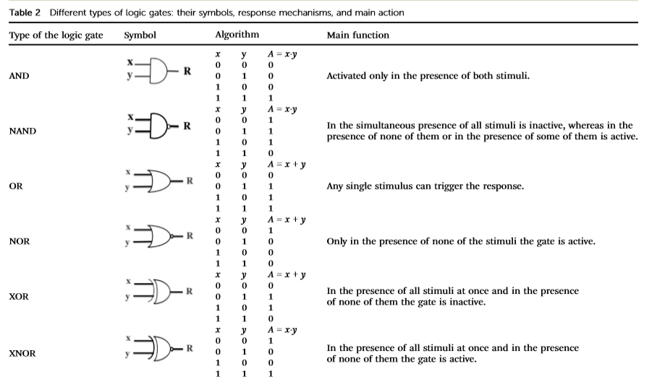
Dual- and multi-responsive MNPs
The combination of Two or more
stimulus for DDS can be used to
increase specificity and accuracy
of the drug delivery process.

Slide 39
Dual enzyme responsive microcapsules
Notes:
Herein, the Drug delivery system will release the drug when been exposed to dual stimuli. When either or both of enzyme are presented , the system will activate the releasing of the drug.
The first enzyme is a protease called trypsin and the other are called hyaluronidase. Those two enzyme are overexpressed under conditions like cancer or inflammation.
The microcapsules that entrapped the drug are fabricated of two elements .
The first one is an arginine rich protein protamine (PR - ) which act as stimuli responsive component that disintegrates in the presence of Trypsin and therefore the drug is released .
And the second one is anionic polysaccharide chondroitin Sulphate (CS – Sulphated Glycosaminoglycan) that disintegrates in the presence of Hyaluronidase.

Slide 40
Reduction-sensitivity responsiveness combined with PH – responsiveness in dual or-gate system

Slide 41
Dual- and multi-responsive MNPs

Slide 42
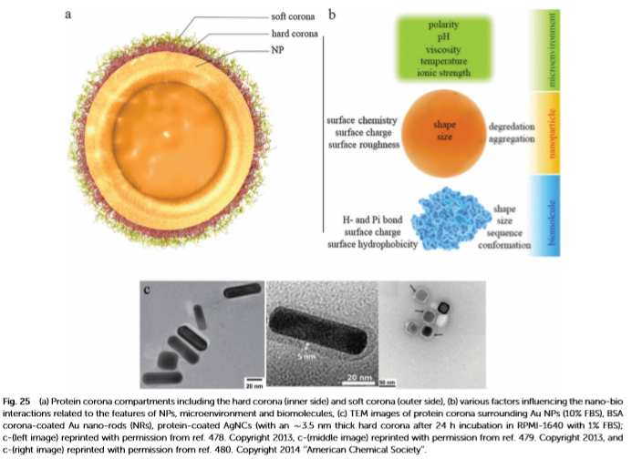
The Protein Corona
NP- Biological Interactions
Serum proteins: albumin, apolipoproteins, immunoglobulin G (IgG), complement factors, and fibrinogen.
Hard corona and soft corona
The structure and composition of the protein corona depends on:
the features of nanoparticle,
the biological environment,
the time of exposure, etc.
Reduce targeting and drug release efficiency
Facilitate macrophage recognition and the uptake of nanoparticles

Slide 43
Nanotoxicology of NPs in Biological Systems
The toxicity of nanomaterials depends on their physicochemical properties.
Different toxic effects of NPs:
Cell membrane damage,
Disruption of ATP production and DNA replication,
Lysosomal degradation/disruption,
Release of radicals,
Mitochondrial damage,
Induction of structural alterations of intracellular proteins,
The protein corona formation, etc.

Slide 44
From concept to the drugstore shelves

