Slide 1
The importance of proteins
Proteins are key compounds of food since they make a significant contribution to sensory properties of foods and they have high nutritive value
They participate in tissue building in plants and muscles
They play a crucial role in human body as enzymes, hormones, transfer agents and antibodies

Slide 2
Protein content of some foods
Food | Protein content (%) | Food | Protein content (%)
Beef | 16.5 | Wheat | 13.3
Chicken breast meat | 23.4 | Soybean (dry, raw) | 34.1
Fish (haddock) | 18.3 | Beans (dry, raw) | 22.3
Milk | 3.6 | Potato | 2.0
Egg | 12.9 | Corn | 10.0

Slide 3
Amino acids
Proteins include carbon, hdyrogen, oxygen, and nitrogen atoms
Amino acids are the smallest compound of proteins
A total of 21 amino acids are naturally found in foods
Nine of these amino acids are essential for human life and the remainder are non-essential

Slide 4
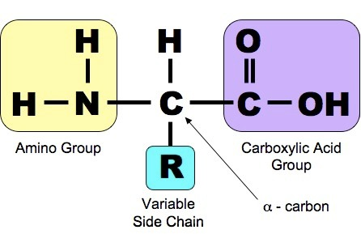
Amino acid structure
Each amino acid has carbon atom (C) attached with an amine group (NH₂), a carboxylic acid group (COOH), a hydrogen atom (H) and a R group.

Slide 5
Protein structure
Proteins are polymer of amino acids linked together by peptide bonds.
The peptide bond, a covalent bond, is formed between the α-carboxyl group and the α-amino group of two amino acids by a condensation reaction with the loss of one molecule water

Slide 6
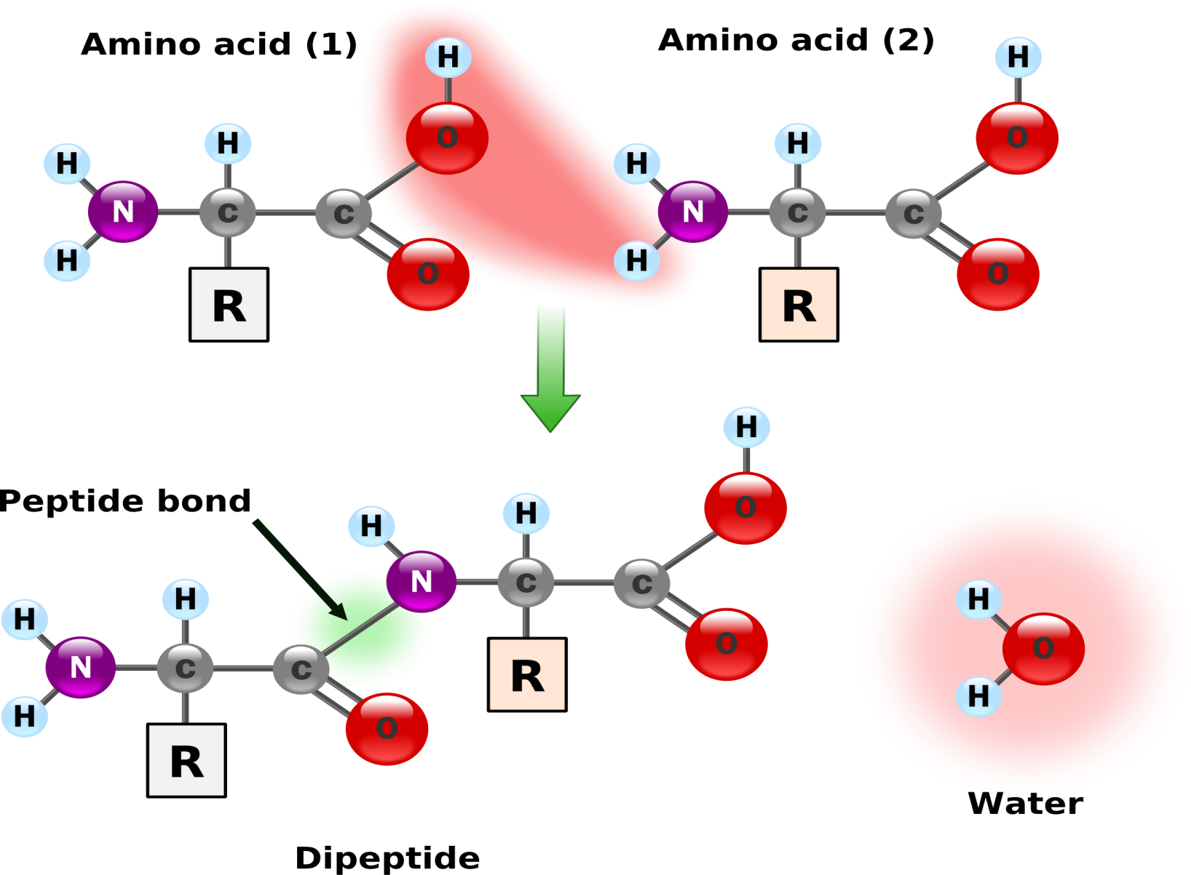
Peptide bond

Slide 7
Classification of proteins
Proteins are classified into one of three groups given below based on their molecular structure
Simple proteins yield only amino acids when they hydrolyze
Albumins, globulins, glutelins, prolamins, scleroproteins, histones, protamines are examples of simple proteins
Conjugated proteins contain an amino acid combined with a non-protein part, which are lipid, nucleic acid, and carbohydrate
Phosphoproteins, lipoproteins, nucleoproteins, glycoproteins, chromoproteins are examples for this class.
Derived proteins

Slide 8
Functions of proteins
Proteins have important functions during food processing.
Hydration
Denaturation and coagulation
Enzymatic browning reactions
Enzymatic reactions
Maillard reactions

Slide 9
Denaturation and coagulation
Denaturation is defined as distruption of protein structure, which results in partial or complete loss of function
Coagulation is described as precipitation of protein in a liquid in the form of semisolid compound
These processes are usually considered to be irreversible.

Slide 10
Browning reactions
Maillard reaction (Nonenzymatic browning reaction)
Enzymatic browning reaction
The reaction between a sugar and a protein, which results in the formation of brown-colored complexes.
A reaction in which an enzyme acts on a phenolic compound in the presence of oxygen to produce brown-colored compounds

Slide 11
References
Brown, A. (2008) Understanding food principles and preparation. (3rd ed.) Pages 41-46. Thomson Wadsworth, California, USA.
Campbell-Platt, G. (2009). Food Science and Technology. Chapter 2: Food chemistry pages 12-20. Blackwell Publishing. (In the library of our department)
deMan, J.M. (1999) Principles of food chemistry. (3rd ed.) Pages 111-134. An aspen publication, Maryland, USA.

