Slide 1
IMMIGRATION INTO THE UNITED STATES
AKE 118 AMERICAN HISTORY II
DR. GAMZE KATI GUMUS

Slide 2
Legal Restrictions Against Immigrants
Notes:
Please check: https://immigrationhistory.org/timeline/

Slide 3
PAGE LAW (1875)
An act supplementary to the acts in relation to immigration.
Be it enacted by the Senate and House of Representatives of the United States of America in Congress assembled, That in determining whether the immigration of any subject of China, Japan, or any Oriental country, to the United States, is free and voluntary . . . it shall be the duty of the consul-general or consul of the United States residing at the port from which it is proposed to convey such subjects . . . to ascertain whether such immigrant has entered into a contract or agreement for a term of service within the United States, for lewd and immoral purposes; and if there be such contract or agreement, the said consul-general or consul shall not deliver the required permit or certificate.*
Notes:
From https://immigrationhistory.org/item/page-act/#

Slide 4
CHINESE EXCLUSION ACT AKA “AN ACT TO EXECUTE CERTAIN TREATY STIPULATIONS RELATING TO CHINESE”
Whereas in the opinion of the Government of the United States the coming of Chinese laborers to this country endangers the good order of certain localities within the territory thereof: Therefore,
Be it enacted by the Senate and House of Representatives of the United States of America in Congress assembled, That from and after the expiration of ninety days next after the passage of this act, and until the expiration of ten years next after the passage of this act, the coming of Chinese laborers to the United States be, and the same is hereby, suspended; and during such suspension it shall not be lawful for any Chinese laborer to come, or having so come after the expiration of said ninety days to remain within the United States .
Notes:
From https://immigrationhistory.org/item/an-act-to-execute-certain-treaty-stipulations-relating-to-chinese-aka-the-chinese-exclusion-law/

Slide 5
IMMIGRATION ACT OF 1882
SEC. 2.-That the Secretary of the Treasury is hereby charged with the duty of executing the provisions of this act . . . he shall have power to enter into contracts with such State commission, board, or officers as may be designated for that purpose by the governor of any State to take charge of the local affairs of immigration in the ports within said State . . . and it shall be the duty of such State commission, board, or officers so designated to examine into the condition of passengers arriving at the ports within such State . . . and if on such examination there shall be found among such passengers any convict, lunatic, idiot, or any person unable to take care of himself or herself without becoming a charge, they shall report the same in writing to the collector of the port, and such persons shall not be permitted to land.
Notes:
https://immigrationhistory.org/item/1882-immigration-act/

Slide 6
IMMIGRATION ACT OF 1903
SEC. 2. That the following classes of aliens shall be excluded from admission into the United States . . . anarchists, or persons who believe in or advocate the overthrow by force or violence of the Government of the United States or of all government or of all forms of law, or the assassination of public officials . . .
** Less than two years after an anarchist assassin killed President McKinley, Congress enacted the Immigration Act of 1903 targeting anarchists for exclusion.
Notes:
From https://immigrationhistory.org/item/1903-anti-anarchist-legislation/

Slide 7
EXPATRIATION ACT OF 1907
SEC. 3. That any American woman who marries a foreigner shall take the nationality of her husband. At the termination of the marital relation she may resume her American citizenship if abroad, by registering as an American citizen within one year with a consul of the United States, or by returning to reside in the United States, or, if residing in the United States at the termination of the marital relation, by continuing to reside therein.
Notes:
From https://immigrationhistory.org/item/an-act-in-reference-to-the-expatriation-of-citizens-and-their-protection-abroad/

Slide 8
IMMIGRATION ACT OF 1917 (BARRED ZONE ACT)
SEC. 3. That the following classes of aliens shall be excluded from admission into the United States: All idiots, imbeciles, feeble-minded persons, epileptics, insane persons: persons who have had one or more attacks of insanity at any time previously; persons of constitutional psychopathic inferiority; persons with chronic alcoholism; paupers . . . persons afflicted with tuberculosis in any form or with a loathsome or dangerous contagious disease; persons . . . mentally or physically defective . . . persons who have been convicted of or admit having committed a felony or other crime or misdemeanor involving moral turpitude; polygamists . . . anarchists . . . prostitutes . . . persons who directly or indirectly procure or attempt to procure or import prostitutes . . . contract laborers . . . persons likely to become a public charge; persons who have been deported under any of the provisions of this Act . . . persons whose tickets or passage is paid for with the money of another . . . stowaways . . . all children under sixteen years of age, unaccompanied by or not coming to one or both of their parents, except that any such children may, in the discretion of the Secretary of Labor, be admitted if in his opinion they are not likely to become a public charge and are otherwise eligible;
unless otherwise provided for by existing treaties, persons who are natives of islands not possessed by the United States adjacent to the Continent of Asia . . .
Although this law is best known for its creation of a “barred zone” extending from the Middle East to Southeast Asia from which no persons were allowed to enter the United States, its main restriction consisted of a literacy test intended to reduce European immigration.**
Notes:
From https://immigrationhistory.org/item/1917-barred-zone-act/

Slide 9
EMERGENCY QUOTA LAW (1921)
World War I and fears of the spread of radicalism produced enough pressure for Congress and the White House to act decisively to reduce immigration severely. Drawing on eugenics research and recommendations of the Dillingham Commission (1907-1911), this temporary measure limited immigration “scientifically” by imposing quotas based on immigrants’ country of birth. Annual quotas for each country of origin were calculated at 3 percent of the total number of foreign-born persons from that country recorded in the 1910 census.**
Notes:
From https://immigrationhistory.org/item/%E2%80%8B1921-emergency-quota-law/

Slide 10
IMMIGRATION ACT OF 1924 (JOHNSON-REED ACT)
The 1921 Emergency Quota Act had been so effective in reducing immigration that Congress hastened to enact the quota system permanently. This Act set its quotas to 2 percent of resident populations counted in the 1890 census, capping overall immigration at 150,000 per year. With a few exemptions, such as specialized employment, education, or tourism, it barred altogether “aliens ineligible for citizenship.” Eastern and southern Europeans were most severely affected by reductions in legal immigration.
Notes:
From https://immigrationhistory.org/item/1924-immigration-act-johnson-reed-act/

Slide 11
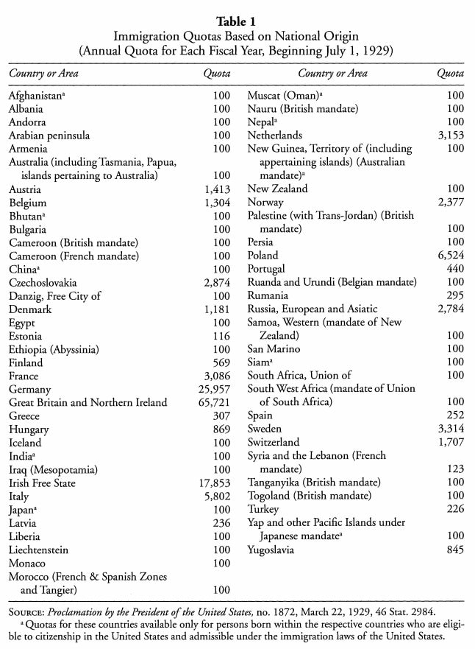
IMMIGRATION ACT OF 1924 (JOHNSON-REED ACT)

Slide 12
Immigration into the US since 1820
http://metrocosm.com/us-immigration-history-map.html

Slide 13
EUGENICS
Eugenics is the philosophy and social movement that argues it is possible to improve the human race and society by encouraging reproduction by people or populations with “desirable” traits (termed “positive” eugenics) and discouraging reproduction by people with “undesirable” qualities (termed “negative” eugenics). The eugenics movement began in the United States in the early part of the 20thcentury; the United States was the first country to have a systematic program for performing sterilizations on individuals without their knowledge or against their will. It was supported and encouraged by a wide swath of people, including politicians, scientists, social reformers, prominent business leaders and other influential individuals who shared a goal of reducing the “burden” on society. The majority of people targeted for sterilization were deemed of inferior intelligence, particularly poor people and eventually people of color.*
The term “eugenics” was first coined by Sir Francis Galton in 1880s.
Notes:
From https://pged.org/history-eugenics-and-genetics/
Also see http://www.eugenicsarchive.org/eugenics/

Slide 14
Sterilization Laws
In 1914, eugenicist Harry Laughlin published a Model Eugenical Sterilization Law that proposed to authorize sterilization of the “socially inadequate” – people “maintained wholly or in part by public expense.” The law included sterilization of the “feebleminded, insane, criminalistic, epileptic, inebriate, diseased, blind, deaf, deformed, and dependent” – including “orphans, ne’er-do-wells, tramps, the homeless and paupers.” Laughlin’s publication was the basis for Virginia’s Eugenical Sterilization Act, passed in 1924, which was first tested in the well-known Buck v. Bell case.*
It can be debated whether North Carolina’s offer of reparation is enough or appropriate compensation. At one time or another, 33 states had statutes under which more than 60,000 Americans were involuntary sterilized. At $50,000 each, that’s a staggering $3,000,000,000.*
Notes:
http://blogs.dnalc.org/2012/01/18/sterilization-laws/

Slide 15
Barbara Benton, Ellis Island: A Pictorial History

Slide 16
Ellis Island
The station on Ellis Island began receiving arriving immigrants on January 1, 1892. More than 12 million immigrants were processed here.*
For numbers of immigrants from different nationalities please visit:
https://www.loc.gov/classroom-materials/immigration/global-timeline/
Notes:
* https://www.statueofliberty.org/ellis-island/overview-history/

Slide 17
Mental examination?
Inattentive
Stupid-looking
Talkativeness
Impudence
Eroticism
Boisterousness
Surliness
Excessive friendliness
Confusion
Stuttering

Slide 18
Madison Grant, The Passing of The Great Race (1916)

Slide 19
Grant and the Eugenic Ideal
“Those possessing these favorable variations will flourish at the expense of their rivals, and their offspring will not only be more numerous, but will also tend to inherit such variations. In this way one type gradually breeds the other out.” (25)
“What is needed in the community most of all, is an increase in the desirable classes, which are of superior type physically, intellectually, and morally, and not merely an increase in the absolute numbers of the population.” (25-26)

Slide 20
Grant and the Eugenic Ideal
“Mistaken regard for what are believed to be divine laws and a sentimental belief in the sanctity of human life, tend to prevent both the elimination of defective infants and the sterilization of such adults as are themselves of no value to the community. The laws of nature require the obliteration of the unfit, and human life is valuable only when it is of use to the community or race.
It is highly unjust that a minute minority should be called upon to supply brains for the unthinking mass of the community, but it is even worse to burden the responsible and larger, but still overworked, elements in the community with an ever increasing number of moral perverts, mental defectives, and hereditary cripples.” (26)

Slide 21
Grant and the Eugenic Ideal
“A rigid system of selection through the elimination of those who are weak or unfit-in other words, social failures-would solve the whole question in one hundred years, as well as enable us to get rid of the undesirables who crowd our jails, hospitals, and insane asylums. The individual himself can be nourished, educated, and protected by the community during his lifetime, but the state through sterilization must see to it that his line stops with him, or else future generations will be cursed with an ever increasing load of victims of misguided sentimentalism. This is a practical, merciful, and inevitable solution of the whole problem, and can be applied to an ever widening circle of social discards, beginning always with the criminal, the diseased, and the insane, and extending gradually to types which may be called weaklings rather than defectives, and perhaps ultimately to worthless race types.” (27)

Slide 22
Better-Babies Contest, Minnesota (1920)
Notes:
https://www.smithsonianmag.com/history/better-babies-contests-pushed-infant-health-also-played-eugenics-movement-180971288/

Slide 23
Fitter Families contestants at Georgia State Fair, Savannah (1924)
Notes:
http://www.eugenicsarchive.org/html/eugenics/static/images/190.html

Slide 24
Eugenics supporters hold signs criticizing various “genetically inferior” groups. Wall Street, New York, c. 1915.*
Notes:
From https://courses.lumenlearning.com/culturalanthropology/chapter/eugenics-in-the-united-states/

Slide 25
Howard Grose, Aliens or Americans? (1906)

Slide 26
Grose, Aliens or Americans?
“Many immigrants are not worth what it cost to raise them, to their native land or any other; and at any rate, a man is only of value where he can fit into the community life and do something it needs to have done. Another naive claim is that every mouth that comes into the country brings with it two hands, the assumption being that there is necessarily work for the two hands. If not, then there is an extra mouth to be fed at somebody else's expense. The real question is one of demand and quality.” (245)

