Slide 1
8.subject
Handicrafts made by using metals as raw materials (part 2)

Slide 2
Handicrafts made by using metals as raw materials
Handicrafts made by using brass
Handicrafts made by using gold and silver
Handicrafts made by using glass

Slide 3
Handicrafts made by using brass
Making heating appliance
stoves and pipes
barbecue, shovel
Fireplace accessories
Making kitchen utensils
pans, boiler, plates, trays
Making transportation tools

Slide 4
Handicrafts made by using gold and silver
Making jewelry
Ring, bracelet, earrings, broosh, halhal
Making using stuff and accessories
watch, cufflink
Making kitchen utensils

Slide 5
Handicrafts made by using glass
Window glass
Mirror
Çeşmi bülbül
Stain glass
Evil eye (eye bead)
accessories

Slide 6
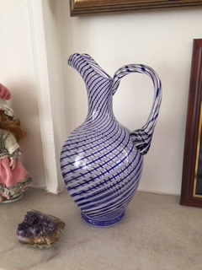
Çeşmi bülbül vase which made from colorful glass, Ankara, 2018

