Slide 1
American History Fall 2020
Dr. GAMZE KATI Gümüş

Slide 2
October 12, 1492
The arrival of Columbus at the Americas-Celebrated as the Columbus Day.
The Indigenous Peoples’ Day

Slide 3
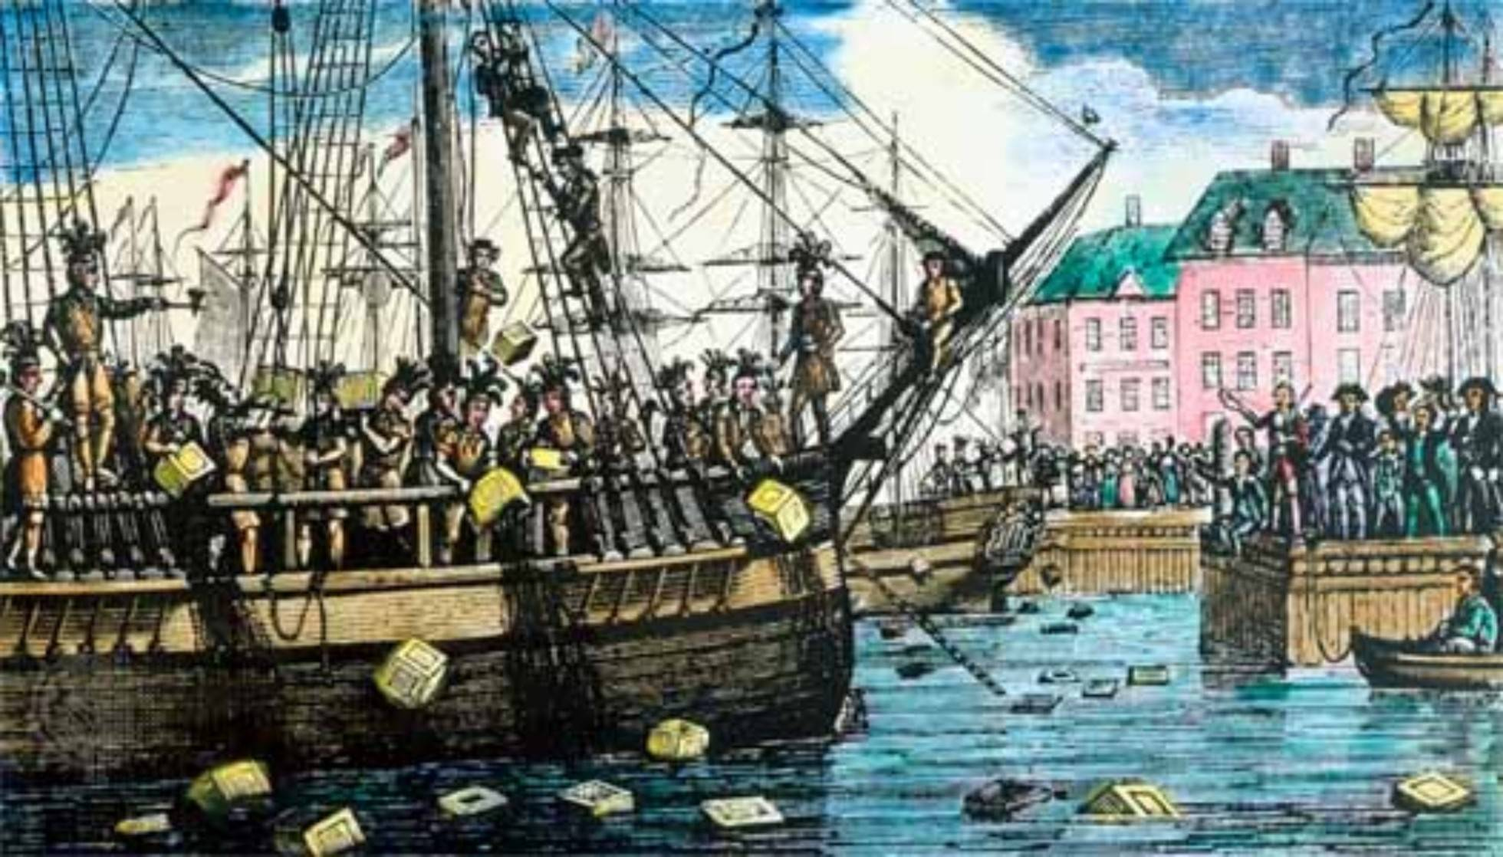
December 16, 1773
Boston Tea Party
The Sugar Act is passed (1764)
Stamp Act is passed (1765)
Duty on tea (1770)
The Boston Massace (1770)
Tea Act imposed (1773)

Slide 4
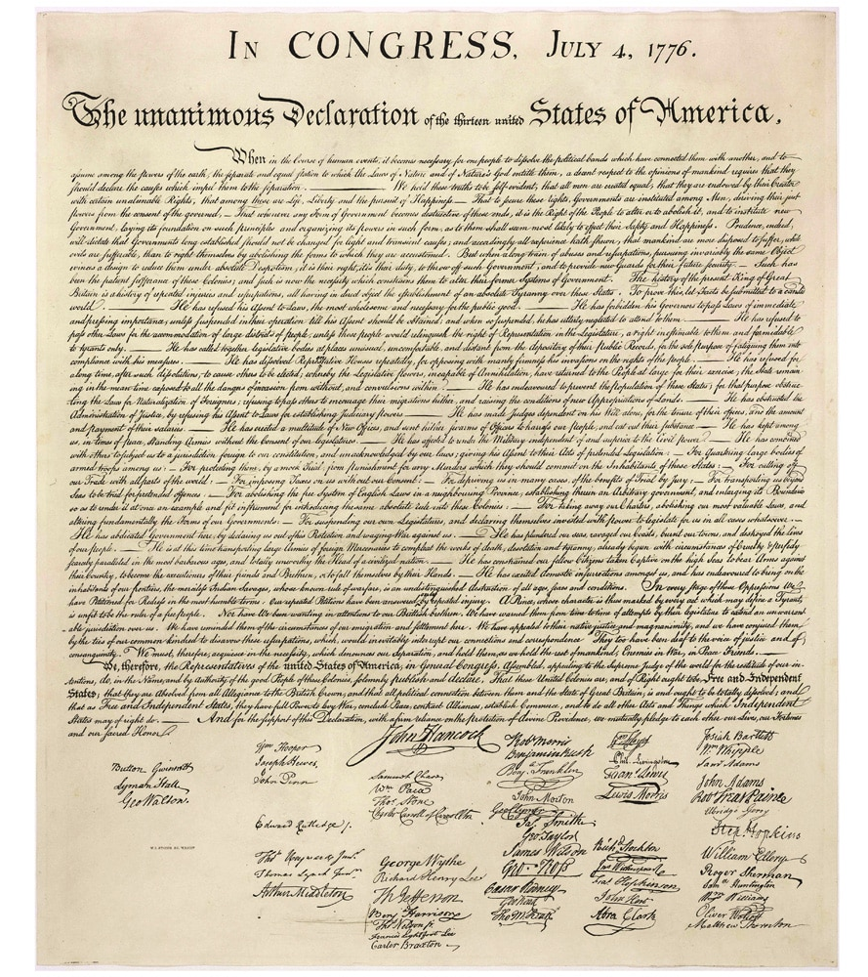
July 4, 1776
The Declaration of Independence

Slide 5
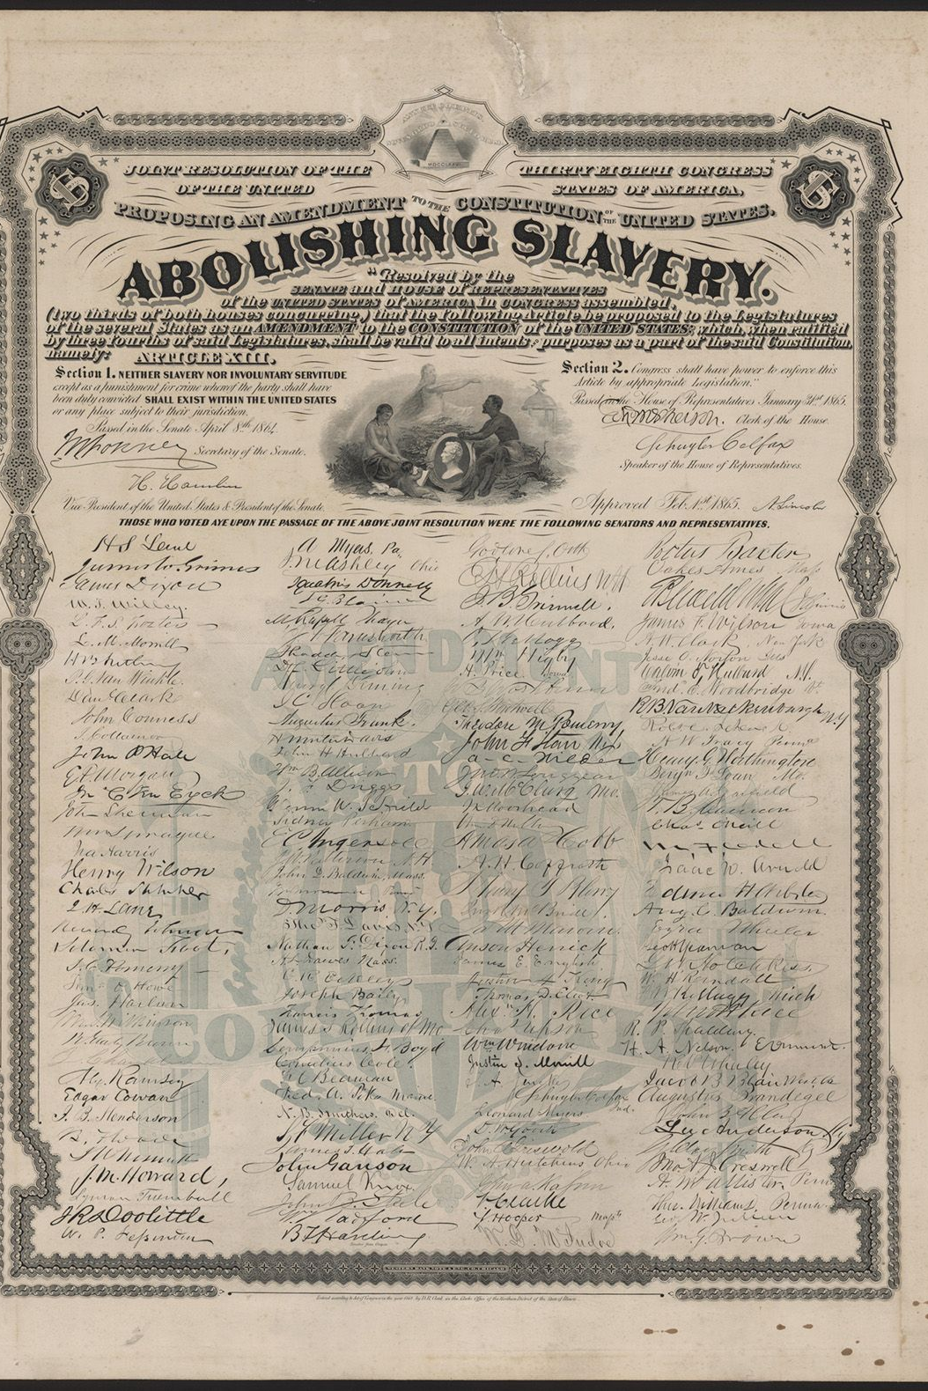
January 31, 1865
13th Amendment passed by the Congress
ratified on December 6, 1865
Abolishes slavery and involuntary servitude in the US. except as punishment

Slide 6
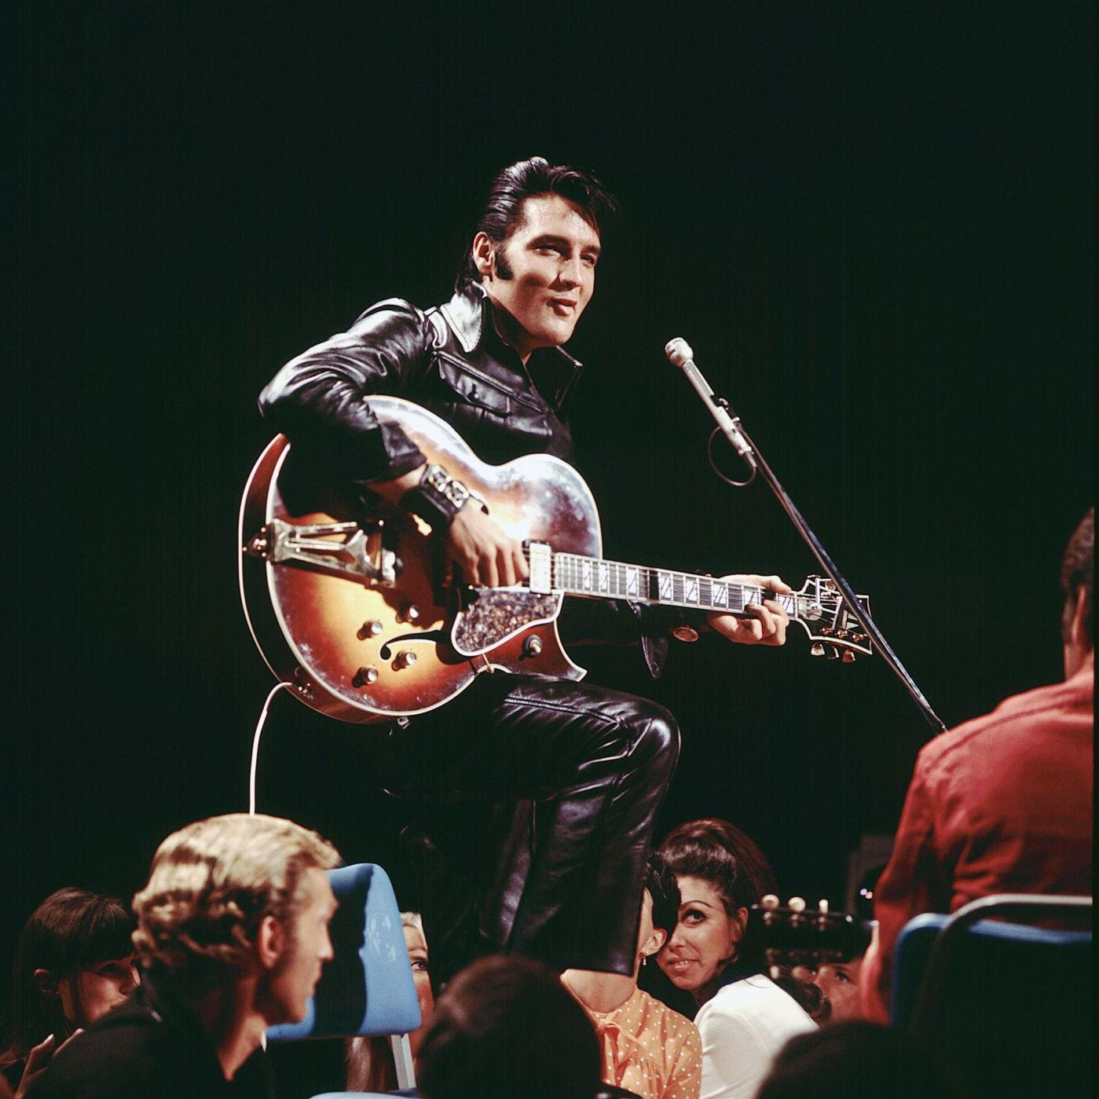
Well…

