Slide 1
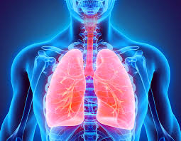
RESPIRATORY SYSTEM
Assoc. Prof. Dr. Yasemin SALGIRLI DEMİRBAŞ

Slide 2
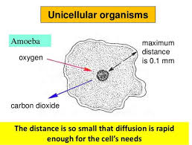
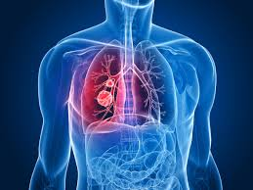
What is respiration?
(1) utilization of oxygen in the metabolism of organic molecules by cell -Cellular respiration
(2) the exchanges of oxygen and carbon dioxide between an organism and the external environment
A unicellular organism can exchange oxygen and carbon dioxide directly with the external environment,
The evolution of large animals required the development of specialized structures to exchange oxygen and carbon dioxide
In mammals, the respiratory system includes the lungs, the series of tubes leading to the lungs, and the chest structures responsible for moving air into and out of the lungs during breathing.

Slide 3
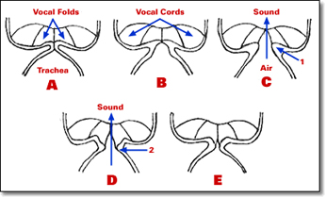
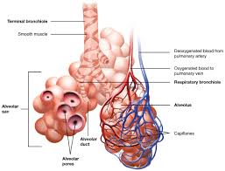
Functions of the Respiratory System
1. Provides oxygen.
2. Eliminates carbon dioxide.
3. Regulates the blood’s hydrogen-ion concentration (pH).
4. Forms speech sounds (phonation).
5. Defends against microbes.
6. Influences arterial concentrations of chemical messengers by removing some from pulmonary capillary blood and producing and adding others to this blood.
7. Traps and dissolves blood clots.

Slide 4
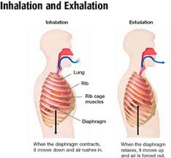
Organization of the Respiratory System
There are two lungs, the right and left, each divided into several lobes.
The lungs consist mainly of tiny air containing sacs called alveoli (singular, alveolus)
The airways are all the tubes through which air flows between the external environment and the alveoli.
Inspiration (inhalation) is the movement of air from the external environment through the airways into the alveoli during breathing.
Expiration (exhalation) is movement in the opposite direction.
An inspiration and an expiration constitute a respiratory cycle

Slide 5
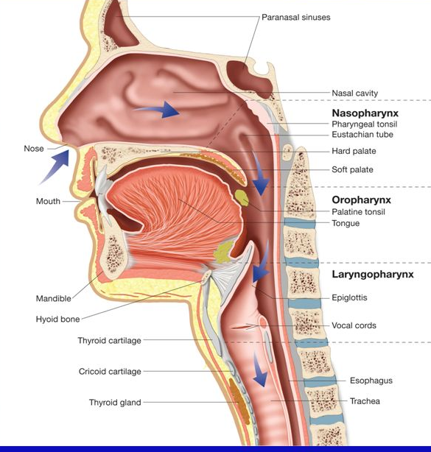
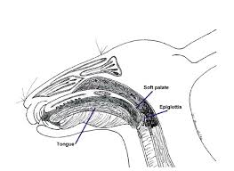
The Airways and Blood Vessels
During inspiration air passes through either the nose (the most common site) or mouth into the pharynx (throat).
Horses and rabbits are obligate nasal breathers.
The pharynx branches into two tubes, the esophagus and the larynx, which is part of the airways.
The larynx houses the vocal cords, two folds of elastic tissue stretched horizontally across its lumen.
The flow of air past the vocal cords causes them to vibrate, producing sounds.
The nose, mouth, pharynx, and larynx are termed the upper airways.

Slide 6
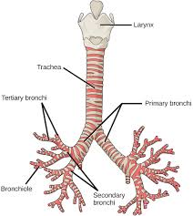
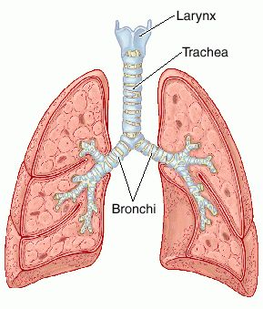
The Airways and Blood Vessels
The larynx opens into a long tube, the trachea, which in turn branches into two bronchi (singular, bronchus), one of which enters each lung.
Within the lungs, there are more than 20 generations of branchings, each resulting in narrower, shorter, and more numerous tubes.
The walls of the trachea and bronchi contain cartilage, which gives them their cylindrical shape and supports them.
The first airway branches that no longer contain cartilage are termed bronchioles

Slide 7
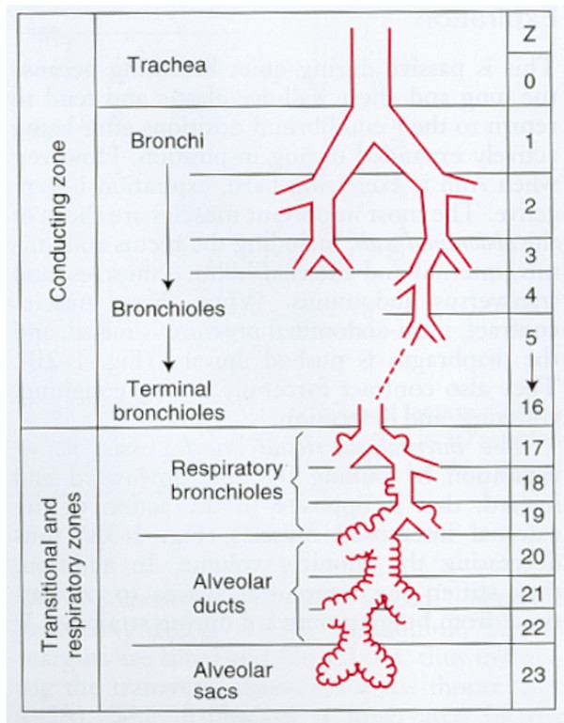
The Airways and Blood Vessels
Alveoli first begin to appear in respiratory bronchioles, attached to their walls.
The airways then end in grapelike clusters consisting entirely of alveoli.
The airways beyond the larynx can be divided into two zones:
(1) The conducting zone extends from the top of the trachea to the beginning of the respiratory bronchioles; it contains no alveoli and there is no gas exchange with the blood
(2) The respiratory zone, which extends from the respiratory bronchioles on down, contains alveoli and is the region where gases exchange with the blood.

Slide 9
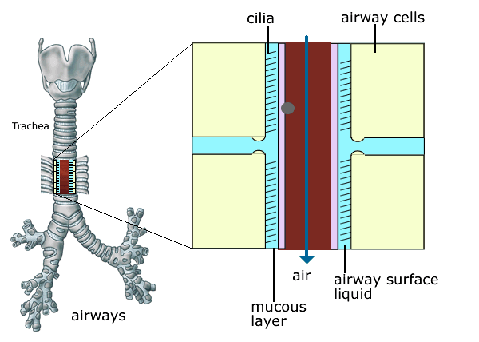
The Airways and Blood Vessels
The epithelial surfaces of the airways, to the end of the respiratory bronchioles, contain cilia that constantly beat toward the pharynx.
They also contain glands and individual epithelial cells that secrete mucus.
Particulate matter (dust) in the inspired air, sticks to the mucus, which is continuously and slowly moved by the cilia to the pharynx and then swallowed.
This mucus escalator is important in keeping the lungs clear of particulate matter and the many bacteria that enter the body on dust particles.
Ciliary activity can be inhibited by many noxious agents. For example: smoking

Slide 10
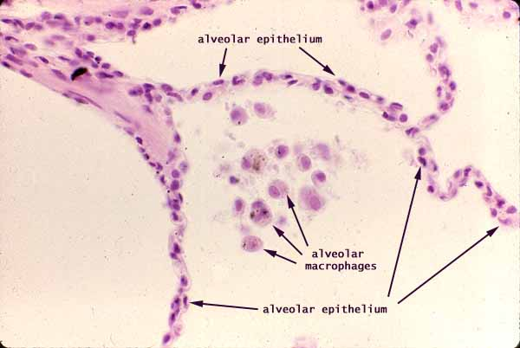
The Airways and Blood Vessels
The airway epithelium also secretes a watery fluid upon which the mucus can ride freely.
A second protective mechanism against infection is provided by cells that are present in the airways and alveoli and are termed macrophages.
These cells engulf inhaled particles and bacteria, rendering them harmless.
Macrophages, like cilia, are injured by cigarette smoke and air pollutants.

Slide 11
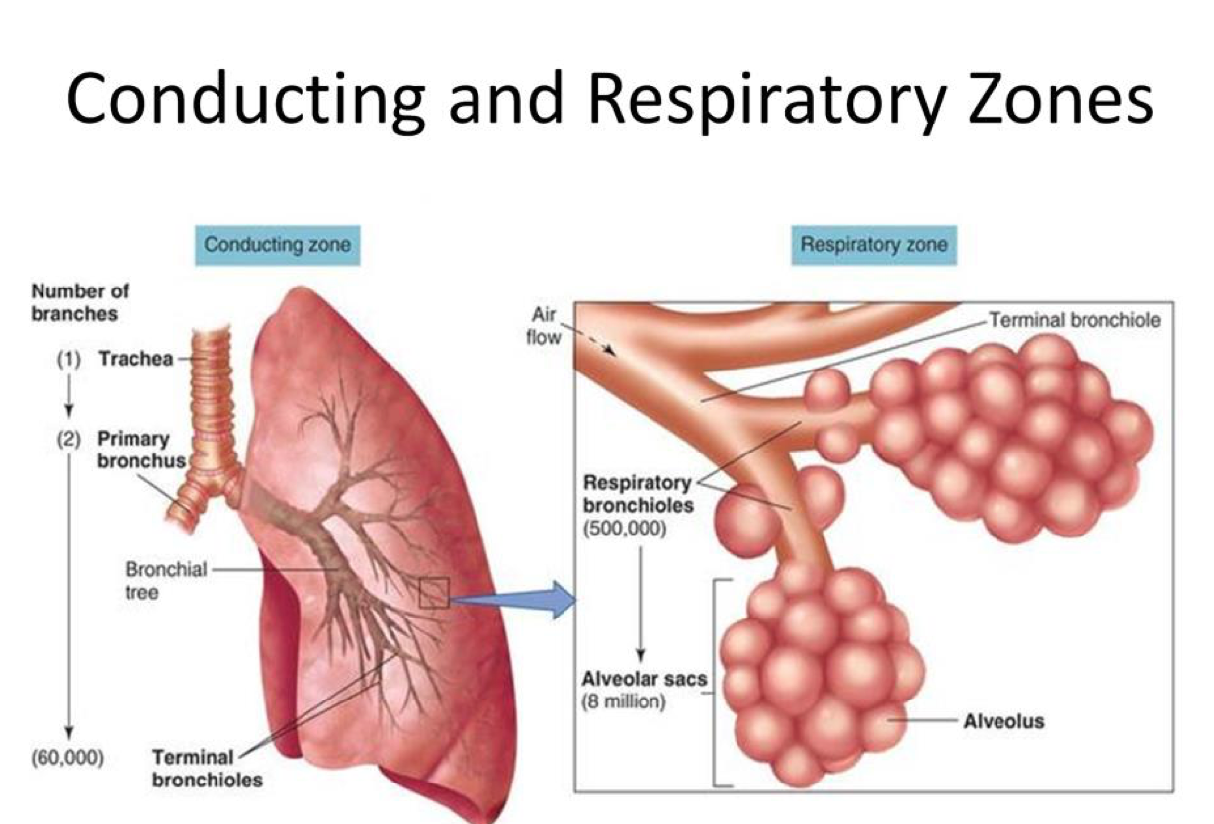
Functions of the Conducting Zone of the Airways
Provides a low-resistance pathway for air flow; resistance is physiologically regulated by changes in contraction of airway smooth muscle and by physical forces acting upon the airways.
Defends against microbes, toxic chemicals, and other foreign matter; cilia, mucus, and phagocytes perform this function.
Warms and moistens the air
Phonates (vocal cords).

Slide 12
Site of Gas Exchange: The Alveoli
The alveoli are tiny hollow sacs whose open ends are continuous with the lumens of the airways.
Typically, the air in two adjacent alveoli is separated by a single alveolar wall.
Most of the air-facing surface(s) of the wall are lined by a continuous layer, one cell thick, of flat epithelial cells termed type I alveolar cells.
Interspersed between these cells are thicker specialized cells termed type II alveolar cells that produce a detergent-like substance, surfactant.

Slide 13
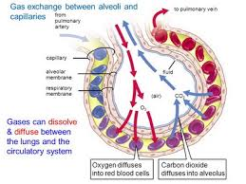
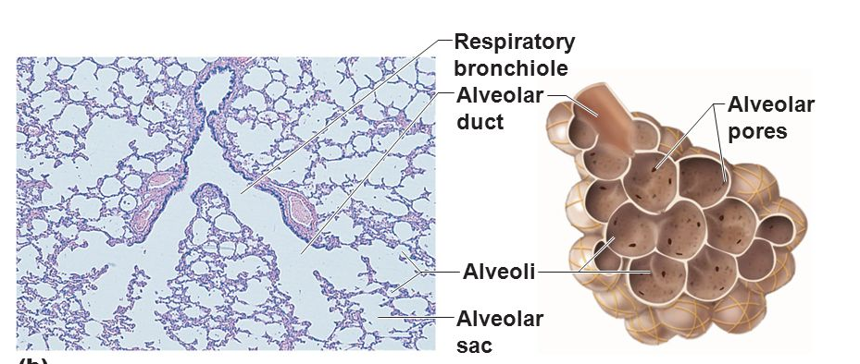
Site of Gas Exchange: The Alveoli
The alveolar walls contain capillaries and a very small interstitial space, which consists of interstitial fluid and a loose meshwork of connective tissue.
In many places the basement membranes of the alveolar-surface epithelium and the capillary-wall endothelium fuse.
The blood within an alveolar-wall capillary is separated from the air within the alveolus by an extremely thin barrier
The total surface area of alveoli in contact with capillaries is roughly the size of a tennis court.
This extensive area and the thinness of the barrier permit the rapid exchange of large quantities of oxygen and carbon dioxide by diffusion.
In some of the alveolar walls, there are pores that permit the flow of air between alveoli.

Slide 14
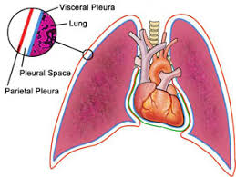
Relation of the Lungs to the Thoracic (Chest) Wall
The lungs, like the heart, are situated in the thorax, the compartment of the body between the neck and abdomen.
“Thorax” and “chest” are synonyms.
Each lung is surrounded by a completely closed sac, the pleural sac, consisting of a thin sheet of cells called pleura.
The two pleural sacs, one on each side of the midline, are completely separate from each other.

Slide 15
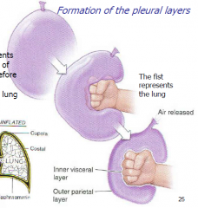
Relation of the Lungs to the Thoracic (Chest) Wall
The relationship between a lung and its pleural sac:
what happens when you push a fist into a balloon :
The arm represents the major bronchus leading to the lung, the fist is the lung, and the balloon is the pleural sac.
The fist becomes coated by one surface of the balloon.
The balloon is pushed back upon itself so that its opposite surfaces lie close together.
Unlike the hand and balloon, however, the pleural surface coating the lung (the visceral pleura) is firmly attached to the lung by connective tissue.
Similarly, the outer layer (the parietal pleura) is attached to and lines the interior thoracic wall and diaphragm.
The two layers of pleura in each sac are so close to each other that normally they are always in virtual contact, but they are not attached to each other.
Rather, they are separated by an extremely thin layer of intrapleural fluid, the total volume of which is only a few milliliters.

Slide 16
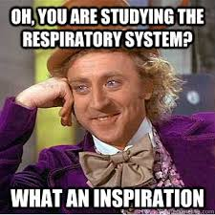
SUMMARY
What is respiration?
Functions of the Respiratory System
Organization of the Respiratory System
The Airways
The Alveoli

