Slide 1
Basic definitions in Electrochemistry
Charge
Coulomb force
Electric field
Electric potential
Electrode
Electrolyte
Electrolysis
Ohm Law
Coulometer
Charge,
In about the seventh century Thales proved that call amber attracted light objects like feathers and thread after it had been rubbed. At that times, It was observed that amber rods or glass rods repel each other after being rubbed, but an amber rod and a glass rod attract each other.
In about 1752, American Benjamin Franklin called electricity phenomenon labeled as positive and negative. He suggested that electricity flows into it to make it positive and negative.
French scientist Charles de Coulomb made studies about the force of attraction or repulsion between charged particles.
If two particles have the same charge, they repel each other (either positive or negative). If, the two particles have different charges, they attract each other.

Slide 2
Coulomb said that the magnitude of the interaction between any two particles is dependent on the distance between their. The force of attraction or repulsion, F, varies inversely with the square of the distance, r, between two charged particles
This equation is known as Coulomb’s law. The force between charged objects is proportional to the magnitude of q1 and q2 charges on the objects. where q1 and q2 are in units of C, r is in units of m
In order to get the correct unit of force, newtons, an additional expression is included in the denominator of the equation. The term ɛ₀ is the permittivity of free space. Its value is 8.854 10⁻¹² C²/(Jm)
ɛr, is dielectric constant as correction factor for electrical charges in some medium. Dielectric constants are unitless

Slide 3
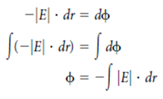
Electric field, E
The electrical field of a q1 charge interactied with another q2 charge is defined by the magnitude of the charge.
Electric potential, ɸ
Electric potential represents how much energy an electric particle can acquire as it moves through the electric field. The magnitude of the electric field IEI is the derivative with respect to position of some quantity called the electric potential, ɸ. We can rewrite this equation and integrate with respect to position r
This integral is solvable as a function of r

Slide 4
Ohm Law: deals with the relationship between voltage and current in an solid conductor. Metallic conductors were known to obey Ohm's Law, The potential difference (voltage) across an ideal conductor is proportional to the current through it.
Ohm's Law is given by:
V = I R
where V is the potential difference between two points which include a resistance R. I is the current flowing through the resistance or V (E or ɸ, namely electromotive force, emf (volt) it is known by this name in electrochemistry commonly.
Because of the electrostatic force, which tries to move a positive charge from a higher to a lower potential, there must be another 'force' to move charge from a lower potential to a higher inside the battery. This so-called force is called the electromotive force, or emf. The SI unit for the emf is a volt (and thus this is not really a force, despite its name).

Slide 5
Material that obeys Ohm's Law is called "ohmic" or "linear" because the potential difference across it varies linearly with the current.
The constant of proportionality is called the "resistance« (ohms), R, depends on the dimensions of the conductor.
Ohm's Law can be used to solve simple circuits. It contains at least one source of voltage and at least one potential drop.
An increase of potential energy in a circuit causes a charge to move from a lower to a higher potential.

Slide 6
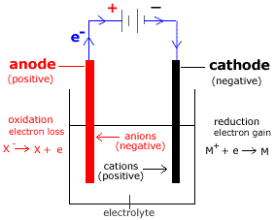
Electrode is a metal (conductors) whose surface serves as the location where oxidation-reduction equilibrium is established between the metal and what is in the solution.
Anode is the positive (+) electrode from which electrons leave the electrolyte (or the electric current enters the electrolyte)
Cathode is the negative (-) electrode from which electrons enter the electrolyte (or the electric current leaves the electrolyte)
Electrolyte: Electrolyte is a any chemical compound that ionizes (dissociates into ions) when molten or in dissolved into a solution. they undergo either a physical or a chemical change that yields ions in solution.
Example of an electrolyte is sodium chloride, any ionized compound, as of sodium, potassium, or calcium. Electrolytes can be solid, liquids, or solutions.

Slide 7
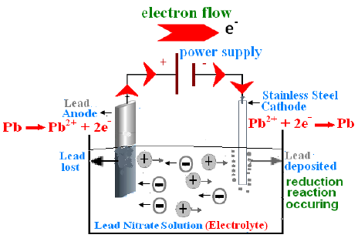
Electrolysis refers to the decomposition of a substance by an electric current. Main components of an electrolysis cell: Battery, Electrolytes, Electrodes
Direct current is passed through the compound (the compound can be in molten or aqueous state). Electrical energy is changed into chemical energy or the decomposition of the compound.
The metal and hydrogen always forms at the cathode.
Non-metal always forms at the anode.
Cations travel to the cathode.
Anions travel to the anode.
.

Slide 8
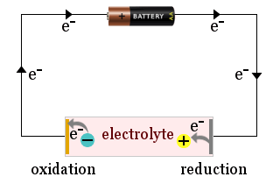
What happens during electrolysis?
Negative ions (Anions) are attracted to the anode while the positive ions (cations) are attracted to the cathode.
When the ions reaches their respective electrodes, they will be discharged. (They lose or gain electrons and form neutral atoms)
At anode, anions are discharged through loss of electrons; while at the cathode, cations are discharged through gain of electrons.

Slide 9
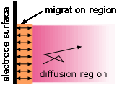
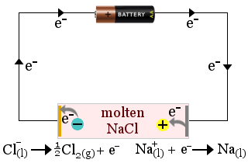
Ions are attracted to the oppositely-charged electrode." This is true only in the very thin interfacial region near the electrode surface. Ionic motion throughout the bulk of the solution occurs mostly by diffusion.
Migration— the motion of a charged particle due to an applied electric field.
Molten sodium chloride acts as an electrolyte in the production of sodium metal. Chlorine gas is also produced.
In this case, the electrolyte is consumed by the cell's redox reactions.
Electrolysis of molten alkali halides is the usual industrial method of preparing the alkali metals:
cathode: | Na+ + e– → Na(l) | E° = –2.71 v
anode: | Cl– → ½ Cl2(g) + e– | E° = –1.36 v
net: | Na+ + Cl– → Na(l) + ½ Cl2(g) | E° = –4.1 v

Slide 10
Electrolysis of water
Electrolysis is the process of using electricity to split water into hydrogen and oxygen.
cathode: | 2 H2O + 2 e– → H2(g) + 2 OH– 2H+ + 2e- → H2(g) | E° = –0.83 v
anode: | H2O → ½ O2(g) + 2 H+ + 2 e– (4OH- → O2(g) + 2H2O + 2e) | E° = –1.23 v
net: | 3 H2O(l) → H2(g) + ½ O2(g) | E = –2.06 v
The electrons flow through an external circuit and the hydrogen ions selectively move across to the cathode.
At the cathode, hydrogen ions combine with electrons from the external circuit to form hydrogen gas.

Slide 11
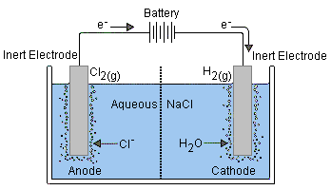
cathode: | 2 H2O + 2 e– → H2(g) + 2 OH– | E =+0.41 v ([OH–] = 10-7 M)
anode: | Cl– → ½ Cl2(g) + e– | E° = –1.36 v
net: | Cl– + H2O → 2 H2(g) + ½ Cl2(g) + 2 OH– | E = –0.95 v

