Slide 1
MECHANISIMS OF DEVELOPMENTAL BIOLOGY
Prof. Dr. Fulya Tekşen

Slide 2
The development of an human beıng FROM ZYGOTE TO an adult…. (DEVELOPMENT IN ANIMAL CELLS) GAIN THE FINAL SHAPE AND SIZE OF THE ORGANS requıres;
- Proliferation- Production of cells
- Cell- Cell interactions- Coordinate behaviour
- Differentiation- Cell specialization- Cells with different characreristics at different positions
- Migration-Cell movement –Rearrangement of cells to form TISSUES and ORGANS
of the cells

Slide 3
Fıgure 1 : Essentıal cell processes ın development

Slide 4
THESE PROCESSES ARE CONTROLLED BY;
GENES……..
Developmental processes are coordinated both with
GENETIC and ENVIRONMENTAL
factors

Slide 5
3 Classes of genes are especıally ımportant ın the development of multıcellular organısms;
1- Cell- cell Adhesıon and CELL SIGNALING Proteın codıng genes
Ex. Sıgnal proteıns, CELL SURFACE RECEPTORS, CELL ADHESION PROTEINS, ION CHANNELS
(n:100)
2- TRANSCRIPTION REGULATORS (n:1000)
DIFFERENTIAL GENE EXPRESSION
3- NON-CODING RNA
Ex.MiRNA N:500 IN HUMANS

Slide 6
The anatomıcal characrerıstıcs of anımals develop through conserved mechanısms
Animals have basic BODY PLANS.

Slide 7
BASIC BODY PLAN OF ANIMALS has 3 axes
A- Anteroposterior Axis (A-P)
mouth-brain (anterior)
|
anüs (posterior)
B- Dorsoventral Axis (D-V)
back (dorsal)
|
belly (ventral)
C- Left-Right Axis OR Animal- Vegetal (A-V)
Internal-External

Slide 8
FIGURE 2 : STAGES OF DEVELOPMENT

Slide 9
POLARIZATION;
is the first step of spatial patterning , in which the primary axes of the body becomes marked out.
Ex. VegT mRNA is localized at the vegetal pole in frog that codes VegT protein, activating a set of genes coding signal proteins that induce MESODERM and ENDODERM formation.
OR
Ex. mRNA coding Wnt11 protein which activates Wnt signal proteins that form the dorsoventral axis of the body.

Slide 10
Fıgure 3 : Development of frog egg

Slide 11
GENES CONTROLLING DEVELOPMENT
Even before FERTILIZATION, the OOCYTE, has EGG-POLARITY GENES that code mRNA or protein, that produce signals to the developing embryo after fertilization.
Such as;
BICOID genes which responsible for the ANTERIOR end of the embryo.
NANOS genes ……… Posterior System
TORSO genes ……..Terminal System
TOLL genes ….. Dorsoventral System
Finally, it is known that these genes coordinate the first part of the development.

Slide 12
SEGMENTATION
Occurs in the second step;
There are 3 groups of Segmentation Genes;
Gap Genes
Pair-rule Genes
Segment Polarity Genes
related with different segments of developing embryo.

Slide 13
Fıgure 4 : Examples of the phenotypes of mutations affecting egg-polarity genes and the three types of segmentatıon genes.

Slide 14
HOMEOTIC SELECTOR- or HOMEBOX gENES
In the last part of development, actually in parallel with the segmentation process these GENES define and preserve the differences between the segments permanently.

Slide 15
FIGURE 5 :The Hox complexes of an insect and a mammal, compared and related to body regıons.

Slide 16
FIGURE 6: An example of the regulatory hıerarchy of egg-polarıty, segmentatıon, and Hox genes.

Slide 17
FIGURE 7: Genes ın Drosophıla

Slide 18
FROM ZYGOTE TO ADULT
ZYGOTE
|
EMBRYO genome activated*
|
BLASTULA
|
GASTRULATION
|
MULTILAYERED STRUCTURE With internal gut

Slide 19
Each part of the body developes from certaın dıfferent layers;
Ectoderm → Epidermis, Nervous System
Endoderm → Gut tube, Lungs, Pancreas, Liver
Mesoderm → Muscles, Connective tissue, Blood, Kidney

Slide 20
Some of the Model organısms are crucıal ın understandıng development
EXPERIMENTAL MODELS
- Fruit fly (Drosofila melanogaster)
- Frog (Xenopus laevis)
- Roundworm (Caenorhabditis elegans)
- Zebrafish (Danio rerio)
- Mouse (Mus musculus)

Slide 21
Systems of the body has, theır own developmental pattern
Differentiation – Synchronized Development
- Tissue interactions
Proliferation
Migration of cells and cell colonies
Programmed cell death

Slide 22
EMBRYONIC DEVELOPMENT IS;
- Growth → Mitosis and Production of extracellular matrix
- Increasing Complexity → Morphogenesis and Differentiation
OF STRUCTURE AND FUNCTION

Slide 23
The cells of the Embryo are plurıpotentıal
Therefore, the formation of new tissues are determined by several factors;
one of them being ;
INDUCTION (The interactions that lead to a change in the course of development of at least one of the interactants).
In other words; a group of cells starts with the same developmental potential and later, a signal generally coming from a a neighbouring cell induces one or more members of the group to change their character.
In the molecular mechanism of induction; the signal transmission between the tissues are important.

Slide 24
The sıgnalıng Pathways take part ın ınductıon are;
Transforming Growth Factor Beta
Wnt
Hedgehog
Notch
Receptor Tyrosine Kinase
They have been shown since 25 years and thought to be highly conserved.

Slide 25
fıgure 8 : INDUCTION

Slide 26
Fıgure 9 : ınductıve sıgnalıng

Slide 27
Fıgure 10 : formatıon of the eye

Slide 28
From Sımple cells to complex PATTERNS
3 Kinds of Mechanisms are responsible;
1- GENE DUBLICATION- Homolog Genes
Ex. Notch Signaling Notch 1 ---- Tissue A
Notch 4 ----- Tissue B

Slide 29
2- COMBINATORIAL SIGNALING
The response of a cell to a given signal protein depends on the other signals that the cell is receiving concurrently.
Different Combination of Signals
↓
A Great Variety of RESPONSES

Slide 30
3- CELL MEMORY
Previous experiences of the responding cell results in different
RESPONSES to the same SIGNAL.

Slide 31
FIGURE 11 : MECHANISMS THAT RESPOND DIFFERENTLY TO THE SAME SIGNAL

Slide 32
IN ORDER TO GAIN THE FINAL SHAPE AND SIZE OF THE ORGANS
These processes, use key developmental molecules forming;
SIGNALING PATHWAYS

Slide 33
SIGNALING PATHWAYS
1- Morphogenes
2- Notch/Delta
3- Transcription factors
4- Receptor tyrosine kinases (RTKs)

Slide 34
1- Morphogenes
These signals indicate the type of the cell that will be specified at a special location and direct the migration of the cells to that location, therefore determine the morphology and function of the tissue.

Slide 35
How do these sıgnal molecules act ?
The morphogenes found in the embryo move to dorsal/ventral, anterior/posterior and medial/lateral axis parts by concentration gradients.
The receptors located on the surface of the cells can attract or repel MORPHOGENES.
The working system of the MORPHOGEN is as follows;
A specialized group of cells produce a MORPHOGEN, and this morphogene is then degraded as it diffuses from the SOURCE.
The speed of diffusion and the half life of the MORPHOGEN together the range and steepness of its resulting gradient.

Slide 36
How can dıfferent cell types From a sıngle cell occur ?
There are some mechanisms that take place in forming different cell types;
LATERAL INHIBITION: A cell signals to its neighbours not to follow the same fate and differentiate in a different way.
THE CONCENTRATION OF THE SIGNAL MOLECULE: according to the amount of the signal molecule, as being, High, Intermediate and Low, quite dfferent developmental pathways occur.
Ex. High ---- Pathway A , Intermediate ------ Pathway B, Low… Pathway C

Slide 37
WHICH molecules are morphogenes ?
A- Retinoic acid
B- Transforming Growth Factor Beta (TGF-β)/Bone Morphogenetic Proteins (BMPs)
C- Hedgehog and Wnt protein families

Slide 38
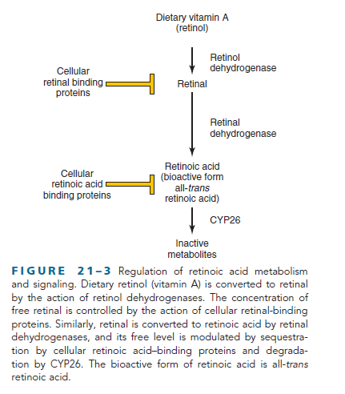
A- RETINOIC ACId
Retinoic acid is the bioactive form of Vitamin A.
Fıgure 12: RETINOIC ACID

Slide 39
FUNCTION
Retinoic acid’s function is posteriorize the body.
Therefore, Retinoic acid’s excessive and deficient amounts result in the body axis development abnormalities.
The targets of retinoic acids receptors in development, are Hox genes.

Slide 40
B- Transformıng Growth Factors-βeta FAMILY
- TGF-β
- BMP
- Activin
- Nodal

Slide 41
Functıon of these Proteıns are;
- To establish the dorsoventral patterning
- Cell fate desicions
- Formation of specific organs (Nervous system, Kidneys, Skeleton)

Slide 42
In humans, there are 3 ısoforms of Transformıng growth factor TGF- βeta
TGF-β 1
TGF-β 2
TGF-β 3
Binding of these factors to heterotetrameric complexes to specific receptors starts the intracellular signaling events.
In this pathway,
TGF-β works with another group of intersellular proteins, namely SMAD proteins.
-

Slide 43
SMAD PROTEINS
- Receptor activated (R- Smads)
1-3,5,8
- Common - partner (co-Smads)
Smad-4
Inhibitory (I-Smads)
Smad6, Smad7

Slide 44
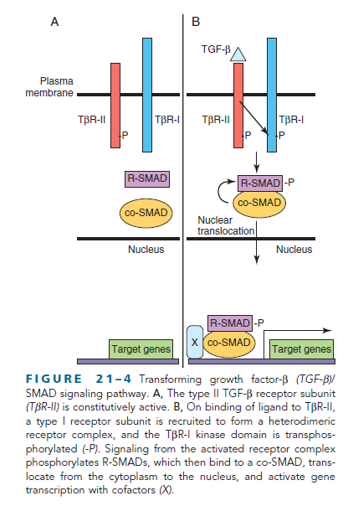
FIGURE 13: TRANSFORMING GROWTH FACTOR Βeta/Smad Sıgnalıng pathway

Slide 45
Fınally,
Various kinds of these ligand-receptor combinations lead to particular developmental and cell spesific-processes.

Slide 46
C- HEDGEHOG
The Hedgehog Morphogenes are also critical in;
- Early patterning
- Cell migration
- Differentiation
of cell types and organ systems in the early development of human beings.

Slide 47
Hedgehogs
- Sonic Hedgehog (Shh)
- Desert Hedgehog
- Indian Hedgehog

Slide 48
FIGURE 14: Sonıc hedgehog/Patched sıgnalıng pathway

Slide 49
Role of SHH (SONIC HEDGEHOG)
Patterning the ventral neural tube.
So, It’s secretion is highest at the mesoderm derived notochord and the concentration level plays active role in the formation of ventral interneuron classes and motor neurons.

Slide 50
Shh and PTCH mutatıons;
PTCH (Patched) is a transmembrane protein that takes place in the transcriptional activation of critical genes.
Mutations of SHH and PTC HAVE BEEN REPORTED TO BE ASSOCIATED WITH;
Holoprosencephaly (Fusion of two cerebral hemispheres)
Anophthalmia or Cyclopia
Dorsalization of forebrain structures

Slide 51
Wnt/ βeta- Catenın pathway
Wnt- secreted glycoproteins are vertebrate orthologs of the Drosophila
gene Wingless.
19 Wnt proteins take place in the development by;
Establishment of cell polarity
Proliferation
Apoptosis
Cell fate specification
Migration

Slide 52
FIGURE 15: Wnt/Beta catenın Sıgnalıng Pathway

Slide 53
2- NOTCH/DELTA pathway
Notch Signaling Pathway determines the fate of the cells that is important in organ development such as;
- Maintenance of stem-cell niches
- Proliferation
- Apostosis
- Differentiation

Slide 54
Fıgure 16: Notch /delta sıgnalıng pathway

Slide 55
3- TRANSCRIPTION FACTORS
These factors regulate the expression of many target genes either by activation or repression depending on;
- The cell in which they are expressed
- The spesific promotor
- Chromatin context
- Developmental stage

Slide 56
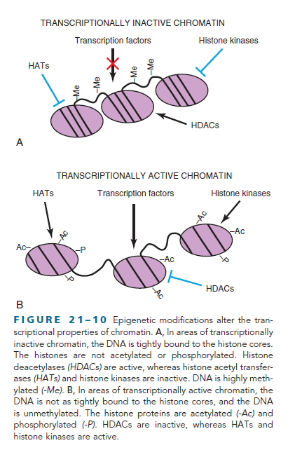
FOR EXAMPLE;
Fig. 17: Transcription factors may regulate their target genes by modifications such as acetylation, phosphorylation of HISTON proteins.

Slide 57
Transcrıptıon factors are;
- HOX/HOMEBOX PROTEINS
They are evolutunary highly conserved genes with 180 base sequence.
Defects in HOXA1 is related with human neural development.
Mutations in HOXA13 and HOXD 13 results in limb malformations.
- PAX GENES
Has been shown to be related with eye and hear formation.
- BASIC HELIX-LOOP-HELIX Transcription factors
These factors regulate cell fate determination and differentiation in tissues such as muscles and nerves during development.

Slide 58
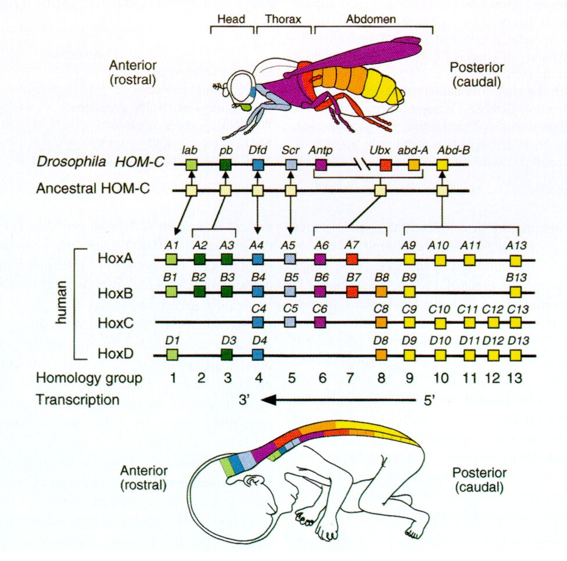
Fıgure 18: HOMEBOX genes

Slide 59
4- receptor tyrosıne kınases
These receptors are critical as; GROWTH FACTORS such as; insülin, epidermal growth factor, nerve growth factor, neurotrphins and members of the platelet-derived growth factor family belong to this group.

Slide 60
FıGURE 19: Receptor tyrosıne kınase sıgnalıng

Slide 61
IN SUMMARY
_ Inductor- Morphogen
(Concentration)
_ Cell- Cell interactions
(Mediated by Signal Pathways at diiferent times)
_ Asymetric Cell Division
_ Regulators of Transcription and Chromatin Structure binding to DNA and activating related GENES at specific times and places
are IMPORTANT points in developing from ZYGOTE to ADULT……

Slide 62
fıgUre 20 : AsymetrIc cell dIvIsIon

Slide 63
References
Bruce Alberts, Alexander Johnson, Julian Lewis, David Morgan, Martin Raff, Keith Roberts, Peter Walter-Molecular Biology of the Cell-Garland Science (2015).
Keith L. Moore, T.V.N. Persaud, The Developing Human, 8th Edt. (2008).

