Slide 1
19th Century British Fiction I
Introductıon

Slide 2
THE READING LIST
FRANKENSTEIN by Mary Shelley
JANE EYRE by Charlotte Brontë
WUTHERING HEIGHTS by Emily Brontë

Slide 3
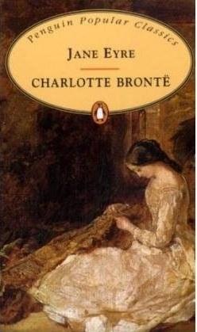
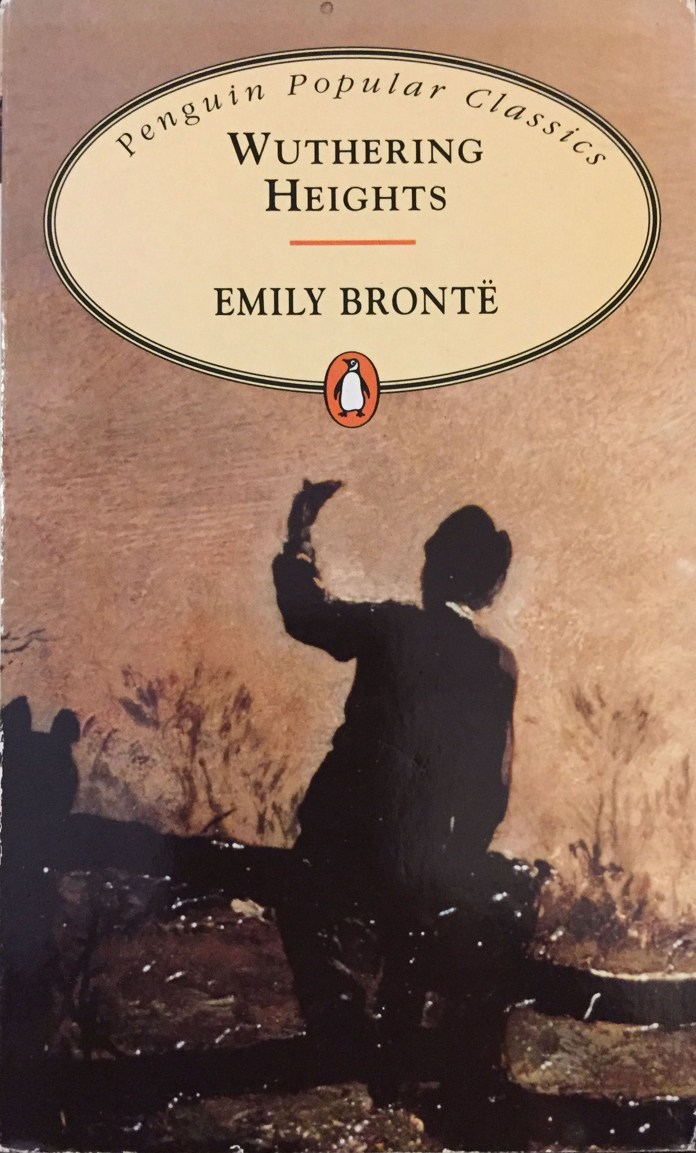
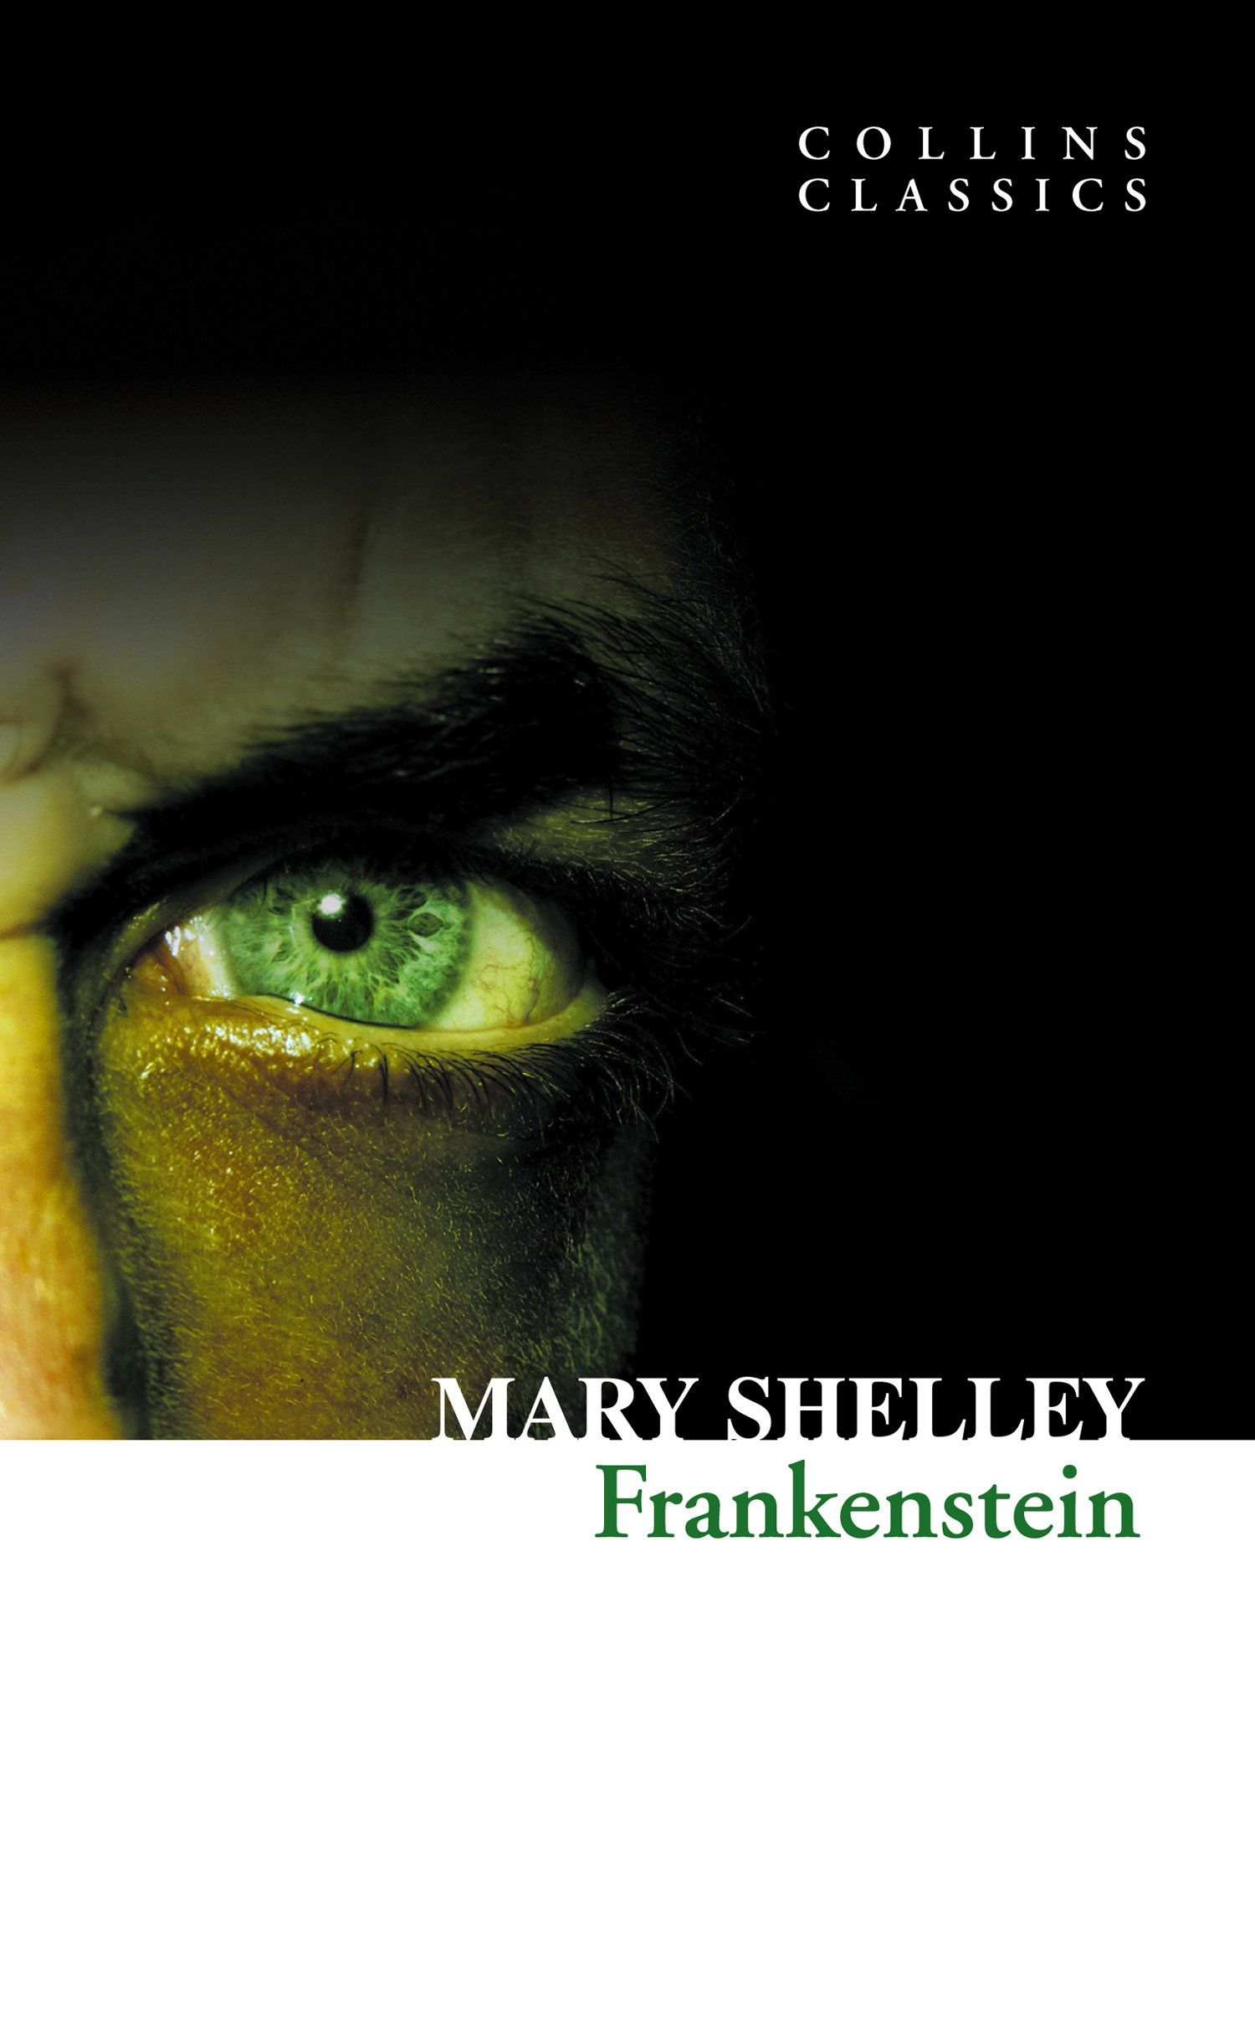

Slide 4
The 19th Century
The aftermath of the Industrial Revolution
A period of social and historical change
Rapid changes due to industrialisation
Decline of the aristocracy
Decline of agriculture
Rise of the middle class

Slide 5
The Middle Class
The link between aristocracy and lower classes
Merchants, financers and manufacturers formed the upper middle class.
They were the dominant force who made money by commerce and industry.
Aristocrats’ social power continued longer than their political and financial power.
The shift in social dynamics led to intermarriages.

Slide 6
Fiction in the 19th Century (1800-1850)
Dominated by the novel
Traditions of romance and Romanticism
Influence of the Gothic
Romance and gothic as sub-genres
Religious and social morality
Conformity to conventions
Virtue rewarded, vice punished
Reading public largely consisting of females, but everyone was reading

Slide 7
Other Novelists
Jane Austen
Charles Dickens
William M. Thackeray
George Eliot
Elizabeth Gaskell
Thomas Hardy
Anthony Trollope
Oscar Wilde
William Morris
Samuel Butler
George Meredith
Wilkie Collins
George Gissing
Henry James
Benjamin Disraeli

Slide 8
Women
Consumers = the majority of the reading public
Producers = half the writing population
Subject matter = woman’s sphere, domestic and family-oriented plots
Gave voice to women on an equal footing with men
on the other hand
Moral education of the young was a priority
Fallen woman should be punished (or the writer would be punished by the critics)
Some authors satirized the angelic depiction of women (Thackeray)

Slide 9
Publications
Three volume novels = three deckers
Circulating libraries (because the working class couldn’t afford them)
Monthly serials
cliff-hangers
vivid, memorable characters
melodramatic plots
adjusting according to readers’ response

Slide 10
Gothic
Dark romanticism
Attempts to to disturb or unsettle the orderly, civilized course of society
Deals with the dark side of humanity or unveils socio-cultural anxiety
Deals with the uncertainties and contradictions of the psyche
Tales of mystery and horror
Interiors are linked with danger; threats come from within the house, within the family and within the self
Plunges its characters into mystery, torment and fear in order to pose disturbing questions to our familiar and comfortable ideas of humanity, society and the cosmos

