Slide 1
EEE322 COMMUNICATION THEORY – I
ANKARA UNIVERSITY
FACULTY OF ENGINEERING
ELECTRICAL AND ELECTRONICS ENGINEERING DEPARTMENT

Slide 2
EEE322 COMMUNICATION THEORY - I
LECTURE 2
LINE SPECTRA AND FOURIER SERIES

Slide 3
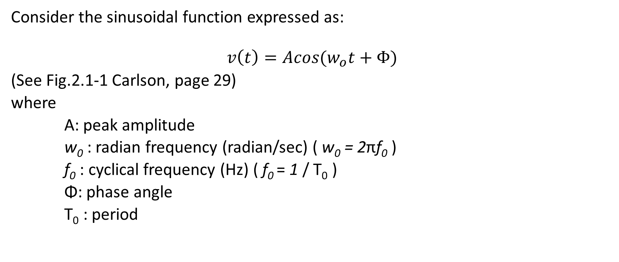
Phasors and line spectra
Consider the sinusoidal function expressed as:
$$v\left(t\right)=Acos(w_{o}t+Φ)$$
(See Fig.2.1-1 Carlson, page 29)
where
A: peak amplitude
w₀ : radian frequency (radian/sec) ( w₀ = 2πf₀ )
f₀ : cyclical frequency (Hz) ( f₀ = 1 / T₀ )
Φ: phase angle
T₀ : period

Slide 4
(a) Phasor diagram (b) Line spectrum (Fig.2.1-2 Carlson, page 30)
Phasor diagram helps us to transfer a sinusoidal signal from time domain to frequency domain.
From Euler’s theorem;
$$e^{±jϴ}=cosϴ±sinϴ$$
then;

Slide 5
An example to line spectrum (one-sided) (Fig.2.1-3 Carlson, page 32)
Given the signal:
We can rewrite:

Slide 6
Two-sided line spectrum and the concept of negative frequency
Using the Euler’s theorem again, we can also express a sinusoidal signal by complex conjugate phasors:
The corresponding phasor diagram and line spectrum are shown in Fig. 2.1–4, Carlson, page 32.

Slide 7
An example to line spectrum (two-sided) (Fig.2.1-5 Carlson, page 33)
Given the signal:
It can be expressed in terms of complex conjugate phasors to obtain two-sided line spectra.

Slide 8
Amplitude Spectrum and Phase Spectrum
In either version, be it one-sided or two-sided line spectra, the amplitude spectrum conveys more information than the phase spectrum. Both parts are required to define the time-domain function, but the amplitude spectrum by itself tells us what frequencies are present and in what proportion (Carlson, page 33).

Slide 9
References
Communication Systems, An Introduction to Signal and Noise in Electrical Communication, 5th edition, A.B. Carlson, P.B. Crilly, J.C. Rutledge, Mc Graw Hill.
An Introduction to Analog and Digital Communications, 2nd edition, S. Haykin, M. Moher, Wiley.

