Slide 1
Mesleki Yabancı Dil 2

Slide 2
Method
4. In a large frying pan over a medium-low heat, fry the onion and garlic in a little oil until softened. Turn up the heat and add the mushrooms and butter, sautéing until the mushrooms are golden brown, then dish up (tabağa koymak, servis etmek)
5. Add a little oil to the pan and fry the beef for 2 minutes, turning, until browned but still pink inside. Stir in the mushroom-onion mixture, add the brandy and reduce for 1 minute or until almost disappeared.
6. Remove from the heat and stir in the cream and parsley. Delicious serve with bread and gherkins (kornişon).

Slide 3
Meat
Beef: the flesh of a cow, bull, or ox, used as food.
"there was the smell of roast beef"
Mutton: the flesh of fully grown sheep used as food.
"a leg of mutton"
Veal: the flesh of a young calf, used as food.
"veal and ham pie"

Slide 4
Meat
Lamb: a young sheep
Venison: meat from a deer.
"venison steaks"
Pork, pork meat
Steak: Biftekhigh-quality beef taken from the hindquarters of the animal, typically cut into thick slices that are cooked by grilling or frying.

Slide 5
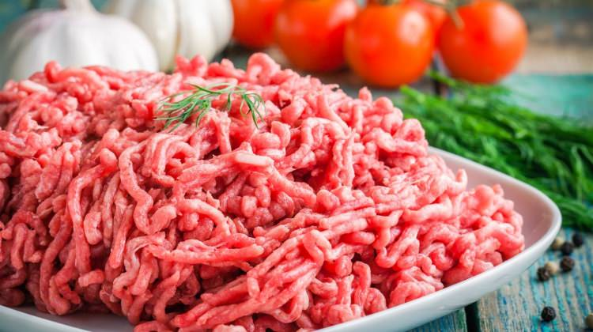
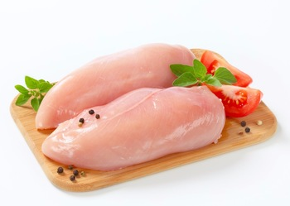
Mince: Kıyma (noun)/ Kıymak (verb)
(verb) cut up (food, especially meat) into very small pieces, typically in a machine.
minced beef/minced meat
‘’…. stir in the mince and fry until browned"
Fillet: Fileto/Kemiksiz Et
Bacon: Pastırma
Giblets/Offal: Sakatat
Kidney: Böbrek
Liver: Karaciğer
Lung: Akciğer

Slide 6
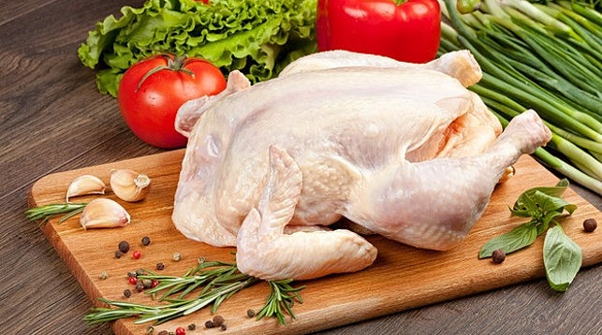
Poultry
Chicken
Chicken Saute / Sauted Chicken
Turkey
Thanksgiving Turkey
Duck
Duck L’Orange
Goose
Foie Gras / Goose Liver

Slide 7
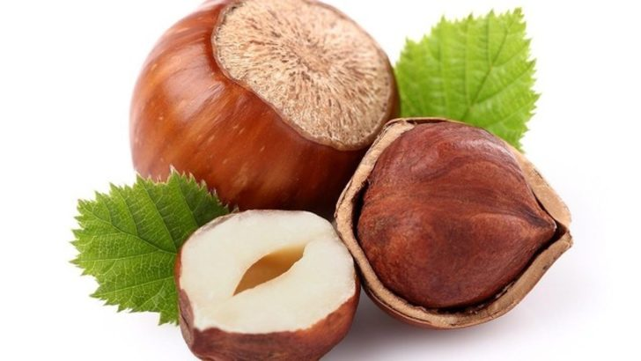
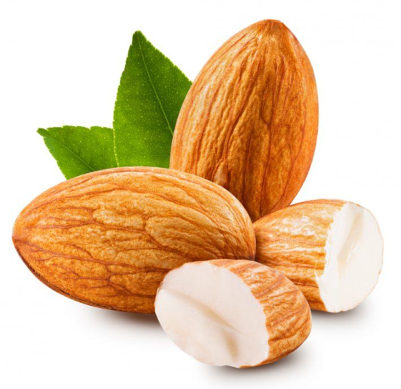
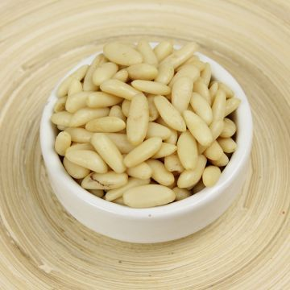
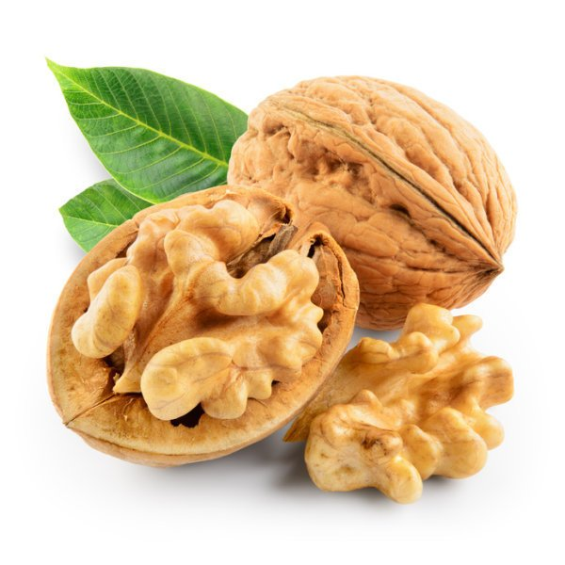
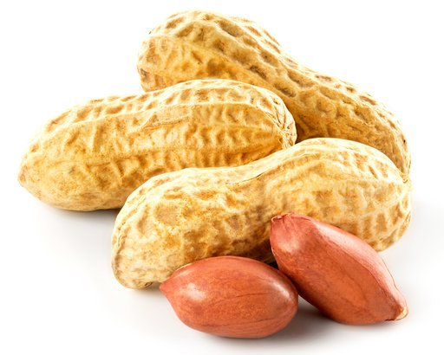
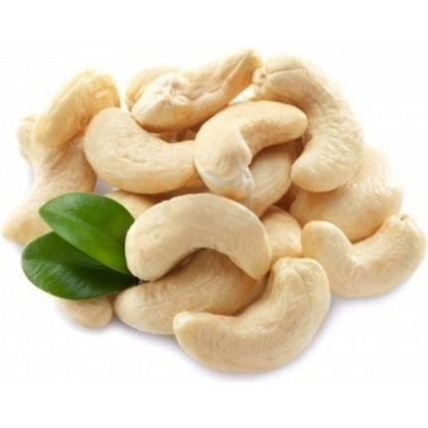
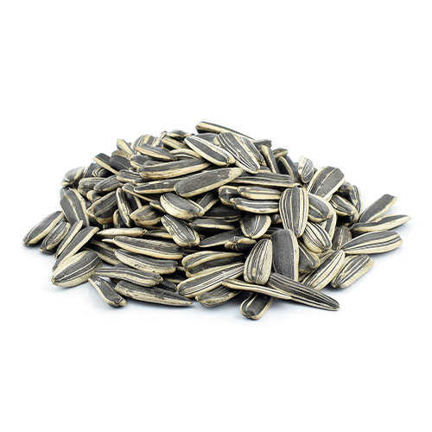
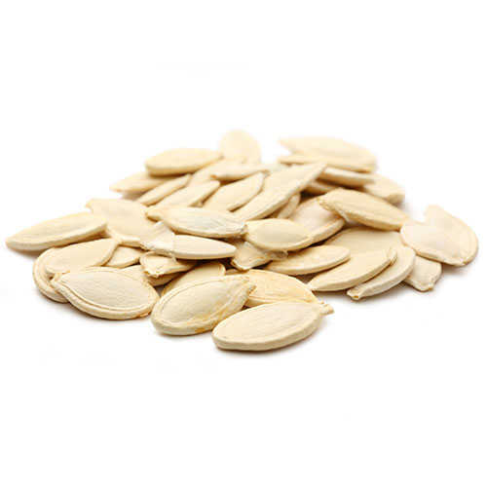
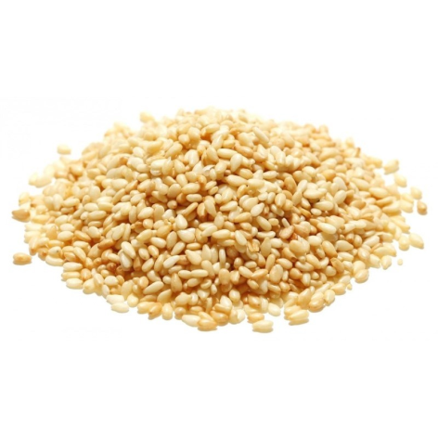
Nuts and Seeds
Almond: Badem
Pine nuts: Çamfıstığı
Walnut: Ceviz
Hazelnut: Fındık
Cashew: Kaju
Peanut: Fıstık
Pumpkin seeds: Kabak Çekirdeği
Sesame: Susam
Sunflower seeds: Ay Çekirdeği

Slide 8
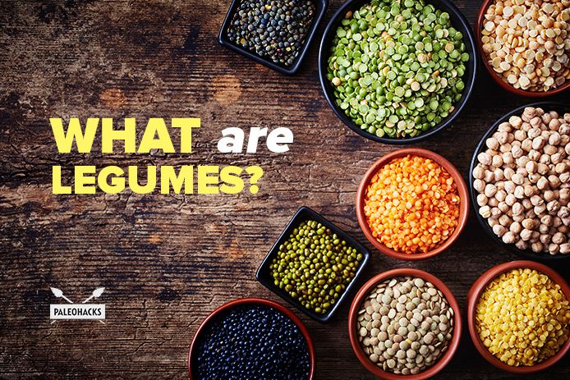
Legumes/Beans
a seed, pod, or other edible part of a leguminous plant, used as food.
"the new diet is high in fruit, vegetables, and legumes"
Dried Beans
Green Lentil
Red Lentil
Chickpea/Garbanzo
Garbanzo is the main ingredient of hummus and falafel.
Pea Meal

