Slide 1
Induced Pluripotent Stem Cells
Dr. Açelya Yilmazer

Slide 2
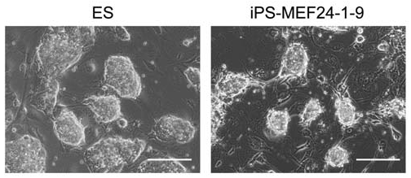
2006, Yamanaka: “introduction of a small set of transcription factors into a differentiated cell was sufficient to revert the cell to a pluripotent state”
Oct3/4
Sox2
Klf4
cMyc
Takahashi &Yamanaka 2006

Slide 3
What do iPS cells offer?
iPS Cells
Somatic Cells
Patient
Neurons
Cardiomyocytes
Hepatocytes
Regenerative medicine
Disease modelling
Drug-screening
www.nobelprize.org

Slide 4
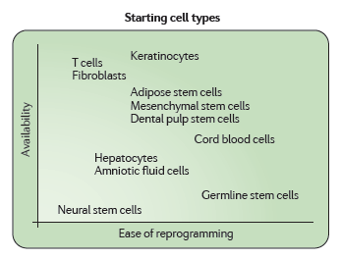
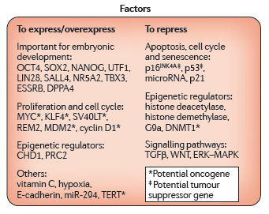
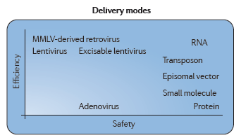
The Reprograming Menu
Gonzalez et al., 2011

Slide 5
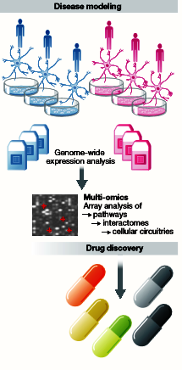
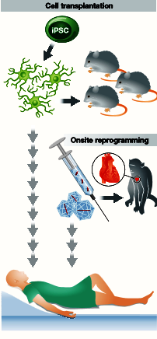
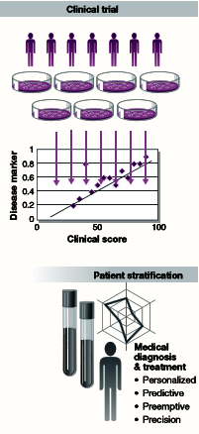
iPS Cell Technology
Inoue et al.2014, THE EMBO JURNAL

Slide 6
Limitations
Main obstacles for clinical translation of reprogrammed somatic cells to a pluripotent state by the forced expression of specific transcription factors are:
the limited efficiency of reprogramming methodologies
long-term culture conditions
the safety of induced pluripotent stem (iPS) cells that may lead to spontaneous formation of teratomas on implantation

