Slide 1
PACKAGING TECHNOLOGIES
Instructor
Assist. Prof. Dr. Eda Demirok Soncu
E-mail: edemirok@eng.ankara.edu.tr
Phone: +90312 203 3300 (3639 ext.)
Office: 2nd floor #212
Fde 228 food packagıng

Slide 2
Different packaging technologies
Different packaging technologies used in the food industry can be classified in one of six groups
Aerobic packaging
Vacuum packaging
Modified atmosphere packaging
Active packaging
Intelligent (smart) packaging
Edible packaging

Slide 3
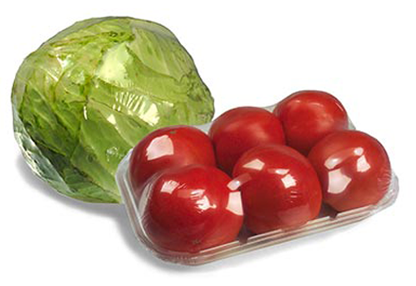
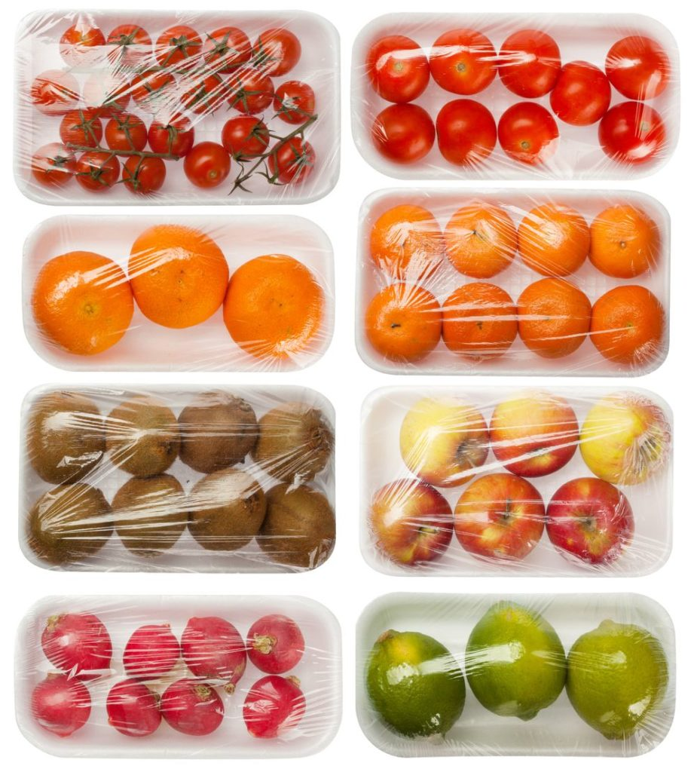
AEROBIC PACKAGING

Slide 4
Aerobic packaging
Aerobic packaging, in other words shrink wrap packaging, is defined as wrapping and shrinkage of PVC (polyvinyl chloride) or PVDC (polyvinylidene chloride) films around the food on PP/EVOH/PE trays or PS (polystyrene) foam
The meaning of aerobic is “the presence of oxygen”
It is used for fresh meat cuts, ground meat, fresh fruits and vegetables

Slide 5
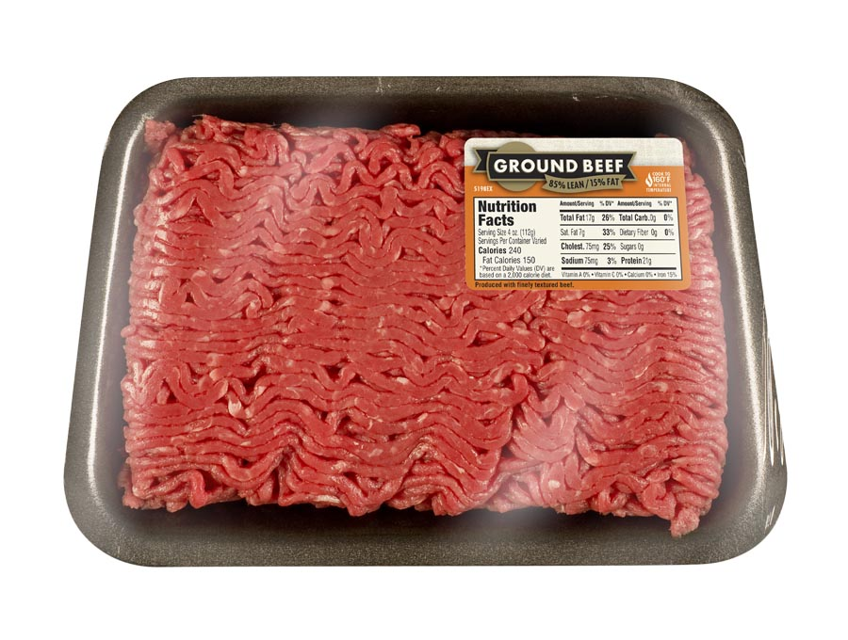
Aerobic packaging
PVC (polyvinyl chloride) or PVDC (polyvinylidene chloride) films around the ground meat on PP/EVOH/PE trays
PVC (polyvinyl chloride) or PVDC (polyvinylidene chloride) films around the ground meat on PS (polystyrene) foam
PP/EVOH/PE: polypropylene + ethylene vinyl alcohol + polyethylene

Slide 6
Aerobic packaging
Advantages
It protects the food from contamination
It reduces mechanical damage
It improves the product appearance
It provides oxymyoglobin formation in raw meats, which results in desirable red color
It provide good surface for stick-on labels

Slide 7
Different color forms of raw meat
Myoglobin, oxymyoglobin and methmyoglobin are the color pigments of raw meat
Oxidation
Oxidation

Slide 8
Aerobic packaging
Disadvantages
The wrapping films used in aerobic packaging have holes, pores or perforations; therefore they are convenient for oxygen permeability
Microbial spoilage can occur due to the growth of aerobic microorganisms
For especially meats
Lipids and proteins oxidize in the presence of oxygen
Off-odor and off-taste formation
Color change from red (oxymyoglobin) to brown (methmyoglobin)
For especially fruits and vegetables
Tissue softening and brown color formation due to enzymatic reactions

Slide 9
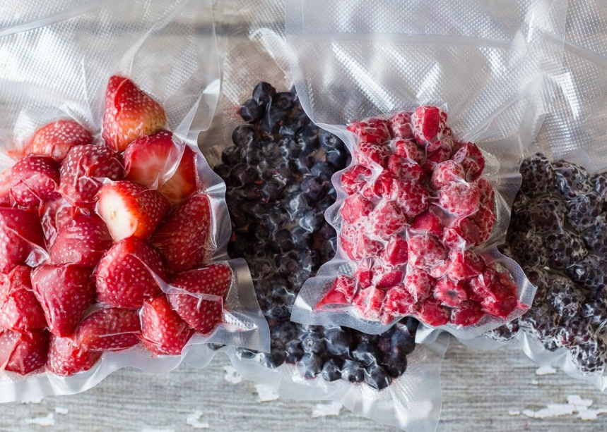
VACUUM PACKAGING

Slide 10
Vacuum packaging
It is described as removal of ambient air (oxygen) from the pouches or vacuum skin packages and sealing the package while the vacuum state is maintained
The packaging material should have low gas/oxygen permeability
It is used for fresh or cooked meats, meat products, fruits and vegetables

Slide 11
Vacuum packaging
Advantages
Vacuum state produces anaerobic (oxygen-free) environment
Additionally, packaging material which has low oxygen transmission rate is usually used
Thus, oxidative and enzymatic reactions are minimized
Growth of aerobic microorganisms are inhibited
Color of a food product is preserved

Slide 12
Vacuum packaging
Disadvantages
Microbial spoilage due to the growth of anaerobic microorganisms can occur
Drip loss can be seen at prolonged storage time

Slide 13
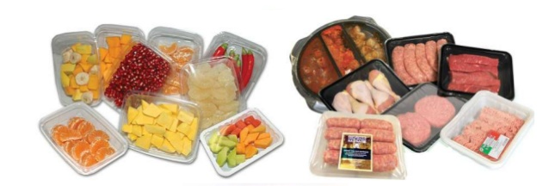
MODIFIED ATMOSPHERE PACKAGING

Slide 14
Modified atmosphere packaging (MAP)
The main objective of MAP is to extend shelf life by preserving sensory properties and by limiting physical, enzymatic, biochemical and microbial degradation
After vacuum treatment is applied, gaseous environment with a blend of O₂, N₂ and CO₂ gases is injected into package and the package is sealed with lidding films
It is used for fresh or cooked meats, meat products, fruits and vegetables

Slide 15
Functions of gases in MAP
Nitrogen is primarily used to replace oxygen in the package to reduce the oxidation of pigments, aromas and fats. It is an inert, odorless gas and is poorly soluble in water or fats, thus preventing shrinkage in the package

Slide 16
Functions of gases in MAP
Carbon dioxide is a bacteriostatic and fungistatic agent that can delay growth of especially molds and aerobic bacteria
Bacteriostatic means inhibition of bacteria growth
Fungistatic means inhibition of fungi growth
The inhibitory effect of CO₂ increases as the temperature decrease due to its improved solubility in the aqueous phase of the product; therefore, MAP products should be refrigerated
Due to its solubility in water and fats, it can sometimes cause shrinkage of the packaging film in long times

Slide 17
Functions of gases in MAP
Oxygen is usually the gas that is being replaced
However, it is included in gas mixtures in some applications
Especially in the case of red meat, where the color can only be preserved by oxygen (for oxymyoglobin formation)
In the case of fish and seafood, to avoid the growth of anaerobic pathogens such as Clostridium
Furthermore, it is essential for plant respiration
At high oxygen concentrations, oxidation in lipids and proteins is disadvantage of oxygen in MAP

Slide 18
 | Aerobic (shrink wrap) packaging | Vacuum packaging | Modified atmosfer packaging
Definition | Wrapping and shrinkage of foods placed on trays or foam plates | Removal of oxygen from the packages and sealing while the vacuum state is maintained | Replacement of gaseous enviroment with a blend of O₂, N₂ and CO₂ gases and sealing the package
Area of usage | Fresh meat cuts and ground meats | Fresh or cooked meats and meat products | Fresh or cooked meats and meat products
Advantages | Protection from contamination Improvement in product appearance Oxymyoglobin formation | Mitigation of oxidative and enzymatic reactions Inhibition of aerobic m.o. growth Meat color is preserved | O₂ is used to enhance meat color N₂ is used as a filler gas CO₂ is used for the inhibition of microbial growth
Disadvantages | Lipid oxidation Protein oxidation Conversion of oxymyoglobin to methmyoglobin Microbial spoilage | Growth of anaerobic microorganisms | Oxidation in lipids and proteins at high oxygen concentrations

Slide 19
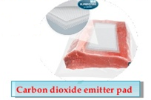
ACTIVE PACKAGING

Slide 20
Active packaging
Active packaging is defined as a system in which the package, packaging environment and the product interact positively in order to
improve product safety and quality
extend the shelf life
It is basically desribed as incorporation of active compounds into packaging material or package environment (headspace) with the aim of maintaning product quality and extending product shelf life
Active packaging is defined with two words
Protection & Preservation

Slide 21
Mechanism of active packaging
Two different mechanisms play an important role for active packaging
Scavenging, or in other words trapping, of some undesirable compounds, which are released from food into the headspace, by package
Releasing of active desirable compounds from package onto the food

Slide 22
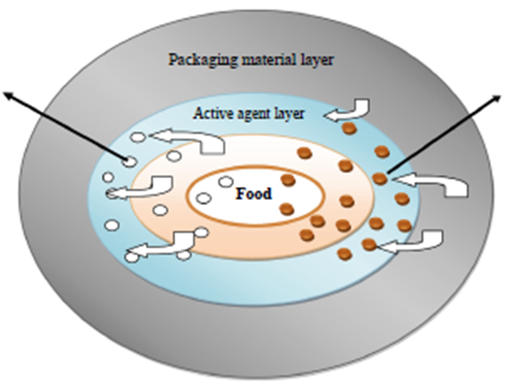
Mechanism of active packaging
Active scavenging system
CO₂
O₂
Moisture
Odor
Ethylene
Active releasing system
CO₂
Antimicrobial agent
Antioxidant
Ethylene
Flavors
Preservatives

Slide 23
Different types of active packaging
Antimicrobial packaging is designed to delay microbial growth
Antioxidant packaging: Natural and synthetic antioxidants are used to retard or prevent oxidative reactions and microbial growth
Oxygen scavengers are used to absorb the environmental oxygen
CO₂ emitters release CO₂ to inhibit aerobic bacteria and fungi growth
CO₂ absorbers are used to remove CO₂ produced by food due to respiration

Slide 24
Different types of active packaging
Moisture regulators are absorbed exudates released from the fresh meats, fruits and vegetables to prevent microbial spoilage and to improve product appearance
Flavor releasers are used to release the desired flavor compound, which is specific for each food product, to preserve its characteristic flavor
Flavor absorbers are used to scavenge undesirable flavors

Slide 25
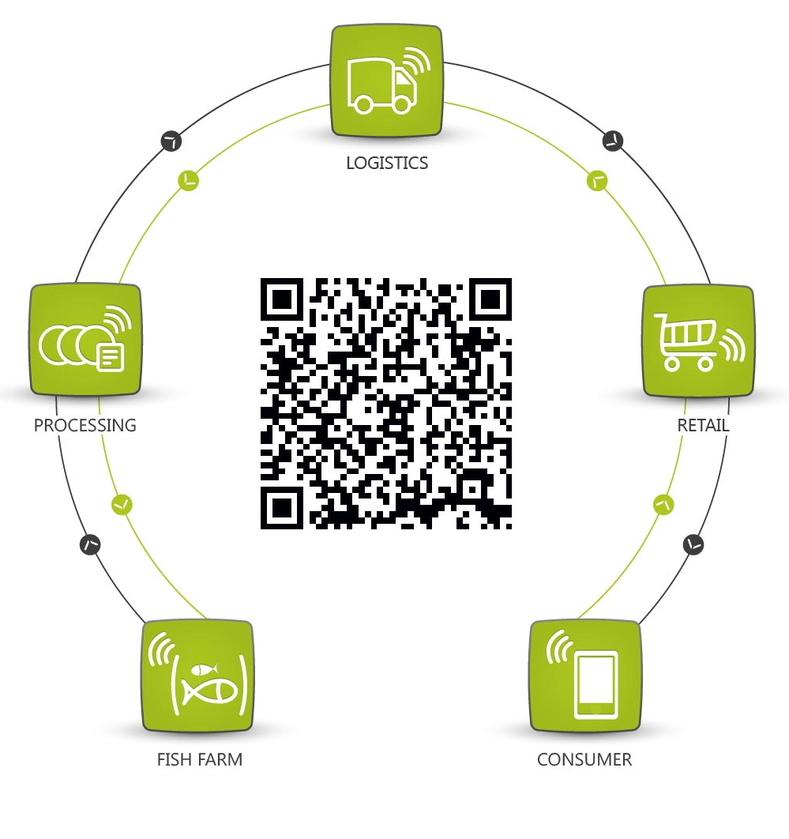
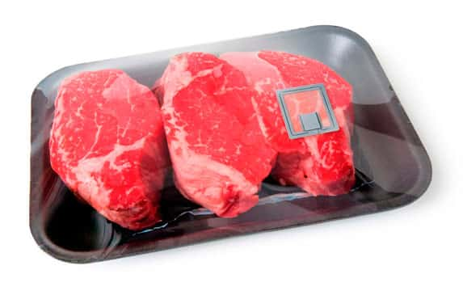
INTELLIGENT (SMART) PACKAGING

Slide 26
Intelligent (smart) packaging
It is basically defined as «a package, which is able to track the product, sense the internal/external changes which occurs in environment of the package, and communicate with the consumer»
Intelligent packaging, or in other words smart packaging, simply defined with three words
track&sense&communicate
Notes:
Since the more powerfull and affordable information tehnology has an important place in our life, the development of the intelligent packaging technology gains speed in recent years.

Slide 27
Different types of smart packaging
Barcodes
Radio frequency identification tags
Smart devices used in smart packaging
Time-temperature indicators
Gas & Pathogen indicators
Freshness indicators

Slide 28
 | BARCODES | QR CODES |  | RFID TAGS
Compatibility | They are used with smart devices which are enabled to read barcodes, QR codes and RFID tags
Information | Packaging date Batch/lot number Package weight Nutritional information Cooking instructions Address of producer |  | Composition and calorie value Health analysis E-coded additives Allergens
Positioning | Positioning with smart devices in front of a barcode or QR code is required |  |  | RFID tags can connect with phones meters away

Slide 29
Different types of smart packaging
Time-temperature indicators warn consumer if there is an undesirable temperature change occurs during transportation or storage of a food product
Gas indicators are activated in the case of CO₂, water vapor, ethanol, hydrogen sulfide formation, which are an indicator of spoilage
Pathogen indicators warn consumer in the presence of pathogen bacteria
Freshness indicators detect the compounds (such as CO₂, ammonia, ethanol, organic acids, biogenic amines, sulphuric compounds which are indicators for deterioration) formed as a result of microbial growth or chemical reactions

Slide 30
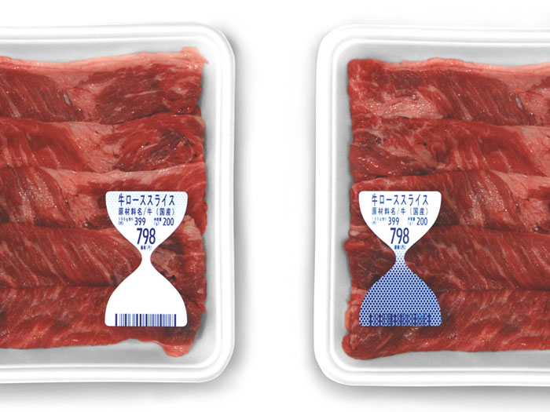
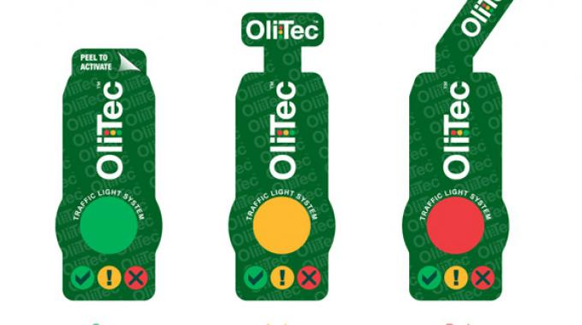
Working principles of indicators
The indicators work based on the color change mechanism when a danger is detected
Freshness indicator for ammonia (a compound formed as a result of protein degradation)
Time-temperature indicator

Slide 31
The difference between active and intelligent packaging
Active packaging causes a modification of the conditions of the packed food to extend shelf life, maintaining the quality of final product
Intelligent packaging system monitors the condition of packaged foods by devices to give information about the quality of products during transportation and storage

Slide 32
EDIBLE PACKAGING

Slide 33
Edible packaging
A definition for edible films and coatings is that they are a primary packaging made from edible materials
Edible packaging is applied in two different ways
It is possible to apply a thin layer of edible packaging directly onto the food by immersion, spraying, and coating. This is called as edible coating
After the edible material is previously formed into a film, then it is used as a food wrap. This is called as edible film

Slide 34
Natural polymers for edible packaging
Natural biopolymers used for the production of edible packaging are grouped in one of three groups
Polysaccharide-based polymers
Lipid-based polymers
Protein-based polymers

Slide 35
Polysaccharide-based polymers
Polysaccharides, such as pectin, alginate, carragenan, gum xantan, gum arabic, cellulose and starch, have been used in recent years as biopolymer compounds
Polysaccharide-based polymers have some advantages such as;
They are non-toxic
They are widely available compounds in nature
They have selective permeability to oxygen and carbon dioxide
Polysaccharide solely packages have the disadvantage of low water permeability

Slide 36
Lipid- and protein-based polymers
Monoglycerides, diglycerides, triglycerides, waxes, cerebrosides, phosphatide, phospholipids, terpenes, fatty acids, fatty alcohol and essential oils are lipid-based biopolymers used to produce edible packaging
Lipid-based polymers minimize moisture loss, provide gloss, reduce complexity, and cost of packaging
Collagen, zein, soybean, gluten proteins, and milk proteins are mostly used protein-based biopolymers for edible packaging

Slide 37
Functions of edible packaging
The edible packagings are carriers of antimicrobial substances, antioxidants, dyes, and vitamins, thus improving the sensory properties of food products
Edible packaging increases shelf life of foods due to the presence of antimicrobials (by inhibiting microbial growth) and antioxidants (by preventing oxidative reactions)

Slide 38
A common example for edible packaging application
Fruits and vegetables are greatly perishable during the postharvest management; there are considerable losses due to microorganisms, insects, respiration, and transpiration
To overcome this problem and to increase their shelf life (for especially during transportation between countries), edible coating with waxes is applied to increase the natural barrier properties of fruit and vegetables
This edible coating is safely eaten as a part of the product and it is environment-friendly

Slide 39
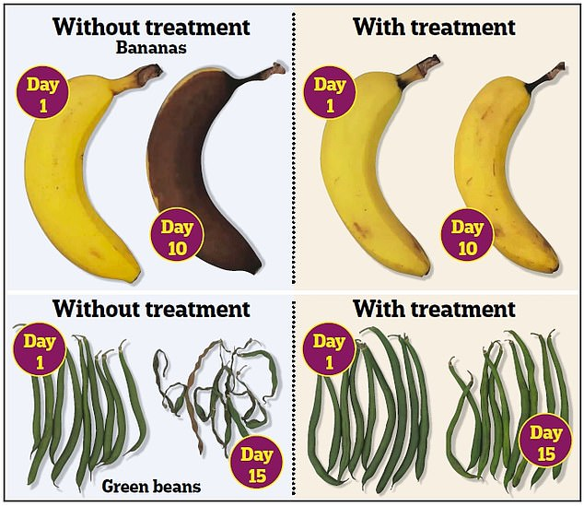

Slide 40
References
Grumezescu, A.M. & Holban, A.M. 2018. Basic and applied concepts of edible packaging for foods (Chapter 1 pages 1-21) in Food Packaging and Preservation (Handbook of Food Bioengineering, volume 9). Academic Press, Elsevier.
McMillin, K.W. 2017. Advancements in meat packaging. Meat Science, 132, 153-162.
Ahmed, I. et al. 2017. A comprehensive review on the application of active packaging technologies to muscle foods. Food Control, 82, 163-178.
Fang, Z. et al. 2017. Active and intelligent packaging in meat industry. Trends in Food Science & Technology, 61, 60-71.
O’Sullivan, M. and Kerry, J.P. 2010. Meat Packaging (chapter 13) In: Handbook of Meat Processing (Ed: Toldrá, F.), Wiley-Blackwell Publishing.
Mullan, M. and McDowell D. 2003. Modified atmosphere packaging (chapter 10) In: Food Packaging Technology (Ed: Coles, R., McDowell D., Kirwan, M.J), Blackwell publishing.
Campbell-Platt, G. (2009). Food Science and Technology. Chapter 11: Food packaging. Pages 279-298. Blackwell Publishing.
Singh, R.P. and Heldman D.R. (2009) Introduction to food engineering. Chapter 15: Packaging concepts (4th ed.) Academic Press, California, USA.

