Slide 1
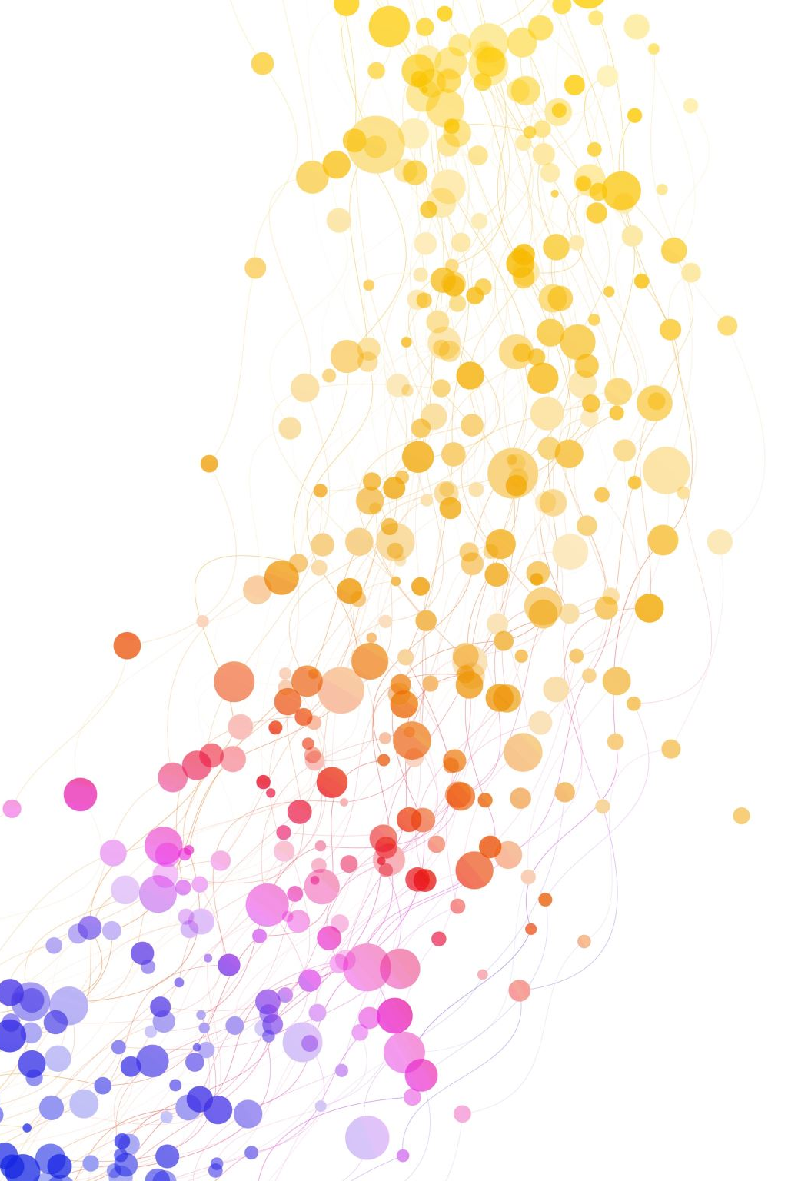
TEXTUAL ANALYSIS: DRAMA
Dr. Gamze Katı Gümüş
AKE 114/ING 118/DING 118

Slide 2
GUIDELINES FOR READING A PLAY
What does this play, scene or passage mean?
How does the play unfold?
How do the elements of drama-plot, characterization, setting, dialogue, music, movement, theme- contribute to the overall meaning and effect of the play?

Slide 3
In order to make a good analysis of a play...
Read the opening stage directions carefully
Read the opening scene slowly, referring back to the cast of characters if you become confused about who is who
Note places in the action where conflicts develop most intensely
Consider what the characters may represent, if they ever do. Examine their relationships with one another
Consider what the speech of characters reveals about them
Notice the visual details of the play and try staging parts of the play in your mind
Consider whether the play is a tragedy, comedy, tragicomedy, farce or melodrama
Consider the play’s mood or tone
Try to some up your sense of the play’s central ideas

Slide 4
Terminology
Drama: a literary form
Drama/ The Drama: terms that cover all writing of drama, or a large number of plays.
e.g. Shakespearean drama, the drama of the 17th century, European drama
A drama: a play which is intensely exciting or moving.
Dramatic:
related to drama
using mimics, different tones and gestures
sad
The theatre: a building in which a play is performed
Theatre: drama

Slide 5
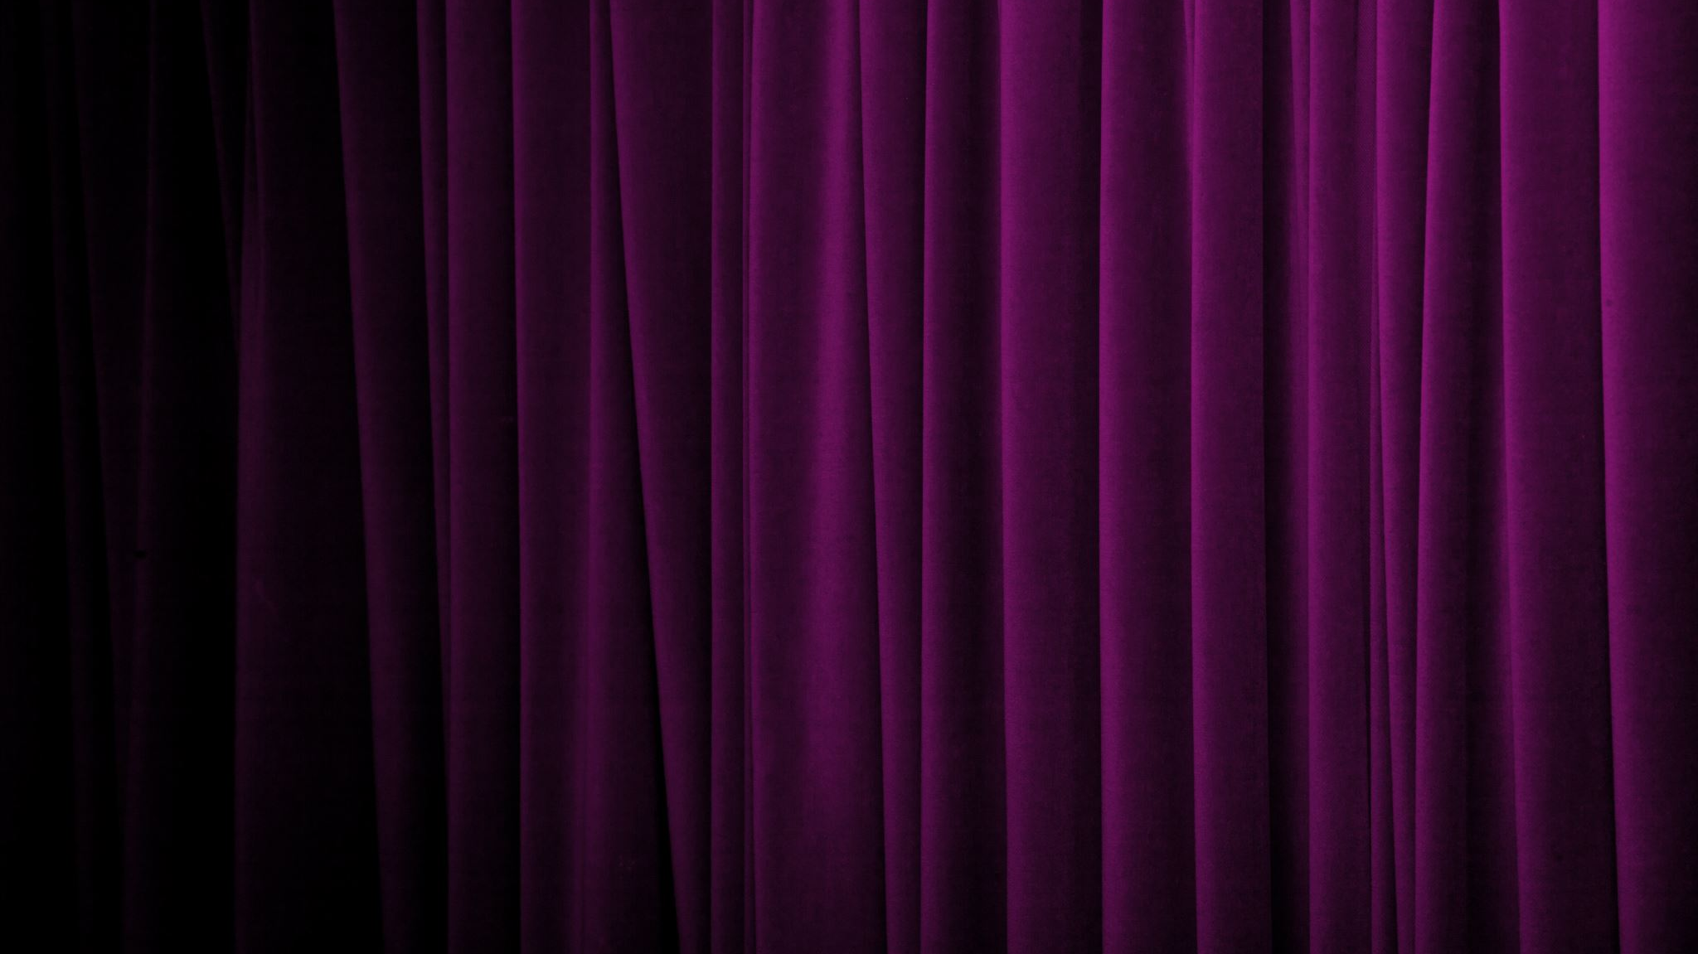
DRAMA
Characters (represented by players)
Action (represented by gestures and movements)
Thought and Ideas (represented by dialogue and action)
Spectacle (represented by scenery and costume)
Audience (who responds to this complex mixture)

Slide 6
DRAMA
Drama both instructs and entertains.
Drama/theater is an illustration of real life. It may be drawn from actual experience or from potential or imagined experience.
According to Aristotle, the dramatic illusion is an imitation of action. He says that drama offers a literary mirror into the human nature.
Originally, drama evolved from Greek and Egyptian rituals, ceremonies that were performed repeatedly in the same manner as it was thought that they had a purifying/forgiving effect on the relationship between men and their gods.

Slide 7
DRAMA
Greek drama was first performed during yearly religious celebrations to god Dionysus.
Early playwrights such as Sophocles, emphasized the will of gods, and set them against the will of men.
In Greek drama, the illusion includes the narratives of ancient myths that were thought to hold profound illumination for the populace.

Slide 8
DRAMA
Greek drama can be characterized with
An intense mythic structure
Formidable (causing fear/dread) speeches
Profound (intense) actions

Slide 9
The 1st Dramatic Age
525 BC
starts with the birth of Aeschylus
385 BC
ends with the death of Aristophanes

Slide 10
Theater for Ancient Greeks
was a way of interpreting their relationship with gods
reinforces their sense of community
was a cultural necessity since it was connected with religious festivals

Slide 11
Tragedy
Drama is the imitation of an action
Tragedy is the imitation of a sad action. It is the first form of drama

Slide 12
Tragedia
Tragos
(goats)
Oida/Odia
(ode)

Slide 13
Tragedy
The first tragedies were written in Greece in the 5th century BC.
Thespis: 1st important writer of tragedies
Aesychylus: 2nd (Agamemnon, the Libation Bearers, the Eumenides)
Sophocles: 3rd (Oedipus Rex, Antigone)
Euripides: 4th (Medea, The Bacchae)

Slide 14
Tragedy
Thespis used the chorus+one actor
Aesychylus used the chorus+two actors
Sophocles used the chorus+three actors
The development of tragedy was complete with Euripides. And yet, the dialogue is much better in Sophocles.
Greek tragedy was written in verse (poetic form) and the actors/actresses wore masks that represented different characters.

Slide 15
Aristotle and The Elements of Tragedy
As the first literary critic, he is the first one to criticize, define and analyze a tragedy. He defines and analyzes the tragedy in The Poetics.
Sad action
Tragic hero: A man of higher ranks/upper-class. Usually a king/a god
Tragic flaw (hamartia): the fault/mistake/defect in the character of the hero which causes his downfall
Tragic flow: flow of events from the beginning till the end of the play, which prepare the destruction of the hero
Tragic end: the end of the hero either by death or destruction

Slide 16
Three Unities of Tragedy
Unity of time
Unity of place
Unity of plot

Slide 17
Plot
The plot in a dramatic work is the structure of its actions, as these actions are ordered toward achieving particular emotional and artistic effects.
The Unified plot, according to Aristotle, is a continuous sequence of beginning, middle and an end.
The Beginning: initiates action, the audience looks forward for the action
The Middle: presumes what happened before and requires something to follow
The End: follows what happened before, but requires nothing further. The audience is satisfied that the plot is complete.

Slide 18
Plot
The Middle
The End
The Beginning
Climax, suspense, crisis
Intro, exposition
Resolution, questions answered

Slide 19
The Wheel of Fortune
Climax (where the tragedy begins)
downfall
starts

Slide 20
The Setting
In a dramatic work, the setting is the general local and the historical time in which the action occurs.
The setting functions as an important element in generating the atmosphere.
It is also related to the scenery on the stage. The furniture/décor used for a theatrical play is therefore called as the setting.

Slide 21
The Setting
The action in Greek plays usually happened outdoors, but the outcomes of what happened inside was shown.
When a character is killed offstage, their corpses would be shown onstage.

Slide 22
CHARACTERIZATION
There are four levels of characterization:
Physical or biological: gender, age, size, coloration and general appearance
Societal: economic status, profession or trade, religion, family relationships
Psychological: character’s habitual responses, desires, motivation, likes and dislikes
Moral: what the characters are willing to do, what they do, and what they think ppl. Should do in those situations

Slide 23
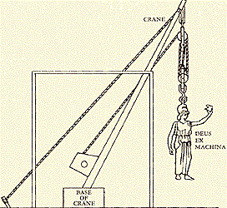
Deus Ex Machina: God from the Machine
The practice of some Greek playwrights to end the drama with a god who was lowered to the stage or lifted towards the roof.
The problems of human beings are solved by the judgment and commands of this god.
This phrase is now used for any forced and/or improbable device a playwright uses to resolve the plot:
Unexpected inheritance
Discovery of a lost will or letter
Unexpected visit

Slide 24
Performers
All men, with masks
No more than three
Extras (supernumeraries) did not have any lines

Slide 25
The Chorus
Among the Ancient Greek, the chorus was a group wearing masks, who chanted or sang verse while dancing at religious festivals.
Roman playwrights such as Seneca took over the chorus from the Greeks, and in the mid-16th century some English playwrights imitated the Senecan chorus.

Slide 26
The Chorus
served as the commentators on the action
represent traditional, moral, religious and social attitudes
summarize events for the audience since everything cannot be shown onstage
pass time when actors changed costumes
sometimes threatened to interfere in the action and give advice
seemed to express the playwright’s point of view
reacting the way, a playwright wanted the audience to react (ideal spectator)
establish mood and heighten dramatic effects
added color, movement and spectacle

Slide 27
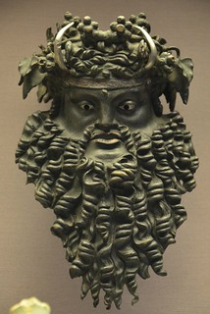
The mask
The use of the mask allowed actors to change rapidly into
Different roles
Female roles
Roles with different age and characteristics
This Photo by Unknown Author is licensed under CC BY-SA

