Slide 1
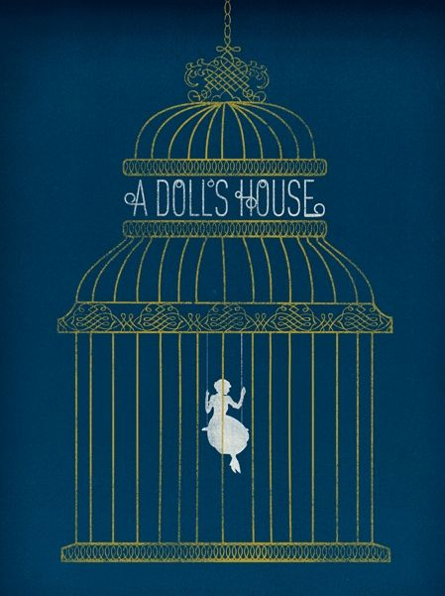
A DOLL’S HOUSE by HENRIK IBSEN
AKE 114/ING 118/DING 118

Slide 2
Realism in Drama
It started around 1870s, after romanticism.
Realism in drama aimed to bring a real representation of life to texts and performances.
Truth in observation
Human problems were the most important themes
The use of contemporary settings
Everyday life and problems are the subjects
Staging and costumes

Slide 3
Realist Playwrights
Henrik Ibsen (A Doll’s House, Ghosts, An Enemy of the People, etc.)
Bernard Shaw (Widowers’ Houses, Mrs. Warren’s Profession, etc.)
Anton Chekhov (The Cherry Orchard, The Seagull, etc. )
Alexandre Dumas (Camille, etc.)

Slide 4
Henrik Ibsen
Ibsen (Norwegian) wrote on the respectability and smugness of the middle-classes.
His characters are common and ordinary people.
His settings and subjects are common, as well.
Ibsen uses
detailed stage-directions
employment of everyday prose
elimination of soliloquies and asides

Slide 5
A Doll’s House: Discussion of the Title

Slide 6
The patriarchal Society associates…
Superiority
Action
Strength
Self-assertion
Domination
with masculinity/the masculine
Inferiority
Passivity
Weakness
Obedience
Self-negation
with femininity/the feminine

Slide 7
Feminism
Feminism tries to
define and establish legal, social and cultural freedom and equality for women
establish equality between sexes in all spheres of life

Slide 8
Feminism
Feminist writers highlight and condemn the plight of women in the patriarchal society and thereby try to introduce to women a sense of
rebellion
self-assertion
self-identity
self-worth

Slide 9
A Doll’s House: A Feminist Play?
Ibsen claimed that this was a humanist play and not a feminist one.

Slide 10
Themes
Focus on the marital relationship
Absence of freedom—dependence on men
Economic dependence
Shocked by her husband’s indifferent attitude
Completely disillusioned
Her treatment like a doll
Doll-child
Doll-wife

