Slide 1
POST MORTEM CHANGES IN MUSCLE AND ITS CONVERSION INTO MEAT

Slide 2
Development of Rigor Mortis
In a resting muscle, ATP serves to keep the muscle in a relaxed state by preventing the formation of actomyosin bridges.
Rigor mortis occurs when the ATP level falls below the very low level (~ 5 mmol kg"1) required to maintain relaxation.
When this happens, the actin and myosin molecules of the thin and thick filaments combine irreversibly to form actomyosin and extensibility of the muscle is lost.

Slide 3
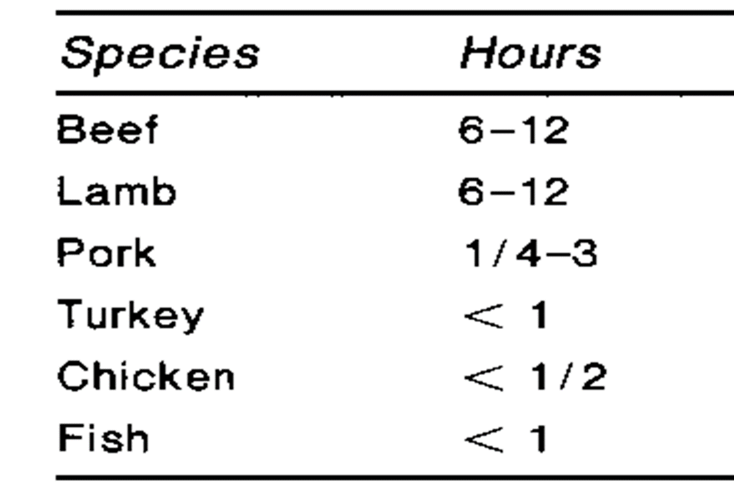
The process of rigor mortis is one of the recognizable signs of death as a result of the chemical changes in the muscles, causing the musculature to lose extensibility and become stiff.

Slide 4
Rigor mortis
Decline of ATP to zero
0% extensibility
Ultimate pH that is reached
Lactic acid that has plateaued

Slide 5
The time of onset of rigor will obviously relate to factors affecting the level of glycogen and creatine phosphate at death and the rate of post mortem muscle metabolism.
For example, in animals that have undergone violent exercise at death, or in which glycogen has been depleted by longer-term stress preslaughter, rigor occurs faster.

Slide 6
Rigor onset is determined only by the availability of ATP, not the pH value of the muscle.
It is possible to have rigor in muscle in which the pH is still high if the animal has been exhausted preslaughter.

Slide 8
The resolution of rigor and tenderization
After a variable period of time there is a progressive ‘resolution’ of rigor when the muscles soften.
Tenderization results from the activities of proteolytic enzymes present in the muscles.
There are two main sorts of enzyme involved, cathepsins and calpains, of which, at least in red meat species and poultry, the calpains are thought to be more important.

Slide 9
Cathepsins
Occur in the lysosomes in the sarcoplasm
Released
Post mortem and have maximum activity in mildly acid conditions.
Degrade
Troponin-T, some collagen cross-links and mucopolysaccharides of the connective tissue
Appear
To degrade actin and myosin below a pH of 5 so this is unlikely to occur under normal conditions in meat.

Slide 10
Calpains
Are activated by calcium ions and have maximum activity in neutral to alkaline conditions.
Calcium-activated sarcoplasmic factor (CASF)
Located
In the region of the Z lines
Have two forms, m-calpain and μ-calpain
Calpastatin
The calpains are inhibited by calpastatin.
High activity reduces the extent of proteolysis in muscles.

Slide 11
After exhaustion of ATP and the development of rigor mortis, the membrane systems of the sarcoplasmic reticulum and mitochondria no longer take up or sequester calcium ions.
These are released into the sarcoplasm and bathe the myofibrils.
Normally the calpains are inhibited by being bound to calpastatin. Calcium removes this inhibition.
The increased calcium concentration activates the μ-calpains allowing proteolysis to proceed.
Calpain activity is promoted by higher calcium levels, higher pH and temperature, and reduced calpastatin activity.

Slide 13
Water Holding Capacity
WHC – the ability of meat to retain water during application of external forces such as cutting, heating, grinding, or pressing.
Isoelectric point of muscle - All charges equal not allowing any charge available to hold the bound and immobilized water.

Slide 14
Free – held on by capillary forces, and their orientation is independent of the charged group.
Bound – hydrophilic groups on muscle proteins attract H₂0, forming a TIGHTLY bound layer.
Immobilized – has less orderly molecular orientation toward the charged group.

Slide 15
Postrigor muscle is about 75% water, with up to 87% of the volume of the muscle cell being myofibrils, which contain the majority of the water.
The decline in muscle pH postharvest associated with the glycolysis and onset of rigor mortis results in a fall in pH from about 7.0 to about 5.5, in a muscle of ‘normal’ quality.

Slide 16
As the pH drops, it comes closer to the isoelectric point of the muscle proteins (5.0–5.1), resulting in a reduction in negative charge between the myofilaments, and these myofilaments can then approach each other more closely.

Slide 17
As the myofilaments approach each other, with a consequent shrinkage in the diameter of the myofibril, less water is held in the myofibrillar structure and the water moves to the intracellular space, and subsequently to the extracellular space, and then is lost from the muscle structure as drip, with associated reduction in water-holding capacity

