Slide 1
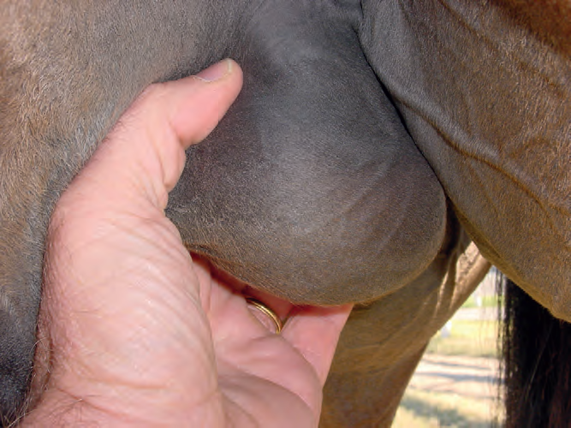
Breeding soundness examination
Sctorum
Total Scrotal Width
(TSW)
9,5 – 11,5 cm
(> 8 cm)

Slide 2
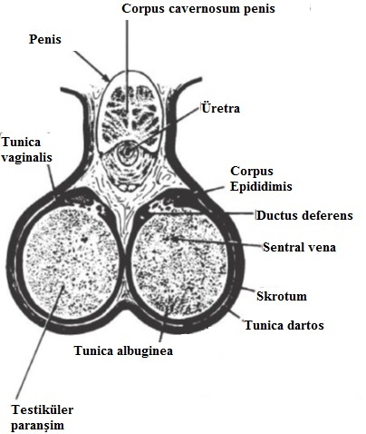
Breeding soundness examination
Testicles
Width: | 4,5-6 cm
Height: | 5-6,5 cm
Lenght: | 8,5-11 cm
0,5233 x Width x Height x Lenght = Testicle volume (TV)
0,024 x TV – (0,76) = Daily Sperm Output (DSO)
Testicle volume (TV)
Daily Sperm Output (DSO)

Slide 3
Breeding soundness examination
Libido / Mounting Behavior
Intensive attention
Exciting behavior
Digging
Whinnying
Smelling, kicking, biting
Flehmen
Erection
30 – 60 seconds

Slide 4
Breeding soundness examination
Libido / Mounting Behavior
Erection
Mounting unhesitant
Intromission
Friction
Ejaculation
Leaving
25 – 35 seconds

Slide 5
Breeding soundness examination
Semen Evaluation
Volume 60 (30 - 300) ml
Color Low-concentration: Gray
High-concentration: Creamy
Viscosity Low-concentration: Thin
High-concentration: Thick
pH 7.2-7.7
Pre-evaluation (Macroscopic)
Volume
Color
Viscosity
pH

Slide 6
Androlojik Muayene Sistematiği
6. Semen evaluation
3.6.2. Microscopic
Concentration
Motility / Progressive Motility
Morphology
Viability
Plasma Membrane Integrity
DNA Integrity
Capacitation
Akrosomal Integrity
Oksidation
…
Conentration 4-12 x 10⁹
Motility >60%
Normal >40%
Head anomaly <%30
Others <%25
9 x 10⁹ spz/ejaculate (200-300 x 10⁶ spz/ml)

Slide 8
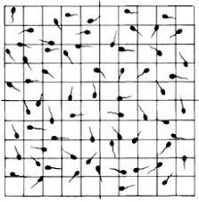
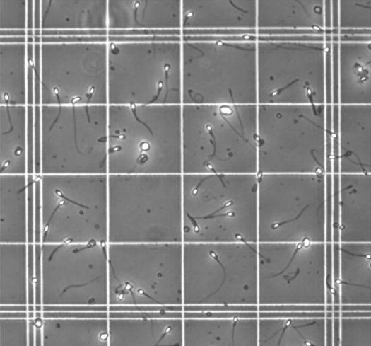
YOĞUNLUK
Yoğunluk (mm³)= Sayılan hücre
Sayılan büyük kare x büyük
kare hacmi x sulandırma oranı
Yoğunluk (mm³)= 60 = 0.3x10⁶ mm³
10 x 1/250 x 1/200

Slide 10
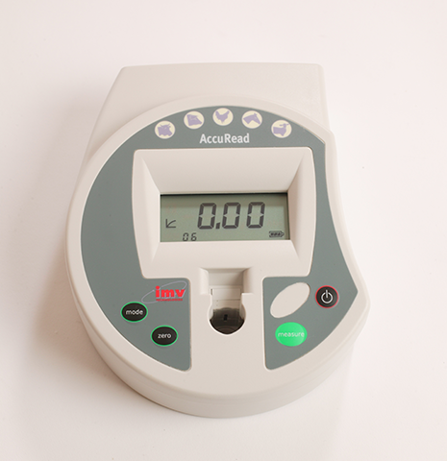
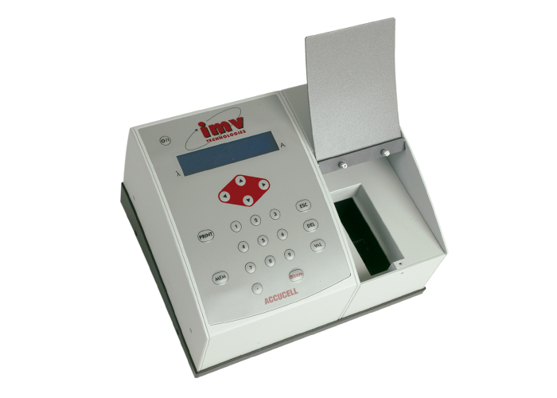

Slide 11
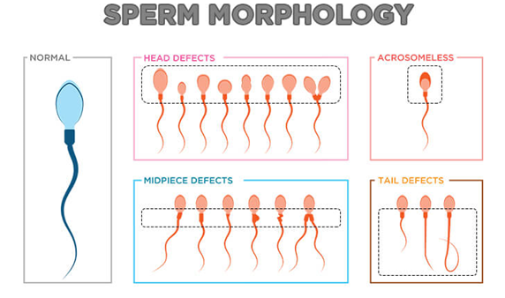
Abnormal Spermatozoa

Slide 12
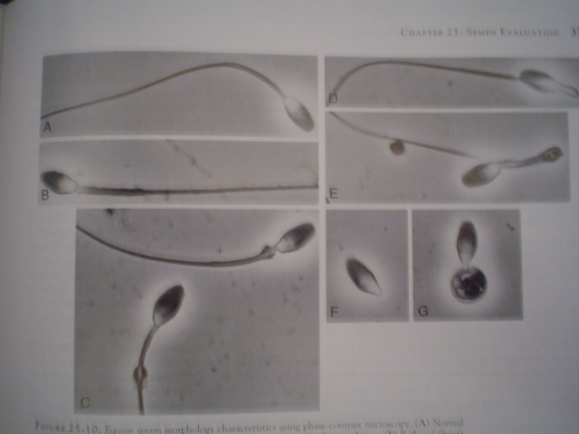

Slide 13
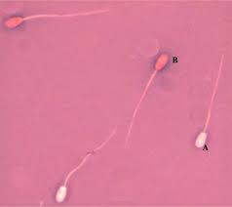
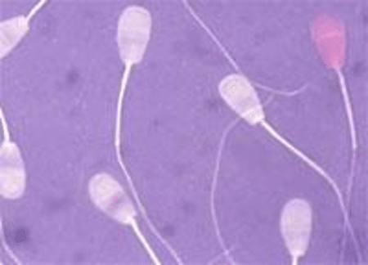

Slide 14
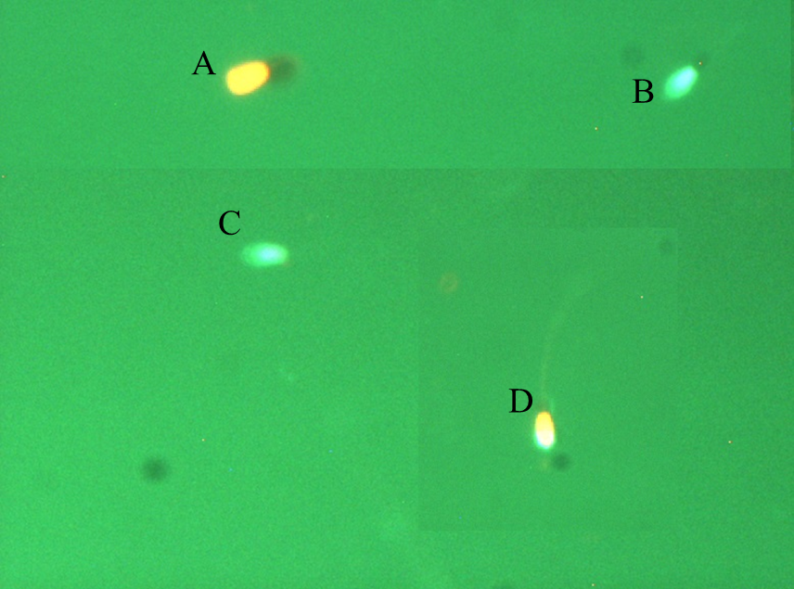
Viability

