Slide 1
Data Sources for Social Research
Altug Yalcintas
Ankara University (faculty member) and TED University (visiting lecturer)
altug.yalcintas@politics.ankara.edu.tr

Slide 2
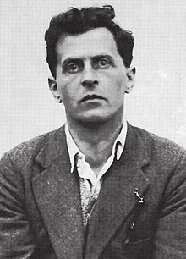
Ludwig Wittgenstein, Tractatus Logico-Philosophicus (1921)
“Proposition 7: Whereof one cannot speak, thereof one must be silent.”
An economist’s interpretation:
Do not start any economic (applied) research if you do not have the facts.
Ludwig Wittgenstein (1889 – 1951)

Slide 3
Do NOT turn into armchair economists*
* See also: Steven E. Landsburg. 1993. Armchair Economist: Economics and Everyday Life. New York: Free Press.

Slide 4
Blackboard economics is not right!
Gary S. Becker, “Nobel Prize” Laureate in Economics (1992), the University of Chicago. Source: https://news.uchicago.edu/story/gary-s-becker-nobel-winning-scholar-economics-and-sociology-1930-2014

Slide 5
What you need:
FACTS

Slide 6
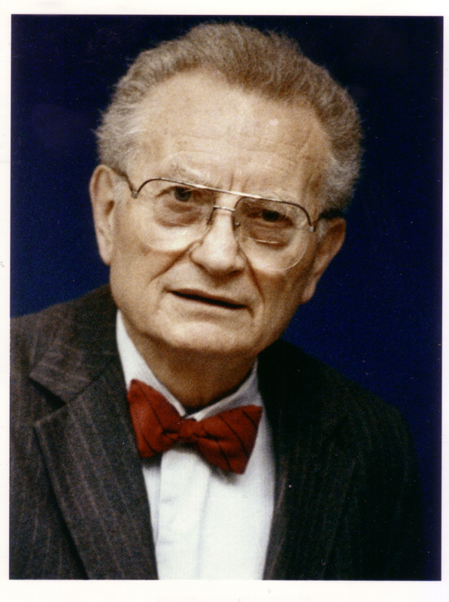
Economics as the queen of social sciences
“Economics is the queen of social sciences”*
* Paul Samuelson 1976 [1948]. Economics.
NY: MacGraw-Hill: 6
Paul Samuelson (MIT)
1970 “Nobel Prize” in Economics (The first American to win the prize)

Slide 7
Opinions, ideologies, and worldviews are not facts!
Source: “Philosophy in the Contemporary World: Thinking about Ideology”
https://blog.apaonline.org/2017/03/30/philosophy-in-the-contemporary-world-thinking-about-ideology/ [August 2019]

Slide 8
Opinions, ideologies, and worldviews are not facts!
Facts are not always objective.

Slide 9
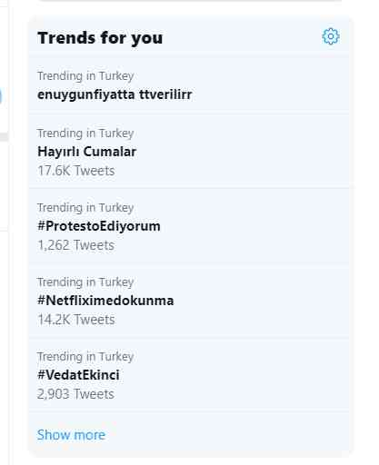
Opinions, ideologies, and worldviews are not facts!
Facts are not always objective.
Some facts are real-time.*
* Visit also: https://threatmap.checkpoint.com/ThreatPortal/livemap.html
Source: Twitter Turkey Trends, [1 August 2019, 09:38 hours]

Slide 10
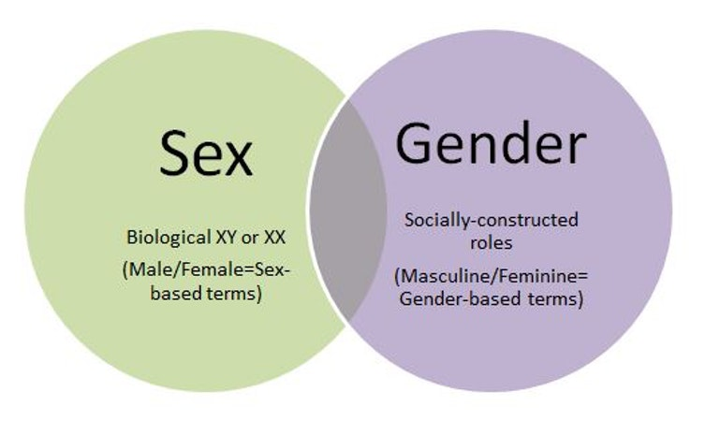
Opinions, ideologies, and worldviews are not facts!
Facts are not always objective.
Some facts are real-time.
Some others are socially constructed.
Source: https://onmogul.com/stories/sex-and-gender [August 2019]

Slide 11
Opinions, ideologies, and worldviews are not facts!
Facts are not always objective.
Some facts are real-time.
Some others are socially constructed.
Facts can be illusive.
Source: https://onmogul.com/stories/sex-and-gender [August 2019]

Slide 12
Opinions, ideologies, and worldviews are not facts!
Facts are not always objective.
Some facts are real-time.
Some others are socially constructed.
Facts can be illusive.
Facts do not speak for themselves; humans do: Storytelling in economics
Source: JILLEAN KEARNEY, “Long-form Storytelling & Thought Leadership: A Content Marketing Success” Scribble Live, https://www.scribblelive.com/blog/2016/11/24/thought-leadership-long-form-storytelling-content-marketing-success-2/ [August 2019]

Slide 13
How should one tell stories in economics?
Case studies: Thorstein Veblen. Imperial Germany and the Industrial Revolution (1915); Robert Fogel (1993, “Nobel Prize” Laureate). Railroads and American Economic Growth; Paul David. “Clio and the Economics of QWERTY” (1985)
Data sets: “The consumer prices in Turkey increased 19.50 percent in April, marking a rate below market expectations” (Source: http://www.hurriyetdailynews.com/turkeys-annual-inflation-rate-falls-to-19-50-pct-in-april-143125)

Slide 14
Creating one’s own data set
Compilation of observations
Calculations
Surveys and questionnaires
Archival work

Slide 15
Using data provided by third parties
Open data
Proprietary and licensed data
Consult your professors for the most appropriate data that you should use in your research.

Slide 16
National Institutions (only Turkey)
Türkiye İstatistik Kurumu
Türkiye Cumhuriyet Merkez Bankası
Borsa İstanbul
İşkur
Dış Ticaret İstatikleri
Yükseköğrenim Kurumu
…

Slide 17
International Institutions
International Monetary Fund
World Bank
Organisation for Economic Cooperation and Development
Eurostat
World Trade Organisation
World Intellectual Property Organisation
World Health Organisation
…

Slide 18
Non-governmental / independent institutions
https://ourworldindata.org (non-profit)
https://www.core-econ.org (non-profit)
https://www.nber.org/data/ (non-profit)
http://eh.net/databases/ (non-profit, only historical data)
Madison Project (non-profit, only historical data)
McKinsey Institute (non-profit)
Bloomberg (for-profit)
Reuters (for-profit)
Clarivate (for-profit, only academic data)
Statista (for-profit)
For the Turkish economy: TEPAV, BETAM etc.

