Slide 1
JEM 227 GEMOLOJİ

Slide 2
Elmas, Beril Grubu Süstaşları

Slide 3
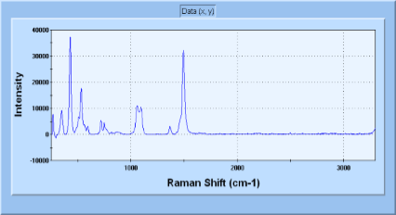
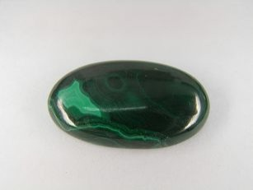
MALAHİT Cu2CO3(OH)2
http://www.uid-ramanlab.com/database/m/

Slide 4
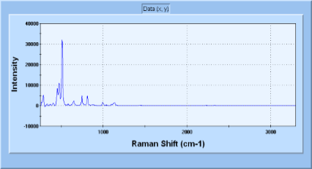
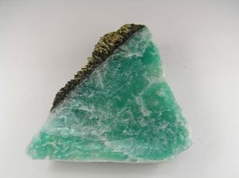
MİKROKLİN
http://www.uid-ramanlab.com/database/m/

Slide 5
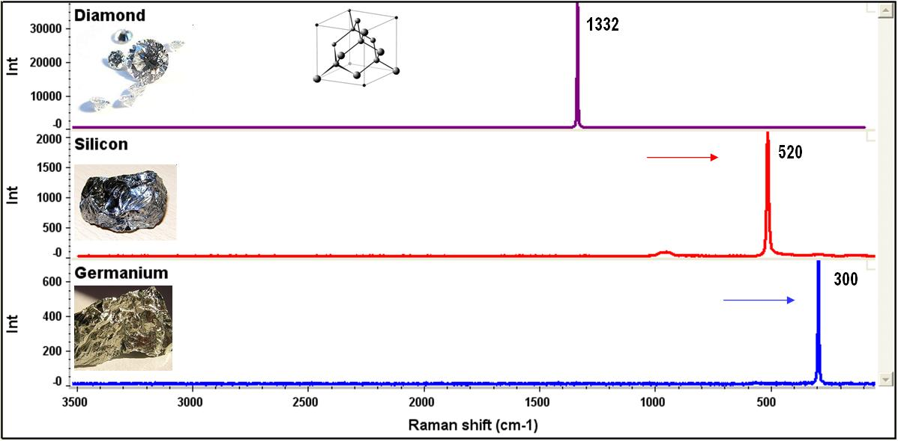
http://www.uid-ramanlab.com/database/m/

Slide 6
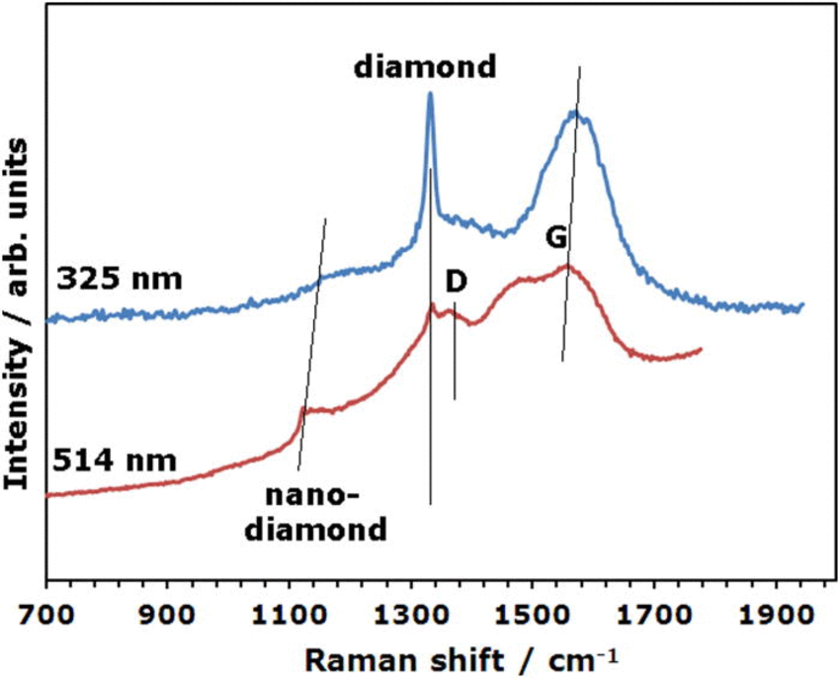
http://www.uid-ramanlab.com/database/m/

Slide 7
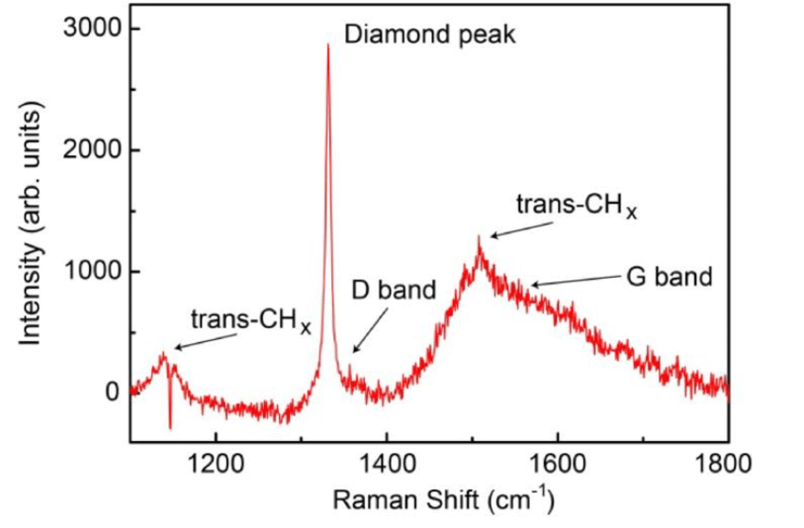
http://www.uid-ramanlab.com/database/m/

Slide 8
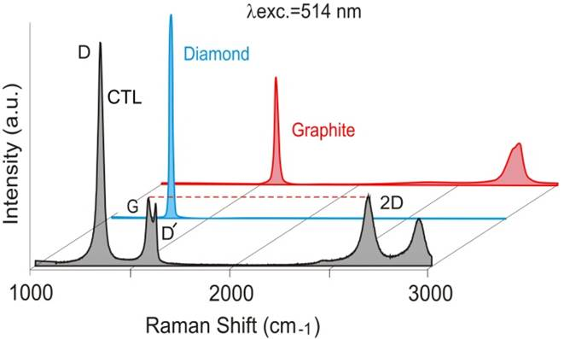

Slide 9
