Slide 1
PHA 297: Laboratory Safety

Slide 2
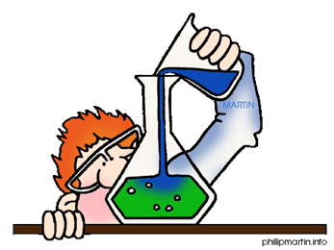
WHY SAFETY?
Science is a hands-on laboratory class.
You will be doing many laboratory activities, which require the use of hazardous chemicals and expensive lab equipment.
Safety in the laboratory is the #1 priority.
To ensure a safe laboratory, a list of rules has been developed and provided to you.
These rules must be followed at all times.
THERE ARE hundreds of “things to learn about safety.”
But, without some framework into which to place all of this information, it just becomes rules and guidelines that are too easy to forget over time.
Understanding the reasons why safety is important is crucial to understanding the reasons that stand behind the facts, rules, and guidelines.

Slide 3
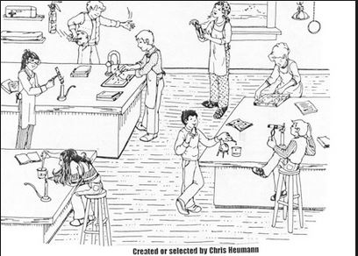

Slide 4
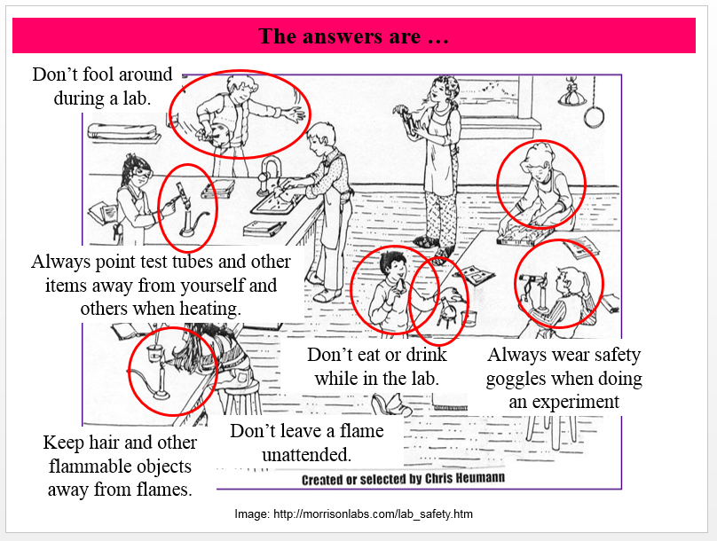
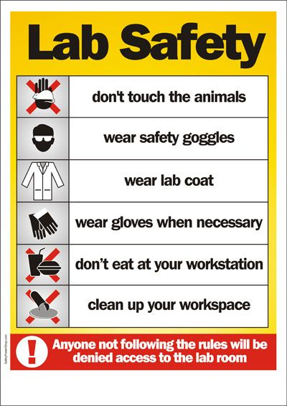

Slide 5
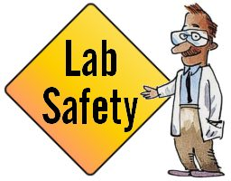
Principles of Safety
Discusses the importance of safety in the laboratory and introduces the four principles of safety and the student safety ethic.
teach you how to work safely in the laboratory. To be safe in the laboratory
or elsewhere, you need to do only four things:
• Recognize hazards.
• Assess the risks of hazards.
• Minimize the risks of hazards.
• Prepare for emergencies.
We use the acronym RAMP to remind the student of these principles—RAMP up for safety

Slide 6
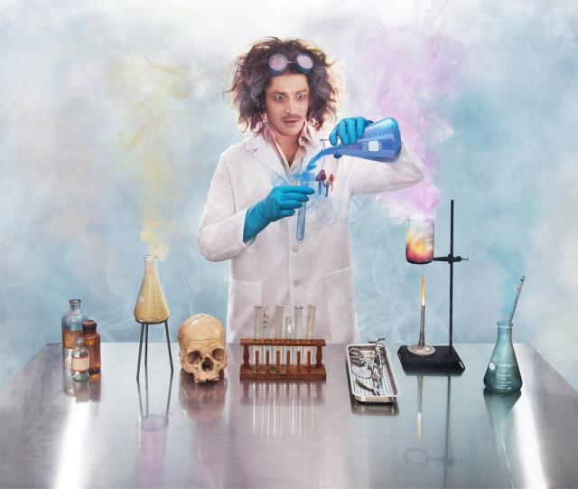
Four simple principles of laboratory and chemical safety to:
1. Recognize hazards;
2. Assess the risks of those hazards;
3. Minimize, manage, or control those hazards; and
4. Prepare to respond to emergencies.

Slide 7
What is Safety?
Safety is freedom from danger, injury, or damage. Being safe requires actions by you and by others. When you decide to adopt safety as an integral part of your laboratory experiences it means that you always seek to do those things that prevent incidents that might cause injury and harm.
This sounds easy, but when doing chemistry experiments in laboratories, it is often easier to get “caught up” in the procedures and trying to understand what you are doing and to forget about making sure you’re doing it safely.

Slide 8
What is Hazard, Risk and Expose?
A hazard is a potential source of danger or harm.
The word potential means something that is capable of being dangerous or harmful.
Many chemicals may have inherent hazardous properties and these hazardous properties never change.
The practice of safety is really about minimizing, managing, or controlling these hazards.

Slide 9
What is Risk?
Risk is the probability of suffering harm from being exposed to a hazard or unsafe situation.
The level of risk depends on many things beyond the inherent hazard of a chemical.
For example, the amount of the chemical, the form it is in (gas, liquid, or solid), and how you handle the chemical all affect the level of risk.

Slide 10
What is Expose?
Exposure means coming in direct contact with a hazard or chemical in a fashion that causes injury or harm.
A dose is the amount that you might ingest, breathe, or spill on your skin.
An exposure might also arise from a fire or explosion.
The dose, the length of exposure, and the path of exposure play significant roles in the extent of harm.
The important thing to remember is that we want to minimize or eliminate exposure to hazards.

Slide 11
Safety from the Experts
Three factors have been identified by Geller that contribute to safety:
(1) environmental factors including facilities, location, equipment, procedures, and standards;
(2) person factors including attitude, beliefs, personality, knowledge, skills, and abilities; and
(3) behavior factors including safe and risky practices.
These factors are interconnected so that each factor influences others.

Slide 12
Safety from the Experts
Suppose, for example, that you see someone fall over something that was out of place, an environmental factor.
You think to yourself (a personal factor), “I need to be more careful about things on the floor that I might trip over.” When you see a wastepaper basket out of place in an aisle, you move it to its place out of the way (a behavior factor).
Being safe requires attention to all three factors since they have significant influence on your safety.

Slide 13
How Do We Learn Safety?
Safety is an empirical discipline.
This means that we often learned how to be safe from past mistakes and incidents.
Most of us do not want to have to personally experience fires, explosions, toxic exposures, or other potentially dangerous incidents. Instead, we should be learning safety guidelines that have developed from the adverse experiences of others. We can reduce our exposure to hazards through continuous and diligent efforts to include considerations about safety in our daily decisions.
This simply involves thinking about safety and taking steps to revent incidents, especially in the laboratory. Unfortunately, there is rarely positive feedback for being safe, but there is often negative feedback for not being safe. The consequence of exposure to Unnecessary risk is likely to be injury or harm to you or others.
Notes:
Experience can teach us a lot, but if you learn safety by making a lot of your own mistakes, you may not survive for long!

Slide 14
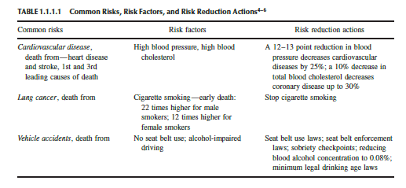
To maintain a safe lab environment, it is critical that everyone minimizes and/or eliminates the risk of exposure to hazards. We do this everyday with precautions that we have learned to prevent or reduce injury and harm.
you will be required to wear splash goggles when working in the laboratory in order to reduce the risk of injury to your eyes from chemical splashes. The goggles don’t guarantee that you will not be injured but experience has shown that wearing splash goggles significantly reduces the chance of injury to your eyes.
Notes:
For example, if we wear seat belts, important because wearing a seat belt does not guarantee that you will be injury-free if you are in a collision, but it does mean that your chances of survival are better if you wear a seat belt. And they will be even better if you observe other public safety rules, such as driving within the speed limit and using defensive driving techniques. Similarly, you will be required to wear splash goggles when working in the laboratory in order to reduce the risk of injury to your eyes from chemical splashes. The goggles don’t guarantee that you will not be injured but experience has shown that wearing splash goggles significantly reduces the chance of injury to your eyes. And, when combined with other safety measures like using a hood or face shield or wearing gloves, risks are decreased even more.

Slide 15
Safety Ethics
To work safely means that you are educated in safety, you continue to learn about safety, you learn to recognize and evaluate hazards, you practice safe procedures, and you maintain a high level of safety awareness.
To avoid unnecessary risk means that you learn to recognize risks and minimize and manage those risks when working in the laboratory.
To accept responsibility for safety as an act of caring for others means that you are responsible and accountable for your safety and for the safety of others. This requires a constant awareness in the laboratory of what you are doing and what other students are doing. Instructors and teaching assistants share the responsibility of maintaining safety in undergraduate teaching laboratories but this does not release you from sharing in this responsibility.

Slide 17
General Safety Guidelines
Be Responsible at All Times. No horseplay, practical jokes, pranks, etc.
Follow all instructions carefully.
Do not play with lab equipment until instructed to do so.
Wash your hands with soap and water after experiments.
Food, drink, and gum are not allowed in the science classroom.
Notify the instructur immediately of any accidents or unsafe conditions in the lab!
Lab Safety: Everyone Is Responsible!

