Slide 1
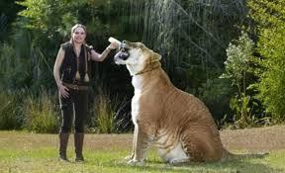
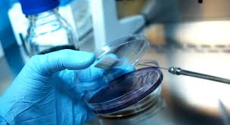
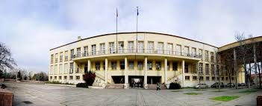
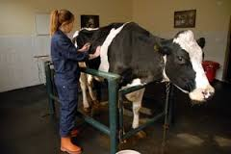
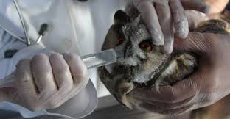
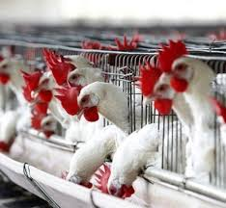
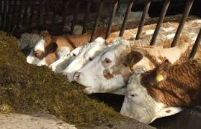
Feed Additives Dr. Özge SIZMAZ University of Ankara Faculty of Veterinary Medicine Department of Animal Nutrition and Nutritional Diseases, Ankara, Turkey

Slide 2
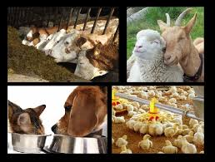
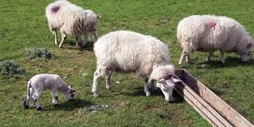
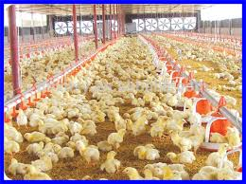
Silage Feed Additives
Purpose:
Perfect protection by effective fermentation
Good quality of nutrients

Slide 3
Silage Feed Additives
Stimulants
Inoculants
Enzymes
Sugars
Inhibitors
Aerobic (acids)
Anaerobics

Slide 4
Silage Feed Additives
Inoculants
Lactic acid bacteria (Lactobacillus spp., Pediococcus spp., Streptococcus spp and yeasts)
Enzymes
Cellulase, amylase, protease
Sugars
Molasses, glucose

Slide 5
Silage Feed Additives
Aerobic
Propionic acid, sorbic acid, acetic acid, propionate, ammonia, formic acid, lactic acid, citric acid ..
Anaerobic
Formaldehyte, SO2

Slide 6
Silage Feed Additives
Stimulants
Bacteria must be 105/gr in hay
Molasses : DM and lactic acid increase, pH and NH3 decrease
add 3-6% to silage

Slide 7
Silage Feed Additives
Stimulants
Whey: rich in CHO and lactic acid bacteria
add 2-3%
Sugar: not common
add 2-3%

Slide 8
Silage Feed Additives
Stimulants
Salt: bactericid
water level increase = benefial bacteria go out besides harmfulls
Limestone: to increase lactic acid concentration in maize silage
add 9kg/ton

Slide 9
Silage Feed Additives
Inhibitors
Formic acid: most common used in silages that are rich in moisture
Propionic acid: in dry hay
Acetic acid : cheap

Slide 10
Silage Feed Additives
Inhibitors
Salts of acids: prevent the silage by increasing the osmotic pressure
inhibit the Maillard reaxions
add 1-1,5%

