Slide 1
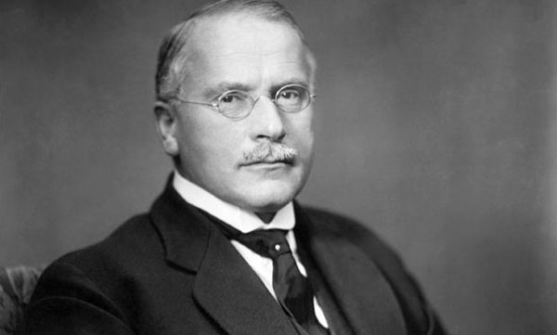
Carl Gustav Jung (1875- 1961)
* Swiss psychologist
* Sigmund Freud’s student and close friend
* In Freud’s words, his «adopted son, his crown
prince and successor»
* Influenced philosophy, anthropology,
literature, religious studies

Slide 2
Jung vs. Freud
*One of the points in which Jung opposed Freud is the idea of libido which is a sexual instict.
* Jung thinks that Freud puts too much emphasis on sexuality and tries to de-center it with a new term.
*What may be resembled to libido in Jungian psychology is psychic energy.
*However, Jung uses it as a broader term which refer to needs of thinking, walking, eating and sexuality. For Jung the purpose of psychic energy was to motivate the individual in a number of important ways, including spiritually, intellectually, and creatively. It was also an individual's motivational source for seeking pleasure and reducing conflict.

Slide 3
The Levels of Consciousness Like Freud, Jung regarded the psyche as made up of a number of separate but interacting systems. The three main ones were the ego, the personal unconscious, and the collective unconscious.
Sigmund Freud | Carl Jung
Conscious Subconscious (Preconscious) Unconscious | Conscious (Ego) Personal Unconscious Collective Unconscious

Slide 4
Conscious – Personal Unconscious
According to Jung, the conscious represents the conscious mind as it comprises the thoughts, memories, and emotions a person is aware of. It is the level of consciousness in which individuals make decisions, learns, obtains wisdom. The ego is largely responsible for feelings of identity and continuity.
The personal unconscious contains forgotten information as well as repressed memories. The personal unconscious can be considered as a combination of Freud’s «preconscious» and «unconscious. Personally unconscious experiences can include childhood memories that are forgotten, or traumatic memories that the mind has represed or blocked from conscious memory.
Jung believed the personal unconscious was dominated by complexes. A complex is literally a grouping of parts around some central emotional theme. In Jung's terminology, it is a system of related thoughts and emotions tied together by a psychologically powerful event. Complexes are due to a person's life experiences, so they were individual and unique, part of the personal unconscious according to Jung. A complex might manifest itself by turning up in dreams or fantasies, or by provoking an unusual reaction to events in the outside world that relate to the complex.

Slide 5
The Collective Unconscious
Jung does not believe that human mind is blank (tabula rasa) when s/he is born. He proposes that individuals are born with a collective unconscious, which contains a set of shared memories, feelings and ideas. Jung thinks that, regardless of the culture that they are born into or the time period in which they live, all people can identify with the content of the collective unconscious.
Collective unconscious is the part of the human consciousness in which collective experiences of humankind from their early ancestors on have been stored and shared universally. It is Jung’s most original and controversial contribution to personality theory. This is a level of unconscious shared with other members of the human species comprising latent memories from our ancestral and evolutionary past. ‘The form of the world into which [a person] is born is already inborn in him, as a virtual image’ (Jung, 1953, p. 188). According to Jung, the human mind has innate characteristics “imprinted” on it as a result of evolution. These universal predispositions stem from our ancestral past. Fear of the dark, or of snakes and spiders might be examples.

Slide 6
ARCHETYPES
*The content of the collective unconscious such as instincts, images, memories and modes of behavior that are more or less the same everywhere and in all individuals. These contents are called archetypes. Jung suggests that archetypes are seen in many cultures which have cultivated similar myths independently of one another and which feature similar characters and themes, such as the creation of the universe.
In Psychological Reflections, Carl Jung states that archetypes “are older than historical man, have been ingrained in him from earliest times, and eternally living, outlasting all generations.
*Archetypes are essentially unconscious forms. (Like Plato’s Forms). The term "archetype" has its origins in ancient Greek. The root words are archein, which means "original or old"; and typos, which means "pattern, model or type". The combined meaning is an "original pattern" of which all other similar persons, objects, or concepts are derived, copied, modeled, or emulated.

Slide 7
The Collective Unconscious
There is a close relationship between archetypes and myths.
Myths are the means by which archetypes become manifest to the conscious mind.
THAT’S WHY the myths are not mere stories or allegories of real events but they are the mirrors by which the collective unconscious of the people is reflected.
* Jung believes symbols from different cultures are often very similar because they have emerged from archetypes shared by the whole human race. For Jung, our primitive past becomes the basis of the human psyche, directing and influencing present behavior. Jung claimed to identify a large number of archetypes but paid special attention to four: Persona , Anima/Animus, Shadow, Self

Slide 8
Archetypes
The Persona
Distinct from our inner self, Jung noted that we each have a persona - an identity which we wish to project to others. Persona is the public image of someone. The original word persona means mask, so the mask we wear in public in order to impose a certain image about us: father, mother, chief, artist, official, president of republic, etc. Persona is therefore a result of social adaptation that plays an important role in dealing with peers. For example, a father may adopt traits which he considers to be typical of a father - serious or disciplining, - rather than those which reflect his actual personality. As the persona is not a true reflection of our consciousness, but rather an idealised image which people aspire to, identifying too much with a persona can lead to inner conflicts and a repression of our own individuality, which Jung claimed could be resolved through individuation, the psychic process by which one becomes himself, indivisibly, uniquely, a monad, as an expression of uniqueness and self-sufficiency.

Slide 9
Archetypes
Anima/Animus archetypes
The anima (in males) or animus (in females) represents the opposite gender to a person's self. The unconscious feminine side in males is anima and the masculine tendencies in women constitute animus. As a person develops a gender identity, such as that of being male, they repress the aspects of their personality which might be considered to be feminine, such as empathy in social situations. Whilst these traits form part of the true, united self, they are held back from our persona and are represented in the form of the feminine archetype anima in males or the masculine archetype animus in females.
Anima ➔ Femininty; irrationality; emotionality; Self-soothing, self-nurturing and self-loving, Strong centre and contained inner life, Capable of empathy, Able to make value judgements beyond the realm of pure rationality, Access to feeling life. Anima, naturally, is originally based on the boy’s image of his mother and this later evolves with his relatedness to more mature romantic relationships.
Animus➔ Masculinty, physical strength, rebellious, creative, rational and logical ability, Problem solving, ability for clear thought, ability to construct by sustained effort and application.

Slide 10
Archetypes
Shadow archetype
The shadow archetype is composed primarily of the elements of ourselves that we consider to be negative. We do not show this side of the self to the outside world as it can be a source of anxiety or shame. The shadow may contain repressed ideas or thoughts which we do not wish to integrate into our outward persona, but these must be resolved in order to achieve individuation. However, it may also include positive traits, such as perceived weaknesses (for example, empathy) which may not fit into the 'toughness' that a person wants to present as a part of their persona.
In literature, the shadow is often presented as a villainous character - for instance, as the snake in the Garden of Eden or The Jungle Book. Jung also observed Hyde, whom Dr. Jekyll transforms into, as representing the character's shadow in Robert Louis Stevenson's 1886 novella The Strange Case of Dr. Jekyll and Mr. Hyde.

Slide 11
Archetypes
The Self archetype
The self is an archetype that represents the unified unconsciousness and consciousness of an individual. Creating the self occurs through a process known as individuation, in which the various aspects of personality are integrated. Jung often represented the self as a circle, square, or mandala.
The self archetype represents the unified psyche as a whole. Jung suggested that there were two different centers of personality. The ego makes up the center of consciousness, but it is the self that lies at the center of personality. Personality encompasses not only consciousness, but also the ego and the unconscious mind. You can think of this by imagining a circle with a dot right at the center. The entire circle makes up the self, where the small dot in the middle represents the ego.
For Jung, the ultimate aim was for an individual to achieve a sense of cohesive self, similar in many ways to Maslow's concept of self-actualization.

Slide 12
Archetypes
Jung described archetypal events: birth, death, separation from parents, initiation, marriage, the union of opposites; archetypal figures: great mother, father, child, devil, god, wise old man, wise old woman, the trickster, the hero; and archetypal motifs: the apocalypse, the deluge, the creation. Although the number of archetypes is limitless, there are a few particularly notable, recurring archetypal images, "the chief among them being" (according to Jung) "the shadow, the wise old man, the child, the mother ... and her counterpart, the maiden, and lastly the anima in man and the animus in woman".
Any attempt to give an exhaustive list of the archetypes, however, would be a largely futile exercise since the archetypes tend to combine with each other and interchange qualities making it difficult to decide where one archetype stops and another begins. For example, qualities of the shadow archetype may be prominent in an archetypal image of the anima or animus. One archetype may also appear in various distinct forms, thus raising the question whether four or five distinct archetypes should be said to be present or merely four or five forms of a single archetype.

Slide 13
Archetypes
Wise Old Man (Mentor) archetype
Through his age and frailty, the Wise Old Man represents the power of peaceful contemplation in the absence of physical prowess. The wise old man, through quiet thought, foresees the future and offers guidance in turbulent times. The wise old man is a prophetic archetype and can often be seen in stories as a wizard, such as Gandalf in J.R.R. Tolkien's The Lord of the Rings.
Villain Archetype
The Villain Archetype tends to display the following characteristics: Tends to be evil purely to be evil. Don’t care who else is hurt in the process. Tends to be complete opposite of Hero Archetype. Selfish, egotistical, power-hungry. The Villain Archetype tends to be less straightforward than the Hero Archetype. There are so many great examples of villain archetypes out there that it's hard to cite only a couple. The White Witch from C.S. Lewis's Chronicles of Narnia, Edmund from Shakespeare's King Lear, Iago from the Bard's Othello, the Joker from the Batman series, and of course J.K. Rowling's Lord Voldemort and J.R.R. Tolkien's Sauron all come to mind as classic villain archetypes.

Slide 14
Archetypes
The Damsel in Distress Archetype
The damsel in distress is a female figure who needs to be rescued by the hero. This archetype is common across many genres, including fairy tales, fantasy, mythology, science fiction, thrillers, and adventure stories. This trope usually involves a beautiful or innocent young woman, placed in a dire predicament by a villain, monster or alien, and who requires a male hero to achieve her rescue. After rescuing her, the hero often obtains her hand in marriage.
Damsel in Distress examples➔ Rapunzel, Jane Porter (Tarzan), Lois Lane (Superman)
The Innocent Archetype➔ Characters representing the innocent archetype are often women or children. These character archetypes are pure in every way. Though often surrounded by dark circumstances, the innocent archetype somehow has not become jaded by the corruption and evil of others. These character archetypes aren't stupid: they're just so morally good that the badness of others cannot seem to mar them.

Slide 15
Archetypes
The Hero Archetype➔ Perhaps the best known of all character archetypes is the hero. And one of the most common, most universal types of plot is the Hero’s Journey. He or she is a character who predominantly exhibits goodness, and struggles against evil in order to restore harmony and justice to society. Common Aspects of the Hero Archetype: Forced to leave home ; Often an orphan, or discovers his/her family is not really his/her family; Tend to be uniformly “good”
Tend to see world as a division of good vs. evil; Often “chosen” in some way to defeat some great evil (prophecy, royalty, etc.); Often has special powers in some form; Usually driven out into the world by some traumatic event. Superman, Simba, King Arthur, Beowulf, Sir Gawain
The Femme Fatale Archetype➔ A female character type who brings upon catastrophic and disastrous events. Her ability to entrance and hypnotise her victim with a spell was in the earliest stories seen as being literally supernatural; hence, the femme fatale today is still often described as having a power akin to an enchantress, seductress, vampire, witch, or demon, having power over men. Pandora; Sphinx, Medea, Aphrodite, Cleopatra

Slide 16
Archetypes
Other archetypes Jung said that there are a large number of archetypes. These are often linked to the main archetypes and may represent aspects of them. They also overlap and many can appear in the same person. For example: Family archetypes The father: Stern, powerful, controlling The mother: Feeding, nurturing, soothing The child: Birth, beginnings, salvation Story archetypes The hero: Rescuer, champion The maiden: Purity, desire The wise old man: Knowledge, guidance The magician: Mysterious, powerful The earth mother: Nature The witch or sorceress: Dangerous The trickster: Deceiving, hidden Animal archetypes The faithful dog: Unquestioning loyalty The enduring horse: Never giving up The devious cat: Self-serving

Slide 17
ARCHETYPES AND MYTHOLOGY IN LITERATURE
*The myth critic is concerned to seek out those mysterious elements that inform certain literary works and shows dramatic and universal human reactions.
*The literary works which gives better insight for the myth critic are usually classic and canonized ones.
*The archetype may be an image, a theme, a symbol, an idea, a character type or a plot pattern.
The 7 story archetypes are:
Overcoming the Monster: There is an evil force threatening our hero/their world/mankind. The hero must fight and slay this monster, which often isn’t easy, but they come out triumphant, and receive a great reward. Beowulf, Dracula and King Kong.
Rags to Riches: This one is fairly self-explanatory: at the beginning, the hero is insignificant and dismissed by others, but something happens to elevate them, revealing them to be exceptional. Think The Ugly Duckling, Aladdina nd Superman.

Slide 18
ARCHETYPES AND MYTHOLOGY IN LITERATURE
The Quest (Hero’s Journey): In the quest, the hero must set out on a long, hazardous journey, and will battle all obstacles until they are triumphant. Think The Lord of the Rings, The Wizard of Oz and Harry Potter.
Voyage and Return: While also based on a journey, the Voyage and Return is very different from The Quest. Here, the hero travels out of their ‘normal world’ into the overwhelming and unknown, before escaping back to the safety of their home. Alice in Wonderland, Finding Nemo and Gulliver’s Travels.
Comedy: A story made up of comedic events, normally involving mistaken identity, misunderstanding or confusion, resulting in hilarious chaos. A Midsummer Night’s Dream, Bridget Jones’ Diary and Some Like It Hot.
Tragedy: This is the story without the happy ending. While other archetypes have seen triumphant heroes and slain monsters, this plot takes a different turn, and ends in loss or death. Think Macbeth, Romeo and Juliet and Breaking Bad.
Rebirth: In Rebirth, sees our hero ‘falling under a dark spell’ – whether this is sleep, sickness or enchantment – before breaking free and being redeemed. Think Sleeping Beauty, Beauty and the Beast and The Secret Garden.

Slide 19
The Collective Unconscious
For example, «Rebirth» is an archetypal topic.
CHRIST
TAMMUZ
DIONYSUS
REBIRTH

Slide 20
An Example of Plot Pattern: Hero’s Journey Archetype
1. The hero is forced into an advanture, although he is not willing to do it, at first. (Departure)
2. The hero crosses a threshold into a new, dangerous and strange world and becomes more mature. (Initiation)
3. The hero passes through impediments, has to endure physical and psychological difficulties and he receives supernatural aid. (The road of trials)
4. The hero enters into an innermost cave, underworld or some other place of great trial. (It may be a physical or psychological.) This experience changes the hero. (The Innermost Cave)
5 . The hero gains wisdom and provides the order that is absent or under threat.

Slide 21
Archetypal Literary Criticism
Archetypal literary criticism is a type of critical theory that interprets a text by focusing on recurring myths and archetypes in the narrative, symbols, images, and character types in a literary work.
Archetypal criticism argues that archetypes determine the form and function of literary works, that a text's meaning is shaped by cultural and psychological myths.

Slide 22
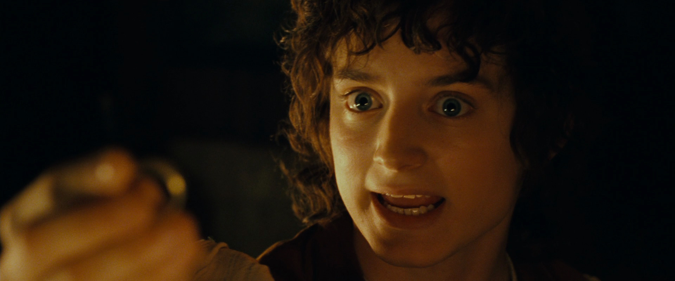
Hero’s Journey Archetype (The Quest): The Lord of the Rings Example
The hero is forced into an adventure though
he is unwilling.
When Frodo learns the secret about the ring,
he tries to give it to Gandalf (a wizard).
However, Gandalf who is afraid of the ring’s
possible power on himself refuses and convinces
Frodo to keep it and to bring it to a rendezvous
place.

Slide 23
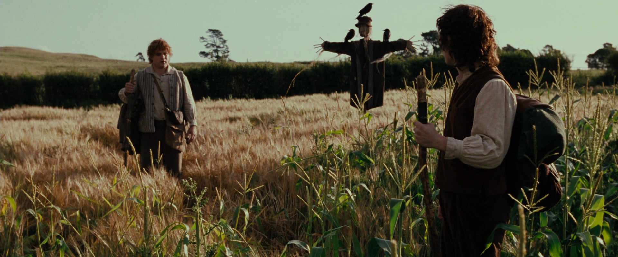
Hero’s Journey Archetype: The Lord of the Rings Example
The hero crosses a treshold into a new world.
The hobbits, who have led a life away from the
chaos of the rest of the world, enter into a new
space.
SAM: If I take one more step, it’ll be the farthest way from home
I’ve ever been.

Slide 24
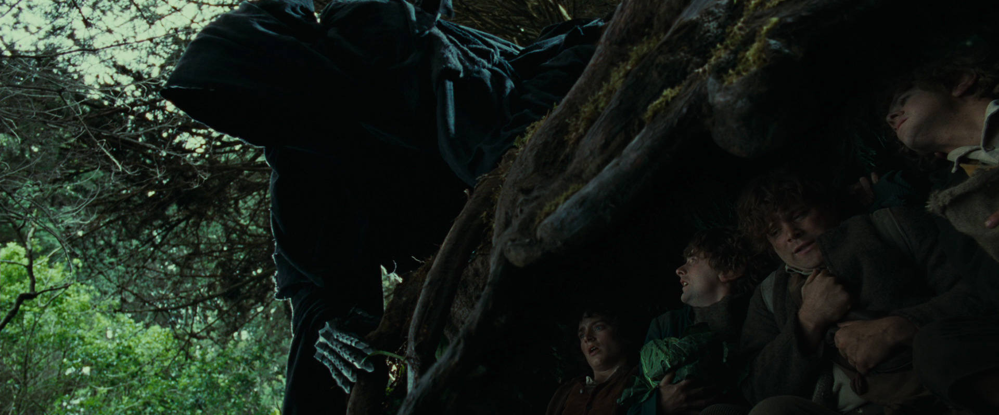
Hero’s Journey Archetype: The Lord of the Rings Example
This is also a dangerous one.
The hobbits are chased by the servants
of Sauron as soon as they leave
Shire where they inhabit.

Slide 25
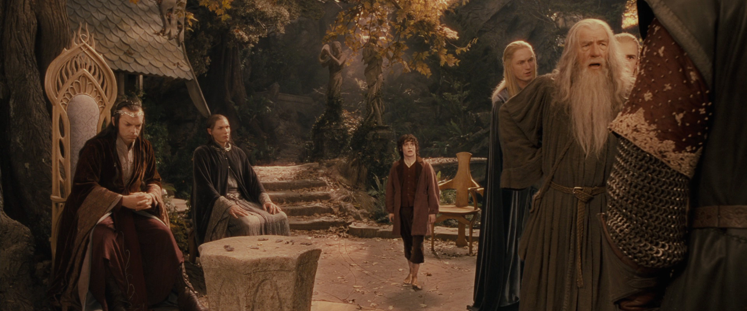
Hero’s Journey Archetype: The Lord of the Rings Example
The hero becomes more mature.
The leaders of Middle-Earth
quarrel over what to do with the
ring and who would carry it.
Frodo volunteers to bear it.
It shows the maturity he has
reached, for the hobbits are
known for their addiction to
comfort.

Slide 26
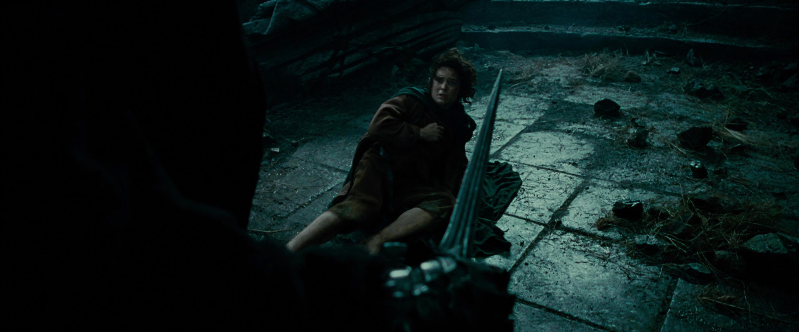
Hero’s Journey Archetype: The Lord of the Rings Example
The hero passes through impediments,
has to endure physical and psychological
difficulties and he receives supernatural aid.

Slide 27
Hero’s Journey Archetype: The Lord of the Rings Example
The hero passes through impediments,
has to endure physical and psychological
difficulties and he receves supernatural aid.
Frodo being attacked by the servants
of Sauron.

Slide 28
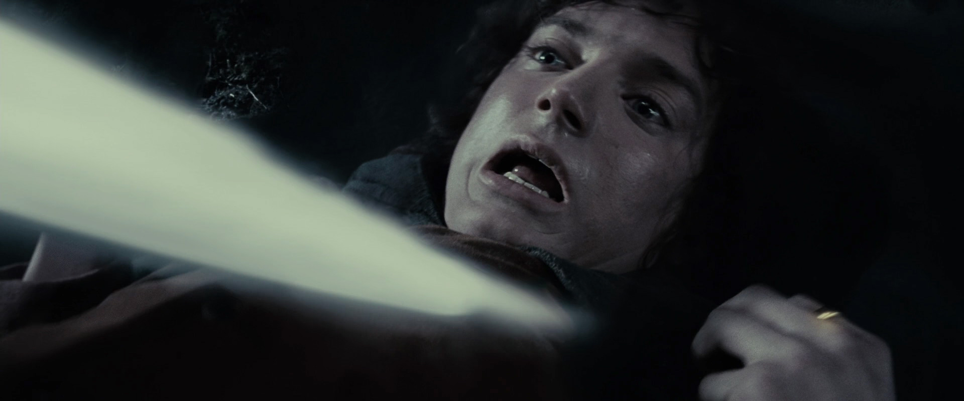
Hero’s Journey Archetype: The Lord of the Rings Example
The hero passes through impediments,
has to endure physical and psychological
difficulties and he receves supernatural aid.
Frodo being stabbed by the servant
of Sauron with a poisonous sword.

Slide 29
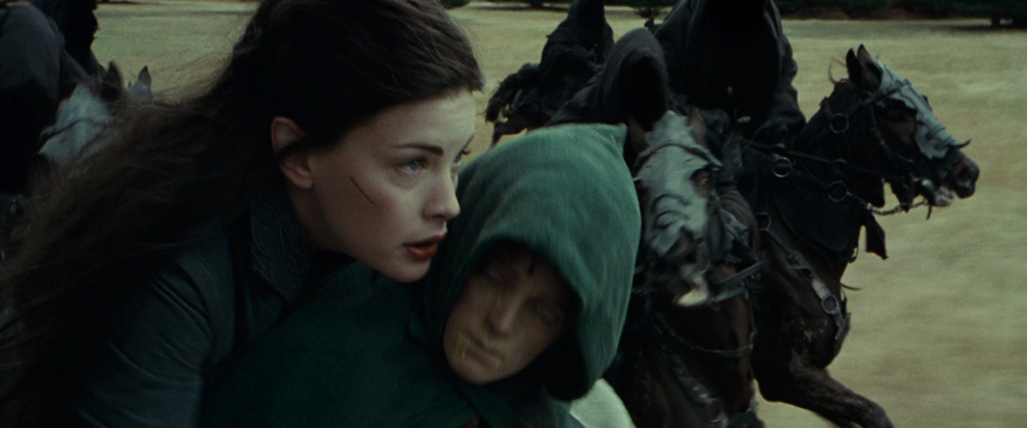
Hero’s Journey Archetype: The Lord of the Rings Example
The hero passes through impediments,
has to endure physical and psychological
difficulties and he receves supernatural aid.
Arwen taking Frodo away for medical help.

Slide 30
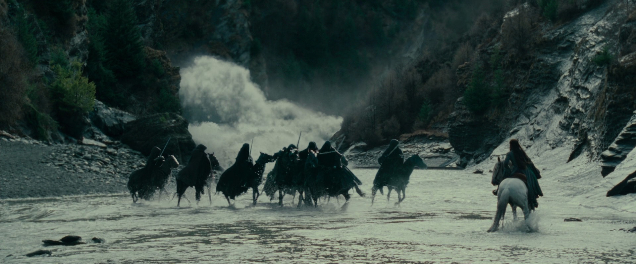
Hero’s Journey Archetype: The Lord of the Rings Example
The hero passes through impediments,
has to endure physical and psychological
difficulties and he receves supernatural aid.
Arwen’s spell to suffocate those pursuing
them.

Slide 31
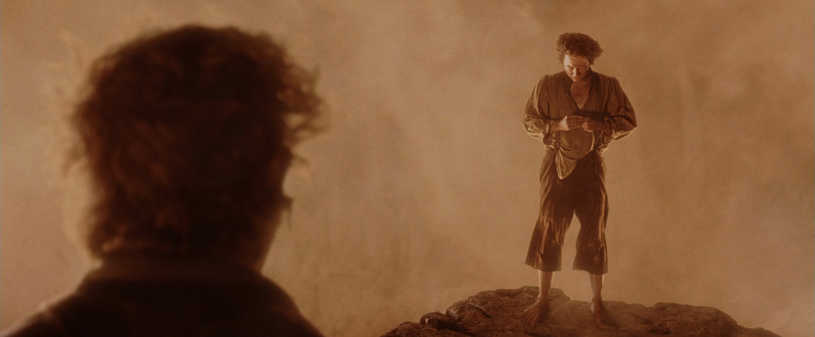
Hero’s Journey Archetype: The Lord of the Rings Example
The hero enters into an innermost cave,
underworld or some other place
of great trial.
(It may be a physical or psychological.)
This experience changes the hero.
Frodo is attracted to the power of the
ring though he has reached to the place
where he can destroy it and for the sake
of which he endured many evils.
Frodo: The ring is mine

Slide 32
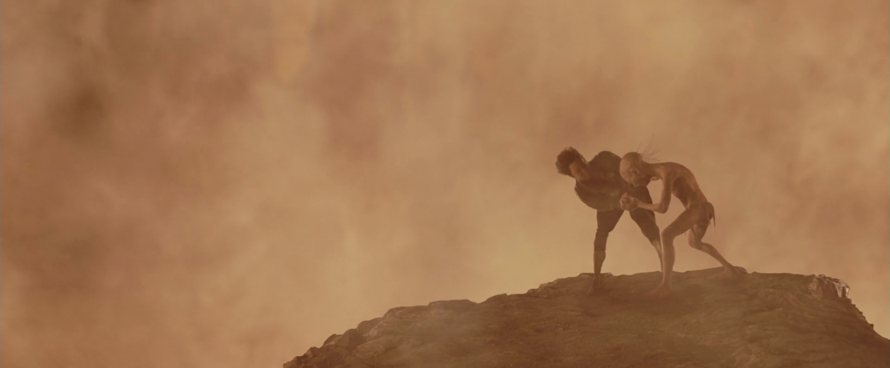
Hero’s Journey Archetype: The Lord of the Rings Example
The hero enters into an innermost cave,
underworld or some other place
of great trial.
(It may be a physical or psychological.)
This experience changes the hero.
Gollum, who has been enchanted by
the ring, captures it from Frodo and
from that point on Frodo realizes why
he was there and attempts to capture it
to destroy, which eventually leads to….

Slide 33
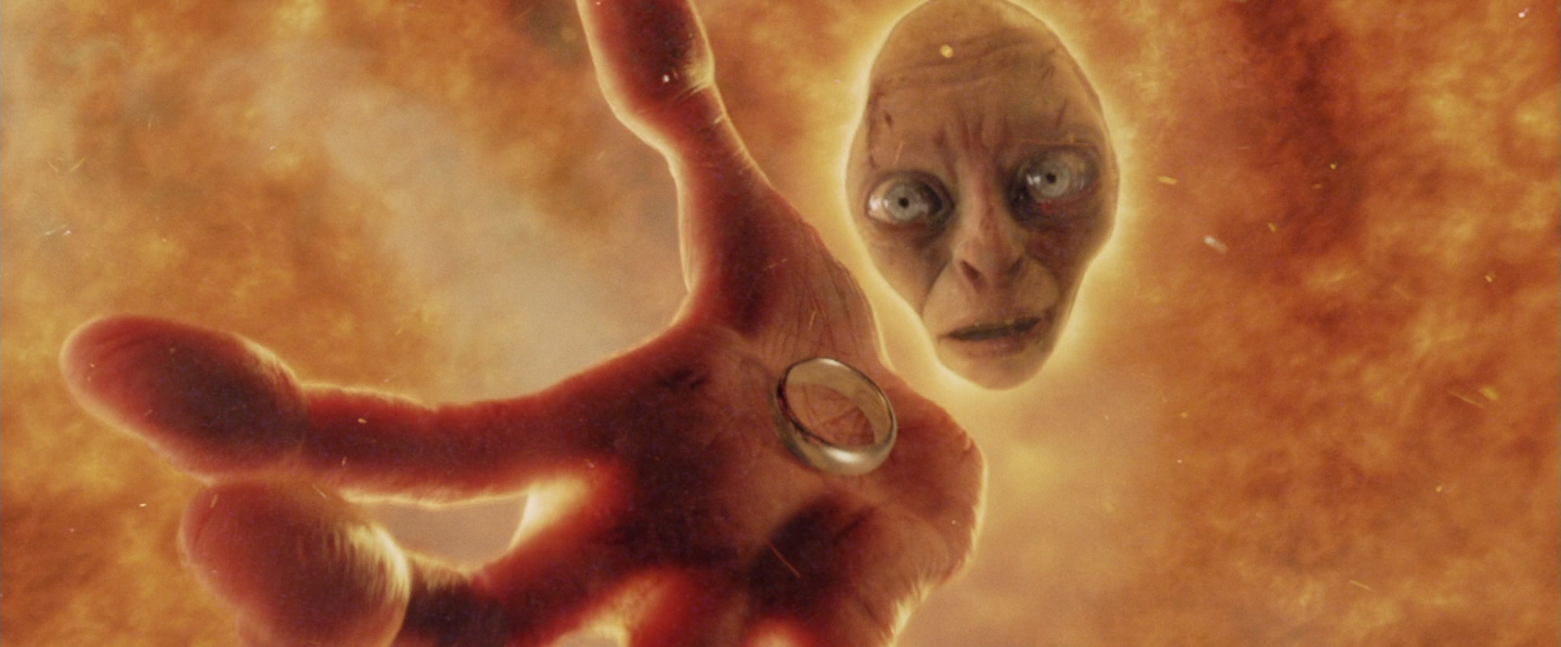
Hero’s Journey Archetype: The Lord of the Rings Example
The hero gains wisdom and
provides with the order
that is absent or under threat
…destruction of the ring and…

Slide 34
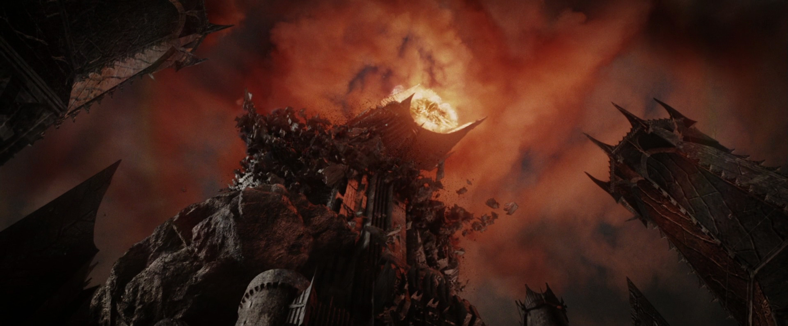
Hero’s Journey Archetype: The Lord of the Rings Example
The hero gains wisdom and
provides with the order that
is absent or under threat
….destruction of Sauron, as well.

