Slide 1
Religion and Politics in Turkey Week 9 Course Materials
By Asst. Prof. Dr. Selman Yılmaz

Slide 2
Interaction
Throughout history both politics and religion influence and try to dominate each other.
Turkey is no exception in this rule.

Slide 3
Process: Hospitality
Turks utilized Islam as a banner against European crusaders through the Middle and New Ages.
Ottomans had claimed the caliphate in the 15th century and employed it to extend and deep its influence in the Islamic word.
On the other hand, Islam has benefited from the Turks’ expansion, increasing its influence in the Middle East and Europe.

Slide 4
Process: Hostility
1923-1950
Rejected religious identity and institutions
But even exploited it to establish a national identity
Since 1950
Oscillating between relative hospitality and hostility

Slide 5
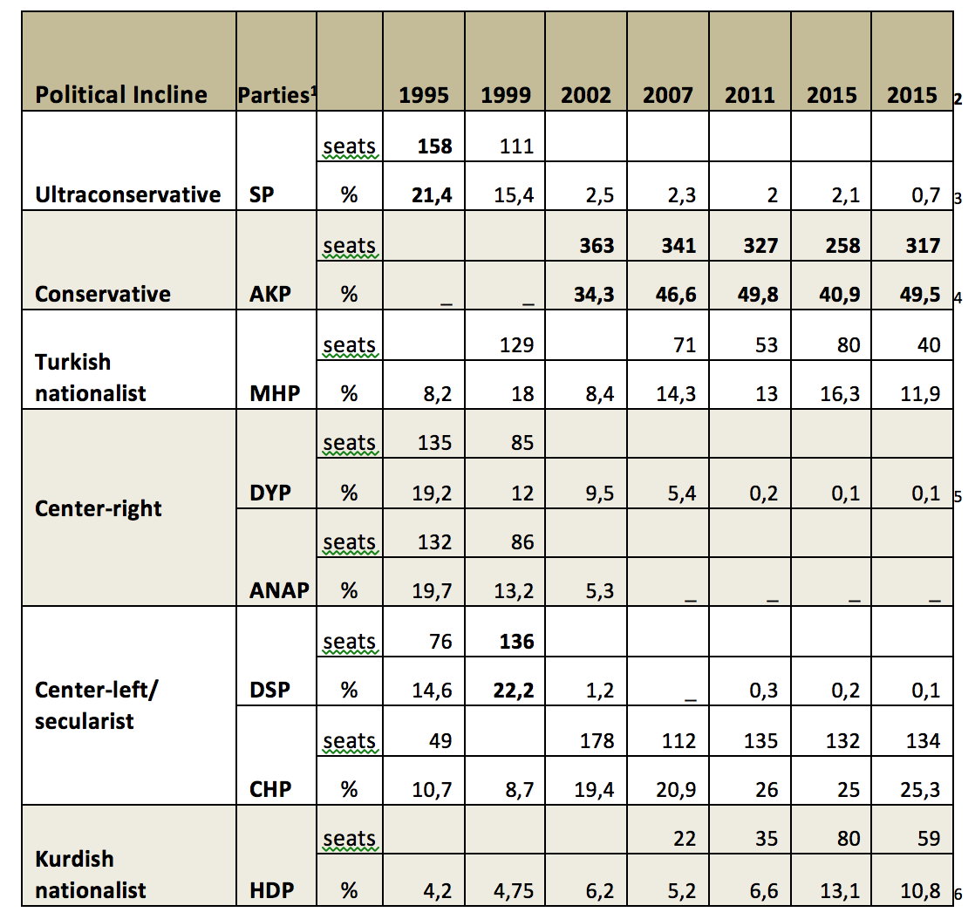
Voting Trends

Slide 6
Review
Any further comments and questions?

Slide 7
References
Yılmaz, Selman (2013). State, Politics, and Religion: Effects of Political and Social Change on the Relationship Between State and Religion in Turkey, 2002-2012. Dissertation. University of Pittsburgh, the Dietrich School of Arts and Sciences. Pittsburgh.
Yılmaz, Selman (2018). Religion and Politics in Turkey. Forthcoming.

