Slide 1
Strength of Materials
• Stress and strain
• Elastic behavior/Plastic behavior
• Toughness and ductility
Hardness
Design and Safety Factor

Slide 2
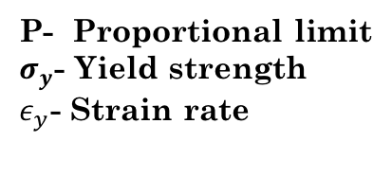
Plastic Deformation
Permanent, non-recoverable deformation.
$$σ$$
Plastic
Typical stress-strain curve for metal showing both elastic and plastic deformation.
$$σ_{y}$$
P
P- Proportional limit
$σ_{y}$- Yield strength
$ε_{y}$- Strain rate
0.002
$$ε_{y}$$
$$ε$$
For crystalline solids, deformation is occurred by slip which involves the motion of dislocation.
For non-crystalline solids plastic deformation occurs by viscous flow.

Slide 3
Tensile Strength
Maximum stress that can be sustained by a structure in tension.
Neck begins to form
The fracture strength corresponds to stress at fracture (F).
$$σ$$
M
$$TS$$
F
$$ε$$
Tensile strength may vary from 50 MPa (for aluminum) to 3000 MPa (for high strength steel)

Slide 4
Ductility
Ductility is a measure of the degree of plastic deformation that has been sustained at fracture.
A material that experiences little or no plastic deformation upon fracture is termed as brittle.
Ductility as percent elongation (%EL)
$$\%EL=\left(\frac{l_{f}−l_{o}}{l_{o}}\right)x100$$
l_{f} ; fracture length
l_{o} ; original lenght
Ductility as reduction in area (%RA)
A_{f} ; fracture area
A_{o} ; original area
$$\%RA=\left(\frac{A_{o}−A_{f}}{A_{o}}\right)x100$$

Slide 5
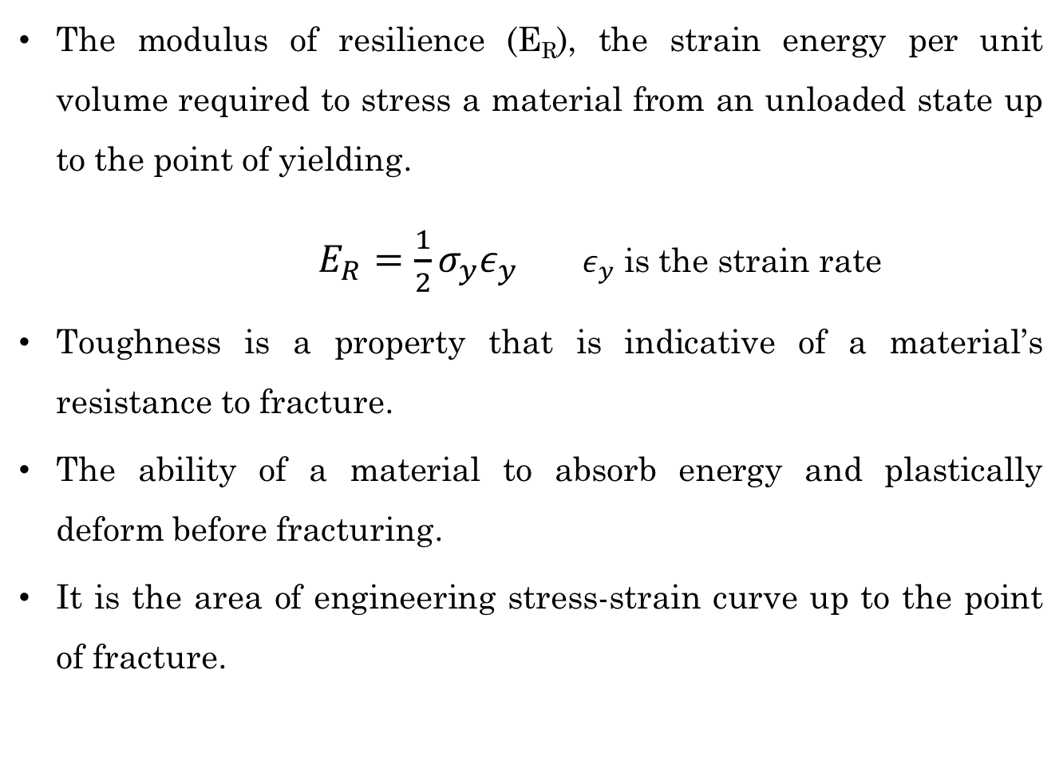
Resilience and Toughness
The modulus of resilience (E_{R}), the strain energy per unit volume required to stress a material from an unloaded state up to the point of yielding.
$E_{R}=\frac{1}{2}σ_{y}ε_{y}$ $ε_{y}$ is the strain rate
Toughness is a property that is indicative of a material’s resistance to fracture.
The ability of a material to absorb energy and plastically deform before fracturing.
It is the area of engineering stress-strain curve up to the point of fracture.

Slide 6
Tensile Properties
Yielding occurs at the onset of plastic deformation.
Yield strength (σ_{y}) is indicative of the stress at which plastic deformation occurs.
Tensile stress is the max. point in the engineering stress –strain curve.
Ductility is a measure of the degree to which a material will plastically deform by the time fracture occurs.
Ductility is measured in terms of percent elongation and reduction in area.
With increasing temperature values of elastic modulus, tensile and yield stress decrease, whereas ductility increases.
Ductile metals are normally more tougher than brittle materials.

Slide 7
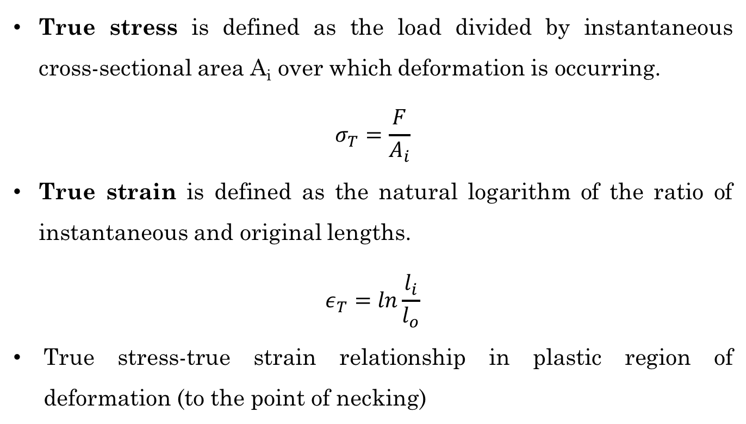
True Stress and True Strain
True stress is defined as the load divided by instantaneous cross-sectional area A_{i} over which deformation is occurring.
$$σ_{T}=\frac{F}{A_{i}}$$
True strain is defined as the natural logarithm of the ratio of instantaneous and original lengths.
$$ε_{T}=ln\frac{l_{i}}{l_{o}}$$
True stress-true strain relationship in plastic region of deformation (to the point of necking)
l_{i} : instantaneous length
l_{o} ; original length
$σ_{T}=Kε_{T}$^{n}
K : constant (vary metal to metal)
n : strain hardening exponent (<1)

Slide 8
References
Donald R. Askeland, Pradeep P. Fulay, Wendelin J. Wright, The Science and Engineering of Materials, Sixth Edition
William D. Callister, David G. Rethwisch, Materials Science and Engineering, Eighth Edition, Wiley, 2011.

